Slide 1
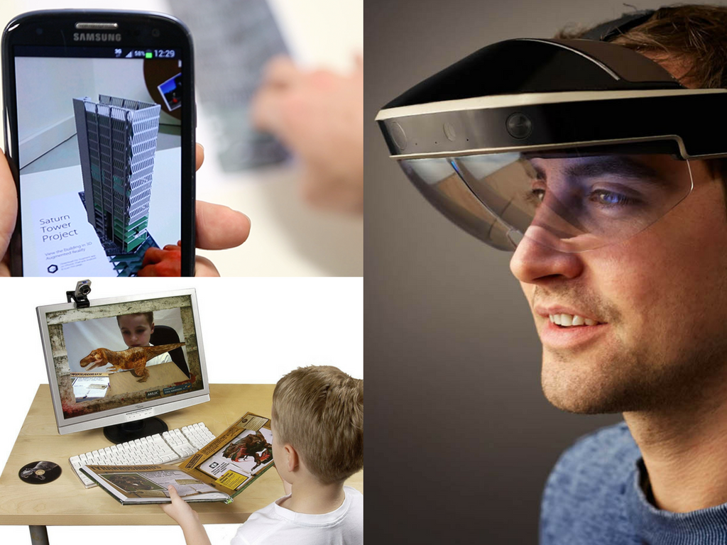
OBJECT TRACKİNG
AND AUGMENTED REALİTY
Digital İmage Processing
2017

Slide 2

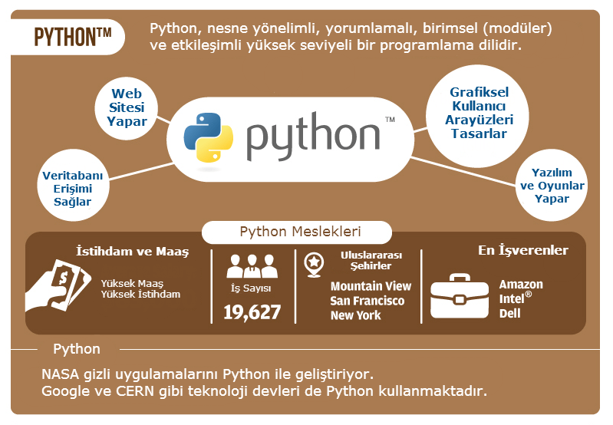
WHY PYTHON OPENCV

Slide 3
WHAT YOU NEED FOR RUN THIS SOFTWARE
PYTHON 2.7
OPENCV 3.3.0
SPYDER 3.2.4
ANACONDA 2(64 Bit)
USING PYTHON MODULES
SCIPY 0.19 1
MATPLOTLIB 2.0.2
NUMPY 1.13.1
LIBFREENECT

Slide 4
PROJECT OBJECTIVES
Adding content to a live video in real-time
Detect and track “fiducial” markers in video stream,
Estimate homography and replace with artificial imagery

Slide 5
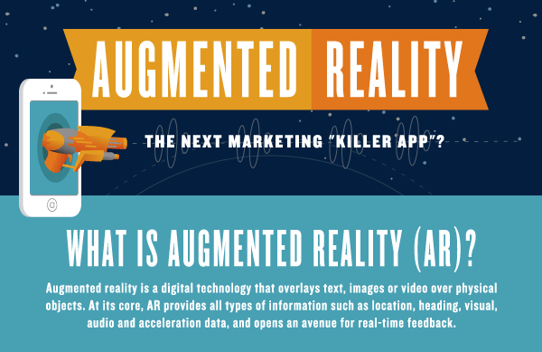
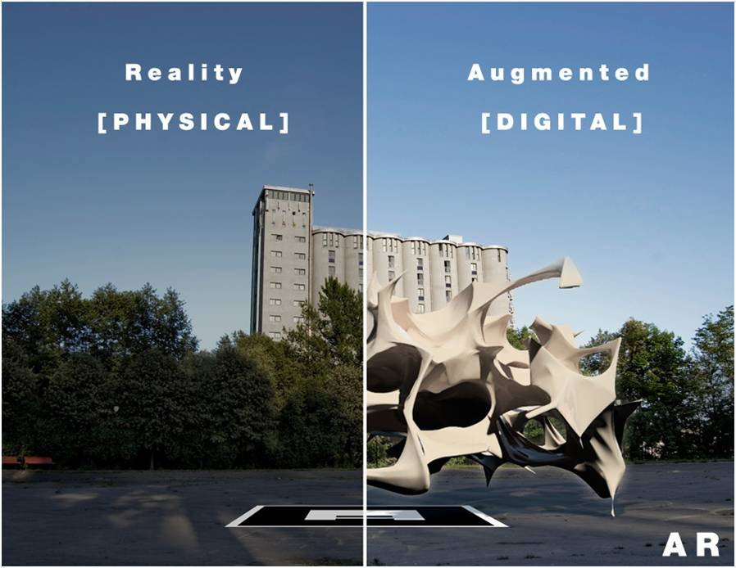

Slide 6
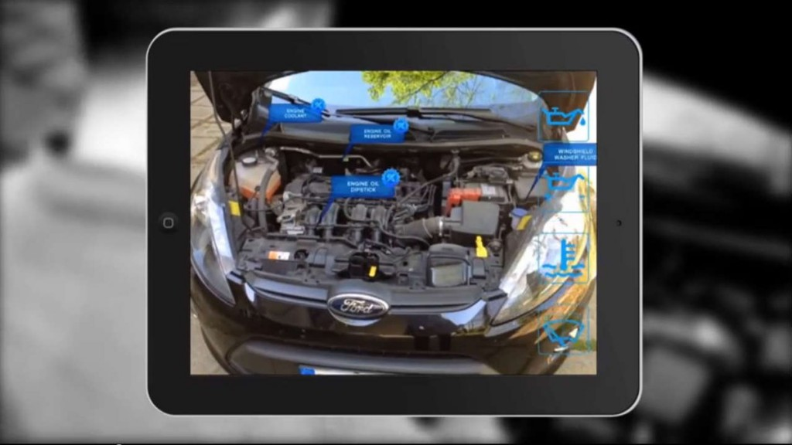
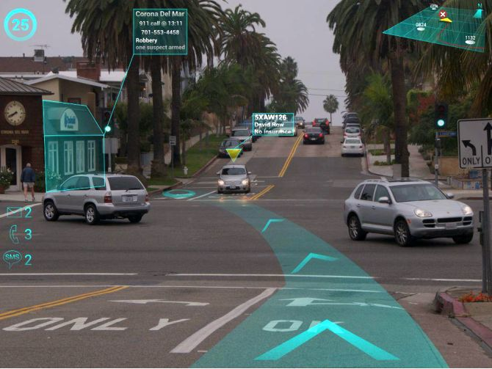
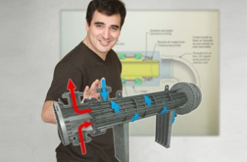
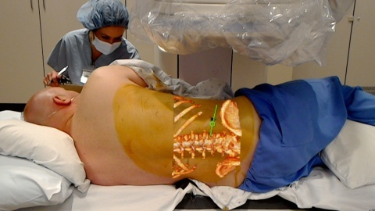
Car Repair
Navigation
Education, training, simulating
Medicine, Surgery

Slide 7
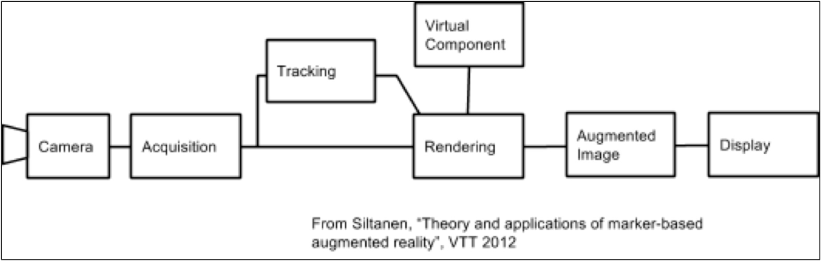
Recognition: Recognition of an image, an object, a face or a body
Tracking: Real-time localization in space of the image, object, face, or body
Mix: Superposition of a media (video, 3D, 2D, text, etc…) on top of this image, object, face or body.

Slide 8
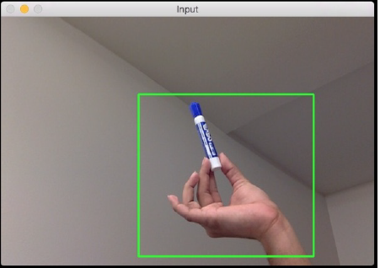
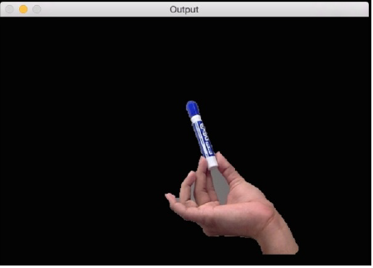
1- DETECTİNG SHAPES AND
SEGMENTİNG AN IMAGE
Method: GrabCut
Once the image has been segmented, it will look something like this:

Slide 9
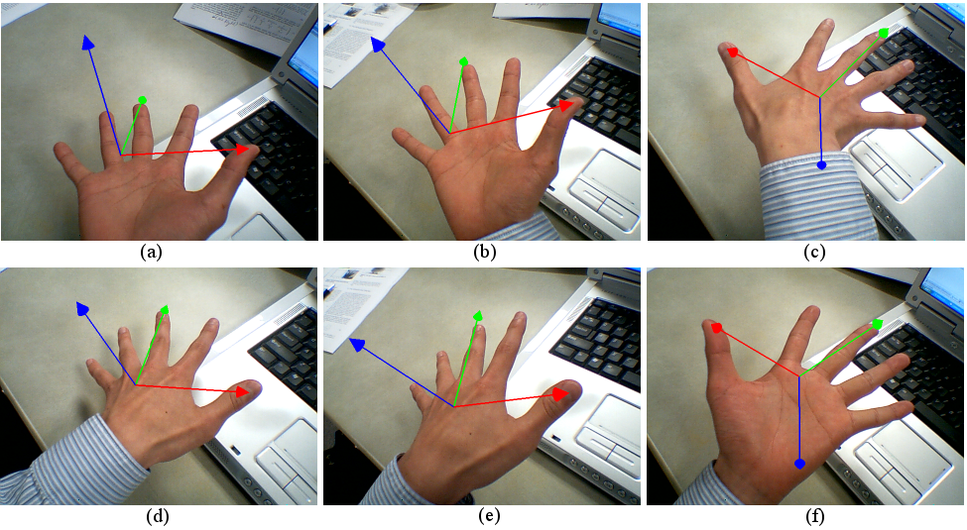
3- POSE ESTİMATİON

Slide 10

REFERENCES
1-
2-
Konrad Koniarski, ‘Augmented Reality Using Optical Flow’, Proceedings of the Federated Conference on Computer Science and Information Systems pp. 841–847, 2015
A. Blake, C. Rother, M. Brown, P. Perez, and P. Torr ‘Interactive Image Segmentation using an adaptive GMMRF model’, European Conference on Computer Vision, 2004
[1]Oliver Toole, Dave Dolben, “Marker Detection and Tracking for Augmented Reality Applications”, Stanford University, 2013
3-
4-

Slide 11
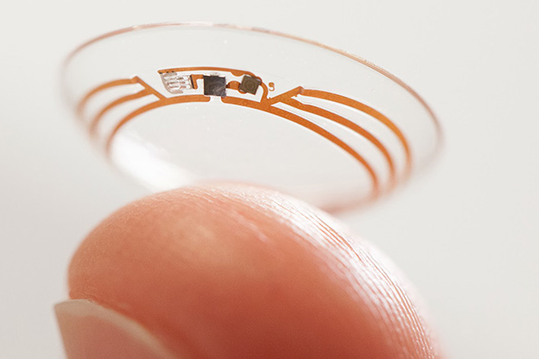
TEŞEKKÜR EDERİM

