Slide 1
Introduction to Java 8
Learning the Basics for Grade 10 Students

Slide 2
Resource
Git - https://github.com/develop2clickcomputers/LearnJavaWithSan
YouTube - TBD
LinkedIn - TBD

Slide 3
What is a Programming Language?
A programming language is a set of rules and instructions that a computer can understand and execute.

Slide 4
What is a CPU, Memory, HDD, Processor, Process? Also, How its related?
CPU (Central Processing Unit)
The brain of the computer where most calculations and logical operations are performed.
Executes instructions from software programs.
Often called the "processor," it handles tasks like arithmetic, data processing, and controlling hardware.

Slide 5
What is a CPU, Memory, HDD, Processor, Process? Also, How its related?
Memory (RAM - Random Access Memory)
The brain of the computer where most calculations and logical operations are performed.
Faster than storage devices but volatile (data is lost when the power is off).
Determines how many tasks or applications can be run simultaneously.

Slide 6
What is a CPU, Memory, HDD, Processor, Process? Also, How its related?
HDD (Hard Disk Drive)
Long-term storage device where data, applications, and operating systems are saved.
Slower than RAM but retains data even when the computer is turned off.
Used to store files, programs, and other persistent information.

Slide 7
What is a CPU, Memory, HDD, Processor, Process? Also, How its related?
Processor
A general term often used synonymously with the CPU.
Can also refer to specialized processing units like GPUs (Graphics Processing Units) or other co-processors designed for specific tasks.
Key to executing instructions and running applications.

Slide 8
What is a CPU, Memory, HDD, Processor, Process? Also, How its related?
Process
An instance of a running program or task.
Includes the program's code, the current state of execution, and allocated system resources (e.g., memory and CPU time).
Multiple processes can run simultaneously, managed by the operating system.

Slide 9
What is a CPU, Memory, HDD, Processor, Process? Also, How its related?
How They Are Related
The CPU uses Memory (RAM) to access data and instructions for executing processes.
The Processor (CPU) performs computations and operations for these processes.
The HDD stores long-term data and applications that are loaded into memory when needed.
A Process represents a running application, and the CPU executes its instructions by working with memory and other system resources.

Slide 10
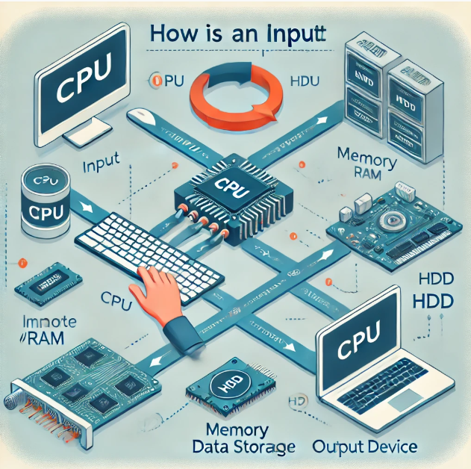
What is a CPU, Memory, HDD, Processor, Process? Also, How its related?

Slide 11
Were does Programming Language come in?
Programming languages will be compiled into machine code that is understood by CPU

Slide 12
What is Java?
Java is a programming language and computing platform.
It is used in various areas such as mobile apps, web applications, games, and bank software.
Java has evolved over time, leading up to Java 8.

Slide 13
Why Learn Java?
Java is one of the most popular programming languages in the world.
It offers benefits such as platform independence, strong memory management, and security features.
Learning Java opens up a wide range of career opportunities in software development.

Slide 14
Getting Started with Java
To start, you need to install Java on your computer.
Setting up the environment includes installing the Java Development Kit (JDK) and an Integrated Development Environment (IDE).
Example of a simple Java program to print 'Hello, World!'

Slide 15
Basic Concepts in Java
Variables are used to store information.
Java has several primitive data types like int, char, and boolean.
Basic operators include addition, subtraction, multiplication, etc.

Slide 16
Java 8 Features
Lambda Expressions help simplify coding and make it more flexible.
Stream API makes it easy to process collections of objects.
The improved Date and Time API helps handle date and time more effectively.

Slide 17
Writing Simple Java Programs
A Java program is structured around classes and methods.
Examples include using variables, control statements like if-else, and loops like for and while.

Slide 18
Interactive Activity
A coding exercise to engage students with a simple task they can try on their computers.
Example problem: Write a program to calculate the sum of numbers from 1 to 10.

Slide 19
Resources to Learn More
Recommended books include 'Head First Java'.
Online resources like Codecademy, Coursera, and YouTube channels are helpful.
Practice platforms like HackerRank and LeetCode are good for practicing Java.

Slide 20
Conclusion and Q&A
A recap of what was covered in the presentation.
Encouragement for students to ask questions to clarify any doubts.

