Slide 1


Slide 2
Problem
Web application that involves lot of JavaScript
Applications end up as tangled piles of Jquery selectors and callbacks.
Hard to keep data in sync between the HTML UI, and JavaScript logic.
You can end up with a pile of spaghetti code-code that is disorganized and difficult to follow.

Slide 3
Why Backbone?
Jquery is cool but..
We have to store object information in to the DOM
var list = "";
$.each(data, function (index, value)
{ list += "<li id="item-" + value.Id + "">" + value.Name + "</li>"; }); $("ul").append(list);

Slide 4
Why Backbone?
Jquery is cool but..
jquery callback hell
$.getJSON("/Items", function (data) {
var list = "";
$.each(data, function (index, value) {
list += "<li id="item-" + value.Id + "">" + value.Name + "</li>";
});
$("ul").append(list);
$("li").click(function () {
var $this = $(this);
var id = $this.attr("id").replace("item-", "");
$.post("/Items", { id: id }, function () {
$this.fadeOut(function () {
$this.remove();
});
});
});
});

Slide 5
Why Backbone?
Its all too easy to create JavaScript applications that end up as tangled piles of jQuery selectors and callbacks.”

Slide 6
Why Backbone?
So, what do we need?
Abstraction
Decoupling UI from data
No more callbacks

Slide 7
Why Backbone?
So, what do we need?(More practically)
Events (to keep UI and data up to date)
A template engine
A solid routing system
All the above things wrapped into a light weight JavaScript framework

Slide 8
Why Backbone?
It exists and it’s called: Backbone.js

Slide 9
Why Backbone?
Model-View-Controller(MVC) framework for JavaScript
Useful for creating single-page web app or complex UI components
Provide structure to UI components
Manage state of the application.
It is a layer above existing JavaScript DOM manipulation libraries like Jquery, Zepto etc.
Works well with Jquery

Slide 10
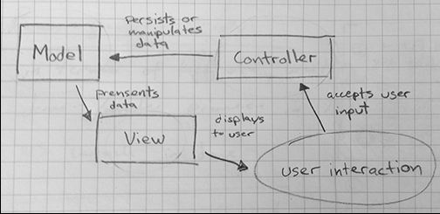
A traditional Model-View-Controller relationship

Slide 11
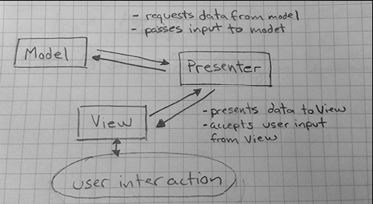
Model-View-Presenter

Slide 12
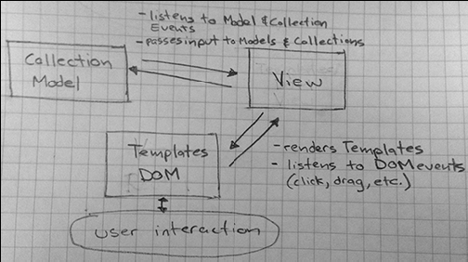
MV*, a pattern for real-world- applications

Slide 13
Does it replace jquery?
No
They are complimentary in their scopes with almost no overlaps in functionality
Backbone handles all high level abstractions, while jquery work with DOM

Slide 14
Why should I be using this?
The front end code devolves into a steaming, dirty pile of nested callbacks, DOM manipulations.
Backbone offers a significantly clean and elegant way of handling this chaos.

Slide 15
Where should I be using this?
It is ideally suited for creating front end heavy, data driven applications.
Examples of front end heavy applications can be Twitter, Gmail etc.
It makes complex Web apps creation simpler.

Slide 16
What we will learn in coming days?
Introduction and Installation

Slide 17
Backbone Models
Creating a Model
Operating with Model attributes
Operating with Model identifier
Validating Model attributes
Overriding getters and setters
Creating undo points to store/restore a model’s state
Implementing workflow for a Model
Using advanced validation in a Model
Validating a HTML Form
Working with nested attributes in a Model
Implementing a one-to-one relationship

Slide 18
Creating a Model
Contains data
Provides validation
Perform access control and
Implements business logic required for your application
var invoiceItemModel = Backbone.Model.extend({
});

Slide 19
Thanks

