Slide 1
Introduction to UX CI Practice
July 2012

Slide 2
Agenda
Interactive Design Capabilities
UCD Definition
Key Objectives
The UCD Process
Discovery
Define
Design
Development
Testing

Slide 3
Interactive Design Capabilities

Slide 4
Interactive Design Capabilities
Consultants (150+) Digital Strategists UX Analysts (Domain/Technology) Information Architects Digital Analytics & Marketing Experts Creative Directors Social Media Experts
Designers (300+) Interaction Designers Mobile Designers Visual Designers Flash Designers Production Artists Print design specialists
UI Developers (850+) Web Developers Flex Programmers Flash/Scripting Programmers RIA Technology architects Accessibility experts
Analytics & Marketing (100+) Analytics Tools Experts Reporting & Insights Experts SEO/SEM Experts
1500+ member strong global talent pool designing world class User Experience solutions across technology platforms.
We are one of the largest Design Services groups in the industry, helping our clients create end-to-end value throughout the customer lifecycle and to deliver a Data-driven Multi-screen Digital Experience.
Key Differentiators
One-stop-shop for integrated UX Design, Development and Measurement services
Experience across front-end technologies
Leverage design experience and best practices from different domains
SMEs with over 10 years hands on industry experience
Experienced in seamlessly collaborating in a multi-disciplinary and multi-vendor environment
Industry known “Two-in-the-box” model

Slide 5
UCD Process

Slide 6
UCD - Definition
In broad terms, user-centered design (UCD) is a design philosophy and a
process in which the needs, wants, and limitations of end users of an
interface or document are given extensive attention at each stage of the
design process.
User-centered design can be characterized as a multi-stage problem
solving process that not only requires designers to analyze and foresee
how users are likely to use an interface, but also to test the validity of
their assumptions with regards to user behavior in real world tests with
actual users.

Slide 7
UCD Objectives
Usefulness - product enables user to achieve their goals - the tasks that it
was designed to carry out and/or wants needs of user.
Effectiveness (ease of use) - quantitatively measured by speed of
performance or error rate and is tied to a percentage of users.
Learnability - user's ability to operate the system to some defined level of
competence after some predetermined period of training. Also, refers to
ability for infrequent users to relearn the system.
Attitude (likeability) - user's perceptions, feelings and opinions of the
product, usually captured through both written and oral communication.
Source: From Jeffrey Rubin, Handbook of Usability Testing

Slide 8
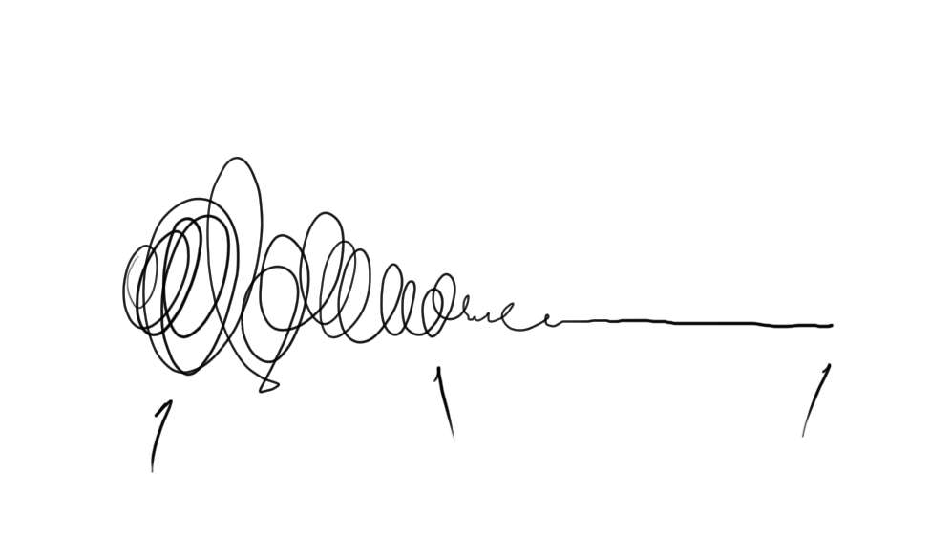

Slide 9
UCD – The Process
Uncertainty | Patterns | Insights Clarity | Focus
Concept Prototype
Design
Research

Slide 10


UCD – The Process
1
2
3
4
Discover
Define
Design
Development
5
Testing

Slide 11

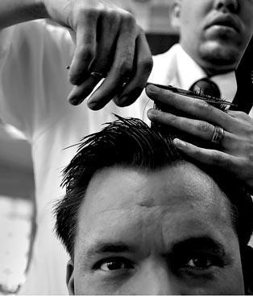

Slide 12
The UCD Process
1
2
3
4
5
Discover
Define
Design
Development
Testing
The Barber Shop Analogy
1
2
3
4
Hi !! How would
you want your
Hair Sir?
Here is the mirror
What do you think?
Snip!! Snip!!
Final polishing
5
Checking in the Mirror

Slide 13
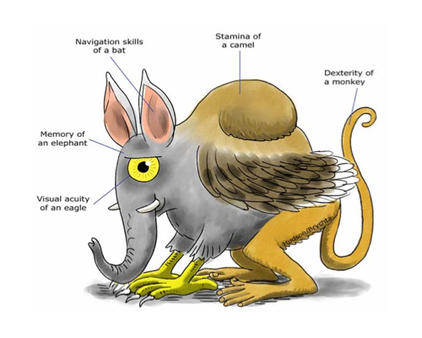
Discovery
Vision
Design Goals
Objectives
User Audience Analysis
‘The Perfect User’
Persona’s
Image
Challenges
Constrains
Field Study
Analysis
Contextual Inquiry
Task / Purpose Analysis
Workflow Analysis
Workflows
Information Architecture
Analysis
Scenarios
Never Make
Wrong Assumptions

Slide 14

Discovery Phase
Vision
Design Goals
Objectives
User Audience Analysis
Persona’s
Image
Challenges
Constrains
Field Study
Analysis
Contextual Inquiry
Task / Purpose Analysis
Workflow Analysis
Workflows
Information Architecture
Analysis
Scenarios
Know Your
Audience

Slide 15

Discovery Phase
Vision
Design Goals
Objectives
User Audience Analysis
Persona’s
Image
Challenges
Constrains
Field Study
Analysis
Contextual Inquiry
Task / Purpose Analysis
Workflow Analysis
Workflows
Information Architecture
Analysis
Scenarios
Listen to your User

Slide 16
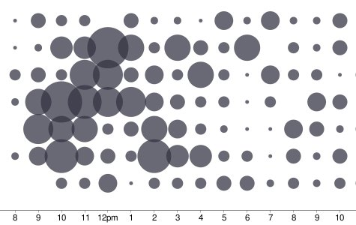
Discovery Phase
Vision
Design Goals
Objectives
User Audience Analysis
Persona’s
Image
Challenges
Constrains
Field Study
Analysis
Contextual Inquiry
Task / Purpose Analysis
Workflow Analysis
Workflows
Information Architecture
Analysis
Scenarios
When you have enough
Data look out for patterns

Slide 17


Discovery Phase
Vision
Design Goals
Objectives
User Audience Analysis
Persona’s
Image
Challenges
Constrains
Field Study
Analysis
Contextual Inquiry
Task / Purpose Analysis
Workflow Analysis
Workflows
Information Architecture
Analysis
Scenarios
Represent these patterns with Persona’s

Slide 18
Define
Vision
Design Goals
Objectives
User Audience Analysis
Persona’s
1
Image
Challenges
Constrains
Field Study
Contextual Inquiry
Define
Task / Purpose Analysis
Workflow Analysis
Workflows
Information Architecture
Analysis
Scenarios

Slide 19

Definition Phase
Vision
Design Goals
Objectives
User Audience Analysis
Persona’s
Image
Challenges
Constrains
Field Study
Analysis
Contextual Inquiry
Task / Purpose Analysis
Workflow Analysis
Workflows
Information Architecture
Analysis
Scenarios
Every decision you take should directly benefit with one of your Persona’s

Slide 20
Design
Conceptual / Mental Model
Metaphors / Analogy
Design Concepts
Navigation Design Structure
2
Storyboards
Wireframes
Screen maps
Design
Paper Prototypes
Online Mockups
Functional Prototypes
Detailed Design

Slide 21
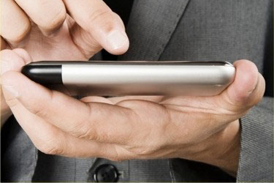
Design Phase
Conceptual / Mental Model
Metaphors / Analogy
Design Concepts
Navigation Design Structure
2
Storyboards
Wireframes
Screen maps
Design
Paper Prototypes
Online Mockups
Functional Prototypes
Detailed Design
Design with the end users' actual needs.

Slide 22

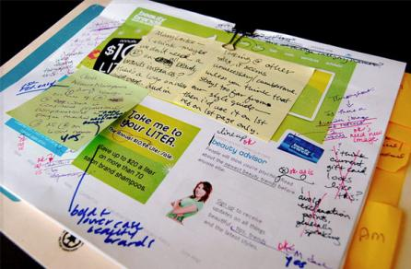
Design Phase
Conceptual / Mental Model
Metaphors / Analogy
Design Concepts
Navigation Design Structure
2
Storyboards
Wireframes
Screen maps
Design
Paper Prototypes
Online Mockups
Functional Prototypes
Detailed Design
Find out the key
information

Slide 23
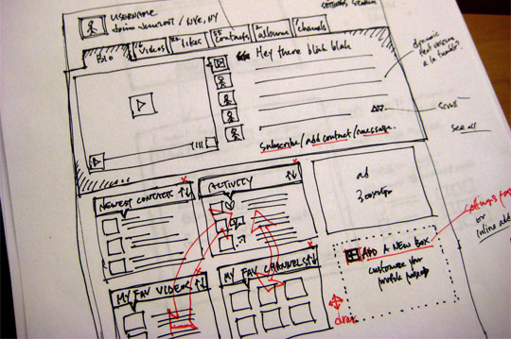
Design Phase
Conceptual / Mental Model
Metaphors / Analogy
Design Concepts
Navigation Design Structure
2
Storyboards
Wireframes
Screen maps
Design
Paper Prototypes
Online Mockups
Functional Prototypes
Detailed Design
Sketch Ideas

Slide 24
Design Phase
Conceptual / Mental Model
Metaphors / Analogy
Design Concepts
Navigation Design Structure
2
Storyboards
Wireframes
Screen maps
Design
Paper Prototypes
Online Mockups
Functional Prototypes
Detailed Design
Continue keeping in mind the Persona’s

Slide 25
Evaluation
Evaluation
(iterate back to design)
Design Walkthroughs
(Cognitive Analysis)
3
Heuristic Evaluation
Evaluation
User Testing
Paper Prototypes
Low fidelity
High fidelity
Informal
Formal

Slide 26
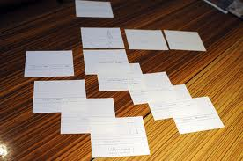
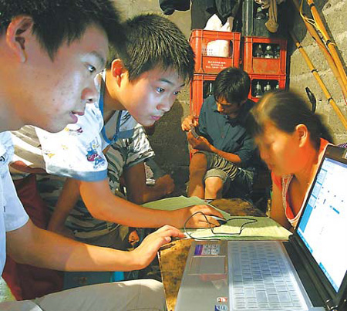

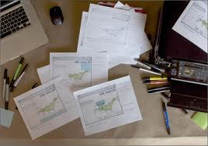
Evaluation Phase
Evaluation
(iterate back to design)
Design Walkthroughs
(Cognitive Analysis)
3
Heuristic Evaluation
Evaluation
User Testing
Paper Prototypes
Low fidelity
High fidelity
Informal
Formal
Real Users !
Real Testing !
Real Insights !

Slide 27
Development
Style Guide
(Set of rules that provide a reference for creating the look and feel of a design by
clearly defining the conventions of each instance in the design. For an interface,
style guides may contain rules for graphic layout grids, exact size and spacing of
elements, fonts, colors, interactive behavior, text messages, and labels.)
4
Development
Reusable Templates
CSS / HTML

Slide 28
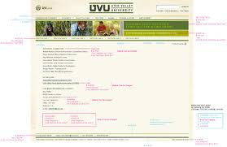

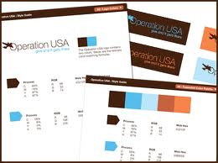

Development Phase
Style Guide
(Set of rules that provide a reference for creating the look and feel of a design by
clearly defining the conventions of each instance in the design. For an interface,
style guides may contain rules for graphic layout grids, exact size and spacing of
elements, fonts, colors, interactive behavior, text messages, and labels.)
4
Development
Reusable Templates
CSS / HTML
Style Guide (Specs)
Reusable Templates
Css / Html

Slide 29
Testing
Summative Testing
(Summative testing is done to test subtle issues (typically after formative testing
has been done and changes have been made) and generally involves a larger
number of participants)
5
Testing
Eye Tracking
Usability Testing

Slide 30

Testing Phase
Summative Testing
(Summative testing is done to test subtle issues (typically after formative
testing has been done and changes have been made) and generally
involves a larger number of participants)
5
Testing
Eye Tracking
Usability Testing
Test design as per users' actual needs.

Slide 31

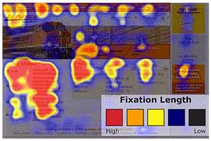
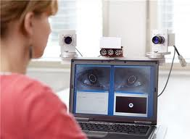

Testing Phase
Summative Testing
(Summative testing is done to test subtle issues (typically after formative
testing has been done and changes have been made) and generally
involves a larger number of participants)
5
Testing
Eye Tracking
Usability Testing
Measure the point of gaze or the motion of an eye.

Slide 32


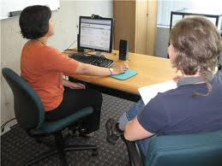

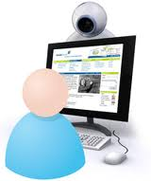
Testing Phase
Summative Testing
(Summative testing is done to test subtle issues (typically after formative
testing has been done and changes have been made) and generally
involves a larger number of participants)
5
Testing
Eye Tracking
Usability Testing
Evaluate a product by testing it on users.

Slide 33
Thank you

