Slide 1
Grunt
Grunt is not hard to learn

Slide 2
What is Grunt?
Before we learn Grunt, let us have a quick summary of things a web developer does on a regular basis:
Compress CSS and minify JavaScript for production
Optimize images to reduce file size without affecting quality
Use Sass for CSS
Work on small chunks of CSS and JavaScript and later on concatenate them for the production
We can term the above mentioned list items as “Task”
What if someone can run those tasks for you? Yes, you have guessed it right. Grunt
will run those tasks for you, after all Grunt is a task runner.

Slide 3
Misconception about Grunt
Grunt runs on Node.js — I don’t know Node You don’t have to know Node. Just like you don’t have to know Ruby to use Sass. Or PHP to use WordPress.
Some people say they have other ways to do the things Grunt could do for them Are they all organized in one place, configured to run automatically when needed, and shared among every single person working on that project?
Grunt is a command line tool — I’m a web developer and I’m not comfortable with CLI You just have to go to your project directory and enter “Grunt” and hit enter. Is it difficult?

Slide 4
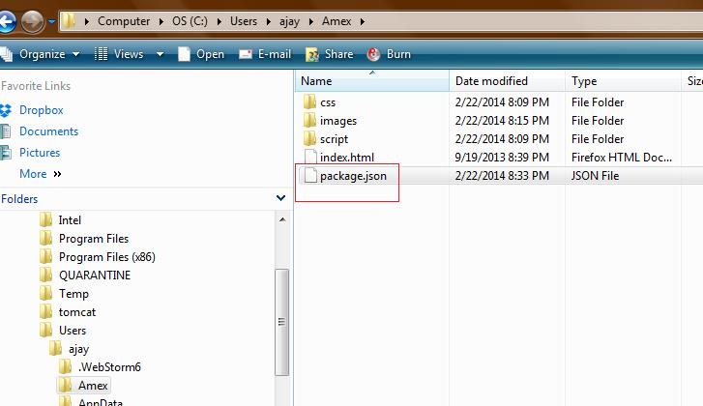
Let’s install Grunt
To install Grunt, You need to have Nodejs installed on your machine. If you don’t have Node installed on your machine, you can install node from http://nodejs.org/
You can install Grunt on a per project basis, say you are working on “Amex” Project, you have to create a package.json file on your root

Slide 5
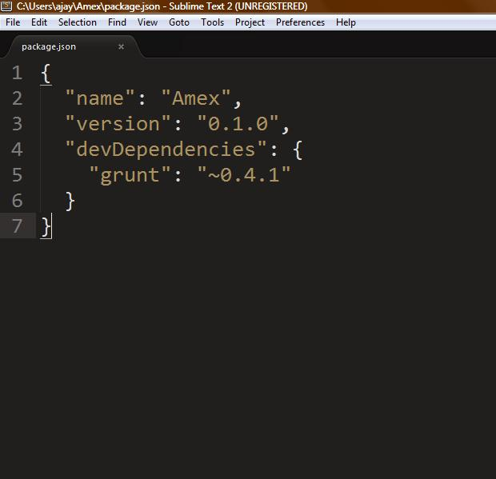
Let’s install Grunt
The content of the Package.JSON will be name of your project, version of your project and if your project has any dependencies then you can specify under “devDependencies”. We have Grunt dependency for this project and it is mentioned in package.json.

Slide 6
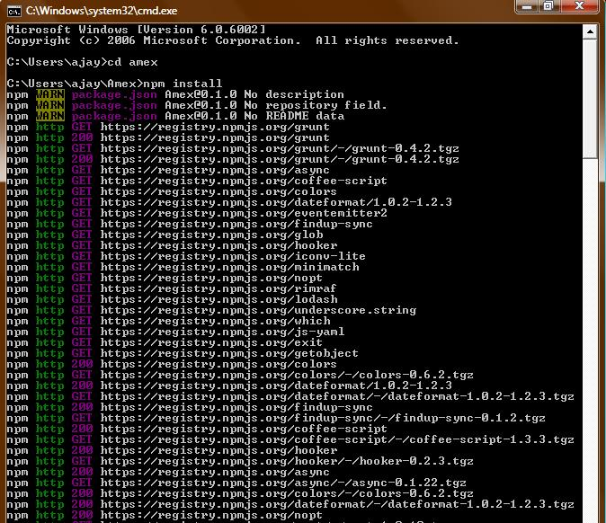
Let’s install Grunt
Navigate to your project folder(Amex) and using Node’s NPM command you can install Grunt. Just enter “npm install” and hit enter.

Slide 7
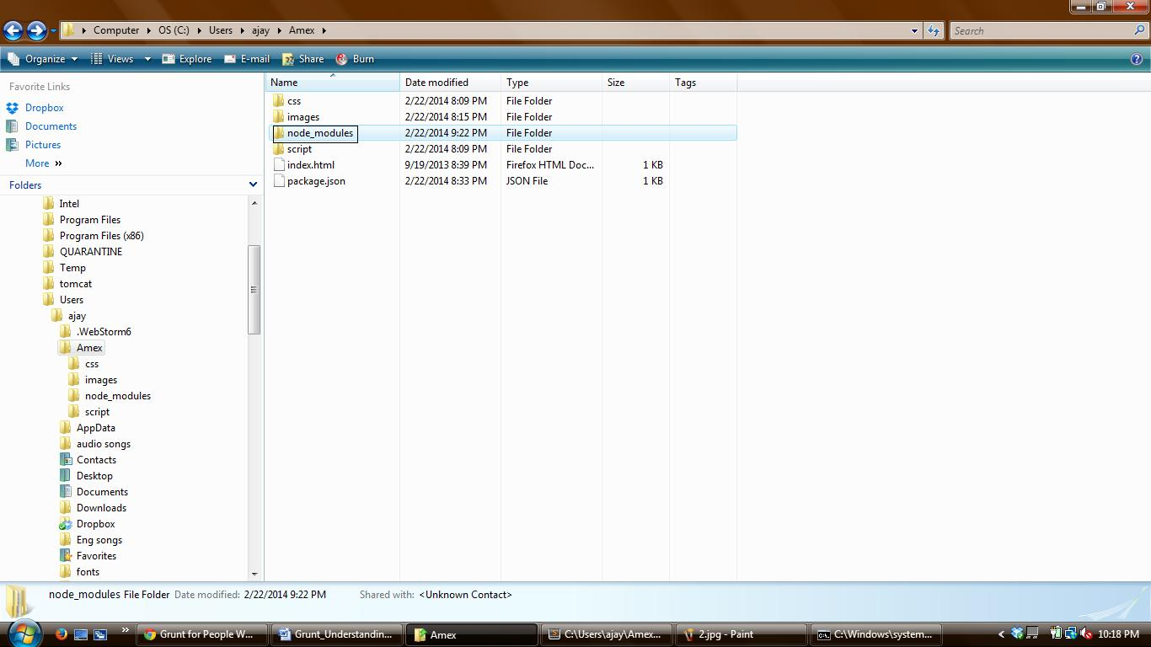
Let’s install Grunt
After successful installation, a folder by name “node-modules” will be shown in your project.

Slide 8
Let’s install Grunt
The last installation step is to install the Grunt CLI (command line interface). That’s what makes the grunt command in the terminal work. Without it, typing grunt will throw a “Command Not Found”-style error.
Just run this command in the command prompt to install Grunt CLI:
npm install -g grunt-cli

Slide 9
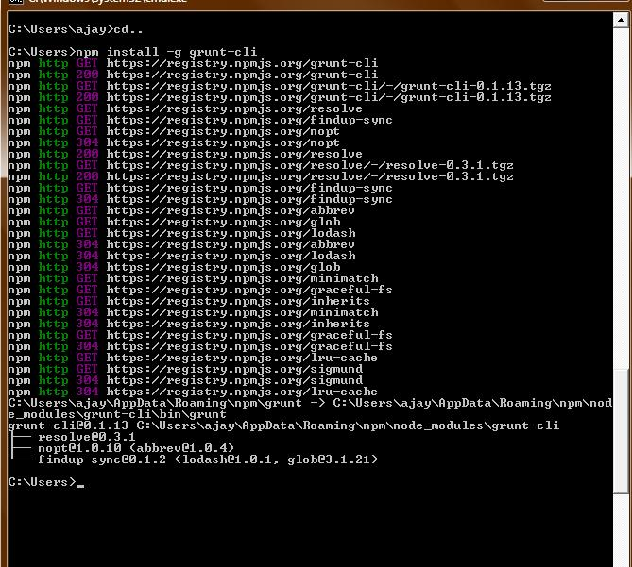

Slide 10
In following section we will see how we can use Grunt to concatenate some files:
Say if we have three JavaScript files in our Amex project
jquery.imagesloaded.js
jquery.wookmark.js
app.js
When we deploy these files on production, we would like to concatenate these 3 files into one (one request is better than 3) for performance reason, we can tell Grunt to do this.
We can set up Grunt to do this for us, so let’s do that.
The official Grunt plug-in for concatenating files is grunt-contrib-concat. You can read more info about it on GitHub, all you have to do to use it on your project is to run this command from the prompt from your project’s root folder:
npm install grunt-contrib-concat --save-dev

Slide 11
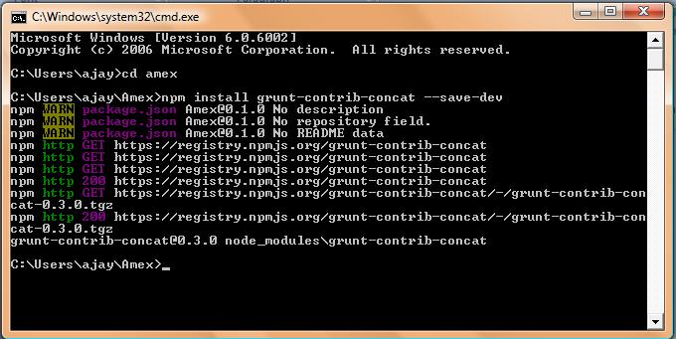
A neat thing about doing it this way: our package.json file will automatically be updated to include this new dependency. You’ll see following line in your package.JSON:
"grunt-contrib-concat": "~0.3.0"

Slide 12
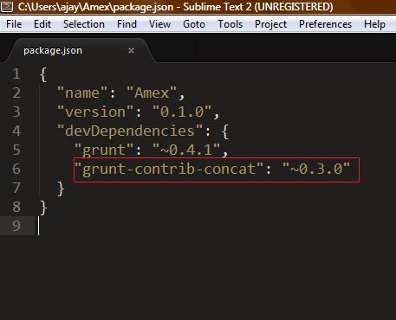
Now we are ready to use it. We will tell Grunt what to do via a configuration file
named Gruntfile.js
Just like our package.json file, our Gruntfile.js has special format.

Slide 13
Now we need to create configuration for concatenating js files.
We have three JavaScript files we’re trying to concatenate. We’ll list file paths to them under src in an array of file paths (as quoted strings) and then we’ll list a destination file as dest. The destination file doesn’t have to exist yet. It will be created when this task runs and squishes all the files together.
Both our jquery.imagesloaded.js and jquery.wookmark.js files are libraries. We most likely won’t be touching them. So, for organization, we’ll keep them in a /script/libs/ folder. Our app.js file is where we write our own code, so that will be right in the /script/ folder.
Now let’s tell Grunt to find all those files and squish them together into a single file named production.js, named that way to indicate it is for use on our real live website.

Slide 14
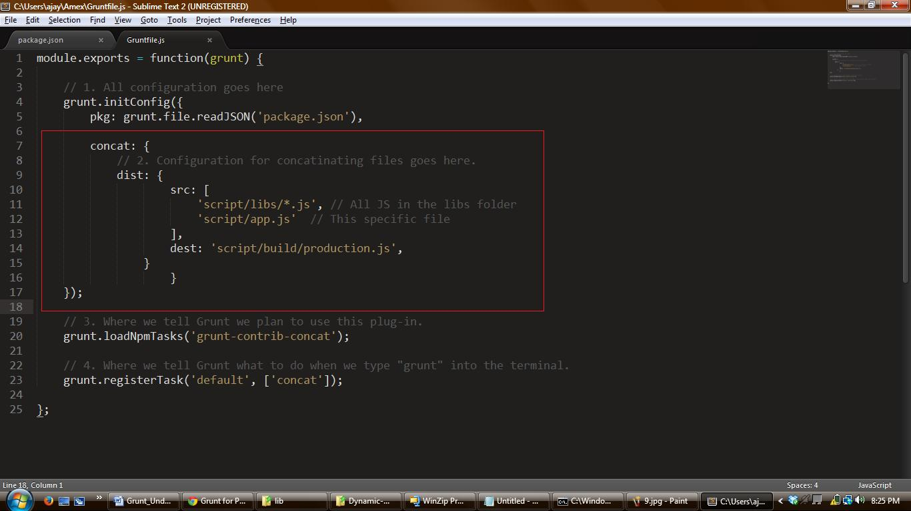
Contents of Gruntfiles.js will be in the following format

Slide 15
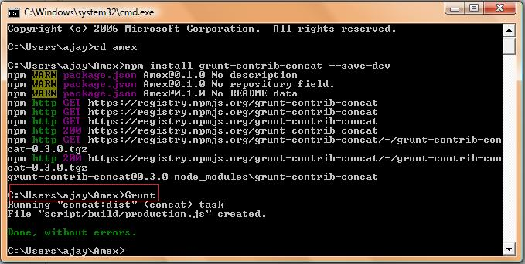
All set, we just have to run Grunt command from your project folder and watch it happen! production.js will be created and will be a perfect concatenation of our three files.

Slide 16
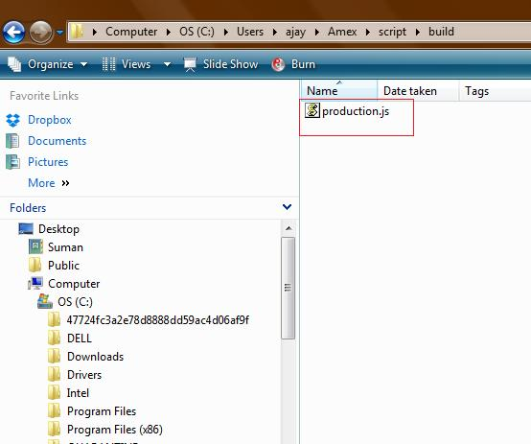

Slide 17
LET’S MAKE GRUNT MINIFY OUR Production.js file:
To minify we have to follow these 3 steps:
Find a Grunt plug-in to minify
Add configuration style of that plug-in to Gruntfile.js and
The official plug-in for minifying code is grunt-contrib-uglify. Just like we did last time, we just have to run an NPM command to install it:
npm install grunt-contrib-uglify --save-dev
Then we alter our Gruntfile.js to load the plug-in:
grunt.loadNpmTasks('grunt-contrib-uglify');

Slide 18
Then we configure it:
uglify: {
build: {
src: 'script/build/production.js',
dest: 'script/build/production.min.js'
}
}
Let’s update that default task to also run minification:
grunt.registerTask('default', ['concat', 'uglify']);

Slide 19
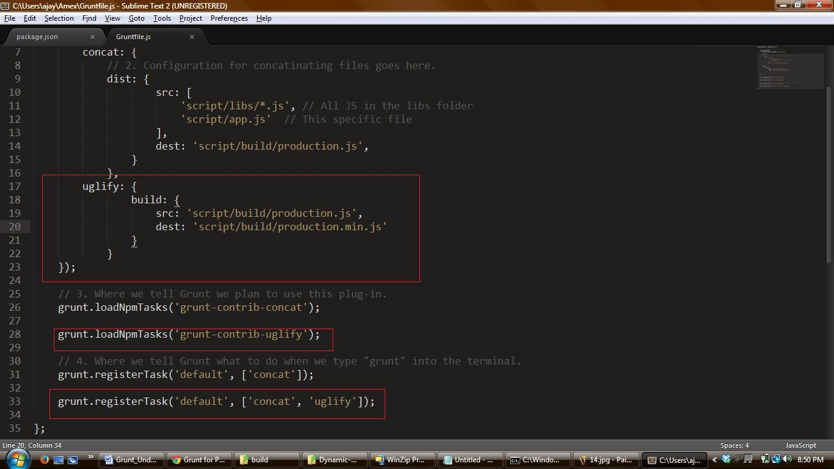
Run grunt at the command prompt from your project folder and you’ll get some deliciously minified version of your production.js as production.min.js

Slide 20
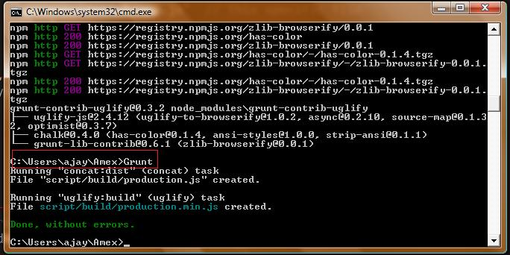

Slide 21
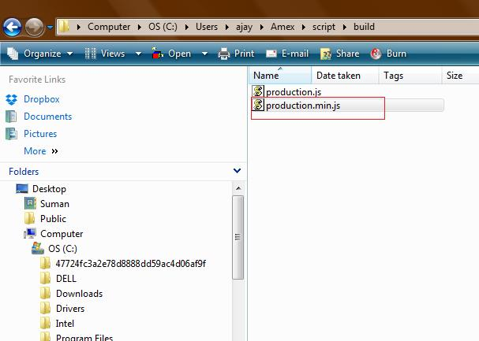

Slide 22
Thanks

