Slide 1
HTML5
LEVEL – LEARNER

Slide 2
Chayan Rathore – 350071 Shashank Shekhar Jha - 354063
BE IT 7 Years of web development exp. BE-IT,MBA 7.5 years of web application development Exp
1.0 and 20-05-2014

Slide 3









Icons Used
Hands on Exercise
Questions
Tools
Coding Standards
Test Your Understanding
Reference
A Welcome Break
Demonstration
Contacts

Slide 4
Overview
HTML 5 a revolution in WEB.
What is HTML 5 ?
Why HTML5 ?

Slide 5
Table of Content
Introduction
History
Browser Support
Elements
Form Elements and Input Types
Attributes
Events
Graphics
SVG and Canvas
Introduction to API
Storage
Local and Session Storage, Cache manifesto, IndexedDB
Geolocation, Web Socket and Web workers

Slide 6
Objectives
After this complete session you will be able to understand:
What is RIA ?
Importance of semantic markup.
HTML 5 tags and APIs.

Slide 7
Do You Know
What is world wide web ?
What is Web site ?
How does a web site work ?
What is HTML ?

Slide 8
HTML5 Introduction
HTML5 is a markup language used for structuring and presenting content for the World Wide Web.
It is the fifth revision of the HTML standard (created in 1990 and standardized as HTML 4 as of 1997).
HTML 5 is a new standard for HTML whose main target is to deliver everything without need to any additional plugins like flash, Silverlight etc. It has everything from animations, videos, rich GUI etc.
HTML5 is cooperation output between World Wide Web Consortium and the Web Hypertext Application Technology Working Group.

Slide 9
HTML5 Introduction cont.
HTML5 ~= HTML + CSS + JS
HTML5 has included new elements for drawing graphics, displaying media content, for better page structure and better form handling, and several new APIs, such as drag and drop, get the geographical position of a user, store local data, and more
Language for Mobile Applications development.

Slide 10
History of Web Standards
91-92 | 93-94 | 95-96 | 97-98 | 99-00 | 01-02 | 03-04 | 05-06 | 07-08 | 09-10 | 11-12 | 13-14
HTML 1 | HTML 2 |  | HTML 4 | XHTML 1 |  |  |  |  | HTML 5
 |  | CSS 1 | CSS 2 |  | T-less D | Web 2.0 |  |  | CSS3
 |  | JS | ECMA, DOM | DOM 2 |  |  | Ajax |  | DOM, APIs
WHATWG : Web Hypertext Application Technology Working Group.
(Apple, Mozilla, and Opera came together to work on web standards)
W3C : The World Wide Web Consortium (W3C) is an international community that develops open standards to ensure the long-term growth of the Web.
2004 | WHATWG started
2008 | W3C Working Draft
2012 (2010) | W3C Candidate Recommendation

Slide 11
Why HTML5
Pros
Better semantics
Lean code
Improved user experience
Cons
Some work is needed to accommodate older browsers
Notes:
What did you mean by semantics

Slide 12
Browser Support
HTML5 is collection of individual features. So we can’t detect “HTML5 support,” because that doesn’t make any sense. But we can detect support for individual features, like canvas, video, or Geolocation.
Microsoft Internet Explorer 9+
Mozilla Firefox 28+
Google Chrome
Apple Safari 5.1+
Opera 21+
http://caniuse.com/

Slide 13
Elements
List of elements newly added and deprecated in HTML5.
<acronym> - Deprecated
<applet> - Deprecated
<article> - specifies independent, self-contained content.
<aside> - defines some content aside from the content it is placed in
<audio> - Used for sound, such as music or other audio streams
<basefont> - Deprecated
<big> - Deprecated
<canvas> - used to draw graphics, on the fly, via JavaScript code.
<center> - Deprecated
<datalist> - specifies a list of pre-defined options for an <input> element

Slide 14
Elements cont.
<details> - specifies additional details that the user can view or hide on demand.
<embed> - for an external application.
<figcaption> - tag defines a caption for a <figure> element.
<figure> - Use to mark up a photo in a document.
<font> - Deprecated.
<footer> - tag defines a footer for a document or section.
<frame> - Deprecated.
<frameset> - Deprecated.
<header> - tag specifies a header for a document or section
<hgroup> - used to group heading elements.
<meter> - defines a scalar measurement within a known range, or a fractional value. This is also known as a gauge.

Slide 15
Elements cont.
<nav> - defines a set of navigation links.
<noframes> - Deprecated.
<progress> - represents the progress of a task.
<section> - defines sections in a document, such as chapters, headers, footers, or any other sections of the document.
<source> - used to specify multiple media resources for media elements, such as <video> and <audio>.
<strike> - deprecated.
<summary> - defines a visible heading for the <details> element.
<video> - specifies video, such as a movie clip or other video streams.

Slide 16

Semantic markup
Semantic HTML is a coding style where the tags embody what the text is meant to convey.
E.G.
<b></b> for bold, and <i></i> for italic should not be used, reason being they just represent formatting, and provide no indication of meaning or structure.
<strong></strong> and <em></em> These tags will have the same bold and italic effects, while demonstrating meaning and structure.

Slide 17
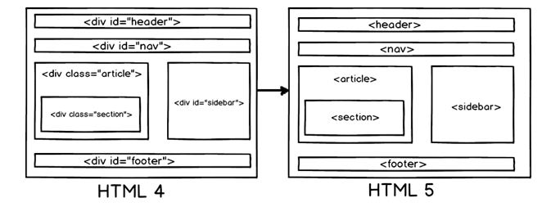
Semantic markup cont.

Slide 18
Input Types
New input type in HTML5.
<input type=“…..” />
Color - To select a color.
Date - To select a date.
Datetime - local - to select a date and time.
Email - Define a field for an e-mail address (Self validated upon submission.)
Month - Define a month and year control.
Number – To define input fields that should contain a numeric value.
Range - input fields with a value from a range of numbers.
Time - Allows the user to select a time.
URL - To define input fields which contain a URL address.
Week - Allows the user to select a week and year.

Slide 19
Form Elements
New form elements in HTML5.
<form >
<datalist >
…..
</datalist>
<keygen name="security">
<output >
…..
</output>
</form>

Slide 20
HTML Attribute Rule & List
HTML elements can have attributes
Attributes provide additional information about an element
Attributes are always specified in the start tag
Attributes come in name/value pairs like: name="value"
Global attributes
Accesskey, class ,contenteditable, contextmenu ,data-* ,dir, draggable, dropzone, hidden, id ,lang ,spellcheck, style, tabindex, title, translate

Slide 21
Attributes
New attributes for <form>
Autocomplete
Novalidate
New attributes for <input>
autocomplete
autofocus
form
formaction
formenctype
formmethod
formnovalidate

Slide 22
Attributes cont.
New attributes for <input>
formtarget
height and width
list
min and max
multiple
pattern (regexp)
placeholder
required
step

Slide 23
Events
What is an Event Attribute?
An event on a web page is browser response to user action. HTML 4 limits us to only a few events: mouse actions (down, move, up, over, out); clicking, double-clicking and selecting; and some form actions (blur, change, focus, submit).
Drag and Drop Event Attributes
HTML 5 adds some specific attributes for dragging and dropping page contents.
ondrag – defines a script to run when the element is dragged
ondrop – defines a script to run when the dragged element is dropped
ondragstart and ondragend – defines a script to run when the drag operation starts and ends
ondragenter, ondragover, and ondragleave – defines scripts to run when the element enters, is over, and leaves a valid drop point

Slide 24
Events cont.
Media Events
New event attributes are the ones for handling multimedia and can be used in any media elements including images, sound, and video and give us lot more flexibility for telling the customer what is happening. For instance:
oncanplay, oncanplaythrough – these allow us to let a customer know when a video or other multimedia element can start playing or can play the whole thing without buffering.
onplay, onplaying, onstalled, onwaiting – when the video is going to start playing, has started, is stalled, or is waiting and is expected to resume
onvolumechange – we can even run a script when the volume changes or is muted.

Slide 25
Events cont.
New Form and Mouse Event
Forms are a critical part of most web applications. we can now trigger scripts when the context menu is triggered (such as the right-click menu), when the form changes, when the form gets user input, and when an entry is invalid.
Two new useful features of the mouse include triggering events when the mousewheel is rotated and when the element’s scrollbar is moved.
Loading Event
HTML 5 adds onunload, onbeforeonload, onbeforeunload. These define scripts that happen when the element is unloaded and just before it’s loaded or unloaded.

Slide 26
Video
Before HTML5, there was no standard for showing videos/movies on web pages. Videos could only be played with a plug-in (like flash). However, different browsers supported different plug-ins.
HTML5 defines a new element which specifies a standard way to embed a video or movie on a web page: the <video> element.
Internet Explorer 9+, Firefox, Opera, Chrome, and Safari.
<video width="320" height="240" controls> <source src="movie.mp4" type="video/mp4"> <source src="movie.ogg" type="video/ogg"> Your browser does not support the video tag. </video>

Slide 27
Audio
Before HTML5, there was no standard for Audio file to play on web pages. Plug-in (like flash) were used. However, different browsers supported different plug-ins.
HTML5 defines a new element which specifies a standard way to embed a audio on a web page: the <audio> element.
Internet Explorer 9+, Firefox, Opera, Chrome, and Safari
<audio controls> <source src="horse.ogg" type="audio/ogg"> <source src="horse.mp3" type="audio/mpeg"> Your browser does not support the audio element. </audio>

Slide 28
Audio
Before HTML5, there was no standard for Audio file to play on web pages. Plug-in (like flash) were used. However, different browsers supported different plug-ins.
HTML5 defines a new element which specifies a standard way to embed a audio on a web page: the <audio> element.
Internet Explorer 9+, Firefox, Opera, Chrome, and Safari
<audio controls> <source src="horse.ogg" type="audio/ogg"> <source src="horse.mp3" type="audio/mpeg"> Your browser does not support the audio element. </audio>

Slide 29
Scalable Vector Graphics
SVG is W3C recommendation. It is used to define vector-based graphics for the Web. defines the graphics in XML format.
SVG graphics do NOT lose any quality if they are zoomed or resized. Every element and every attribute in SVG files can be animated.
SVG images can be created and edited with any text editor.
SVG images can be searched, indexed, scripted, and compressed
SVG is a language for describing 2D graphics in XML.
https://www.ibm.com/developerworks/library/wa-scalable/
https://developer.mozilla.org/en-US/docs/Web/SVG/Tutorial

Slide 30
Canvas
Canvas is used to draw graphics, on the fly.
It is only a container for graphics. We must use a script to actually draw the graphics. it has several methods for drawing paths, boxes, circles, text, and adding images.
When defined on page, it is just a rectangular area on an HTML page with no border and no content.
http://www.w3schools.com/html/html5_canvas.asp
http://www.ibm.com/developerworks/web/library/wa-htmlmark/index.html

Slide 31
Canvas cont.
<canvas id=“canvas” width=“150” height=“150”>
</canvas>
function draw() {
var canvas = document.getElementById(“canvas”);
if (canvas.getContext) {
var ctx = canvas.getContext(“2d”);
ctx.fillStyle = “rgb(200,0,0)”;
ctx.fillRect (10,10,55,50);
ctx.fillStyle = “rgb(0,0,200)”;
ctx.fillRect (30,30,55,50);
}
}
Output:

Slide 32
Storage - Offline Applications
<html mainfest=“http://m.health.unm.edu/someapp.manifest”>
…
</html>
CACHE MANIFEST
#v1.01
#Explicitly cached files
CACHE:
index.html
Stylesheet.css
Images/logo.png
NETWORK:
Search.cfm
Login.cfm
/dynamicpages
FALLBACK:
/dynamicpage.cfm /static.html
someapp.manifest
http://www.whatwg.org/specs/web-apps/current-work/multipage/offline.html

Slide 33
Storage - Local Storage
Beyond cookies- local storage
Manipulated by JavaScript
Persistent
5MB storage per “origin”
Secure (no communication out of the browser)
Session storage
Lasts as long as the browser is open
Each page and tab is a new session
Browser based SQLite or IndexedDB

Slide 34
Storage - Local Storage cont.
Web storage
window.localStorage[‘value’] = ‘Save this!’;
Session storage
sessionStorage.useLater(‘fullname’, ‘Garth Colasurdo’); alert(“Hello ” + sessionStorage.fullname);
Database storage var database = openDatabase(“Database Name”, “Database Version”); database.executeSql(“SELECT * FROM test”, function(result1) { … });

Slide 35
Location
Geolocation API is used to get the geographical position of a user with his/her consent.
<script> var x = document.getElementById("demo"); function getLocation() { if (navigator.geolocation) { navigator.geolocation.getCurrentPosition(showPosition); } else{x.innerHTML = "Geolocation is not supported by this browser.";} } function showPosition(position) { x.innerHTML = "Latitude: " + position.coords.latitude + "<br>Longitude: " + position.coords.longitude; } </script>

Slide 36
Web Worker
A web worker is a JavaScript code that runs in the background, independently of other scripts, without affecting the performance of the page and user can continue to do whatever he want: clicking, selecting things, etc., while the web worker runs in the background.
Limitations:
Since web workers are in external files, they do not have access to the following JavaScript objects:
The window object
The document object
The parent object
http://www.w3schools.com/html/html5_webworkers.asp

Slide 37
Web socket
Create a new EventSource object, and specify the URL of the page sending the updates
Each time an update is received, the onmessage event occurs
Other event include onopen, onerror
Server Side
Set the "Content-Type" header to "text/event-stream"
Specify that the page should not cache
Output the data to send (Always start with "data: ")
Flush the output data back to the web page
Notes:
if(typeof(EventSource) !== "undefined") { var source = new EventSource("demo_sse.php"); source.onmessage = function(event) { document.getElementById("result").innerHTML + =event.data + "<br>"; }; } else { // Sorry! No server-sent events support.. }
<?php header('Content-Type: text/event-stream'); header('Cache-Control: no-cache'); $time = date('r'); echo "data: The server time is: {$time}\n\n"; flush(); ?>

Slide 38
Questions

Slide 39
Test Your Understanding
What is HTML 5 ????
Will HTML 5 work without <! DOCTYPE html> ????
Which browsers support HTML 5 ????
What is “Semantic HTML ????
What are different Storage type in HTML5 ????

Slide 40
Demos
HTMl5 Demos with browser support listed http://html5demos.com
Disclaimer: Parts of the content of this course is based on the materials available from the Web sites and books listed above. The materials that can be accessed from linked sites are not maintained by Cognizant Academy and we are not responsible for the contents thereof. All trademarks, service marks, and trade names in this course are the marks of the respective owner(s).

Slide 41
Developer Sorce
W3C http://dev.w3.org/html5/html-author/ W3Schools HTML 5 Reference http://www.w3schools.com/html5/
Dive Into HTML 5 (prerelease site for an O’Reilly book) http://diveintohtml5.org
Web Kit (Safari and Chromium) http://developer.apple.com/safari/library/navigation/ http://www.chromium/home/
Mozilla http://developer.mozilla.org/en/html/html5/
IE 8 & 9 http://msdn.microsoft.com/en-us/library/aa737439.aspx http://ie.microsoft.com/testdrive/
Disclaimer: Parts of the content of this course is based on the materials available from the Web sites and books listed above. The materials that can be accessed from linked sites are not maintained by Cognizant Academy and we are not responsible for the contents thereof. All trademarks, service marks, and trade names in this course are the marks of the respective owner(s).

Slide 42
Source
http://www.tutorialspoint.com/html5/html5_pdf_version.htm
http://www.html-5-tutorial.com/all-html-tags.htm - Tags
http://www.tutorialspoint.com/html5/html5_events.htm - Events
http://www.w3schools.com/html/html5_geolocation.asp - Location
Disclaimer: Parts of the content of this course is based on the materials available from the Web sites and books listed above. The materials that can be accessed from linked sites are not maintained by Cognizant Academy and we are not responsible for the contents thereof. All trademarks, service marks, and trade names in this course are the marks of the respective owner(s).

Slide 43
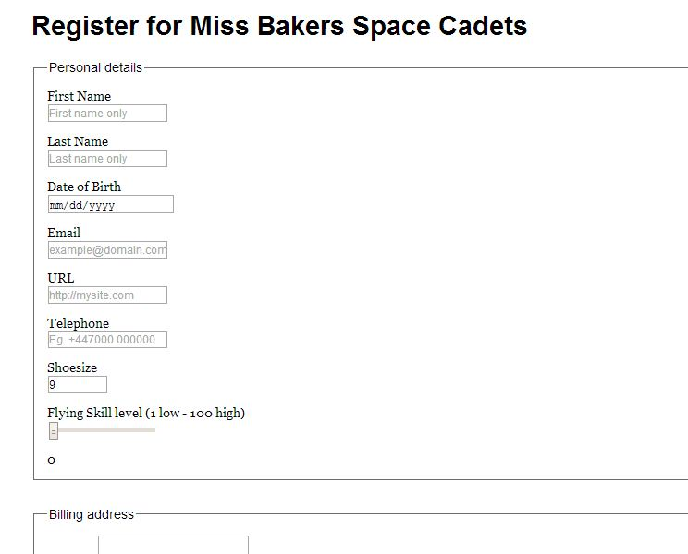
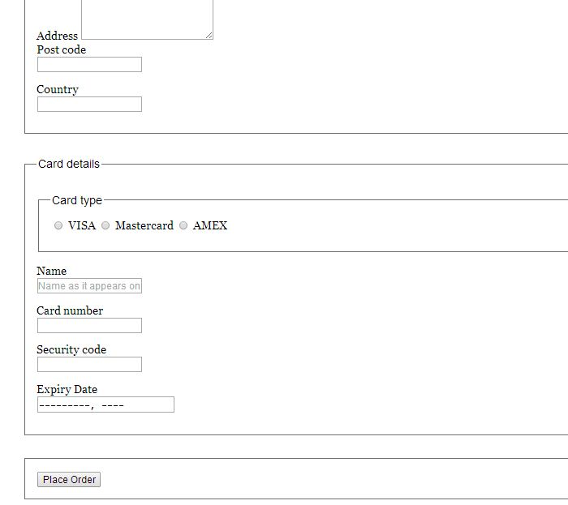
Hands On

Slide 44
HTML5
You have successfully completed.

