Slide 1
Cross-Browser Compatible

Slide 2
Cross-Browser Compatible
Cross-Browser Compatible
Compatible with all major browsers available
“Compatibility” (in this context) is not a term which means “looks and behaves identically” — instead, it may be better described as “performs equivalently under alternative conditions.”

Slide 3
Cross-Browser Compatible
A lot of cross-browser issues amount to this: you didn't specify something, and different browsers make different assumptions. Therefore:
Major Desktop Browsers Available
These are the major desktop browsers available:
Internet Explorer
Google Chrome
Opera
Firefox
Safari
Text based browsers for Lynx operating system or the visually impaired

Slide 4
How do I Make My Site Cross-Browser Compatible?
To create a cross-browser compatible website:
Use only standard compliant coding.
Don't use browser specific (proprietory) HTML tags and features.
These only work in the browser they were created for and may even break your web page when viewed in another browser.
Validate your web pages.
Validate your HTML/XHTML coding using the W3C free validation service
Validate your cascading style sheets using the W3C free validation service

Slide 5
Cause – Web browser engines
Engine | Browsers
WebKit | Safari Chrome
Gecko | Mozilla Firefox
Trident | Internet Explorer
Presto | Opera

Slide 6
Cause – Web browser engines
Different CSS support – CSS2
` |  |  | Trident | Gecko | WebKit | KHTML | Presto | Prince XML
CSS2 | !important | Weight increasing | 7.0 | 1.0 | 85 | Yes | 1.0 | Yes
 | /*Comment*/ | Comments | 3.0 | 1.0 | 85 | Yes | 1.0 | Yes
 | @import | Import stylesheet | 8.0 | 1.0 | Yes | Yes | 1.0 | 2.1
 | @charset | Character set | 5.5 | 1.0 | Yes | 4.2.3 | 1.0 | Yes
 | @media | Media-specific rules | 5.5 | 1.0 | Yes | Yes | 1.0 | 5.1
 | @page | For paged media | 8.0 | 19.0 | Nightly Build | No | 1.0 | 6.0

Slide 7
Solution – How to solve it?
How to solve it?
What tools to check compatibility?
What ways to prevent conflicts?
Solution – Check compatibility
Tools introduction
Cross Browser Testing
MS modern.IE
Google Browser Compatibility Detector
Markup Validation Service
CSS Validation Service

Slide 8
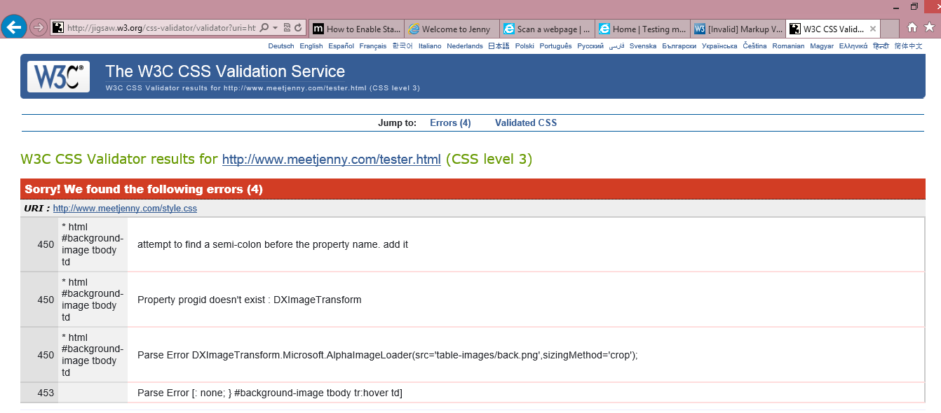
Solution – Check compatibility
CSS Validation Service

Slide 9
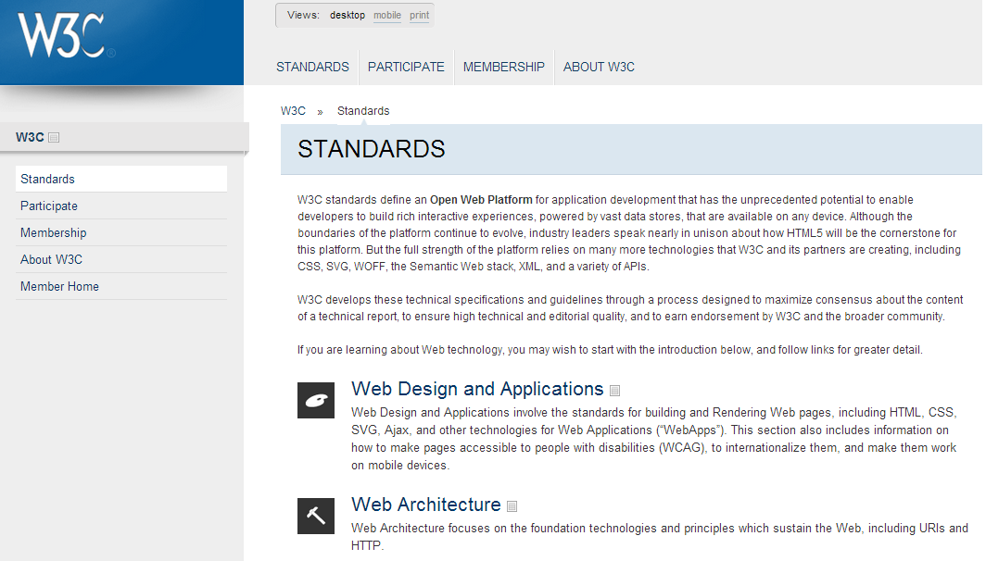
Solution – Follow web standards
Check web standard

Slide 10
Solution – Prevent possible conflicts
Reset CSS
html,body,div,ul,ol,li,dl,dt,dd,h1,h2,h3,h4,h5,h6,pre,form,p,blockquote,fieldset,input,hr {margin:0; padding:0;} h1,h2,h3,h4,h5,h6,pre,code,address,caption,cite,code,em,strong,th {font-size:1em; font-weight:normal; font-style:normal;} ul,ol {list-style:none;} fieldset,img,hr {border:none;} caption,th {text-align:left;} table {border-collapse:collapse; border-spacing:0;} td {vertical-align:top;}

Slide 11
Solution – Prevent possible conflicts
Internet Explorer conditional comments
<!--[if IE]> <link href="ie.css" rel="stylesheet" type="text/css" /> <![endif]-->
<!--[if IE6]> <link href="ie.css" rel="stylesheet" type="text/css" /> <![endif]-->
.class { width:200px; /* All browsers */ *width:250px; /* IE */ _width:300px; /* IE6 */ .width:200px; /* IE7 */ }

Slide 12
Browser Specific Hacks
/***** Attribute Hacks ******/
/* IE6 */
#once { _color: blue }
/* IE6, IE7 */
#doce { *color: blue; /* or #color: blue */ }
/* Everything but IE6 */
#diecisiete { color/**/: blue }
/* IE6, IE7, IE8 */
#diecinueve { color: blue\9; }
/* IE7, IE8 */
#veinte { color/*\**/: blue\9; }
/* IE6, IE7 -- acts as an !important */
#veintesiete { color: blue !important; }

Slide 13
Browser Specific Hacks
/***** Selector Hacks ******/
/* IE6 and below */
* html #uno { color: red }
/* IE7 */
*:first-child+html #dos { color: red }
/* IE7, FF, Saf, Opera */
html>body #tres { color: red }
/* IE8, FF, Saf, Opera (Everything but IE 6,7) */
html>/**/body #cuatro { color: red }

Slide 14
Solution – Tips
Avoid complexity
Inclusion of DOCTYPE
Choose target browsers
Code validation
Web Analytics

Slide 15
Validate
First off, validate your site. Ironing out those XHTML and CSS errors can often solve those pesky browser bugs. I suggest running your site through W3′s XHTML Validator and CSS Validator.

Slide 16
Cross-Browser Compatible
Thanks

