Slide 1
Fluid Layout

Slide 2
Fluid Layout
It's actually pretty easy with "the magic formula".
target ÷ context = result
We just enhance the formula with percentage, as follows
(target / context) x 100 = result %
You get the result in percentage,
ex:-
(900 / 960) x 100 = 93.75%

Slide 3
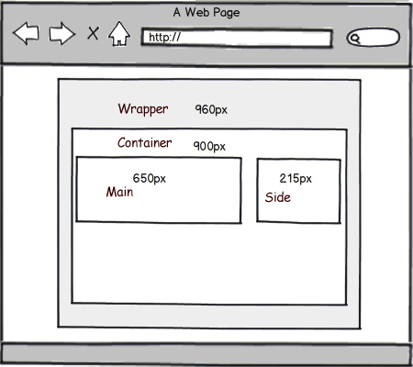
Fluid Layout

Slide 4
EM vs PX
“Ems” (em): The “em” is a scalable unit that is used in web document media. An em is equal to the current font-size, for instance, if the font-size of the document is 12pt, 1em is equal to 12pt. Ems are scalable in nature, so 2em would equal 24pt, .5em would equal 6pt, etc. Ems are becoming increasingly popular in web documents due to scalability and their mobile-device-friendly nature.
Pixels (px): Pixels are fixed-size units that are used in screen media (i.e. to be read on the computer screen). One pixel is equal to one dot on the computer screen (the smallest division of your screen’s resolution). Many web designers use pixel units in web documents in order to produce a pixel-perfect representation of their site as it is rendered in the browser. One problem with the pixel unit is that it does not scale upward for visually-impaired readers or downward to fit mobile devices.

Slide 5
Converting “px” to “em”
body { font: normal 100% Helvetica, Arial, sans-serif; }
With a font-size of 100%, all the elements in our page are sized relative to the browser’s default type size, which in most cases is 16px.
how do we size the text to 24 pixels?
target ÷ context = result
24 ÷ 16 = 1.5
h1 {
font-family: Georgia, serif;
font-size: 1.5em; /* 24px / 16px = 1.5em */
}

Slide 6
Fluid Layout
Thanks

