Slide 1





TDD – BDD - Jasmine

Slide 2

Agenda
Introducing TDD
Steps to BDD
Familiarize terminology
Installation
Executing jasmine
Write tests in jasmine
What next?

Slide 3
TDD
Involves writing tests before writing the code being tested
Write a small test first (at this point of time no code being written!)
Run the test (obviously, it fails!)
Now make the test pass (well write some code)
Observe the design, refactor

Slide 4
TDD - Challenges
As the code size increases more refactor becomes critical
Since most of the time the features are not pre-determined reviewing/refactoring does prove as time consuming and becomes expensive

Slide 5
So what next???
In real time objects are the carriers
They extend the behavior of classes
This would be mean, “what an object does is significantly more important!”
It’s all behavior

Slide 6
BDD
Behaviour Driven Development is an Agile development process that comprises aspects of
  Acceptance Test Driven Planning,
  Domain Driven Design
  Test Driven Development

Slide 7
BDD
BDD puts the focus on Behavior rather than structure
Examples
  User inputting values
  Awaiting for the feedback
  Calculations/logic
It’s all behavior

Slide 8
BDD Triad
For better communication across the levels (Business analysts, Developers, Testers) in software development we narrate/describe the logical chunks as scenarios
Given/When/Then – called as BDD triad

Slide 9
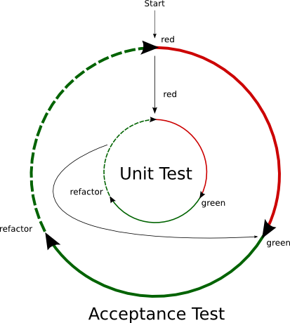
BDD Cycle

Slide 10

Jasmine

Slide 11

Jasmine
  It’s a BDD Framework for testing JavaScript
    Does not depend on other frameworks
    Does not require a DOM
    Clean & Obvious syntax
    Influenced by Rspec, JSSpec, Jspec
    Available as stand-alone, ruby gem, Node.js module, as Maven plugin

Slide 12
Principles
  Should not be tied to any browser, framework, platform or host language
  Should have idiomatic and unsurprising syntax
  Should work wherever JavaScript runs
  Should play well with IDE’s

Slide 13
Goals
  It should encourage good testing practices
  It should be simple to get start with
  It should integrate easily with continuous build systems

Slide 14
Terminology
Specs
Suites
describe
it
expect
matchers
mocks
spies

Slide 15
Installation
Required files/structure
Download stand alone zip file include the lib files <script type="text/javascript" src="lib/jasmine-1.0.0.rc1/jasmine.js"></script>
<script type="text/javascript" src="lib/jasmine-1.0.0.rc1/jasmine-html.js"></script>
Include styles as well
<link rel="stylesheet" type="text/css" href="lib/jasmine-1.0.0.rc1/jasmine.css">

Slide 16
Implementation/File structure
jasmine-example/
  lib/
    jasmine-1.3.1/jasmine.js
    jasmine-1.3.1/jasmine-html.js
    jasmine-1.0.0.rc1/jasmine.css
  specs/
    SpecHelper.js
    BasicMathSpec.js
  scripts/
    BasicMath.js

Slide 17
http://try-jasmine.heroku.com/

Slide 18
describe ... it
// Jasmine
describe “Calculate”, function() {
describe “#Add”, function(){
it “should give sum”, function(){
-----
-----
};
});
});
describe accepts a string or class. Helps in organizing specs
  it is what describes the spec. It optionally takes a string

Slide 19
Filters
Pretty handy to create data for each test
before runs the specified block before each test.
  after runs the specified block after each test.
// Jasmine
var calc;
beforeEach(function(){
calc = new Calculator();
});
afterEach(function(){
calc.reset();
});

Slide 20
Expectations
  //Jasmine
  it (“should return the sum”, function(){
  calc = new Calculator();
  expect(calc.Add(4,5).toEqual(9));
  expect(calc.Add(4,4).not.toEqual(9));
  });

Slide 21
http://try-jasmine.heroku.com/

Slide 22
Specs - variables
Spec -
describe('panda',function(){
it('is happy',function(){
expect(panda).toBe('happy');
});
});
JavaScript
panda = “happy”;

Slide 23
Specs - functions
Spec
describe('Hello World function',function(){
it('just prints a string',function(){
expect(helloWorld()).toEqual("Hello world!");
});
});
JavaScript
function helloWorld(){
return "Hello world!";
}

Slide 24
Specs –matchers
Spec
describe('Hello World function',function(){
it('just prints a string',function(){
expect(helloWorld()).toContain("world!");
});
});
JavaScript
function helloWorld(){
return "Hello world!";
}

Slide 25
What next?
  Spies
  Mocking/Faking
  coffee-script
  jasmine-jquery
  jasmine-fixture
  jasmine-stealth

Slide 26
Thanks
References:
http://blog.bandzarewicz.com/blog/2012/03/08/jasmine-cheat-sheet/
http://evanhahn.com/how-do-i-jasmine/
http://tobyho.com/2011/12/15/jasmine-spy-cheatsheet/
https://github.com/pivotal/jasmine/wiki/Spies
tosumanthkrishna@gmail.com

