Slide 1
jQuery

Slide 2
What is jQuery?
A library of JavaScript functions
Features
Select and manipulate HTML
Manipulate CSS
JavaScript Effects and animations
HTML DOM traversal and modification
AJAX
Utilities

Slide 3
How jQuery Works
The jQuery syntax is used to select HTML elements and perform some action on those element(s).
Basic syntax: $(selector).action()
A dollar sign to define jQuery
A (selector) to find HTML elements
An action() to be performed on the element(s)

Slide 4
Simple example
Function which hides a <p> element when clicked
<html> <head> <script type="text/javascript" src="jquery.js"></script> <script type="text/javascript"> $(document).ready(function() { $("p").click(function() { $(this).hide(); }
); }
); </script> </head> <body> <p>If you click on me, I will disappear.</p> </body> </html>

Slide 5
window.onload
We cannot use the DOM before the page has been constructed. jQuery gives us a more compatibile way to do this.
The DOM way
The direct jQuery translation
The jQuery way
window.onload = function() { // do stuff with the DOM }
$(document).ready(function() { // do stuff with the DOM });
$(function() { // do stuff with the DOM });

Slide 6
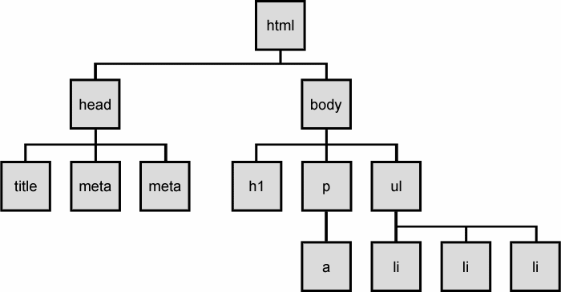
Aspects of the DOM and jQuery
Identification: how do I obtain a reference to the node that I want.
Traversal: how do I move around the DOM tree.
Node Manipulation: how do I get or set aspects of a DOM node.
Tree Manipulation: how do I change the structure of the page.
The DOM tree

Slide 7
Selecting groups of DOM objects
name | description
getElementById | returns array of descendents with the given tag, such as "div"
getElementsByTagName | returns array of descendents with the given tag, such as "div"
getElementsByName | returns array of descendents with the given name attribute (mostly useful for accessing form controls)
querySelector * | returns the first element that would be matched by the given CSS selector string
querySelectorAll * | returns an array of all elements that would be matched by the given CSS selector string

Slide 8
jQuery node identification
// id selector
var elem = $("#myid");
// group selector
var elems = $("#myid, p");
// context selector
var elems = $("#myid < div p");
// complex selector
var elems = $("#myid < h1.special:not(.classy)");
http://api.jquery.com/category/selectors/

Slide 9
jQuery / DOM comparison
DOM method | jQuery equivalent
getElementById("id") | $("#id")
getElementsByTagName("tag") | $("tag")
getElementsByName("somename") | $("[name='somename']")
querySelector("selector") | $("selector")
querySelectorAll("selector") | $("selector")

Slide 10
jQuery terminology
the jQuery function
refers to the global jQuery object or the $ function depending on the context
a jQuery object
the object returned by the jQuery function that often represents a group of elements
selected elements
the DOM elements that you have selected for, most likely by some CSS selector passed to the jQuery function and possibly later filtered further

Slide 11
The jQuery object
The $ function always (even for ID selectors) returns an array-like object called a jQuery object.
The jQuery object wraps the originally selected DOM objects.
You can access the actual DOM object by accessing the elements of the jQuery object.
// false
document.getElementById("id") == $("#myid");
document.querySelectorAll("p") == $("p");
// true
document.getElementById("id") == $("#myid")[0];
document.getElementById("id") == $("#myid").get(0);
document.querySelectorAll("p")[0] == $("p")[0];

Slide 12
Using $ as a wrapper
$ adds extra functionality to DOM elements
passing an existing DOM object to $ will give it the jQuery upgrade
// convert regular DOM objects to a jQuery object
var elem = document.getElementById("myelem");
elem = $(elem);
var elems = document.querySelectorAll(".special");
elems = $(elems);

Slide 14
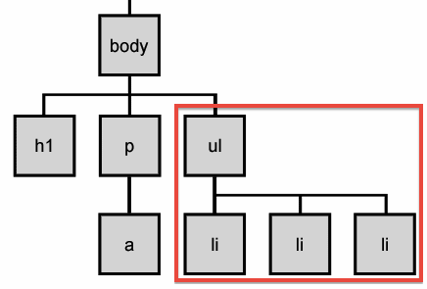
DOM context identification
You can use querySelectorAll() and querySelector() on any DOM object.
When you do this, it simply searches from that part of the DOM tree downward.
Programmatic equivalent of a CSS context selector
var list = document.getElementsByTagName("ul")[0];
var specials = list.querySelectorAll('li.special');

Slide 15
find / context parameter
jQuery gives two identical ways to do contextual element identification
var elem = $("#myid");
// These are identical
var specials = $("li.special", elem);
var specials = elem.find("li.special");

Slide 16
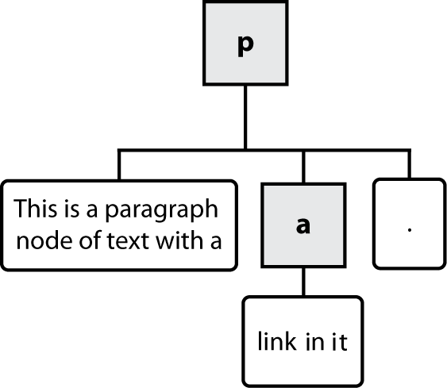
Types of DOM nodes
<p>
This is a paragraph of text with a
<a href="/path/page.html">link in it</a>.
</p>

Slide 17
Traversing the DOM tree
name(s) | description
firstChild, lastChild | start/end of this node's list of children
childNodes | array of all this node's children
nextSibling, previousSibling | neighboring nodes with the same parent
parentNode | the element that contains this node

Slide 18
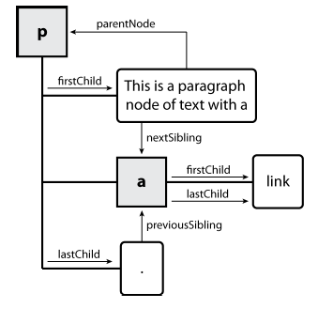
DOM tree traversal example
<p id="foo">This is a paragraph of text with a
<a href="/path/to/another/page.html">link</a>.</p>

Slide 19
jQuery Selectors
Syntax | Description
$(this) | Current HTML element
$("p") | All <p> elements
$("p.intro") | All <p> elements with class="intro"
$(".intro") | All elements with class="intro"
$("#intro") | The first element with id="intro"
$("ul li:first") | The first <li> element of each <ul>
$("[href$='.jpg']") | All elements with an href attribute that ends with ".jpg"
$("div#intro .head") | All elements with class="head" inside a <div> element with id="intro"

Slide 20
jQuery Effects
Function | Description
$(selector).hide() | Hide selected elements
$(selector).show() | Show selected elements
$(selector).toggle() | Toggle (between hide and show) selected elements
$(selector).slideDown() | Slide-down (show) selected elements
$(selector).slideUp() | Slide-up (hide) selected elements
$(selector).slideToggle() | Toggle slide-up and slide-down of selected elements
$(selector).fadeIn() | Fade in selected elements
$(selector).fadeOut() | Fade out selected elements
$(selector).fadeTo() | Fade out selected elements to a given opacity
$(selector).fadeToggle() | Toggle between fade in and fade out

Slide 21
Manipulating CSS
CSS Properties | Description
$(selector).css(propertyName) | Get the style property value of the first selected element
$(selector).css(propertyName,value) | Set the value of one style property for selected elements
$(selector).css({properties}) | Set multiple style properties for selected elements
$(selector).addClass(class) | Apply style class to the selected elements

Slide 22
Manipulating HTML
Function | Description
$(selector).html(content) | Changes the (inner) HTML of selected elements
$(selector).append(content) | Appends content to the (inner) HTML of selected elements
$(selector).after(content) | Adds HTML after selected elements

Slide 23
Custom Animations
The syntax of jQuery's method for making custom animations is:
$(selector).animate({params},[duration],[easing],[callback])
The key parameter is params. It defines the CSS properties that will be animated. Many properties can be animated at the same time:
animate({width:"70%",opacity:0.4,marginLeft:"0.6in",fontSize:"3em"});
The second parameter is duration. It specifies the speed of the animation. Possible values are "fast", "slow", "normal", or milliseconds.

Slide 24
Animation Example
<script type="text/javascript">
$(document).ready(function(){
$("button").click(function(){ $("div").animate({height:300},"slow"); $("div").animate({width:300},"slow"); $("div").animate({height:100},"slow"); $("div").animate({width:100},"slow"); }); }); </script>
<script type="text/javascript"> $(document).ready(function(){ $("button").click(function(){ $("div").animate({left:"100px"},"slow"); $("div").animate({fontSize:"3em"},"slow"); }); }); </script>

Slide 25
Callback Functions
Function called after action is completed
$("p").hide(1000,function(){ alert("The paragraph is now hidden"); });
Instead of
$("p").hide(1000); alert("The paragraph is now hidden");
In 2nd example the alert will show before the paragraph is hidden, since the alert happens immediately and the hide takes 1 second. Calling the alert from a callback function ensures that it won’t happen until the paragraph is hidden.

Slide 26
Changing HTML Content
$(selector).html(content)
The html() method changes the contents (innerHTML) of matching HTML elements.
$("p").html(“Stern is the best");
Will change all html within a <p> tag to “Stern is the best”

Slide 27
Can also append or prepend content
Adding HTML content
$(selector).append(content)
The append() method appends content to the inside of matching HTML elements.
$(selector).prepend(content)
The prepend() method "prepends" content to the inside of matching HTML elements.

Slide 28
After and Before
$(selector).after(content)
The after() method inserts HTML content after all matching elements.
$(selector).before(content)
The before() method inserts HTML content before all matching elements.

Slide 29
jQuery AJAX
Asynchronous Javascript and XML
AJAX
Allows javascript to dynamically communicate with a server without reloading the page.
jQuery provides a rich set of methods for AJAX web development.
With jQuery AJAX, you can request TXT, HTML, XML or JSON data from a remote server using both HTTP Get and HTTP Post.
And you can load remote data directly into selected HTML elements of your web page!
This is the magic that allows for web pages to dynamically change parts of their content instead of having to reload the whole page. No more click submit and wait for new page.
Example: Google Earth, Google maps
More map tiles are loaded in the background while you look at part of the map, so that when you move, the next area is already loaded.

Slide 30
jQuery load method
The jQuery load() method is a simple (but very powerful) AJAX function. It has the following syntax:
$(selector).load(url,data,callback)
Use the selector to define the HTML element(s) to change, and the url parameter to specify a web address for your data.

Slide 31
jQuery load Example
<html>
<head>
<script type="text/javascript" src="jquery.js"></script>
<script type="text/javascript">
$(document).ready(function(){
$("button").click(function(){
$("div").load('test1.txt');
});
});
</script>
</head>
<body>
<div><h2>Let AJAX change this text</h2></div>
<button>Change Content</button>
</body>
</html>

Slide 32
The jQuery GET Method
We will use the jQuery get() method to retrieve data from the server asynchronously.
Without a postback.
Uses the JavaScript XMLHttpRequest
Hides browser differences.
Hides differences between get and post.
http://api.jquery.com/jQuery.get/

Slide 33
The jQuery GET Method
$.get(url, data, callback)
url
Page to request
Must be a page on the same server
data
Query string or JavaScript object literal to send to server
callback
Function to process result
Note that there is no jQuery selector
$ stands alone

Slide 34
The jQuery GET Method
The Callback Function
Takes two parameters, both strings
data
Whatever the server sent as its response
status
'success' or error message

Slide 35
jQuery POST Method
The jQuery.post( url, [data], [callback], [type] ) method loads a page from the server using a POST HTTP request.
The method returns XMLHttpRequest object.
Syntax:
Here is the simple syntax to use this method:
$.post( url, [data], [callback], [type] )

Slide 36
jQuery POST Method
Parameters:
Here is the description of all the parameters used by this method:
url: A string containing the URL to which the request is sent
data:: This optional parameter represents key/value pairs or the return value of the .serialize() function that will be sent to the server.
callback:: This optional parameter represents a function to be executed whenever the data is loaded successfully.
type:: This optional parameter represents a type of data to be returned to callback function: "xml", "html", "script", "json", "jsonp", or "text".

Slide 37
Getting JSON data
There would be a situation when server would return JSON string against your request. JQuery utility function getJSON() parses the returned JSON string and makes the resulting string available to the callback function as first parameter to take further action.
Syntax:
Here is the simple syntax for getJSON() method:
[selector].getJSON( URL, [data], [callback] );
Here is the description of all the parameters:
URL: The URL of the server-side resource contacted via the GET method.
data: An object whose properties serve as the name/value pairs used to construct a query string to be appended to the URL, or a preformatted and encoded query string.
callback: A function invoked when the request completes. The data value resulting from digesting the response body as a JSON string is passed as the first parameter to this callback, and the status as the second.

Slide 38
JQuery AJAX Methods:
Methods and Description
jQuery.ajax( options ) Load a remote page using an HTTP request.
jQuery.ajaxSetup( options ) Setup global settings for AJAX requests.
jQuery.get( url, [data], [callback], [type] ) Load a remote page using an HTTP GET request.
jQuery.getJSON( url, [data], [callback] ) Load JSON data using an HTTP GET request.
jQuery.getScript( url, [callback] ) Loads and executes a JavaScript file using an HTTP GET request.
jQuery.post( url, [data], [callback], [type] ) Load a remote page using an HTTP POST request.
load( url, [data], [callback] ) Load HTML from a remote file and inject it into the DOM.
serialize( ) Serializes a set of input elements into a string of data.
serializeArray( ) Serializes all forms and form elements like the .serialize() method but returns a JSON data structure for you to work with.

Slide 39
JQuery AJAX Events:
You can call various JQuery methods during the life cycle of AJAX call progress. Based on different events/stages following methods are available:
Methods and Description
ajaxComplete( callback ) Attach a function to be executed whenever an AJAX request completes.
ajaxStart( callback ) Attach a function to be executed whenever an AJAX request begins and there is none already active.
ajaxError( callback ) Attach a function to be executed whenever an AJAX request fails.
ajaxSend( callback ) Attach a function to be executed before an AJAX request is sent.
ajaxStop( callback ) Attach a function to be executed whenever all AJAX requests have ended.
ajaxSuccess( callback ) Attach a function to be executed whenever an AJAX request completes successfully.

Slide 40
jQuery
Thanks

