Slide 1
🔍 Trace IQ
AI-Powered Log Analysis & Regression Detection
🚀 Team: Quantum Coders

Slide 2
🎯 The Problem
• Manual log analysis is time-consuming
• Hard to pinpoint issues across Server, ML App, or Alloy Teams
• Regression detection requires extensive manual effort
• No standardized way to compare workflow executions

Slide 3
💡 Our Solution
Trace IQ - An intelligent log analysis tool that:
• Compares Blue-Green workflow logs automatically
• Uses AI-powered analysis (Llama 3 8B)
• Provides root cause identification for errors
• Detects regressions between baseline and validation
• Functional workflow check with code repository integration

Slide 4
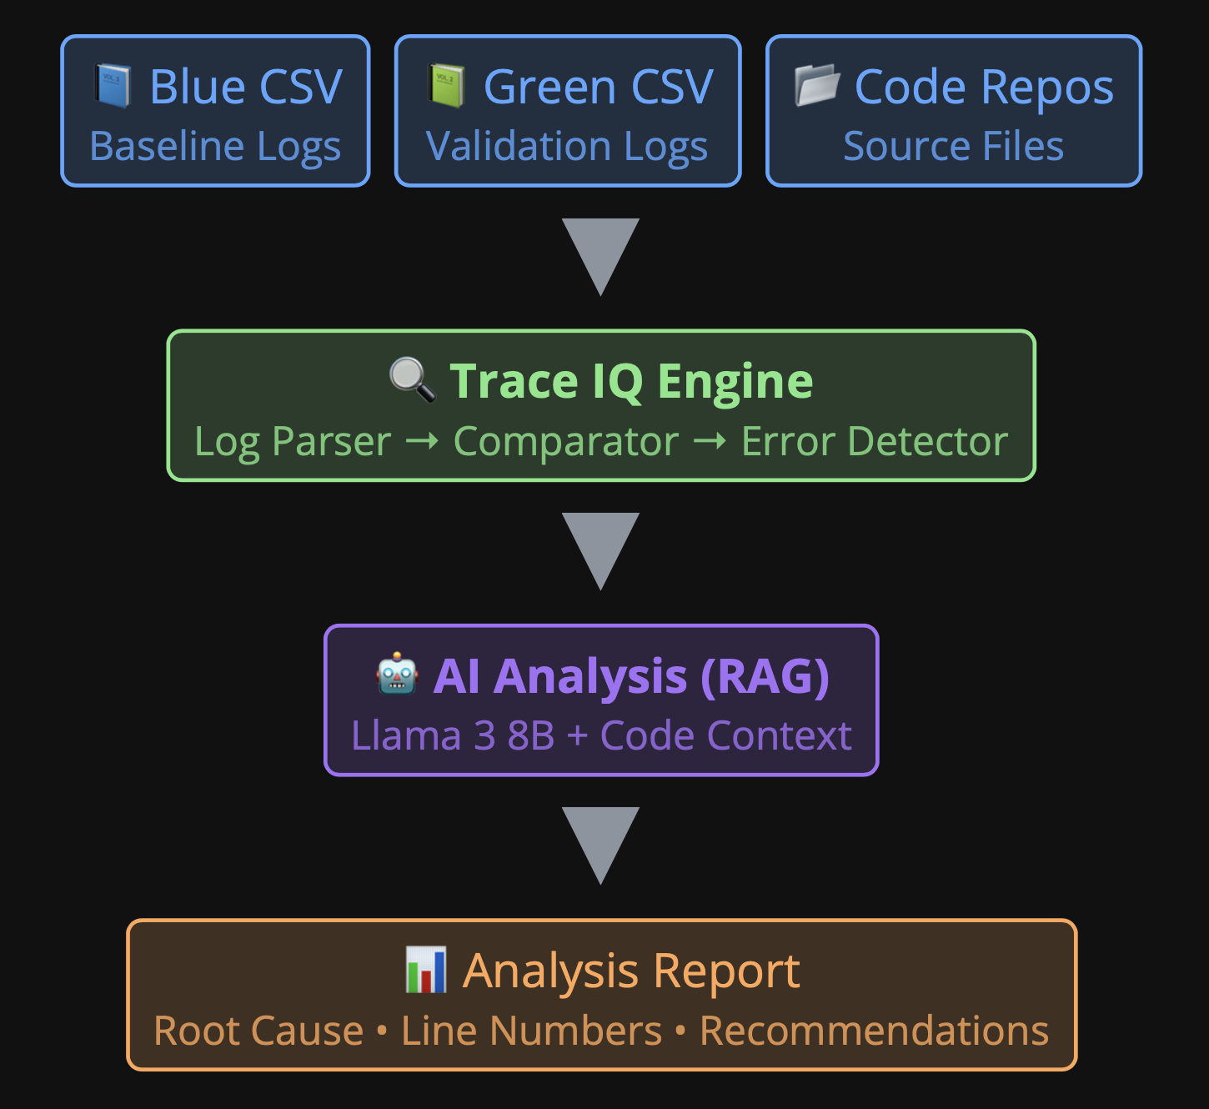
🏗️ Architecture

Slide 5
🎯 Easy Root Cause Identification
Pinpoint issues across Server, ML App, or Alloy Teams
• Detects error patterns from different services
• Correlates failures with specific code files
• Provides exact CSV line numbers
• Categorizes errors (NULL_STATE, EXCEPTION, SESSION_ERROR)

Slide 6
⚡ Faster and More Efficient
Reduce debugging time from hours to minutes
• Automated Analysis - No manual log parsing
• Intelligent Scoring - High-confidence errors prioritized
• Repository Context - AI understands your codebase
• One Command - Get comprehensive analysis instantly

Slide 7
🔒 Secure & Private
Your data never leaves your environment
• Offline AI Model - Local Llama 3 via Ollama
• No Data Exposure - Stays within infrastructure
• No API Keys - Self-contained solution
• Compliance Friendly - Meets privacy requirements

Slide 8
🖥️ Sample Output
### Root Cause Suggestions:
1. Line 35 in green.csv:
• Error: Session variable failure
• Related file: adk-services/config/adk.yml
2. Line 72 in green.csv:
• Error: Message delivery timeout
• Related file: moviusConnectTeams/src/SIP/MessageUtil.ts
### Confidence Level: HIGH

Slide 9
🔮 Future Proposals
• Regression Automation Testing - CI/CD integration
• ELK API Integration - Direct log fetching
• Web Dashboard - Interactive UI, error heatmaps
• Alert System - Slack/Teams notifications
• Multi-Workflow Support - Compare multiple workflows
• Multi-Baseline Comparison - Multiple blue files

Slide 10
Thank You!
🚀 Team Quantum Coders

