Slide 1
Objectives
Navigating
Zooming
Investigating
XD Document
Workspace
https://github.com/developer-godwinlarry/User-Experience

Slide 2
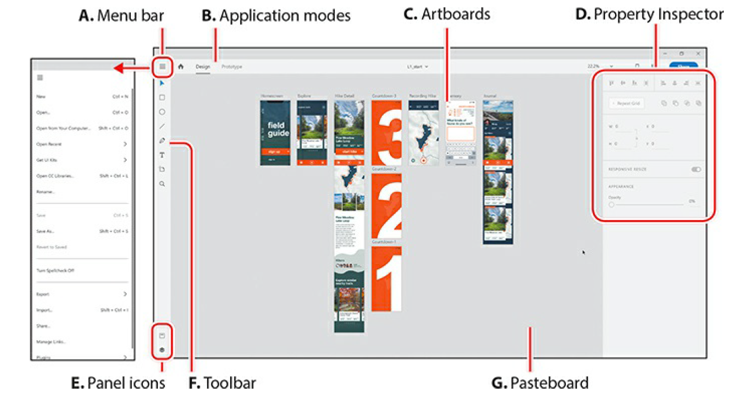
Overview

Slide 3
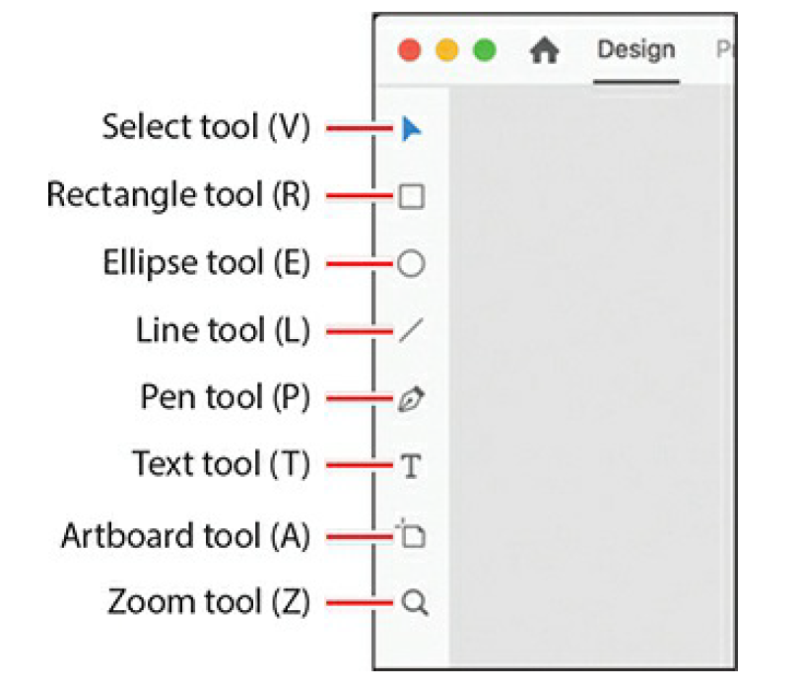
Tools

