Slide 1
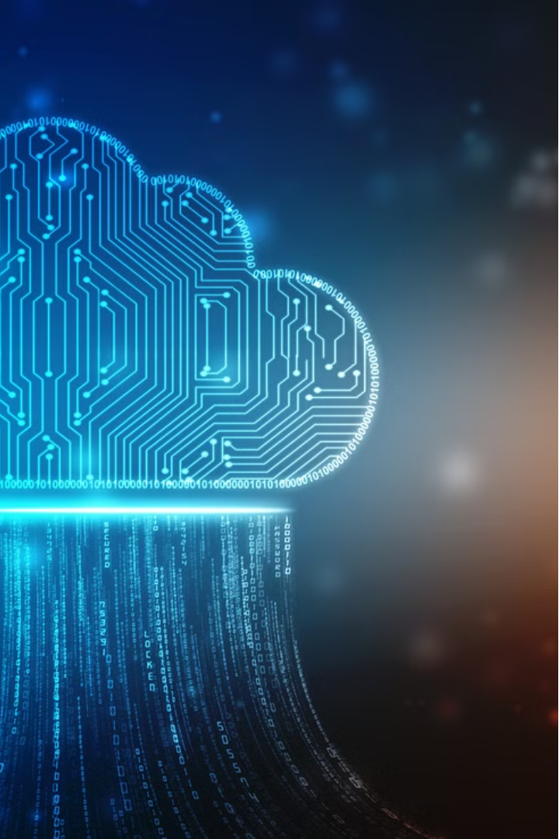

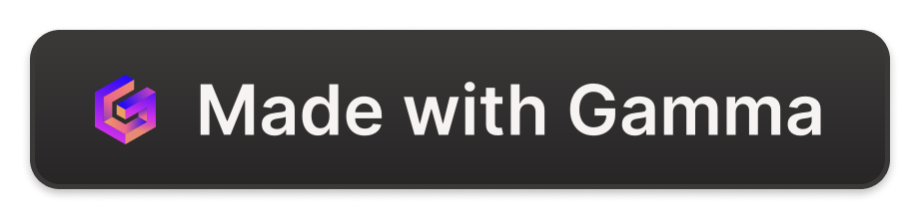
Cloud Native Artificial Intelligence
Cloud Native (CN) and Artificial Intelligence (AI) have become the most critical technology trends today. Cloud Native technology provides a scalable and reliable platform for running applications, while recent advancements in AI and Machine Learning (ML) have made AI a dominant cloud workload. This whitepaper explores the intersection of these two transformative technologies, discussing the current state, challenges, opportunities, and potential solutions for organizations to harness the power of Cloud Native Artificial Intelligence (CNAI).
by Hammad Rehman

Slide 2
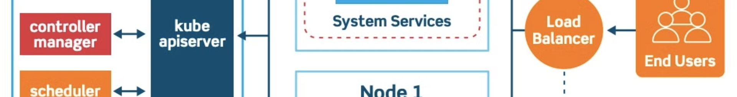
The Emergence of Cloud Native
Containerization
1
The rise of container technologies, from LXC to Docker and Kubernetes, has been a key driver in the growth of Cloud Native. Containers provide a scalable and reliable platform for running applications, enabling modular design, easy deployment, and high resilience.
2
Kubernetes as a Platform
Kubernetes has evolved to become the de facto cloud operating system, with private, public, and hybrid cloud offerings. It implements a distributed orchestrator that handles network, storage, and compute resources, allowing for efficient management of diverse workloads, including AI/ML.
DevOps Practices
3
Cloud Native aligns with DevOps best practices, such as GitOps, enabling engineers to make high-impact changes frequently and predictably with minimal effort. This approach helps organizations build and run scalable applications in modern, dynamic environments.

Slide 3
The Evolution of Artificial Intelligence
Discriminative AI
Generative AI
Breakthroughs
Discriminative AI focuses on learning decision boundaries or classifications, with the knowledge captured as a "model" that is used to predict new data. This type of AI is commonly used for tasks where the desired output is known, such as image classification or spam detection.
Generative AI, on the other hand, learns latent structures or representations within data, enabling the synthesis of new data like stories, music, and visual art. This type of AI is used for tasks where the desired output is unknown or ill-defined.
Recent advancements in Convolutional Neural Networks, Transformers, and Large Language Models have pushed the boundaries of AI, allowing for more accurate, creative, and human-like interactions. These innovations have been made possible by the availability of vast datasets and the evolution of specialized hardware and software infrastructure.

Slide 4
Merging of Cloud Native and Artificial Intelligence
1
Computational Demands
2
Data Considerations
Generative AI models require extremely high computational power and specialized hardware, while predictive AI models have more moderate needs that can be met by general-purpose hardware.
Generative AI models require massive, diverse datasets for training, while predictive AI models rely on specific historical data for accurate predictions.
3
Scalability and Elasticity
4
Storage and Throughput
Generative AI models demand highly scalable and elastic infrastructure to handle their variable and intensive computational requirements, while predictive AI models have lower elasticity needs and can benefit from batch processing or event-driven tasks.
Generative AI models require high-performance storage with excellent throughput to handle diverse data types, while predictive AI models focus more on efficient storage with moderate throughput for structured data analysis.

Slide 5
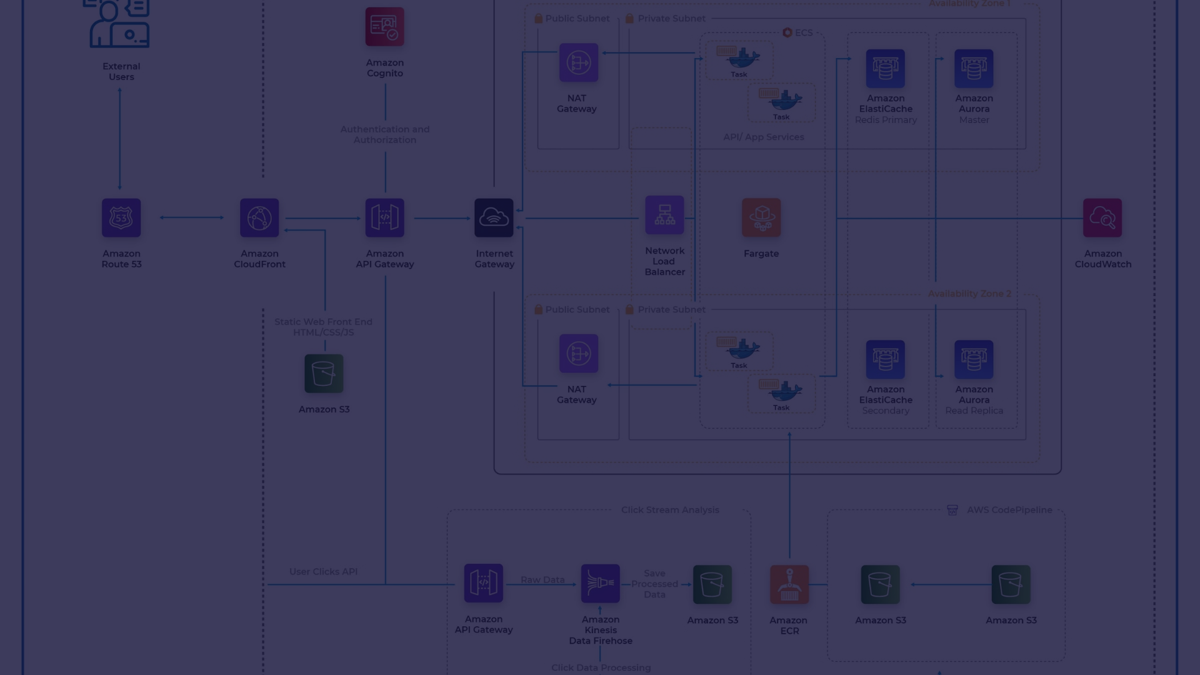
What is Cloud Native Artificial Intelligence?
Leveraging Cloud Native Infrastructure
Containerization and Orchestration
Data Access and Management
CNAI utilizes cloud-based data storage and processing services, such as data lakes and warehouses, to provide AI models with the high-quality data needed for training and testing. Additionally, treating models as containerized artifacts enables the application of software supply chain best practices, like artifact signing and validation.
Cloud Native Artificial Intelligence (CNAI) refers to approaches and patterns for building and deploying AI applications and workloads using the principles of Cloud Native. By leveraging the underlying cloud infrastructure's computing, network, and storage capabilities, as well as providing isolation and controlled sharing mechanisms, CNAI accelerates AI application performance and reduces costs.
CNAI solutions leverage containerization and Kubernetes-based orchestration to deploy and manage AI models. Containerization allows for the isolation of model dependencies, enabling flexible model deployments, while Kubernetes provides scalable and resilient infrastructure for running these models.

Slide 6




Challenges for Cloud Native Artificial Intelligence
Data Preparation
Model Training
Model Serving
User Experience
Addressing the challenges of managing large data sizes, ensuring data synchronization, and adhering to data governance policies is crucial for the success of CNAI systems.
The rising processing demands, cost efficiency, and scalability requirements of AI/ML workflows pose significant challenges, particularly in managing and orchestrating diverse compute resources like GPUs.
Serving AI models at scale requires addressing considerations such as load variability, latency requirements, service resiliency, and the distinct characteristics of different AI model types (e.g., classical ML, DL, LLMs).
Providing a seamless and user-friendly experience for AI practitioners, who may not have extensive cloud or systems expertise, is crucial for driving CNAI adoption.

Slide 7




Path Forward with Cloud Native Artificial Intelligence
Flexibility
Sustainability
Custom Dependencies
Reference Implementation
Leveraging existing tools and techniques, while adapting to new offerings, is key to navigating the evolving CNAI landscape.
Improving the accountability of AI workload environmental impact and optimizing resource utilization are essential for ecological sustainability.
Ensuring the Cloud Native environment has the required GPU drivers and supports GPU acceleration is crucial for AI workloads.
Providing a user-friendly, open-source reference implementation of CNAI tools can help teams quickly get started and scale their AI/ML efforts.

Slide 8
Opportunities and the Future of CNAI
CNCF Project Landscape
The Linux Foundation, CNCF, and LF AI & Data groups provide a hub for AI projects that both AI and cloud engineers can leverage, like the Cloud Native Landscape.
CNAI for Kids and Students
Introducing kids to the basics of AI and Cloud Native technologies early can help address diversity, equity, and inclusion issues in the field.
Participation and Education
The growing AI ecosystem offers numerous opportunities for

