Slide 1
Amazon India: Sales Performance Analysis
April –June 2022 · 1,28,975 Orders · Tools: PostgreSQL · Power BI · Excel
DATA ANALYTICS PORTFOLIO PROJECT

Slide 2

Key Performance Metrics
1,28,975
Total Orders
Apr–Jun 2022
₹7.34Cr
Total Revenue
Gross sales value
₹609.83
Avg Order Value
Per transaction
13.32%
Cancellation Rate
17,185 orders lost

Slide 3




Project Overview & Dataset
Objective
Extract actionable insights from Amazon India's fashion e-commerce transactional data using SQL, Power BI, and Python (Pandas).
Dataset
1,28,975 rows × 21 columns — order identity, product details, shipping, financials, and fulfilment type.
Tools
MySQL
17 analytical queries, CTEs, window
functions
Power BI
Interactive dashboard with slicers & KPIs
Python
Data profiling & validation

Slide 4
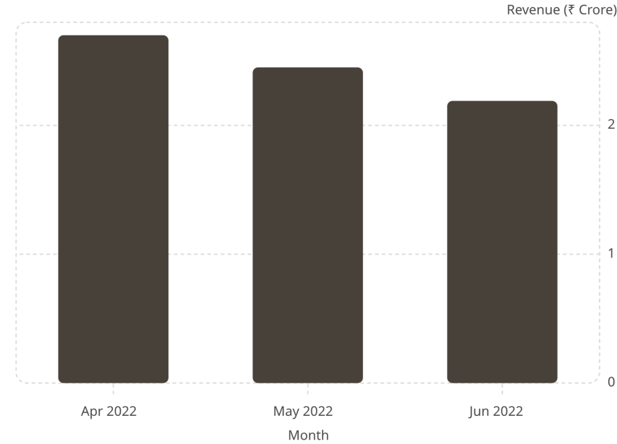
Revenue & Order Volume Trends
Downward Trend
Revenue declined ~18.8% over the quarter: April (₹2.70 Cr, 36.7% share) → May (₹2.45 Cr) → June (₹2.19 Cr). This warrants investigation into seasonal demand, marketing spend, or inventory constraints.
April was the strongest month — a cohort analysis of new vs returning customers is recommended to pinpoint the drop's cause.

Slide 5
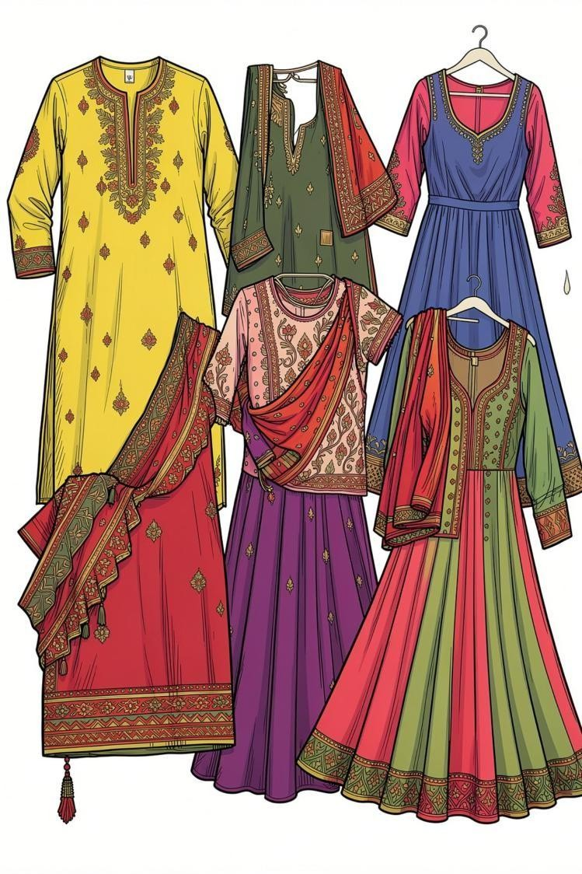
Product Category Performance
Set — #1 Category
₹3.67 Cr · 47,207 orders · Ranked #1 every month (Apr–Jun)
Kurta — #2 Category
₹1.96 Cr · 45,917 orders · Together with Set, accounts for 86.4% of total
revenue
Western Dress
₹1.06 Cr · 14,713 orders · Third-largest contributor
Cancellation Concern
Set (14.60%) and Kurta (14.66%) have the highest cancellation rates — potential sizing or quality-expectation issues

Slide 6
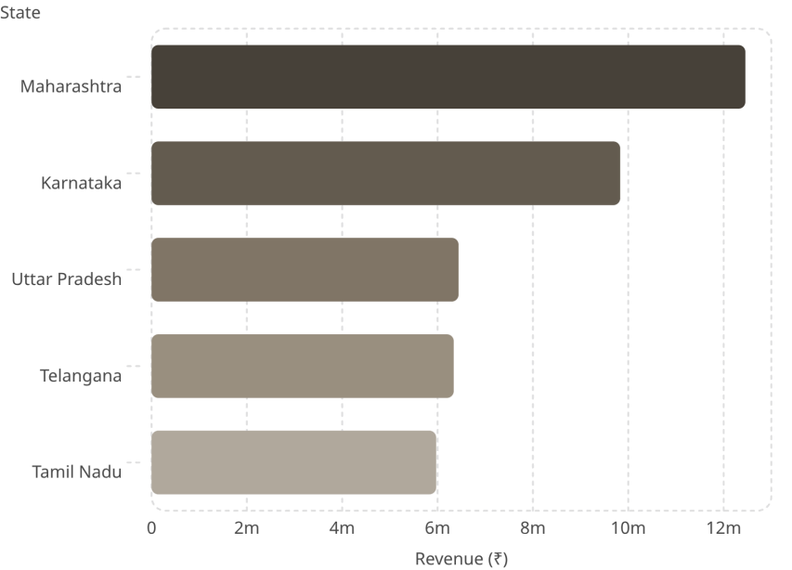
Geographic Distribution
Top 5 States Drive ~55% of Revenue
Maharashtra alone contributed ₹1.25 Cr. Karnataka follows at ₹98.3 Lakh.
Top Cities by Shipped Orders
Bengaluru — 7,262
Hyderabad — 5,271
Mumbai — 4,158
Chennai — 3,691
New Delhi — 3,660
Metro cities dominate fulfilment, reflecting strong urban demand for fashion e-commerce.

Slide 7
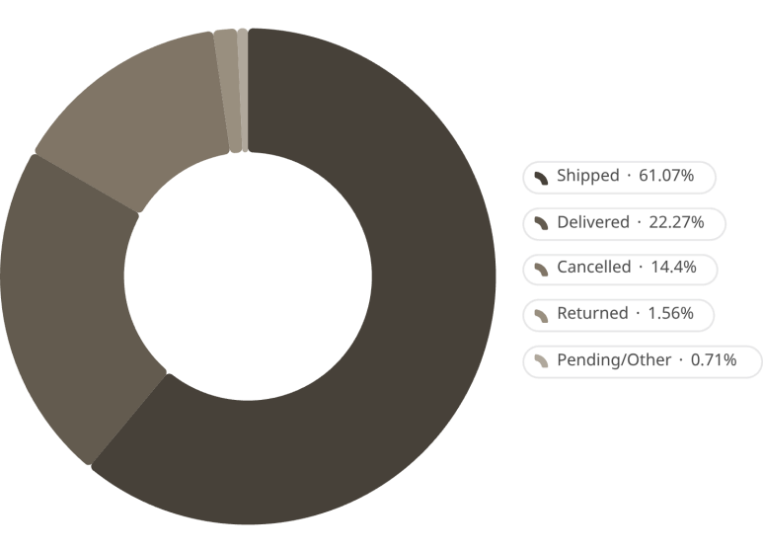
Fulfilment, Shipping & Order Status
Fulfilment & Shipping
Amazon Fulfilled and Expedited orders command higher revenue share
— indicating larger basket sizes and customer preference for speed.
Order Status Breakdown
Cancellation rate of 13.32% exceeds the 5–8% fashion e-commerce benchmark.
Amazon Fulfilled
65.1% orders · 69.3% revenue
Expedited Shipping
68.9% orders · 69.2% revenue

Slide 8
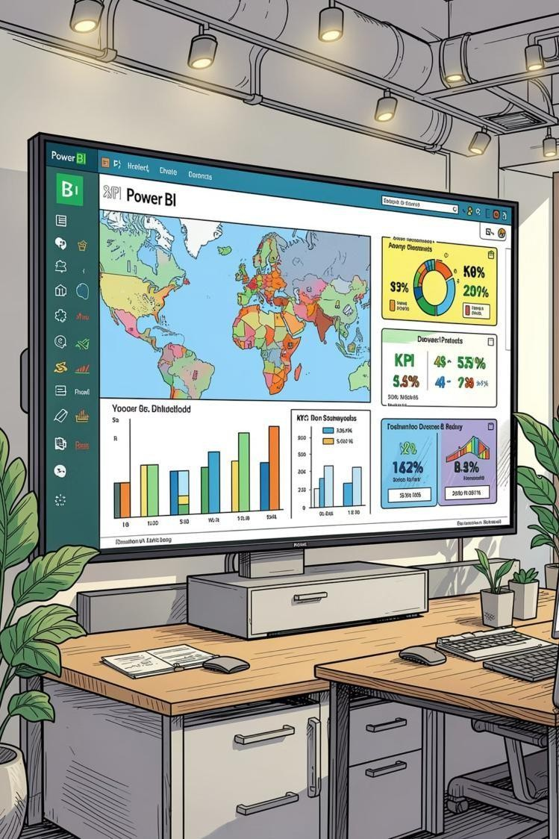



Power BI Dashboard
An interactive dashboard built to communicate SQL findings to non-technical stakeholders through dynamic filters and drill-downs.
KPI Cards
Total Orders, Revenue, AOV, Cancellation Rate at a glance
Map Visual
Geographic revenue distribution across Indian states
Slicers
Dynamic filtering by Month, Category, State, Fulfilment & Shipping
Trend Charts
Month-over-month revenue trend and category performance

Slide 9



Business Insights & Recommendations
Revenue Decline
18.8% drop Apr→Jun. Run cohort analysis on new vs returning customers.
1
Reduce Cancellations
Kurta & Set at ~14.6%. Improve size guides, photography; analyse COD vs prepaid split.
2
Focus on Top States
Maharashtra & Karnataka = 30.1% revenue. Pilot same-day delivery in Mumbai, Pune, Bengaluru, Hyderabad.
3
Expand B2B Channel
Only 0.62% B2B share. Dedicated portal for bulk orders could diversify revenue.
4
Upsell Expedited Shipping
68.9% already use expedited. Convert remaining 31.1% via Prime promotions.
5

Slide 10

Skills Demonstrated & Conclusion
Skills Showcased
SQL — 17 queries: CTEs, NTILE, RANK, PARTITION BY
Power BI — KPIs, maps, charts, interactive slicers
Key Takeaways
₹7.34 Cr revenue base with clear category & geographic concentration
13.32% cancellation rate — significant recovery opportunity
'Set' consistently #1 category across all three months
Maharashtra & Karnataka are highest-priority states for marketing
End-to-end workflow: data ingestion → SQL → Power BI
→ business recommendations.
•
•
Business Acumen — Actionable recommendations
with revenue context
•

