Slide 1
ES6
(Part – 01)

Slide 2
Topics
What is ES6?
ES6 - Features

Slide 3
What is ES6?
ES6 is EcmaScript 6 / EcmaScript 2015.
EcmaScript is not any scripting language instead a standard that Javascript is based upon. So, ES6 is a new version or new standard of Javascript.
Almost all the modern browsers supports ES6.
But for the old browsers, there are many transpilers (e.g. Babel.js) those we need to include at top of our code to transpile ES6 to ES5 (Javascript with old standards).

Slide 4
ES6 - Features
Block-Scoped Constructs Let and Const
Default Parameters
Multi-line Strings
Destructuring Assignment
Arrow Functions

Slide 5
ES6 - Features
Classes
Modules
Template Literals
Enhanced Object Literals
Promises

Slide 6


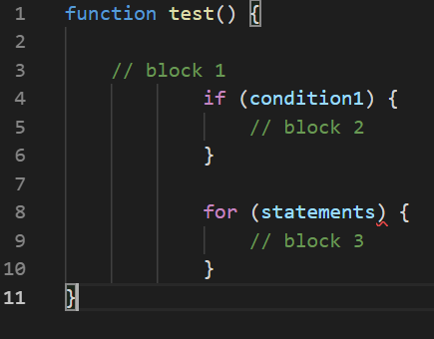



Block-Scoped "Let" and "Const"
Blocked scope determines the visibility or accessibility of a variable within the block (Generally, whenever you see {curly brackets}, it is a block).

Slide 7
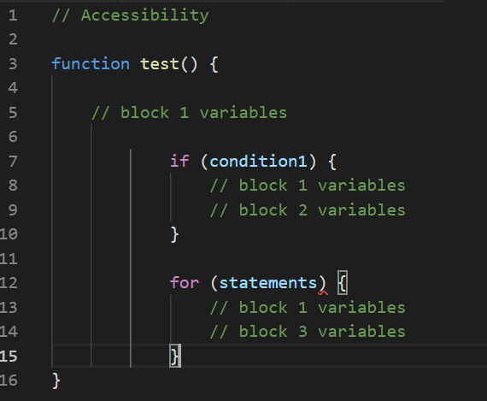
Block-Scoped "Let" and "Const"

Slide 8
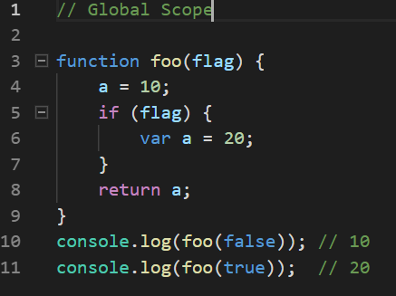
Why are we going for Blocked scope?

Slide 9
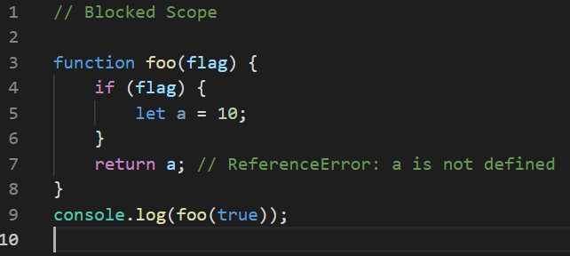
Why are we going for Blocked scope?

Slide 10
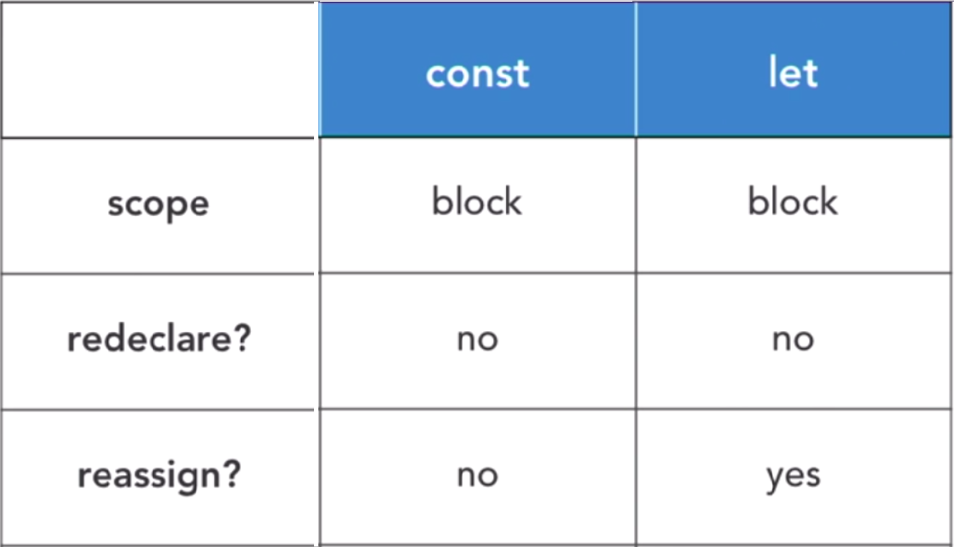
Const vs Let

Slide 11
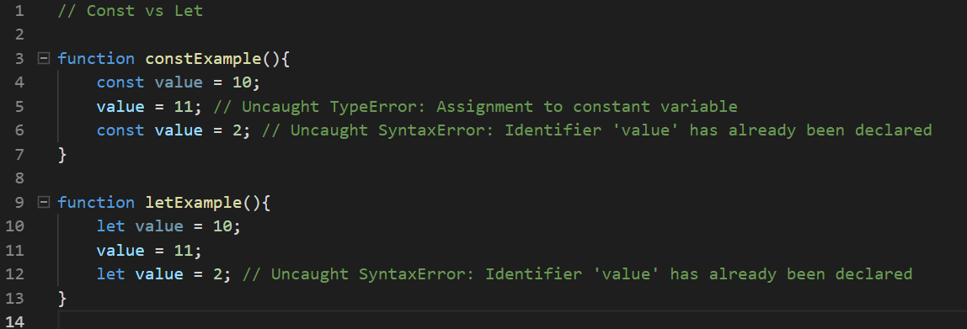
Const vs Let

