Slide 1
Bluetooth Chat App
Developed Using Bluetooth API in Android
BY
Priyanka

Slide 2
Features Include
Scanning for other Bluetooth devices
Connecting to a remote device
Send text over bluetooth

Slide 3
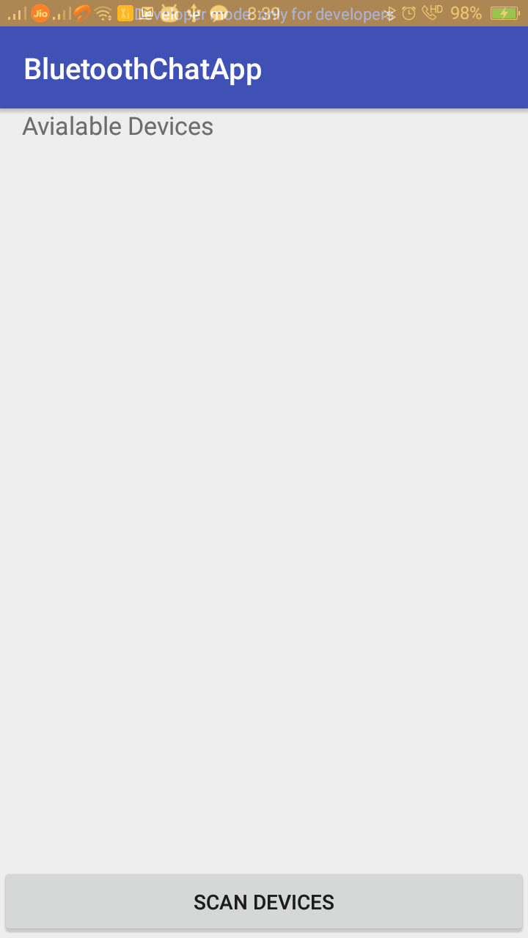
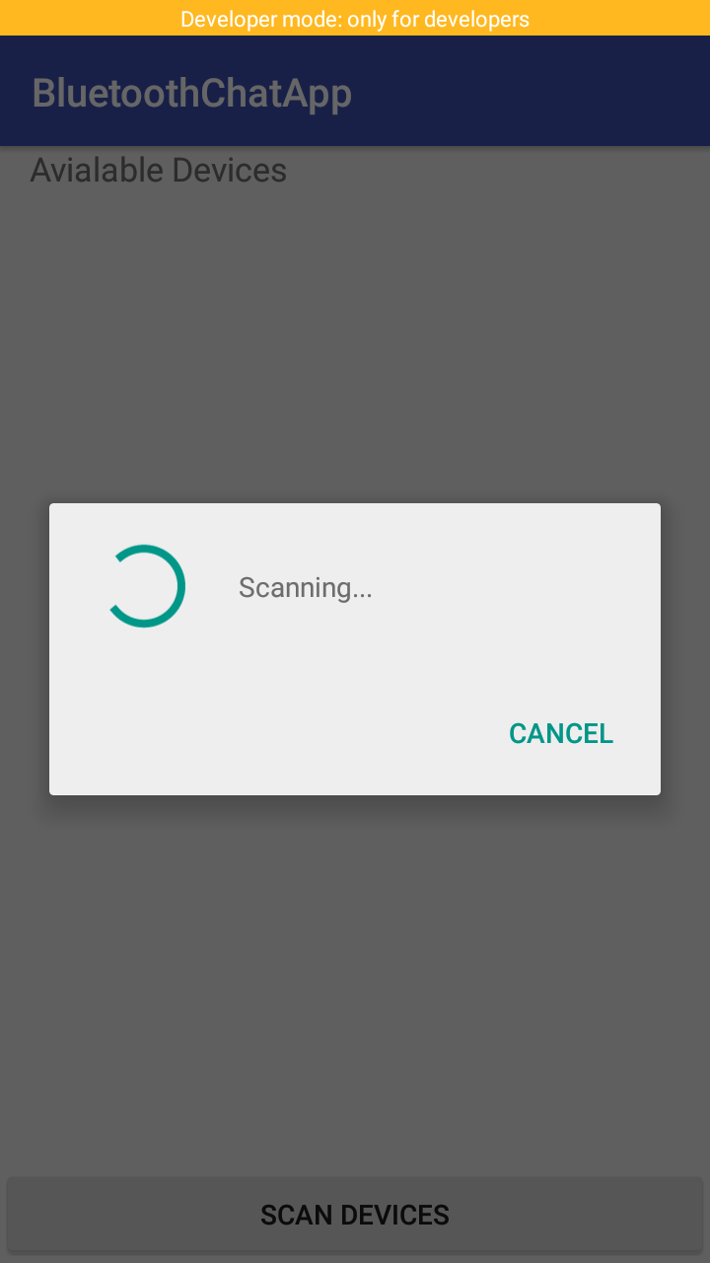
Apps Screenshots

Slide 4
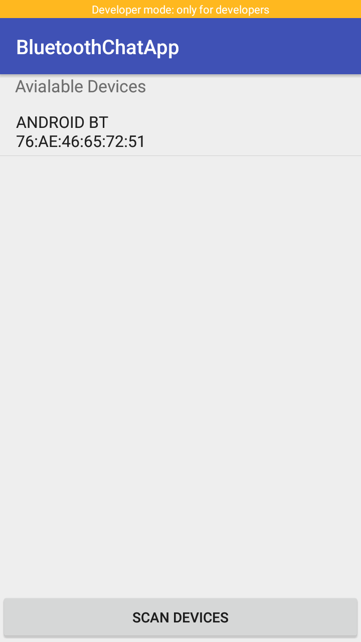
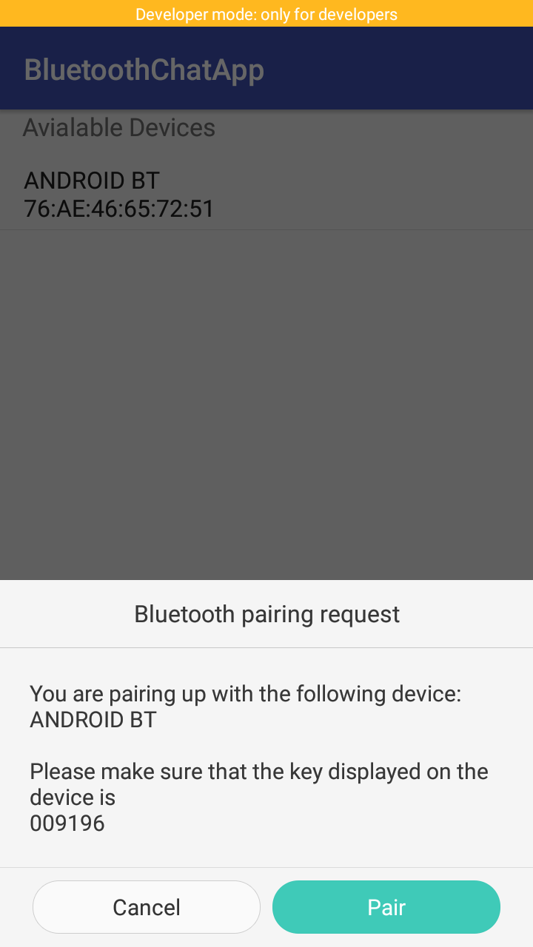

Slide 5
