Slide 1


Slide 2

Introduction To

Slide 3
Who We Are ??
OSAC(Open Source Ascol Circle) is a tech based community of enthusiastic and energetic students where each can learn and share knowledge.
Established in November 19 2011 With the motive of learning together and sharing other also organizing tech programs like tech talk, workshops and expos in regular intervals.
Each of the student of ASCOL (CSIT) holds this.

Slide 4
What we do ?
Conducts free training programs each Friday(Now Sunday).
Gives chance to each student who wants to play with new techniques.
Enhances sharing and learning mechanism between students.
Helps to visualize the growing needs of technology
Bridges the technological gap

Slide 5
Why OSAC ?
Learning and sharing at same time.
Technological troubleshooting
Enhance programming and networking technique
Core practical behind many of the topics

Slide 6

Our Best Achievements

Slide 7
Starting….@#! (101)
Hello World !
We started from the date 19th November 2011 and we came up to here now. we begin from our first program : Pace towards Linux( 1st program of OSAC) -- 25th November 2011

Slide 8
OSAC TALK
Linux Installation
Tricks on Facebook
Advanced Graphics Designing using Photoshop
Basics on Ethical hacking
Black art of hacking using Key logger
Windows Password Cracking.

Slide 9
OSAC TALK
WIFI Password Hacking
Basics of Networking
Advanced PHP
Python Programming
Hide Data Stenography
Encrypt my File
Digital and Analog Clock using C

Slide 10
Online OSAC Talk
We are Open Learners So we would like to learn technology regardless of the developing organization. We are open to learn any technology BUT we prefer Open Source Technology over closed source because Open Source provide more flexibility to learn.
On the same sprite we have fixed our 10th "OSAC TALK' with topics "Learn some windows commands" for 13th July 2012. But the college get closed. So we decided to conduct it online. A facebook event Online "OSAC TALK" was created for 13th July 8:00pm to 9:00pm. At that time we members appear online and post some commands we know. The participants seems to be shearing enthusiastically. Nice and useful command were sheared there.
As the starting of "OSAC TALK" have the initiatives of running it regardless of any obstacles, the Online Talk act as our 1st attempt to overcome such obstacle.

Slide 11



# Silent Talk !!

Slide 12

Silent Talk
We OSAC have conducted a unique type of talk "Silent Talk" as our 9th "OSAC TALK". There in Lab we setup projector, the presenter sits on the computer connected to projector, participants on their seats. The presenter have shown some steps about how to crack Linux Desktop password through the use of live boot media. The presenter have communicated with the participants with the help of nano text editor and the cracking steps are performed on terminal. It was new and nice experience for us.

Slide 13
As a main organizer
1st ASCOL OPEN EXPO 2013
2nd ASCOL EXPO 2014
Open Data Day 2013
Open Data Day 2014
Open Data Day 2015

Slide 14
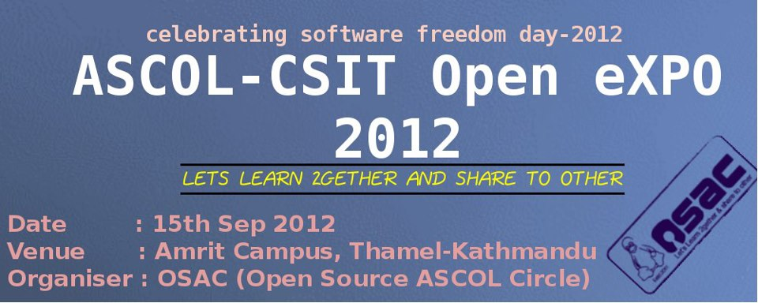

Slide 15
What we did this day ?
1. PRESENTATION COMPETITION & PRESENTATION BY EXPERTS. 2. GAMING COMPETITION(NFS, MOTO-GP, CS etc.). 3. DART COMPETITION. 4. STALL OF DIFFERENT COLLEGE AND OTHER ORGANIZATION. 5. GB SATA SAT. 6. 3D MOVIE SHOW. 8. DESIGN COMPETITION. 9. CODING COMPETITION. 10. DISTRO DEMO & LINUX INSTALLATION CAMP. 11. OPEN CHAUTARI. 12. FOSSIALS.(REFRESHMENT).

Slide 16
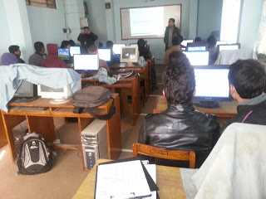
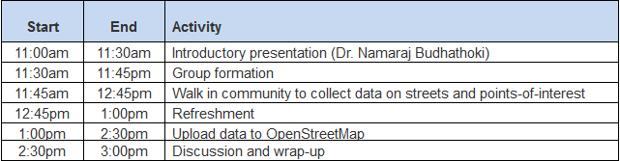
Open street Map(OSM) Mapping Party
Under regular friday program, this Friday OSAC organized an Open street map (OSM) mapping party dated on January 25. Members from OSM Nepal lead the program and narrated on the history, consequences and usage of open street maps. Dr. Namaraj Budhathoki shared his experience and knowledge regarding mapping with the OSAC members. The programme was scheduled as below :

Slide 17

Document Freedom Day 2013
Following this trend of celebration,for the first time in Nepal , this year Open knowledge foundation Nepal (OKFN) and OSAC combinely involved in celebration , organizing a program . The programme was based on presentation , talk and demonstration on Open data , Open standards and Open data tools . GPA Nepal , Kamaladi was chosen as the venue for the event.
Firstly Prakash Neupane (our Senior Brother) presented on Document freedom and open Standard . Secondly Bhim Doj Shrestha (Head central department of library and information science TU) presented on Document Freedom and its Relevance in Libraries . In the similar manner Hempal Shrestha from FOSS Nepal discussed on interrelation of Open source with the Open documents and open standards . Last but not the least , Utshab Bhetuwal and Rajendra Sharma (members from OSAC ) presented and demonstrated on Open data tools (LibreOffice and Bluefish Editor) .

Slide 18
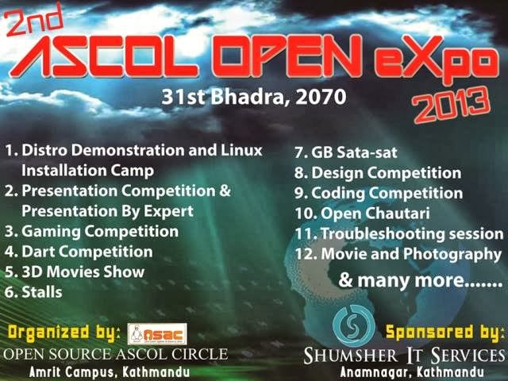

Slide 19
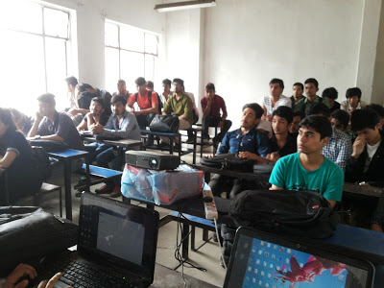
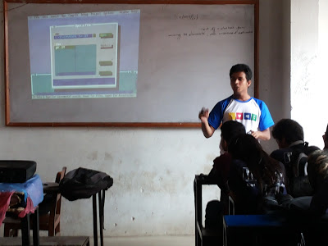
One Week Basic HTML and CSS Training(9-15 August 2015)

Slide 20

OBUNTU Customization

Slide 21
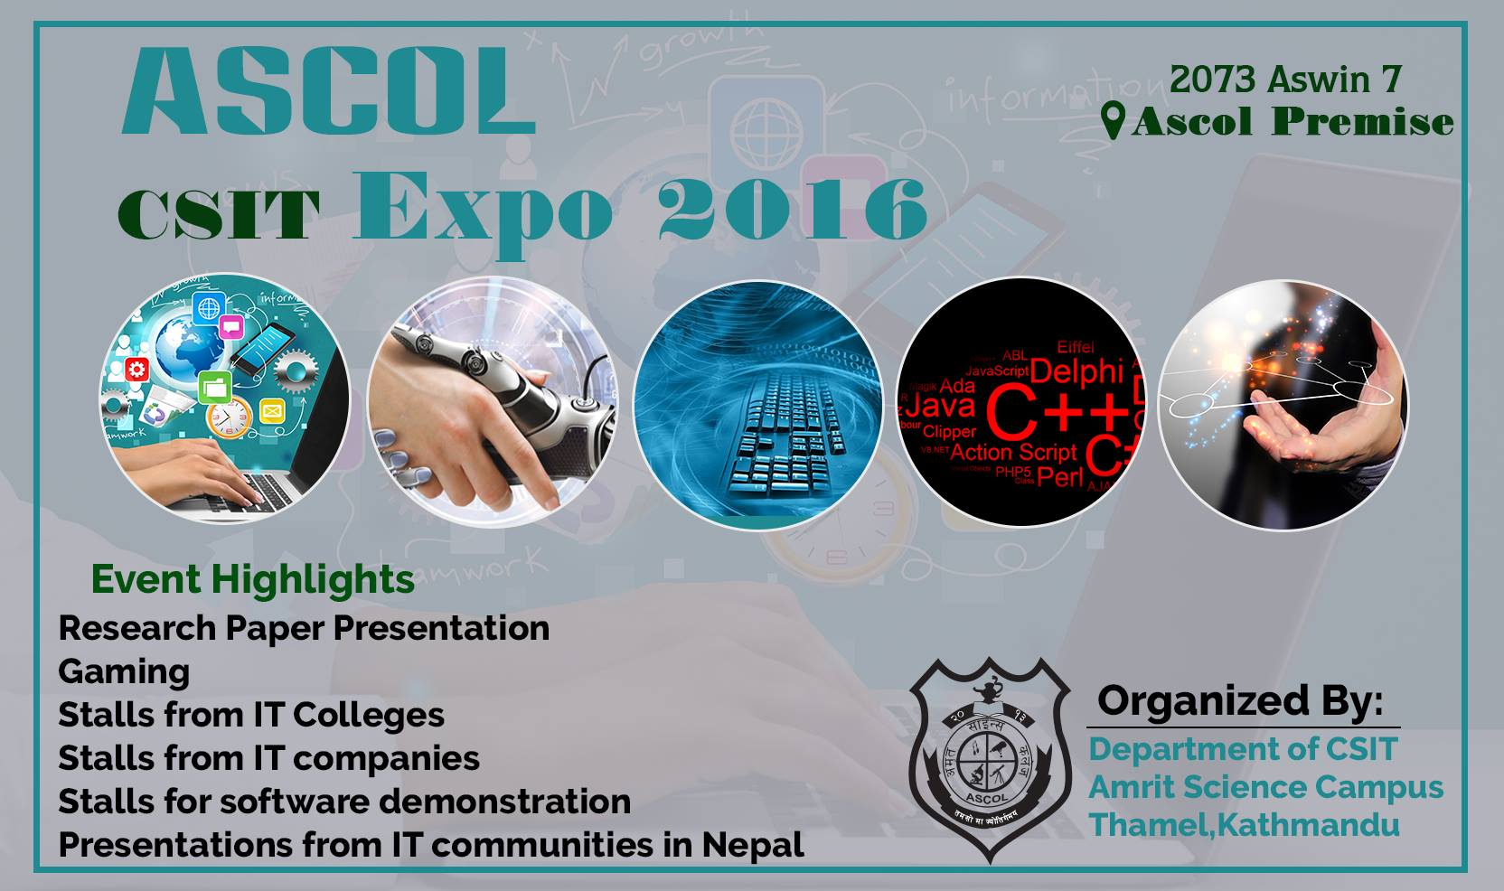

Slide 22
Other Event Participation
MAPATHON at ASCOL 2013
Technological Meet up with Young People for Development International (YPD) = 2013 November 7-14
Youth Development Meetup at Dhulikhel with Sambhawana.

Slide 23
Other Event Participation
OSAC team as Participant in Ideathon 2014
OSAC team as Participant in Ideathon 2015
OSAC with OBUNTU 2 at national Science Day 2014

Slide 24
Trainings Conducted
A week on Linux Customization lead by Obuntu 2 Customizers
Advanced PHP training
Python Programming
Basics on Networking
WIFI password Cracking

Slide 25
What we have achieved?
Understanding the need of Linux and problems that arise during installation and bundling the essential software for Programing, we customized Ubuntu and developed our own OS named as
OBUNTU Ver. 1
OBUNTU Ver. 2

Slide 26

For Upcoming Events !!!
Stay Tuned

Slide 27


