Slide 1

Renderly
Documents to pixel-perfect PDFs — in milliseconds, anywhere
Seed Round · July 2026

Slide 2

The Problem
Server-side document conversion still depends on LibreOffice or headless browsers — heavy, slow, and fragile.
Enterprises convert 40M+ documents daily for archiving, e-signing, and compliance.
Fidelity failures (broken tables, swapped fonts) create legal and brand risk.
Notes:
Pain: heavyweight toolchains. Anchor with the 40M/day stat.

Slide 3
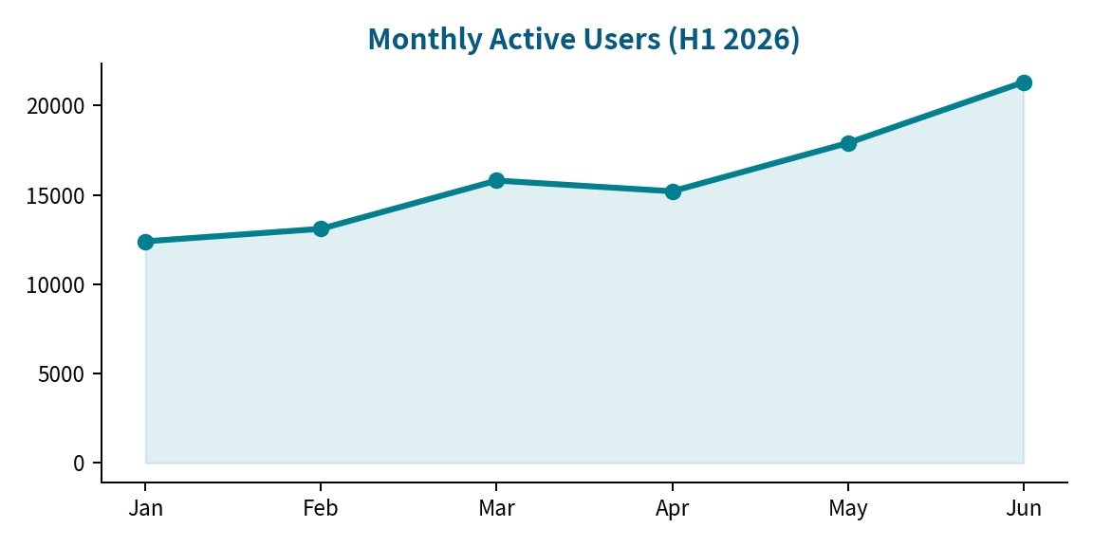
Traction
2,300+
$1.8M
99.98%
enterprise tenants
ARR, +19% MoM
conversion success rate
Notes:
MAU chart bottom center; growth driven by self-serve.

