Slide 1

Flow 2.0 Launch Plan
Go-to-market briefing — internal
August 2026

Slide 2
Launch Timeline
Beta freeze
Aug 3
Press embargo
Aug 17
Public launch
Aug 24
Follow-up webinar
Sep 8
Pricing unchanged at launch; usage-based tier ships in October.
All hands demo on Aug 20 — recording will be shared.
Notes:
Chevron = milestone. Public launch highlighted.

Slide 3
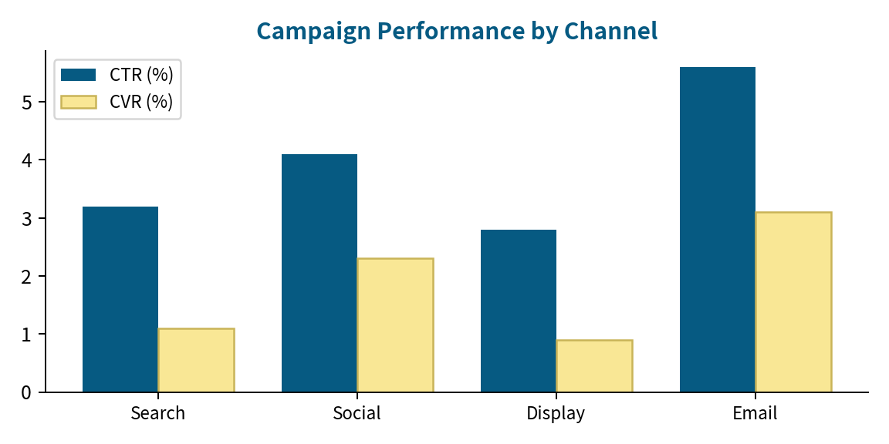
Channel Mix
Email remains the highest-converting channel (3.1% CVR).
Display retargeting paused pending creative refresh.
Search budget +20% for launch week.
Notes:
CVR by channel from June cohort.

