Slide 1

AX Solutions
Company overview for partners
2026

Slide 2
What We Value
C
C
C
Craft
Candor
Customers
Ship quality, measure fidelity
Direct feedback, shared context
Their document is the spec
Notes:
Three values with initial-letter medallions.

Slide 3
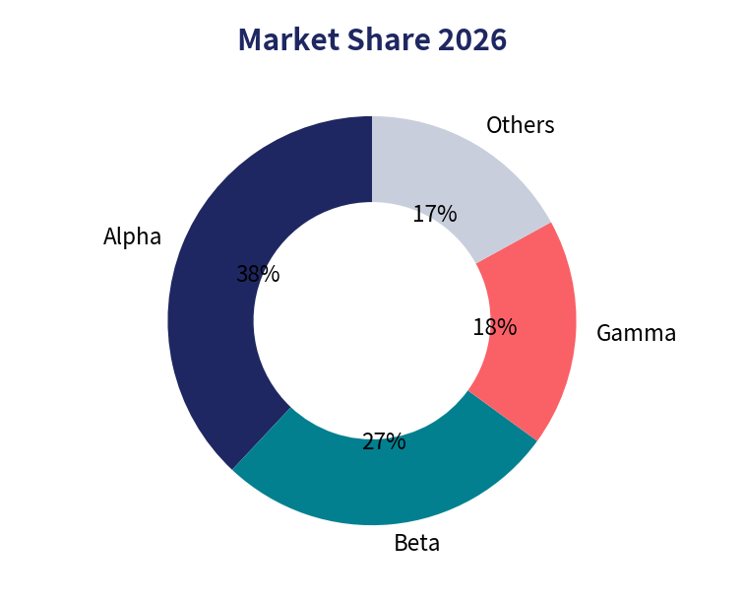
By the Numbers
87
2,300+
38%
employees across 4 offices
enterprise customers
market share (segment)
Notes:
Donut chart: market share.

