Slide 1
H1 2026 Marketing Report
Performance, spend, and learnings
July 2026 · Growth Team

Slide 2
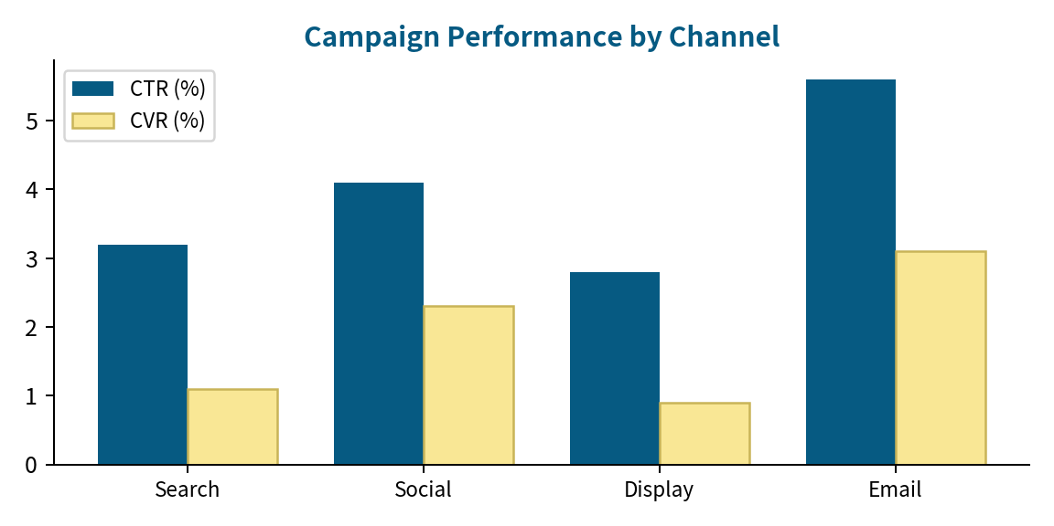
Headline Results
$412K
18,200
$22.6
total spend (-3% vs plan)
MQLs (+31% YoY)
blended CAC, -18%
Notes:
CAC improvement from email + lifecycle automation.

Slide 3
What We Learned
Webinar-sourced leads close 2.1× faster than paid social.
Localized landing pages (DE/KR/JP) lifted signup conversion 14%.
Brand search volume doubled after the v2 launch — protect the term.
Next: shift 15% of display budget into partner co-marketing.
Notes:
Reallocation proposal at the end.

