Slide 1
IMPORTANCE OF SMART DATA MANAGEMENT IN HEALTHCARE RECORD KEEPING

Slide 2
Introduction
To guarantee the quality, confidentiality, but also effectiveness of health information, efficient data handling in documentation keeping is crucial.
It aids in keeping the data structured and managed, as well as ensuring data accuracy.
Furthermore, it enables healthcare professionals to access and evaluate data rapidly, which helps them make wiser judgments.
Notes:
S.N: Medical data is kept accurate, secure, and consistent with the use of efficient information management. Healthcare professionals may easily locate but also study the data thanks to this, which helps them come to wiser conclusions. To enable efficient health documents and records, a database using MYSQL with such a PHP design can be established Instead of Code or XAMPP.

Slide 3
Aim and Objectives
To utilize MySQL but also PHP, develop a secure and functional medical record-keeping program.
To set higher standards for patient care by using sophisticated data processing.
To improve these patient records' reliability and accuracy.
To establish rules for both data integrity and anonymity.
It should be upgraded to disclose current, thorough patient statistics.
To cut expenses while increasing the efficiency of hospital facilities.
Notes:
S.N: Considering the aim of improving the accuracy and efficacy of specific patient papers, the goal underlying this suggestion is to design an efficient data retention system for keeping clinical records using a MySQL database, PHP programming in Visual Studio Code, or deliberately XAMPP.

Slide 4
Research Questions
What benefits may sophisticated handling of information systems provide to the maintenance of medical records?
How might smart data handling infrastructure enhance the security associated with medical data?
What difficulties do smart storage and retrieval solutions related to medical documentation keep present?
How is maintaining medical records affected by utilizing a database like MySQL along with a programming language like PHP throughout VS Code or XAMPP?
What further advantages can smart management of information technologies offer for maintaining medical records?
Notes:
S.N: By utilizing data instantaneously, sophisticated solutions for managing data enable medical organizations to make more informed decisions and provide superior care for patients. Clever data governance solution implementation may prove costly and time-consuming (Bani et al. 2021). Pharmaceutical organizations must also make certain that information is submitted and kept correctly in accordance with the proper format. Pharmaceutical organizations may store while collecting patient information fast and correctly throughout databases like MySQL alongside a design language like PHP throughout VS Code or XAMPP. As a result, managing records will take less time and effort. That can assist expedite the documentation keep operation.

Slide 5
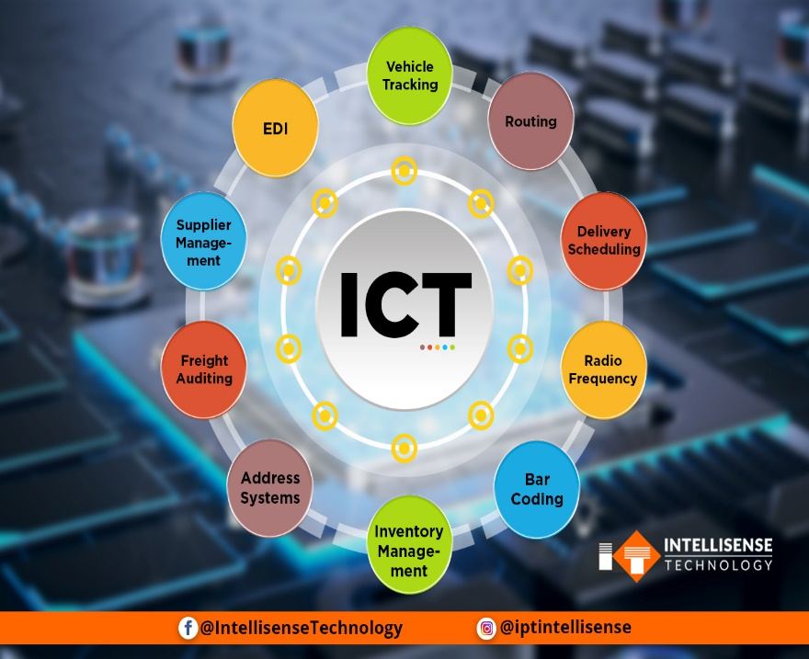
Literature Review
Information and Communication Technologies (ICT)
Augmented Reality (AR)
Artificial Intelligence (AI)
Sources: https://intellisensetechnology.ca
Notes:
S.N: Malignant cancer represents a complex illness. For this with the evaluation and management of these diseases, a number of approaches but also methods have indeed been presented and over centuries (Mourtzis et al. 2021). Both procedures of treatment and forecasting can be improved by technological advancements in such fields as information and communication technologies (ICT), augmented reality (AR), and artificial intelligence (AI).

Slide 6
Literature Gap
Enhancing Accessibility
Higher Level of Care
Better Patient Protection
Saving the Cost
Enhancing Data Integrity
Lack of Knowledge
Drawbacks
Bogus Information
(Source: Self-Create in MS-PowerPoint)
Notes:
S.N: By doing this, the proper patient will receive the appropriate care at the appropriate time. Medical practitioners may create excellent judgments with increased knowledge available, which raises the standard of care. It enables improved interaction between healthcare professionals and enables individuals to concentrate their judgments on reliable and current data (Farahat et al. 2022). Eliminating procedures, it may additionally increase the effectiveness of the medical system. Inside the modern era of electronic healthcare, where customer records must always be maintained private and safe, this seems to be particularly crucial.

Slide 7
Research Approach
To examine the significance of efficient data processing in maintaining healthcare records, designers shall adopt an inductive strategy.
To learn more about whether intelligent data handling might enhance medical documents and records, designers will take a deductive approach.
To comprehend the significance of sensible data processing in healthcare recording and reporting, designers will study the data amassed across both ways but also compare the outcomes.
Inductive Approach
Deductive Approachy
(Source: Self-Create in MS-PowerPoint)
Notes:
S.N: To get the views of industry leaders in the medical field regarding this issue, the designer employs an internet-based questionnaire. MYSQL will serve as our database, and PHP inside VS Code or XAMPP is going to be used to create its data model. That inductive method will enable us to comprehend the opinions of professionals regarding the significance of smart handling of information in maintaining medical records (Nasrudin et al. 2023). Designers can learn more about how smart handling of data may enhance medical record keeping by using the deductive method. To comprehend the significance of intelligent organization of data in the maintenance of such healthcare records, we shall analyze the information obtained using both methods.

Slide 8
Research Philosophy
The positivism ideology of thought emphasizes the significance of information integrity and correctness for efficient medical record maintenance.
Subsequently underlines the usage of trustworthy, accurate, while current information kept in a safe database like MySQL and using the right design tools like PHP inside VS Code or XAMPP.
A simplified and effective method of organizing medical records was provided by positivism
Notes:
S.N: When utilized in hospital record-keeping, the fundamental positivism concept emphasizes the significance of accurate and consistent data. It promotes the utilization of trustworthy and safe databases like MySQL and suitable design applications like PHP within VS Code or XAMPP. This attitude allows for the organized and effective storage and management of medical records.

Slide 9
Research Design
By establishing a smart data handling platform, it's going to become possible to gather, store, and analyze combined qualitative but also quantitative data for use in the medical record.
A safe and effective method for collecting but instead maintaining medical files will be provided by a database utilizing MYSQL and perhaps development and improvement employing PHP in VS Code or XAMPP.
A sophisticated system for handling data for medical records will facilitate better judgment, and enhance patient care, but also lower the possibility of such record-keeping mistakes.
Qualitative Analysis
Quantitative Analysis
(Source: Self-Create in MS-PowerPoint)
Notes:
S.N: Effective data handling in medical information is a potent tool for raising the standard of medical treatment. Healthcare professionals can get the information they require to make educated choices and deliver the best treatment by putting in place an effective and reliable infrastructure for keeping and maintaining patient information.

Slide 10
Research Strategy
Examine the software but also archiving solutions currently utilized for maintaining medical records.
Determine the optimal strategies for intelligent data management.
Create a technique for managing data.
Notes:
S.N: This study plan aims to comprehend the significance of sensible information management throughout healthcare keeping records as well as to create a safe and effective platform for healthcare documentation keeping. Analyzing current software and archive systems, locating best practices for information management, including creating a strategy enabling information management are all components of such research method (Sakthi & DafniRose, 2022). This one will entail an evaluation of the current software but also technologies used for keeping track of medical records, including MYSQL, PHP, VS Code, and XAMPP.

Slide 11
Research Method
Collecting pertinent information
Creating Database
Design the Database
Methods
MySQL
XAMPP
VS Code
(Source: Self-Create in MS-PowerPoint)
Notes:
S.N: The proper data must be gathered in order to assure the quality and dependability of overall data, which is a crucial stage in smart information management. Classification methods and storage using databases make it possible to obtain the data quickly when necessary. Data organization and storage using databases make it possible to obtain the info quickly when necessary. Designing the repository employing tools including PHP in Against Code or XAMPP in accordance with the specifications.

Slide 12
Data Collection Method
Primary Data Collection Method
Secondary Data Collection Method
Database
Primary Data Collection Method
Secondary Data Collection Method
(Source: Self-Create in MS-PowerPoint)
Notes:
S.N: Medical record keeping requires sophisticated data processing because it enables reliable, effective, but also safe storage of data. Such essential data may be collected using primary data-gathering techniques including software. It is also possible to obtain secondary data using techniques including literature reviews, government papers, including web resources. Databases may be utilized for efficient storage of information, and PHP is compatible with VS Code or XAMPP to execute designs.

Slide 13
Research Ethics
Research Ethics
Legal
Social
Ethical
Developed the Accuracy of the Record
Increase Effectiveness
Supports achieving legal obligations
(Source: Self-Create in MS-PowerPoint)
Notes:
S.N: Efficient data handling is employed to prevent mistakes in the maintenance of healthcare records, consequently leading to more accurate information. Effective data administration guarantees rapid and effective utilization of client records, improving the effectiveness of keeping medical records. Effective data management ensures data safety and confidentiality while assisting healthcare businesses in adhering to numerous regulatory obligations.

Slide 14

Discussion on the Expected Result
Enhancing Functionality
Improved Cybersecurity
Enhancing Decision Processing
Source: https://www.progressiverailroading.com
Notes:
S.N: This makes it easier and faster for doctors, nurses, or other medical workers to obtain patient records. That serves to safeguard patients' confidential information and prohibit unwanted access to healthcare information. Recognizing patients' health problems and aspirations aids healthcare providers in providing superior patient care.

Slide 15
Reference List
Bani-Salameh, H., Al-Qawaqneh, M. and Taamneh, S., 2021. Investigating the Adoption of Big Data Management in Healthcare in Jordan. Data, 6(2), p.16.
Farahat, I.S., Aladrousy, W., Elhoseny, M., Elmougy, S. and Tolba, A.E., 2022. Improving Healthcare Applications Security Using Blockchain. Electronics, 11(22), p.3786.
Miyachi, K. and Mackey, T.K., 2021. hOCBS: A privacy-preserving blockchain framework for healthcare data leveraging an on-chain and off-chain system design. Information processing & management, 58(3), p.102535.
Notes:
Mourtzis, D., Angelopoulos, J., Panopoulos, N. and Kardamakis, D., 2021. A smart IoT platform for oncology patient diagnosis based on ai: towards the human digital twin. Procedia CIRP, 104, pp.1686-1691.
Nasrudin, M.W., Zainuddin, N.S.A., Ahmad, R.A.R., Yob, R.C., Ahmad, M.Z.Z., Mustafa, W.A., Veeraperumal, V. and Zulkifli, N.D.M., 2023. Smart Management Waiting System for Outpatient Clinic. Journal of Advanced Research in Applied Sciences and Engineering Technology, 29(3), pp.48-61.
Sakthi, U. and DafniRose, J., 2022. Blockchain-enabled smart agricultural knowledge discovery system using edge computing. Procedia Computer Science, 202, pp.73-82.
Shahat Osman, A.M. and Elragal, A., 2021. Smart cities and big data analytics: a data-driven decision-making use case. Smart Cities, 4(1), pp.286-313.
Σπυροπούλου, Σ., 2022. Development of an electronic system for the safe management of health records using Blockchain technology.

Slide 16


