Slide 1
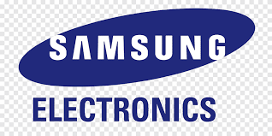
UNDERSTANDING TRENDS & FORECASTING

Slide 2
SAMSUNG COMPANY
Samsung is leading in chip making.
The chips are sustainable, fast processing, and consume less power.
The company is focused on customer-oriented innovations.
Notes:
The selected brand is Samsung. The company is leading in chip making. The company is ahead of its competitors in the performance of Smartphones (Haizar et al. 2020). The generation of new chips, allows fast processing, reduced consumption of power, and also the sustainable type of performance over a long time period. The company is successful due to its innovations that are mostly oriented toward the customers. Huge investments are made by the company in the R&D sector.

Slide 3
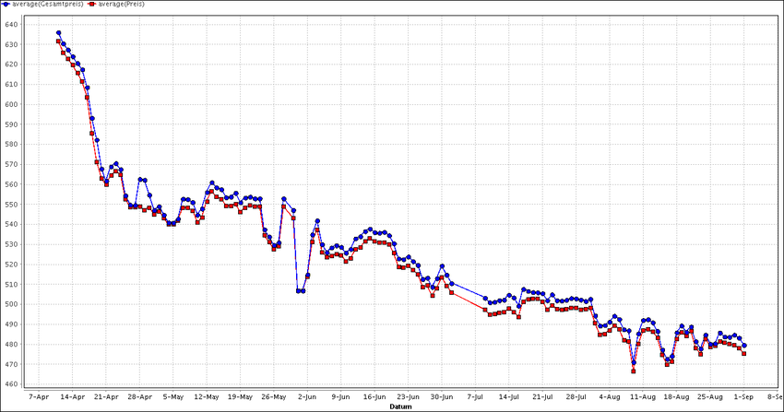
TRENDS OF SAMSUNG
The company has trending Galaxy devices that have multitasking capability.
The expansive and leverage crisp screen that provides options for using multiple apps.
Office productivity is enhanced as it allows easy access to MS Office and Google Workspace.
(Source: https://www.researchgate.net)
Notes:
The Company has the capability of multitasking as it has preferred Galaxy devices. The Galaxy devices leverage crisp and expansive screens that provide users with a wide variety of options to work with multiple apps (Han et al. 2022). There are different features of Samsung smartphones, such as Galaxy Note II. This has allowed for multitasking experiences. It has a wider range of ecosystems of apps on the Android device. This also enhances office productivity by provisioning easy access to Google Workspace and MS Office.

Slide 4
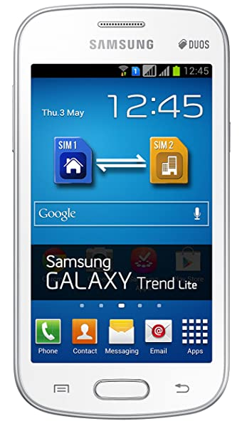
TARGET CUSTOMER
The target audience of Samsung varies from the 15- 45 age group.
The audience follows the latest technologies and trends.
The mobile has unique features that attract customers.
(Source: https://m.media-amazon.com)
Notes:
The target audience of Samsung varies from the age group of 15 - 45 who is following the latest trends in technology. The lifestyle of the customers is based on huge consumption of TV and other digital media as they are engaged with local series of TV along with celebrities and other aspirational lifestyles. Mobile phones have power sharing and a battery that is long-lasting.

Slide 5
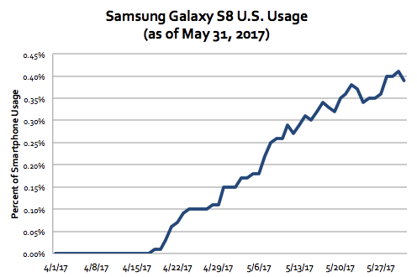
STRATEGY OF SAMSUNG COMPANY
The company adopt dynamic changes and produce a diverse range of product for customer satisfaction.
The competitive advantage of the company is innovative research, cost-effectiveness, and unparalleled features.
A wide range of electronic product is produced like smart TV, watch, monitor, memory storage, etc.
(Source: https://www.scientiamobile.com)
Notes:
The strategy of the Samsung Company is the development of the marketing trends by adapting the dynamic changes and different products are produced to satisfy the target demands. The company is a brand that is customer-centric that offers a diversified product to its customers (Abdelshafie et al. 2021). The product range of the company varies from smartphones and other related accessories like watch, smart TV, memory storage, and monitor.

Slide 6
FUTURE TECHNOLOGY
The company is focused on introducing foldable phones.
Different technological innovations are adopted to bring new products to its customers.
A wide range of mobile phones are manufactured by the company with different features.
Notes:
The Company is focused on the new technology of foldable phones. The company is popular for the wide range of products that the company has manufactured (Siriram, 2022). This includes Galaxy S23 Ultra, Galaxy Tab S8, etc. The competitive advantage of the company is technology cutting edge, innovative research, cost-effectiveness, and also unparalleled features of the product.

Slide 7
REFERENCE LIST
Singhal, S., Anand, A. and Singh, O., 2020. Studying dynamic market size-based adoption modeling & product diffusion under stochastic environment. Technological Forecasting and Social Change, 161, p.120285.
Chumnumpan, P. and Shi, X., 2019. Understanding new products’ market performance using Google Trends. Australasian marketing journal, 27(2), pp.91-103.
de Medeiros, A.H.G., 2020. Equity Research-Samsung Electronics Co., LTD (Doctoral dissertation, Universidade de Lisboa (Portugal)).
Notes:
Haizar, N.F.B.M., Kee, D.M.H., Chong, L.M. and Chong, J.H., 2020. The impact of innovation strategy on organizational success: A study of Samsung. Asia Pacific Journal of Management and Education (APJME), 3(2), pp.93-104.
Han, F., Yoon, S., Raghavan, N. and Park, H., 2022. Investigating Company’s Technical Development Directions Based on Internal Knowledge Inheritance and Inventor Capabilities: The Case of Samsung Electronics. Sustainability, 14(5), p.3117.

