Slide 1



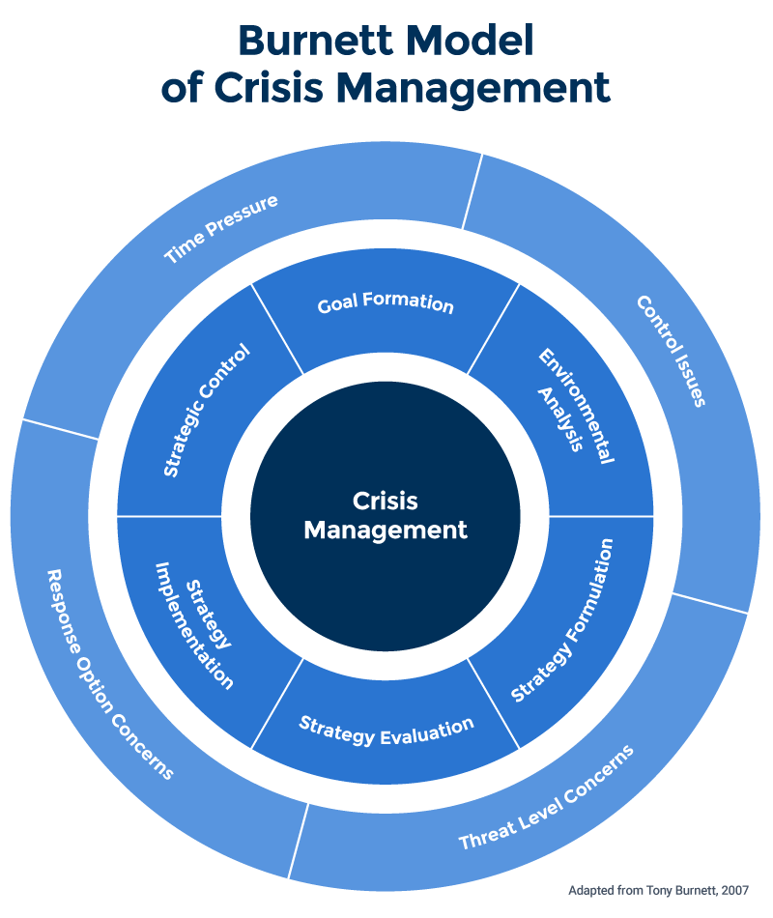

INTRODUCTION ON ROLE OF LEADERSHIP IN EFFECTIVE CRISIS MANAGEMENT IN THE HEALTHCARE SETTING
Rationale
The role of leadership in effective crisis management in the healthcare setting is critical to ensure the safety and well-being of patients, staff, and the community.
Leaders must ensure that there is a plan in place to respond to a crisis and that all stakeholders are aware of the plan (McCombs & Williams, 2021).
Leaders should also ensure that everyone involved in the crisis is properly informed and trained to respond appropriately.
This research can assist pinpoint areas where leadership should be strengthened to strengthen crisis management capabilities
Applicable Theories
Transformational Leadership: Transformational leadership is a highly effective approach to crisis management, as it focuses on the long-term vision and encourages employees to take initiative and take ownership of the situation (McCombs & Williams, 2021). Transformational leaders motivate and inspire people to take action and come up with creative solutions to the crisis.
-Scope, aim and objectives
Scope: This research will focus on the role of leadership in managing healthcare crises in the healthcare setting. It will explore how leadership can be used to effectively manage healthcare crises and the impact that this has on the healthcare setting.
Aim: The aim of this research is to investigate how effective leadership can be used to manage healthcare crises in the healthcare setting.
Objectives:
1.To analyse the roles and responsibilities of leadership in the healthcare setting during a crisis.
2. To identify factors that influence the success of healthcare leaders in crisis management.
3. To assess the impact of leadership on effective crisis management within the healthcare setting.
4. To identify strategies that increase the effectiveness of healthcare leaders in crisis management.
-Potential for insightful outcomes
The following are some insightful findings from studies on the role of leadership in efficient crisis management in the healthcare setting:
1. Identifying effective crisis management techniques that leaders may utilise to guarantee successful crisis management, such as preparation and communication.
2. Analyzing how different leadership philosophies, such as collaborative or authoritarian ones, affect crisis management.
3. Analyzing the connection between the organisation's general culture and environment and crisis management effectiveness.
Systems Theory: A healthcare crisis that is caused by a lack of coordination between healthcare providers, leading to a lack of access to care or inadequate services. This can be solved through a Systems Theory that can help to identify the causes of this lack of coordination and to develop strategies for improving communication and collaboration among healthcare providers (Curnin et al., 2022).
Social Exchange Theory: The power relationships between various healthcare stakeholders, including hospitals, insurance providers, and pharmaceutical firms, as well as how these parties interact with patients, may be identified using the social exchange theory (Mykhailova and Mykhailov, 2022). This might be helpful in creating crisis management strategies that are adapted to the exact requirements of the individual healthcare situation.
-Evidence
Evidence is to be gathered from a variety of sources, such as Journals. Articles, crisis management case studies in healthcare and evaluating real-life crisis management activities in healthcare.
-Method of Analysis
The process of analysis chosen for the leadership role in effective crisis management in the healthcare environment is known as secondary data analysis. It requires obtaining and interpreting current data from a variety of sources in order to respond to a particular study issue. Journals, focus groups, media reports, old studies, and other sources can all be used as secondary data sources. (Pandey and Pandey, 2021).

Slide 2
References
Curnin, S., Brooks, B., Owen, C. and Brooks, O., 2022. Perceptions of strategic decision‐making by crisis management teams during exercising: Establishing key dimensions. Journal of Contingencies and Crisis Management.
McCombs, K., & Williams, E. (2021). The resilient effects of transformational leadership on well-being: examining the moderating effects of anxiety during the COVID-19 crisis. Leadership & Organization Development Journal, 42(8), 1254-1266.
Mykhailova, Y. and Mykhailov, S., 2022. THEORETICAL APPROACHES TO CRISIS MANAGEMENT DURING THE INFORMATION WAR. Three Seas Economic Journal, 3(1), pp.129-132.
Pandey, P. and Pandey, M.M., 2021. Research methodology tools and techniques. Bridge Center.

