Slide 1
THE IMPACT OF TECHNOLOGY ON THE FIRM PERFORMANCE IN THE HOTEL INDUSTRY

Slide 2
Introduction
Technology is changing the whole world, and so is the hotel industry
Hotel Managers are aware of the requirement of technological features required for the industry
The context of the study will cover the state of the research from where the research is left to collect the data
Initial situations for the research will be highlighted for the impact of technology on the first performance in the hotel industry
Notes:
Technology is changing the whole world, and so is the hotel industry, as the process of technology can be used to help in the process and speeds up the operations, which has a direct effect on the provinces for the satisfaction of the guest. Hotel Managers are aware of the requirement of technological features required for the industry and keep up the needs of the ever-evolving customer needs. The context of the study will cover the state of the research from where the research is left to collect the data. Any such initial situations for the research will be highlighted for the impact of technology on the first performance in the hotel industry. The research goal and the approach of the research defining the research methods will also be made.

Slide 3
Initial situation
The impact of technology on the firm performance in the hotel industry thus attracts a lot of guests from various places
The hotel industry is also called the hospitality industry and they face several issues due to the impact of technology on the operation of their organization
Robot assistants are used for check-in purposes thus creating issues while robots do not understand every language and cannot communicate like human beings
The customers thus face various challenges when they arrive at the hotel to stay as they might not get the similar rooms that they have booked online
Notes:
The impact of technology on the firm performance in the hotel industry thus attracts a lot of guests from various places. The hotels are booked online by seeing the relevant features of the hotel and the facilities they are offering. The hotel industry is also called the hospitality industry and they face several issues due to the impact of technology on the operation of their organization. The management introduces special technological features for their automation and smooth running of performance to book orders from the customers (Tarsakoo and Charoensukmongkol, 2020). Automation check-in process by face recognition thus creates issues by capturing the exact face of the customers and it might be morphed by reapplying the picture. Robot assistants are used for check-in purposes thus creating issues while robots do not understand every language and cannot communicate like human beings. The customization of choosing the hotel rooms as per the guest's comfort and the number of guests thus follow some uniqueness while booking the hotels online.
The customers thus face various challenges when they arrive at the hotel to stay as they might not get the similar rooms that they have booked online. The images that are shown for the hotel rooms are found differently when the customer arrives for a stay in the hotel. The chat-bots that the hotel industry has fixed in the booking system to do the chatting-related purpose with the customer and accept the booking from the customer are controlled. AI features have also lagged in the automation of hotel booking and thus similar features and rooms that are booked are being given to the customers as per the availability of the rooms (Ribeiro-Navarrete et al., 2021). Touch-free hotel keys are used as a major technological jump for the broader public to open their room with just a hotel key card and must keep that safe while they enter and take exit from the rooms. If the card is lost and the broader public has locked them out by reaming the keycard inside the room then they need to get access to another keycard from the hotel management to open the room again.
Technology thus needs to be used by the hotel industry with utmost care so that the client, as well as the management, need not face any challenges regarding the technological dialect of using the hotel industry. Technology thus affects and speeds up operations that thus have a direct effect on guest satisfaction.

Slide 4
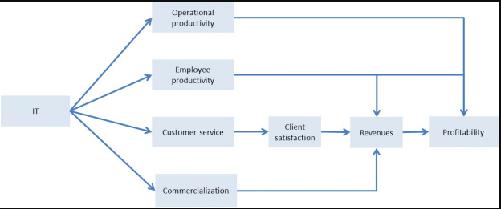
State of Research
Technology plays an important role in the hospitality and tourism industry, where both the business owners and customers get full advantage and benefits of using the technology
It is the advances of the guest serving system and reservation policy required to be utilized in the process of business operations
Technology thus allows smooth communication with the broads from booking the hotels till they check out from the hotels
It thus serves as a streamline for guest experiences and their stay in the hotel. Hotels directly get connected with the guests by offering any such personalized experience and leisure taken from the hotel
Notes:
Technology plays an important role in the hospitality and tourism industry, where both the business owners and customers get full advantage and benefits of using the technology. It is the advances of the guest serving system and reservation policy required to be utilized in the process of business operations. Technology thus allows smooth communication with the broads from booking the hotels till they check out from the hotels. It thus serves as a streamline for guest experiences and their stay in the hotel. Hotels directly get connected with the guests by offering any such personalized experience and leisure taken from the hotel. Likewise, any such business from the hotel would be required to cut down on the experiences for the coast by enhancing the efficiency of the staff notably in using online reservations.

Slide 5
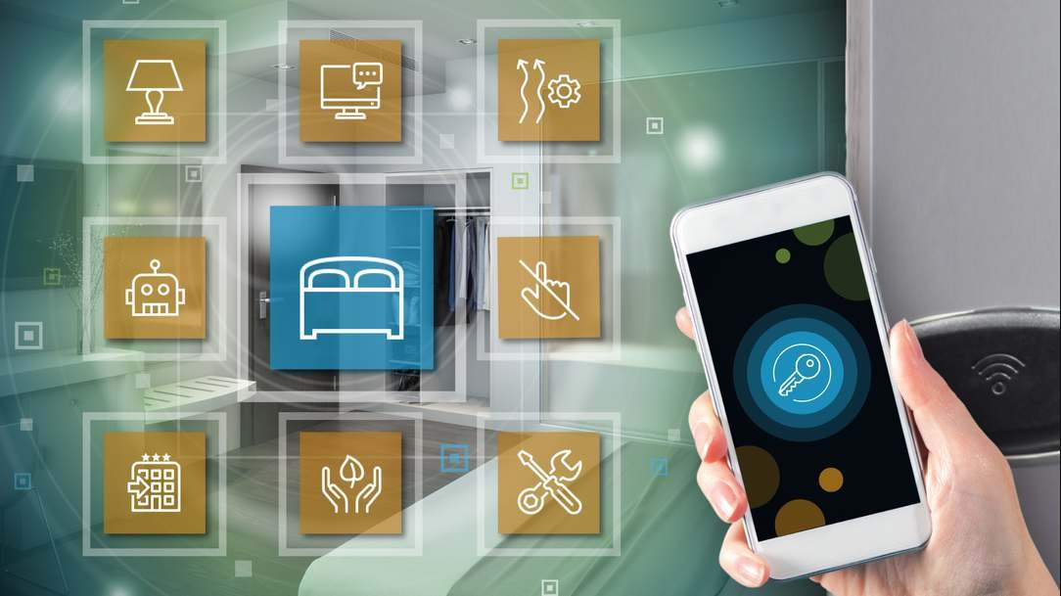
Cont.
The technology thus helps top remain the guests maintain social distancing and sanitize their hands and body with the automation of robots
It thus improves the commutation between the staff of the hotels and the guests that are arriving
Technology has positively changed the hotel industry by making room services available with the billing to be seamless
It is of obvious condition that when the hotel management system becomes automated then the technology deployed would play an important role to provide seamless effort in serving positive customers
Notes:
This can enhance properly with the guest experience for the streamline operations and manage the post-COVID-19 impact protocols. The technology thus helps top remain the guests maintain social distancing and sanitize their hands and body with the automation of robots. It thus improves the commutation between the staff of the hotels and the guests that are arriving. Technology has positively changed the hotel industry by making room services available with the billing to be seamless. It is of obvious condition that when the hotel management system becomes automated then the technology deployed would play an important role to provide seamless effort in serving positive customers.

Slide 6
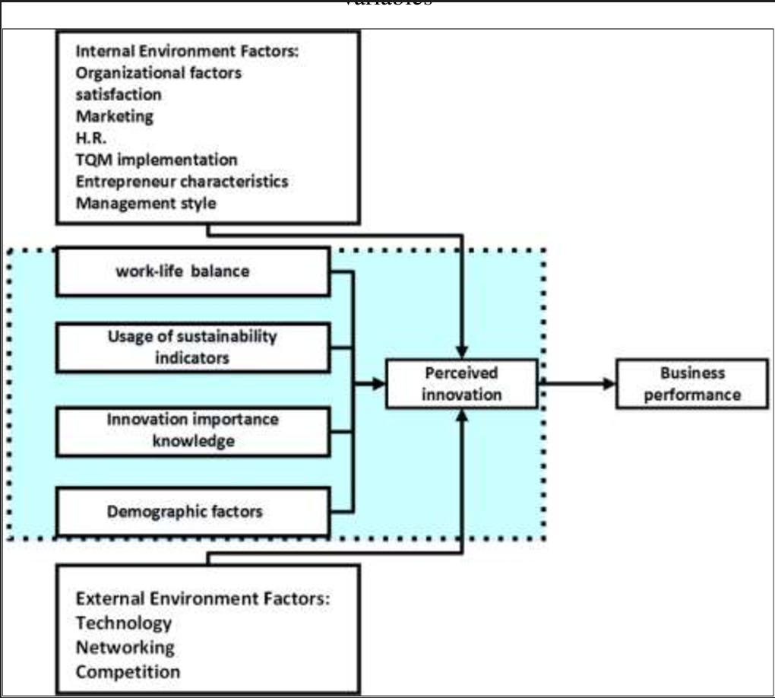
Cont.
Mobile technology and robotic operations of hotel booking and taking bookings from the customers help to connect a bonding between the hotel management and the customers
Hotel needs to strike a balance that needs to be used between personal interactions and the use of technology
Hotel technology software thus needs to keep track of everything that is used for the kind of pillows used and the food that is served in the hotels along with the rooms that are served to the guests
The Automatic Database system of the hotel thus helps to keep a track of the guests that are coming to the hotels and thus their faces are being captured parallel with their booking to be made completely while staying at the hotel when they arrived for the stay
Notes:
Mobile technology and robotic operations of hotel booking and taking bookings from the customers help to connect a bonding between the hotel management and the customers. However, the hotel needs to strike a balance that needs to be used between personal interactions and the use of technology. Using the hotel technology software thus needs to keep track of everything that is used for the kind of pillows used and the food that is served in the hotels along with the rooms that are served to the guests. The Automatic Database system of the hotel thus helps to keep a track of the guests that are coming to the hotels and thus their faces are being captured parallel with their booking to be made completely while staying at the hotel when they arrived for the stay. It's the opportunity to let the guests be known for what they have value and simply not just get another entry in the booking ledger.

Slide 7
Gap Analysis
The gap of the research is to define or identify the unexplored parts that have remained in the research
Researching through various journals and online articles, the researchers still felt that there might be some information missing regarding the impact of technology on the firm performance in the hotel industry
Due to the sequentially of the information in the article and the lack of information due to the proper research
Acknowledging the article the information is being rigged with the Research gap that needs to be fulfilled to complete the research etiquette completely
Notes:
The gap of the research is to define or identify the unexplored parts that have remained in the research. By researching through various journals and online articles, the researchers still felt that there might be some information missing regarding the impact of technology on the firm performance in the hotel industry (Wilke et al., 2019). Due to the sequentially of the information in the article and the lack of information due to the proper research, there is a gap in the research. By acknowledging the article the information is being rigged with the Research gap that needs to be fulfilled to complete the research etiquette completely.

Slide 8
Research Goal
What technology must be used on the firm performance by the hotel industry?
How can the technology be used by the management of the hotel to execute the firm performance successfully?
What are the challenges faced by the management of the hotel industry as well as clients for booking hotels through technological means?
How can the challenges be mitigated by the management of the hotel industry to improve their firm performance?
Notes:
What technology must be used on the firm performance by the hotel industry?
How can the technology be used by the management of the hotel to execute the firm performance successfully?
What are the challenges faced by the management of the hotel industry as well as clients for booking hotels through technological means?
How can the challenges be mitigated by the management of the hotel industry to improve their firm performance?

Slide 9
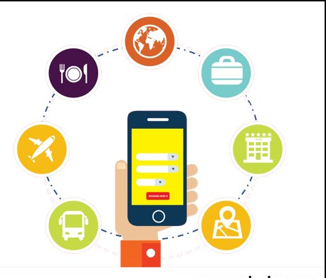
Research Approach
In this research to analyze the impact of technology on the firm performance of the hotel industry interpretivism philosophy will be adopted
An inductive approach will be selected for this research to develop the use of secondary research data and theoretical implementation of the performance management of the hotel industry
The descriptive research design will be adopted in this research to assess the firm performance and customer satisfaction approach of the hotel industry using technology such as service automation, and cashless transactions
The secondary data collection method will be adopted in this research by studying authentic research journals from Google Scholar and Science Direct to analyze the firm performance of the hotel industry
Thematic analysis of the secondary data will be developed in this research to evaluate the collected secondary qualitative data for this research
Notes:
The research approach can guide the process of research development in a particular field of study (Pandey and Pandey, 2021). In this research to analyze the impact of technology on the firm performance of the hotel industry interpretivism philosophy will be adopted. The use of the interpretivism philosophy can be effective to interpret the way hotel operational technologies such as AI solutions can be implemented in the service process of the firms. The interpretation of data regarding the process of analyzing the firm performance to satisfy the clients coming into the hotels can be effectively presented in this research.
An inductive approach will be selected for this research to develop the use of secondary research data and theoretical implementation of the performance management of the hotel industry. The service development of the operational process of the hotel industry can be evaluated by analyzing the secondary data using an inductive method. The descriptive research design will be adopted in this research to assess the firm performance and customer satisfaction approach of the hotel industry using technology such as service automation, and cashless transactions. The data collection method will be used in this research to analyze the data regarding the development of technological implications in the business performance of the hotel industry. The secondary data collection method will be adopted in this research by studying authentic research journals from Google Scholar and Science Direct to analyze the firm performance of the hotel industry.
Thematic analysis of the secondary data will be developed in this research to evaluate the collected secondary qualitative data for this research. A few themes will be developed to assess the secondary data regarding the development of technological implementation in hotel performance development (Rhou and Singal, 2020). The reliability and validity of the research data will be maintained by the researcher in the data analysis process to evaluate the performance management of the hotel industry.

Slide 10
Conclusion
It can be concluded that the research is a proposal about the impact of technology on firm performance in the hotel industry
Thus the advancement of information technology and services has transformed the hotel and hospitality industry to be leveraged in several ways like making everything automated and using AI features
Services such as wireless internet, booking, and billing can be used to leverage taking the hotel industry to a new level
This has improved the safety of hotels making the customers that would be considered to be more comfortable
The state of the research literature has been discussed, with proper gap analysis
Notes:
From the above topic and discussion made so far, it can be concluded that the research is a proposal about the impact of technology on firm performance in the hotel industry. Thus the advancement of information technology and services has transformed the hotel and hospitality industry to be leveraged in several ways like making everything automated and using AI features. Services such as wireless internet, booking, and billing can be used to leverage taking the hotel industry to a new level. This has improved the safety of hotels making the customers that would be considered to be more comfortable. Based on the context of the study the challenges faced by using the technology have been discussed in the research. The state of the research literature has been discussed, with proper gap analysis. Research questions have been discussed and also proper methodological approaches for the research have been discussed.

Slide 11
Reference List
Hameed, W.U., Nisar, Q.A. and Wu, H.C., 2021. Relationships between external knowledge, internal innovation, firms' open innovation performance, service innovation, and business performance in the Pakistani hotel industry. International Journal of Hospitality Management, 92, p.102745.
Pandey, P. and Pandey, M.M., 2021. Research methodology tools and techniques. Bridge Center.
Zhou, Y. and Singal, M., 2020. A review of the business case for CSR in the hospitality industry. International Journal of Hospitality Management, 84, p.102330.
Ribeiro-Navarrete, S., Botella-Carrubi, D., Palacios-Marqués, D. and Orero-Blat, M., 2021. The effect of digitalization on business performance: An applied study of KIBS. Journal of Business Research, 126, pp.319-326.
Tajeddini, K., Martin, E. and Ali, A., 2020. Enhancing hospitality business performance: The role of entrepreneurial orientation and networking ties in a dynamic environment. International Journal of Hospitality Management, 90, p.102605.
Tarsakoo, P. and Charoensukmongkol, P., 2020. Dimensions of social media marketing capabilities and their contribution to the business performance of firms in Thailand. Journal of Asia Business Studies, 14(4), pp.441-461.
Úbeda-García, M., Claver-Cortés, E., Marco-Lajara, B. and Zaragoza-Sáez, P., 2021. Corporate social responsibility and firm performance in the hotel industry. The mediating role of green human resource management and environmental outcomes. Journal of Business Research, 123, pp.57-69.
Wilke, E.P., Costa, B.K., Freire, O.B.D.L. and Ferreira, M.P., 2019. Interorganizational cooperation in a tourist destination: Building performance in the hotel industry. Tourism Management, 72, pp.340-351.
Notes:
Hameed, W.U., Nisar, Q.A. and Wu, H.C., 2021. Relationships between external knowledge, internal innovation, firms' open innovation performance, service innovation, and business performance in the Pakistani hotel industry. International Journal of Hospitality Management, 92, p.102745.
Pandey, P. and Pandey, M.M., 2021. Research methodology tools and techniques. Bridge Center.
Zhou, Y. and Singal, M., 2020. A review of the business case for CSR in the hospitality industry. International Journal of Hospitality Management, 84, p.102330.
Ribeiro-Navarrete, S., Botella-Carrubi, D., Palacios-Marqués, D. and Orero-Blat, M., 2021. The effect of digitalization on business performance: An applied study of KIBS. Journal of Business Research, 126, pp.319-326.
Tajeddini, K., Martin, E. and Ali, A., 2020. Enhancing hospitality business performance: The role of entrepreneurial orientation and networking ties in a dynamic environment. International Journal of Hospitality Management, 90, p.102605.
Tarsakoo, P. and Charoensukmongkol, P., 2020. Dimensions of social media marketing capabilities and their contribution to the business performance of firms in Thailand. Journal of Asia Business Studies, 14(4), pp.441-461.
Úbeda-García, M., Claver-Cortés, E., Marco-Lajara, B. and Zaragoza-Sáez, P., 2021. Corporate social responsibility and firm performance in the hotel industry. The mediating role of green human resource management and environmental outcomes. Journal of Business Research, 123, pp.57-69.
Wilke, E.P., Costa, B.K., Freire, O.B.D.L. and Ferreira, M.P., 2019. Interorganizational cooperation in a tourist destination: Building performance in the hotel industry. Tourism Management, 72, pp.340-351.

Slide 12


