Slide 1
Health and Wellbeing
Student Name:
Student ID:

Slide 2
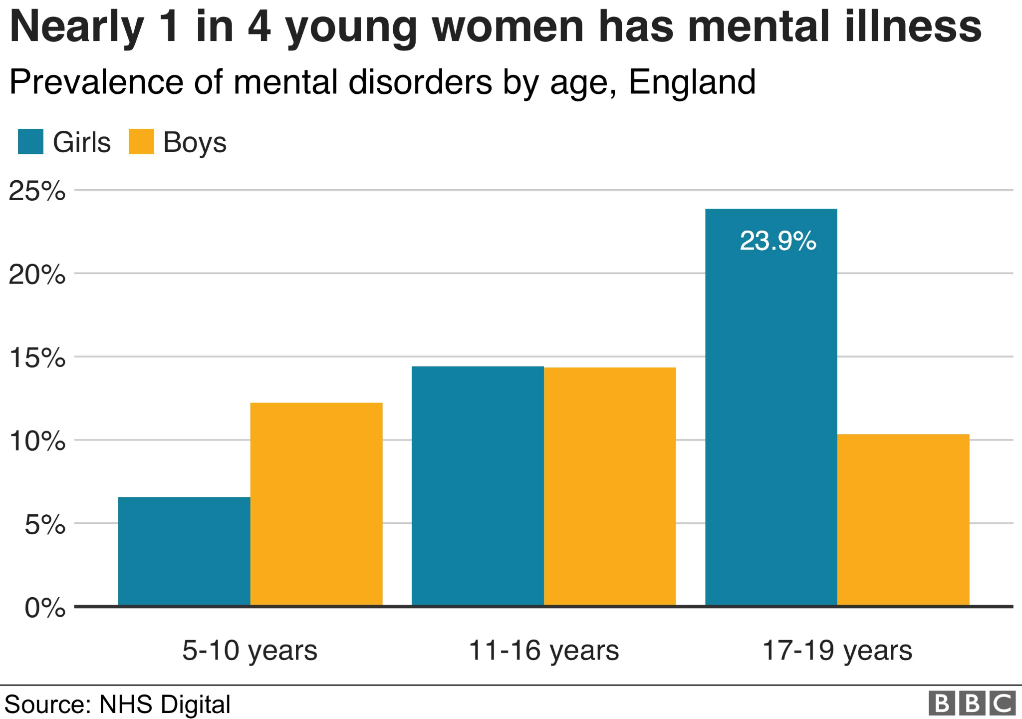
Introduction
Chosen Population: Kids of age range 12-16 years (Bbc, 2021)
Target Activities are awareness of mental health, the addition of nutrition
Source: Bbc, 2021)
Notes:
Credible Messengers are an online support group who provides emotional support to children in their time of need. Young children falling in the age range of 11 to 16 years are struggling with mental health. Primary-aged children are suffering significantly from mental illness. In order to improve the situation, the incorporation of different activities such as “nutrition programs” or “physical activities” can help in balancing the situation. It is important to raise awareness about health issues such as physical activities or the importance of becoming more active.

Slide 3
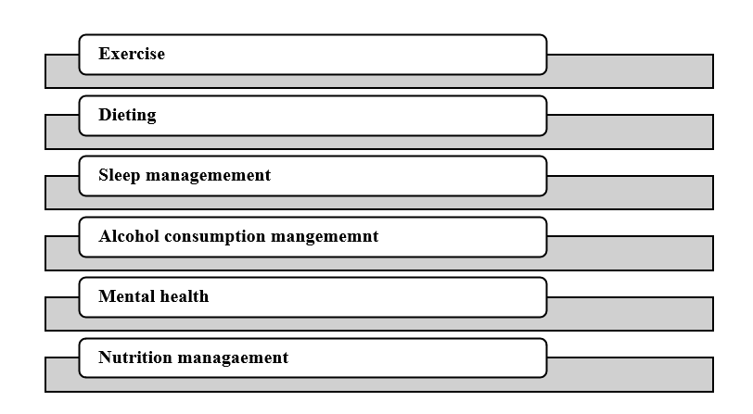
Activities
Spreading awareness about the importance of good night sleep (Thesleepcharity, 2021)
Importance of consumption of nutrition foods (Publishing. service, 2022)
Notes:
The start date of the campaign is the 27th of April. Activities are starting from attending light exercises to following a dieting week. Sleep management week is important as well. The fourth week is “mental health” week which focuses on creating awareness of paying extra care to the well-being of mental health. This campaign is focusing on the addition of different activities in order to improve conditions. Nutrition management programs help to ensure the consumption of a “balanced diet”. Ending date is 1st May

Slide 4

Short-term and long term consequences
Short-term consequence: Change in attitude and behavior of children
Long-term consequence: development of a better future (Mind,l2021)
Notes:
One of the important consequences of these programmes is that it helps in bringing a significant change in terms of the behavior of children. Following different activities such as exercising on a regular abscess helps in improving the situation. However, the most important aspect in this regard is to have access to relevant information which can further help in improving the condition. In order to support someone, the most important aspect is to review available information and offer help or support accordingly.

Slide 5
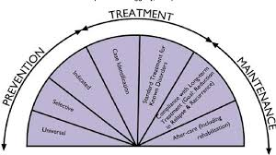
Conclusion
The study concludes that the inclusion of a good habits is an important approach
Raising awareness supports change in behavior
Notes:
The study concludes that one of the most important aspects of a health campaign is the creation of awareness about different issues of mental illness. In order to provide support the most important strategy is to discuss with the children about different issues and highlight the importance of chosen activities as well. Observing all the steps helps in ensuring a better future in this process

Slide 6
Reference List
Bbc (2021), https://www.bbc.com/news/health-46306241 [accessed on 17th april, 2023]
Thesleepcharity (2021) https://thesleepcharity.org.uk/about-us/what-we-do/[accessed on 17th april, 2023]
Publishing.service (2022), https://assets.publishing.service.gov.uk/government/uploads/system/uploads/attachment_data/file/774106/Change4Life_Evidence_review_26062015.pdf [accessed on 17th april, 2023]
Mind (2021), https://www.mind.org.uk/ [accessed on 17th april, 2023]

Slide 7


