Slide 1
WHAT MIGHT THE FUTURE OF SHOPPING LOOK LIKE?
THE GROWING POWER OF THE CONSUMER ARE HAVING A MAJOR IMPACT ON RETAILERS
Student Name:
Student ID:

Slide 2
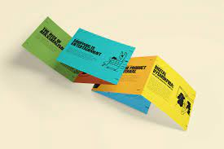
Introduction
The main aim of the study is to analyze the power of consumers over controlling businesses (Helm et al. 2020)
The inclusion of digital marketing helps in improving the quality of business research
The study is targeting to analyze the impact of digital marketing across the retail sector
Notes:
One of the important aspects of digital marketing is that it helps in understanding the changing demands of customers. The demand of customers is changing significantly in the post covid pandemic time. The objective of the study is to evaluate the prevailing power of customers across the retail sector.

Slide 3
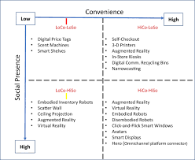
Background of the topic
In order to win customers, the most important condition is to develop products as per requirement (Hänninen et al. 2021)
The retail sector is targeting to operate across “e-platforms”
Increased competition in the retail sector is accounting for a significant driving force in terms of increasing the business
Notes:
“In-stores” of retail sectors are planning new strategies in terms of retaining customers for the business. It also includes assessing changing demands of customers and developing products accordingly. Hence, consumer trends are an important factor that the retail sector needs to pay attention to.

Slide 4
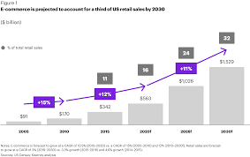
Data collection
Secondary data sources have been used to collect data
Data are collected from secondary sources such as “Journal articles” (Roh et al. 2019)
Data is collected using different journals
Notes:
One of the important features in this regard is using information from journals that are not more than five years old. This is an important technique that helps in analyzing ongoing trends regarding the topic of the research. It is only using qualitative information. No quantitative information has been used in the research process.

Slide 5
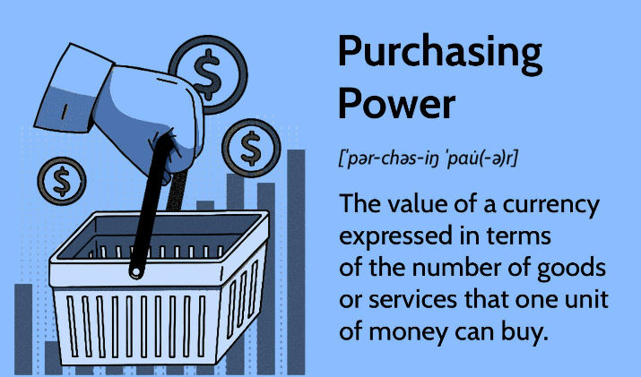
Data collection
Key sources such as “Google Scholar”, “Newspaper articles”, “authentic websites” and “government websites” have been used to collect data
The relevant information has been extracted at the beginning of the research to conduct the study process (Posada-Quintero and Chon, 2020)
Data used in the study are only qualitative information
Notes:
No numerical or quantitative information has been added. At the beginning of the research, keywords have been identified as relevant to the topic which further helped in collecting relevant information. This study uses information from government websites in order to ensure that authentic information is added

Slide 6
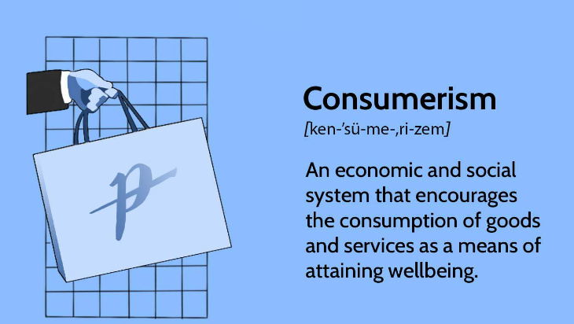
Data collection
Data is collected from journals published in English only
It is important to use the information published in a language understandable by all (Jianwattanapaisarn and Sumi, 2022)
It uses existing information which helps in saving time of the research process.
Notes:
One of the important aspects of using a secondary research method is that it helps in saving time in the research process. It also uses only qualitative information so no formula or additional statistics have been used for the research process.

Slide 7

Findings
The increase power of the consumer is changing the overall strategies adopted by businesses of the retail sector
Changing the “behavior of consumer” is an important factor of analysis to ensure growth of the business (van Esch et al. 2019)
Changing behavior of consumers owing to the impact of covid on the population
Notes:
Increased preference of consumers towards buying online products is a significant reason responsible for the development of “e-commerce” platforms. Consumers are preferring to buy products online as the single platform is giving chance to buy a wide range of products on one platform

Slide 8
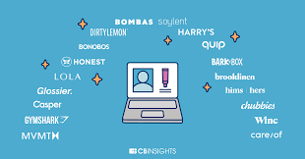
Findings
Identification of risk factors account as an important way to reduce the chance of failure
Developing price of a product using customer feedback is an important strategy (Akram et al. 2021)
The power of consumers lies in determining the product price section as well
Notes:
One of the important conditions in this regard is that it helps in the analysis of past shopping experiences of customers. Increased preference for online shopping is directly hampering the traditional shopping approach. In this regard, the growing power of consumers is posing an influence in terms of the establishment of online as well as offline business platforms.

Slide 9

Evaluation of findings
Focusing on instore technology
Making demonstration of the new technologies adaptation (Alexander and Kent, 2021)
Developing the innovation process regarding the technological operation
Notes:
From this research, this can be identified that the customers of the future generation would keep the focus on better purchasing behavioral control which would be the market regulator. Herein, the new technologies adaptation would also be introduced which can upgrade the feasibility of the business process. In addition, the level of customer satisfaction can be upgraded. With the help of the innovation process-based development, the possibility of making an upgradation of the present work culture can be identified. This can ensure business sustainability.

Slide 10
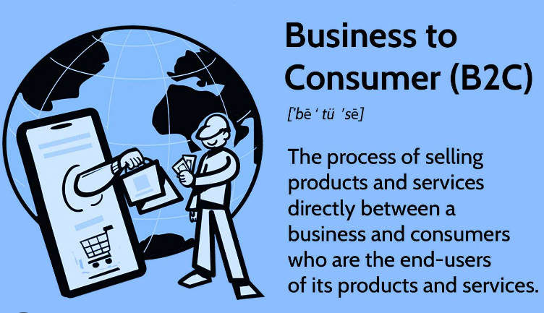
Evaluation of findings
Inconsistent business product delivery process development
Providing stress on the new product announcement (Grewal et al. 2020)
Assessing the customer perception and customers buying behavior
Notes:
With the help of the research finding process, the probable identification of the business delivery can be confirmed. In addition, the probability of making an announcement of the new product would ensure the development of the customer's demands mitigation concern as well. In addition to that, the customer perception and customers buying behavior are to be assessed which can help to make the risk reduction process regarding future business development and operation

Slide 11
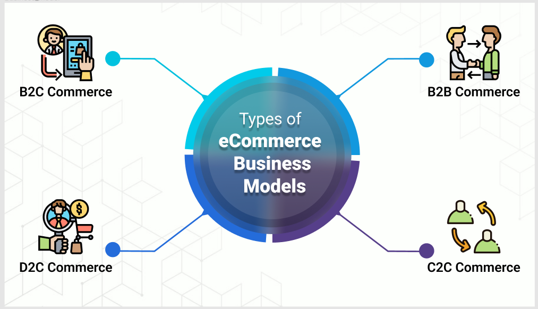
Evaluation of findings
Omnichannel retailing process
Changing in the growing power of consumer rate (Alexander and Kent, 2021)
Brand equity and brand image development to measure the revenue generation
Notes:
Regarding the process of developing the research regarding findings, this would require to make identification of the omnichannel retailing practice-based identification. In addition, the specification of changing the growing power of consumer rate would help to upgrade the consumption rate as well. On the other hand, the application of brand equity and brand image development can reduce the risk regarding shopping process-based product development.

Slide 12
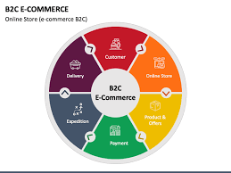
Conclusion
The study concludes that “customer feedback” is a necessary tool in the current business
Online shopping preferences of customers are changing the business of retail sectors (Shankar et al. 2021)
Technological advancement is thus impacting business design
Notes:
The study concludes that the power of consumers is quite high in terms of developing effective decisions for business processes.

Slide 13
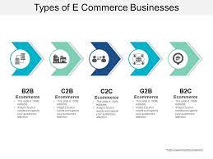
Recommendations
Providing detailed information about the product across online platforms of business (Roggeveen and Sethuraman, 2020.)
Developing an understanding about consumer budget
Establishment of “cross-border” platforms for business
Notes:
One of the effective recommendations is understanding the demands of consumers which ensure the success of the business.

Slide 14

Reflection
In order to generate better outcomes, one important strategy is time management (Reinartz et al. 2019)
Indulging in deep research before starting the study, in my opinion, is a better technique
Improper use of resources is another significant fallout
Notes:
I think I would have used resources more appropriate to the objectives of the research.

Slide 15

Reflection
Gantt chart in use reflects the different stages of the research (Shavitt and Barnes, 2020)
Proper division of time into different activities helps in meeting objectives in a given timeline
It reduce the chance of missing deadline of the job
Notes:
I believe the Gantt chart developed is ideal for this research process. Changing preferences of consumers are accounting as an important perspective in terms of bringing change in the working style of the retail sector.

Slide 16
Reference list
Helm, S., Kim, S.H. and Van Riper, S., 2020. Navigating the ‘retail apocalypse’: A framework of consumer evaluations of the new retail landscape. Journal of Retailing and Consumer Services, 54, p.101683.
Hänninen, M., Kwan, S.K. and Mitronen, L., 2021. From the store to omnichannel retail: looking back over three decades of research. The International Review of Retail, Distribution and Consumer Research, 31(1), pp.1-35.
Roh, Y., Heo, G. and Whang, S.E., 2019. A survey on data collection for machine learning: a big data-ai integration perspective. IEEE Transactions on Knowledge and Data Engineering, 33(4), pp.1328-1347.
Posada-Quintero, H.F. and Chon, K.H., 2020. Innovations in electrodermal activity data collection and signal processing: A systematic review. Sensors, 20(2), p.479.
Jianwattanapaisarn, N. and Sumi, K., 2022. Investigation of real-time emotional data collection of human gaits using smart glasses. Journal of Robotics, Networking and Artificial Life, 9(2), pp.159-170.
van Esch, P., Arli, D., Gheshlaghi, M.H., Andonopoulos, V., von der Heidt, T. and Northey, G., 2019. Anthropomorphism and augmented reality in the retail environment. Journal of Retailing and Consumer Services, 49, pp.35-42.
Akram, U., Fülöp, M.T., Tiron-Tudor, A., Topor, D.I. and Căpușneanu, S., 2021. Impact of digitalization on customers’ well-being in the pandemic period: Challenges and opportunities for the retail industry. International Journal of Environmental Research and Public Health, 18(14), p.7533.

Slide 17
Reference list
Grewal, D., Noble, S.M., Roggeveen, A.L. and Nordfalt, J., 2020. The future of in-store technology. Journal of the Academy of Marketing Science, 48, pp.96-113.
Alexander, B. and Kent, A., 2021. Tracking technology diffusion in-store: a fashion retail perspective. International Journal of Retail & Distribution Management, 49(10), pp.1369-1390.
Shankar, V., Kalyanam, K., Setia, P., Golmohammadi, A., Tirunillai, S., Douglass, T., Hennessey, J., Bull, J.S. and Waddoups, R., 2021. How technology is changing retail. Journal of Retailing, 97(1), pp.13-27.
Roggeveen, A.L. and Sethuraman, R., 2020. How the COVID-19 pandemic may change the world of retailing. Journal of retailing, 96(2), p.169.
Reinartz, W., Wiegand, N. and Imschloss, M., 2019. The impact of digital transformation on the retailing value chain. International Journal of Research in Marketing, 36(3), pp.350-366.
Shavitt, S. and Barnes, A.J., 2020. Culture and the consumer journey. Journal of Retailing, 96(1), pp.40-54

Slide 18


