Slide 1
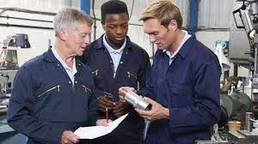
Role of Formal Team Making in Workplace to Improve Productivity in Manufacturing Sector

Slide 2
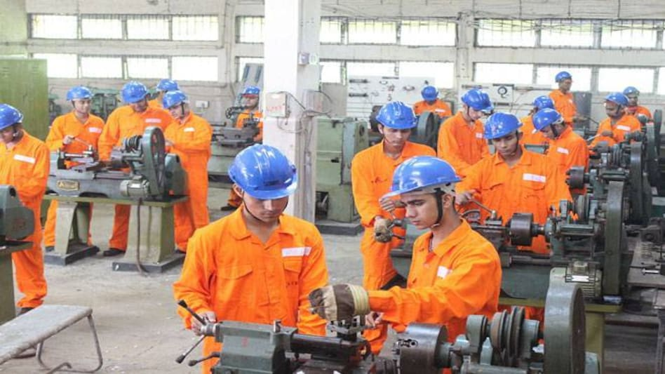
Introduction of the chosen company and proposed issue
Formal team-making is usually done based on a significant purpose.
They are responsible for handling issues within an organisation.
It has a leader and roles are allocated to each team member.
It has a serious influence to increase the productivity of a firm.
Notes:
With the help of making a formal team, it becomes quite easy for an organisation to facilitate continuity and consistency in the working procedure. In addition to this, the stability of this type of team is able to motivate the employees in the process of increasing the productivity of a firm.

Slide 3

Introduction of the chosen company and proposed issue.. (Conti..)
The importance of formal team-making is quite effective in manufacturing.
It encourages communication, trust and support.
The development of a positive environment can be seen.
Notes:
The basic advantages of formal team-making can be observed in increasing the productivity of manufacturing sectors. It actually allows manufacturing organisations in order to bring positive changes in the working environment and at the same time resolving complex issues.

Slide 4

Research project objectives
To analyse the importance of formal team making.
To investigate the role of the team in improving productivity.
To discuss the importance of formal team-making in the manufacturing sector.
To identify the advantages of formal team-making in the process of improving productivity in manufacturing.
Notes:
The basic aim of this research proposal is to highlight the importance of formal team-making in the process of improving the productivity of an organisation. Additionally, it is also going to discuss the advantages of formal tram-making procedures in order to enhance productivity in the manufacturing sector.

Slide 5

Influencing literature
Meeting significant objectives can be done by using the formal team.
Encourages bonds and connection.
Increase the productivity of a firm.
Notes:
In the words of Giudici and Filimonau (2019), formal team working is known to be the process of catering a perfect team for the benefit of an organisation and to meet significant objectives. The importance of having a formal team within an organisation can assist a firm in the process of developing connections and bonding among the team members that can ultimately bring positive changes in productivity. The overall dynamics of a formal team are seen to be quite effective in the process of influencing the aspiration of the individual engaged in a manufacturing project.

Slide 6

Influencing literature… (Conti..)
A diversified team can provide more effective solutions to the manufacturing sectors.
Sharing stress and responsibilities can encourage employees.
Creative ideas can help in effective decision-making.
It can clearly outline the relationship among the employees.
Notes:
Islam et al. (2020) stated that the basic advantages of the formal team in the manufacturing sector can be observed in interlinking, integrating and coordinating between teammates. It gives greater importance to doing work without putting much stress on an individual employee and prioritising the entire team effectively. Going into the details of it, it should be mentioned that clear definitions of rules and procedures are effective to engage employees in a systematic manner while enhancing productivity.

Slide 7

Influencing literature… (Conti..)
Effective communication is essential in the production chain.
Lack of communication reduces the level of productivity.
A formal team can be able to identify the issues in the supply chain.
Developing competitive strategies in manufacturing can be easy by using different ideas.
Notes:
In the words of Aceto et al. (2019), it has been identified that communication is considered to be one of the crucial components within the teams in manufacturing sectors. It has the ability to enhance the productivity level among the employees who are employed within a manufacturing project. The overall complexities of the production system can easily be solved by using the bonding and connection of a formal team.

Slide 8

Proposed methodology
A deductive research approach is going to be followed (Young et al., 2020).
It can help to gather data about formal tam making in a systematic way.
Can explain the connection between variables and concepts.
Notes:
The deductive approach is going to assist the research with the possibility of quantitatively measuring concepts and ideas regarding the role of formal teams in manufacturing.

Slide 9

Proposed methodology…(Conti..)
The research is going to obtain a descriptive research design.
It is also using a case-study research strategy.
Notes:
With the help of descriptive research design, it can be helpful to describe the overall phenomenon of the influencing factors of formal team-making in manufacturing.

Slide 10
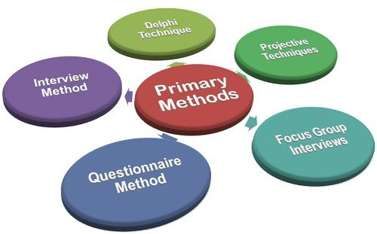
Proposed methodology…(Conti..)
Primary as well as secondary data collection method is going to be obtained.
An interview will be conducted to collect primary data.
Pre-existing sources of information will be used for gathering secondary information (Ruggiano and Perry 2019).
Qualitative data analysis will be done.
Notes:
Both primary and secondary data collection procedure is going to be used to gather a huge amount of data in regard to the topic. Qualitative data analysis is going to enrich the research with authentic and credible information.

Slide 11
Ethical approval
Copying information is going to be prohibited.
Consent will be taken from the participants before engaging in the research.
Confidentiality of the personal data of the research participants will be maintained.
No harm will be done to anyone.
Notes:
Some of the ethical considerations are going to be followed in the process of conducting this research. At the time of collecting secondary data, no copy will be done and consent will be taken from the research participants during the time of taking interviews. In addition to this, the personal data and identity of the participants taking part in the interviews are going to be maintained. Additionally, no harm is going to be done to anyone at the time of conducting the research.

Slide 12
Reference list
Aceto, G., Persico, V. and Pescapé, A., 2019. A survey on information and communication technologies for industry 4.0: State-of-the-art, taxonomies, perspectives, and challenges. IEEE Communications Surveys & Tutorials, 21(4), pp.3467-3501.
Giudici, M. and Filimonau, V., 2019. Exploring the linkages between managerial leadership, communication and teamwork in successful event delivery. Tourism Management Perspectives, 32, p.100558.
Gomez, L.E. and Bernet, P., 2019. Diversity improves performance and outcomes. Journal of the National Medical Association, 111(4), pp.383-392.
Islam, A.M., Gaddis, I., Palacios López, A. and Amin, M., 2020. The labor productivity gap between formal businesses run by women and men. Feminist Economics, 26(4), pp.228-258.
Ruggiano, N. and Perry, T.E., 2019. Conducting secondary analysis of qualitative data: Should we, can we, and how?. Qualitative Social Work, 18(1), pp.81-97.
Young, M., Varpio, L., Uijtdehaage, S. and Paradis, E., 2020. The spectrum of inductive and deductive research approaches using quantitative and qualitative data. Academic Medicine, 95(7), p.1122.

Slide 13


