Slide 1
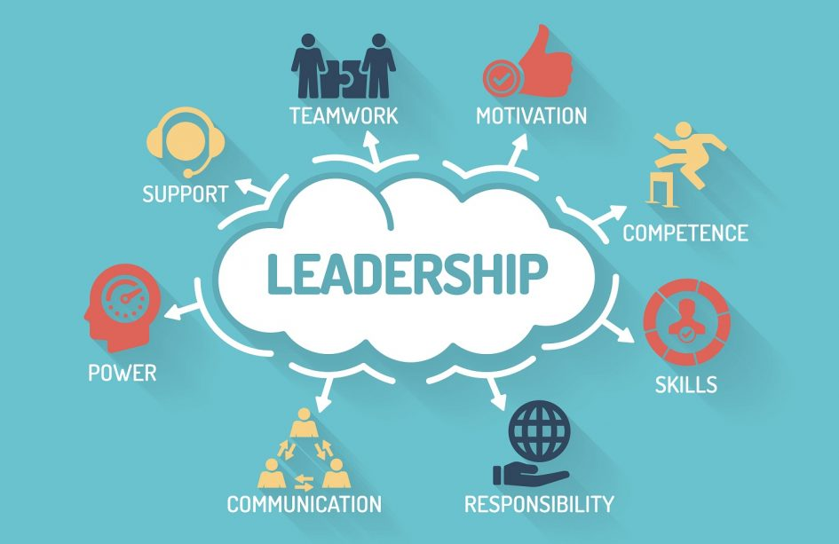
LEADERSHIP AND CHANGE MANAGEMENT

Slide 2

Introduction
This reflective study is going to be reflected my role.
For completing this study, Gibbs reflective model is going to be followed.
This reflective study will highlight the description of my experience in carrying out my responsibility
Notes:
This reflective study is going to be reflected my role on the team in completing the assessment of Leadership and change management. For completing this study, Gibbs's reflective model is going to be followed. Using this framework, it is possible to get in-depth information on my experience in the team for completing the assessment. This reflective study will highlight the description of my experience in carrying out my responsibility. In addition to it, this study will reflect on what well went and what did not. Furthermore, an action plan will also be identified here.

Slide 3
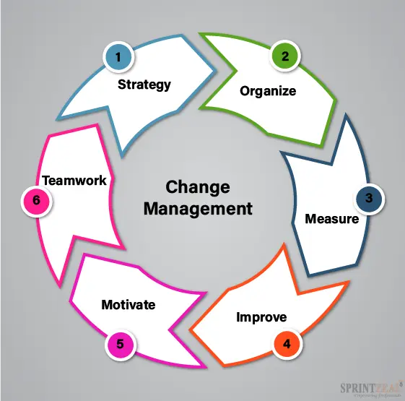
Description
My team was working on the assessment of leading people through change.
We identified various points of the assessment topic and divided each part among the team.
I also made a mind map.
Notes:
In order to describe my experience as a part of the team, Gibbs's reflective model is used. This model is a framework for discussing an individual’s experience and was developed by Graham Gibbs (my.cumbria.ac.uk, 2019). My team was working on the assessment of leading people through change. For completing this assessment, first, we identified various points of the assessment topic and divided each part among the team. We found that there are 2 key points on the topic- leadership growth and change management. It can be found that leadership growth is the driving factor in many companies (hbr.org, 2019). I took the point of change management. In this way, it is easy for us to complete the project on time. In addition to it, I also made a mind map so that it is easier for us to identify the key points and carry out our job. Moreover, I have also found out there are various change theories that can impact leadership management.

Slide 4
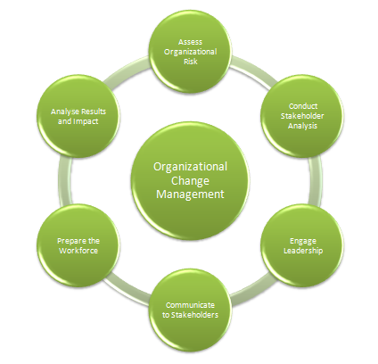
Feelings
I can say that it was a great experience for everyone.
It was also possible for us to gain more in-depth insights into the research topic.
This assessment also provided an excellent opportunity for us to get to know each other.
Notes:
Upon completing the assessment with my group, I can say that it was a great experience for everyone. Only for this project, all the members were able to come close and create a stronger bond with each other. Upon conducting the assessment, it was also possible for us to gain more in-depth insights into the research topic. I have gained various knowledge on leadership management and how it can affect an organisation. It can be found that change leadership is all about working together (ccl.org, 2022). I am also able to gain more information on leading people through change. In addition to it, this assessment also provided an excellent opportunity for us to get to know each other. Moreover, it was also possible for me to identify the strengths and weaknesses of individuals. \

Slide 5

Evaluation
In order to complete the project, I was given the role of team leader.
I tried my best for carrying out my responsibility and achieve the assessment objectives.
However, there have some problems that pose a threat for me to complete the assessment efficiently.
Notes:
It can be derived that it was a great experience for everyone in the team including. In order to complete the project, I was given the role of team leader. As a team leader, I tried my best for carrying out my responsibility and achieve the assessment objectives. However, there have some problems that pose a threat for me to complete the assessment efficiently. It has been found that there wasn't enough information available on the internet on some specific topics. Therefore, it was difficult for my team members to carry out their roles and respond effectively. However, everyone on the team helped everyone to complete the project on time. It can also be derived that due to this project, everyone can experience growth in their character.

Slide 6

Analysis
In the end, everything came out smoothly.
One of the major issues that arose was not having enough knowledge on how to handle a team.
As it was everyone’s first time being in a team, everyone was a little bit confused.
Moreover, I have used the knowledge gained while carrying out the responsibility.
Notes:
As a leader, it was my responsibility to ensure that the project is completed within the given timeframe. In the end, everything came out smoothly, however, there were various issues that arises during the project. One of the major issues that arose was not having enough knowledge on how to handle a team. It was the biggest challenge for me. At first, it was impossible for me to coordinate with my team members effectively. Therefore, conflicts between the team were found. However, I tried my best to tackle the issues and overcome them. Upon completing the project, it can be found that a great leader can be a role model for his members (globaljournals.org, 2019). As it was everyone’s first time being in a team, everyone was a little bit confused. However, with time everyone became accustomed and everything was fine. Moreover, I have used the knowledge gained while carrying out the responsibility in the project to control the team.

Slide 7

Conclusion
The experience gained from the project has proven beneficial for us in terms of personal growth.
An effective leadership strategy is required for managing a team effectively.
In addition to it, my feelings and experiences while completing the project are also mentioned in the study.
Notes:
Upon analysing the above reflective study, it can be found that the experience gained from the project has proven beneficial for us in terms of personal growth. It can also be derived from the above study that an effective leadership strategy is required for managing a team effectively. Moreover, in the above reflective study, various challenges that arise while completing the job are also identified here. In addition to it, my feelings and experiences while completing the project are also mentioned in the study.

Slide 8

Action Plan
The experience I got while completing the project and as leader of the team can be proven beneficial for me in my future life.
In addition to it, If I have been given the opportunity to lead a team, then also I can use my experience.
This gained knowledge can also be proven beneficial for me in terms of carrying out my role as a team leader more effectively.
Notes:
The experience I got while completing the project and as leader of the team can be proven beneficial for me in my future life. In near future, if I go to any organisation for work, there I can use my experience to carry out my role and responsibility. In addition to it, If I have been given the opportunity to lead a team, then also I can use my experience. Furthermore, the topic of our project was leadership and change management. I have gained various insights on the topic. This gained knowledge can also be proven beneficial for me in terms of carrying out my role as a team leader more effectively.

Slide 9

Recommendation
There were many aspects that I need to look into and develop myself more.
It has been found that it was difficult for me to carry out my role as team ladder.
Moreover, I have to develop my communication skills more.
Notes:
Upon completing the above project, It can be derived that there were many aspects that I need to look into and develop myself more. It has been found that it was difficult for me to carry out my role as team ladder. However, with the help of everyone, I managed to do it. Therefore, I have to look into my leadership quality and develop it. Moreover, I have to develop my communication skills more, so that I can carry out my role effectively as a team leader.

Slide 10
References
my.cumbria.ac.uk (2019) Gibbs’ reflective cycle - University of Cumbria. Available at: https://my.cumbria.ac.uk/media/MyCumbria/Documents/ReflectiveCycleGibbs.pdf (Accessed: April 17, 2023).
hbr.org (2019) Change management and leadership development have to Mesh, Harvard Business Review. Available at: https://hbr.org/2019/01/change-management-and-leadership-development-have-to-mesh (Accessed: April 17, 2023).
ccl.org (2022) How to be a successful change leader, CCL. Available at: https://www.ccl.org/articles/leading-effectively-articles/successful-change-leader/ (Accessed: April 17, 2023).
globaljournals.org (2019) How effective leadership can facilitate change in organizations through ... Available at: https://globaljournals.org/GJMBR_Volume15/1-How-Effective-Leadership.pdf (Accessed: April 17, 2023).

Slide 11


