Slide 1
A video-recorded reflection

Slide 2
Introduction
Consumption of processed food is increasing day by day and this is causing obesity and other health-related issues
The benefits of good food and a healthy lifestyle were realised during COVID-19
Most people do not know how to cook and as a result, they are bound to consume processed fast food
Notes:
The consumption of processed food is not good for health because they are high in calories and fat, which causes obesity. People these days do not cook at home because they lack cooking skills and they do not have adequate knowledge of healthy foods. However, during COVID-19 when restaurants were closed, people realised the necessity of self-cooking and all the health-related factors of good food. Therefore, cooking classes are an exceptional alternative that can enable people to cook good foods with high nutrients food.

Slide 3
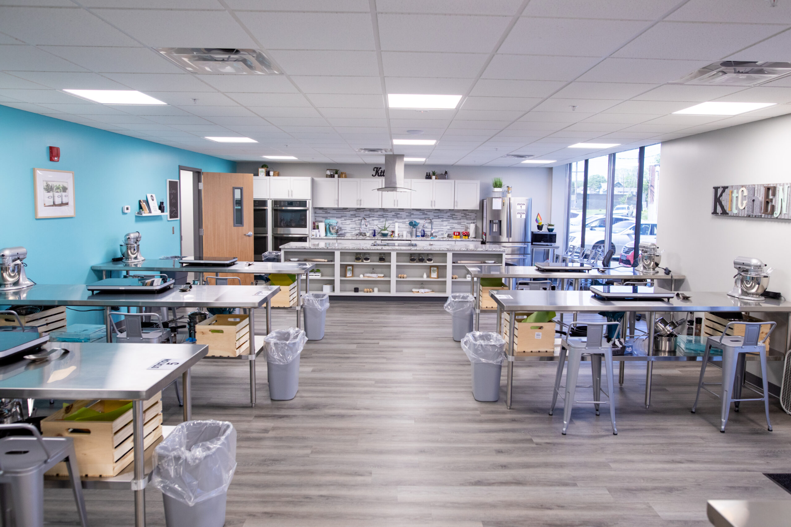
The objective of Cooking classes
The primary objective of cooking classes is to enhance the cooking skills of the pupils and develop their self-confidence
Cooking classes help one to get familiar with the kitchen, kitchen apparatus and different food ingredients and their health benefits (Hasan et al. 2019)
Cookings classes introduce international cuisines to the pupils and consequently spread cultural awareness of cooking
Notes:
Cooking classes have become quite popular because previously most people knew how to cook but at present people do not have the skills and habits to cook good foods. As a result consumption of processed and fast food has increased significantly and the obesity rate of people is constantly increasing. Therefore, cooking classes are one such alternative that can enable people to acquire adequate cooking skills. Furthermore, cooking classes help an in individual to get acquainted with diverse cultures through multicultural cuisine. Having adequate knowledge of cooking and a basic understanding of different food ingredients also boost the motivation and confidence level of people to cook.

Slide 4
Similarity between the objectives of Coventry City Council and Cooking classes
The primary objective of Coventry City Council is to teach people how to cook good food and cooking classes have this objective at the core
Coventry City Council wishes to teach people the benefits of healthy food and Cooking classes have this objective as well
The objective of Coventry City Council is to make the people realise that healthy food is equivalent to good health; the Cooking classes too teach the same
Notes:
The objectives of Coventry City Council are a good synch with the objectives of cooking classes. It is because Coventry City Council aims to resolve the national concern of increasing obesity and cooking classes can make people self-dependent in terms of cooking. Cooking classes also prepare people to know the health benefits of different foods and they also teach preparation of foods of varied cuisine. People will be benefitted from cooking classes and it can be expected that the aim of Coventry City Council will be achieved as well.

Slide 5
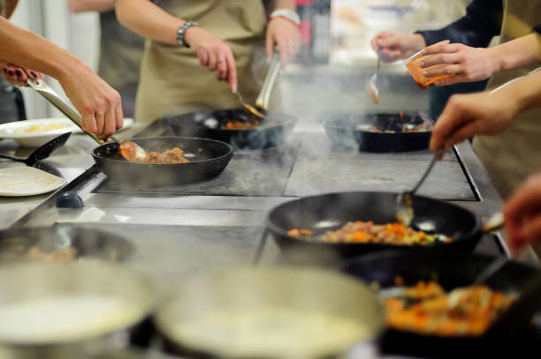
Multicultural aspects of cooking
The world is highly diversified so is cooking and cooking classes can make one acquainted with the beauty of different cuisines
People with the help of cooking classes learn to cook the most healthy dishes of different cuisines (Davis et al. 2021)
Food is a carrier of culture, therefore, food can spread cultural harmony
Notes:
The world is diversified and cooking style differs from one place to another. Cooking classes teach cooking of multicuisine and thus cooking classes help to learn about different cultures. Furthermore, some dishes of different cuisine are rich in nutrients and health benefits and therefore cooking classes can play a significant role in preparing individuals to cook good foods in different regions.

Slide 6
Workshops on cooking
In my locale cooking workshops can be organised to teach people how to cook
The workshop can be organised in schools, colleges
Both students and guardians and even teachers can participate in the workshops
Teachers for the workshops can be selected by the advertisement
Notes:
A cooking workshop is a great idea and I think that in my local area, this idea of a cooking workshop can be implemented. Cooking is our daily need and we cannot live without food. However, a high amount of processed food consumption is not good for our health. Thus, cooking classes can be organised to teach students and even their parents about how to cook and the potential benefits of fresh healthy food. Teachers too can participate in the workshops and learn about cooking. However, skilled cooking teachers need to be selected for the workshops, in this regard advertisement can help.

Slide 7
NFP organisations for cooking classes
NFP organisations aim to assist people without making profits
Different organisations like social welfare and health promoting companies can come support
People will get immensely benefited because of their active participation
Notes:
NFP organisations can be invited to hold the workshop programmes because the objectives of the workshops and the objectives of NFP companies are in sync. NFP organisation that works for social awareness and health programmes participate.

Slide 8
Reference
Hasan, B., Thompson, W.G., Almasri, J., Wang, Z., Lakis, S., Prokop, L.J., Hensrud, D.D., Frie, K.S., Wirtz, M.J., Murad, A.L. and Ewoldt, J.S., 2019. The effect of culinary interventions (cooking classes) on dietary intake and behavioral change: a systematic review and evidence map. BMC nutrition, 5, pp.1-9.
Davis, J.N., Pérez, A., Asigbee, F.M., Landry, M.J., Vandyousefi, S., Ghaddar, R., Hoover, A., Jeans, M., Nikah, K., Fischer, B. and Pont, S.J., 2021. School-based gardening, cooking and nutrition intervention increased vegetable intake but did not reduce BMI: Texas sprouts-a cluster randomized controlled trial. International Journal of Behavioral Nutrition and Physical Activity, 18(1), pp.1-14.

Slide 9
Thank you

