Slide 1
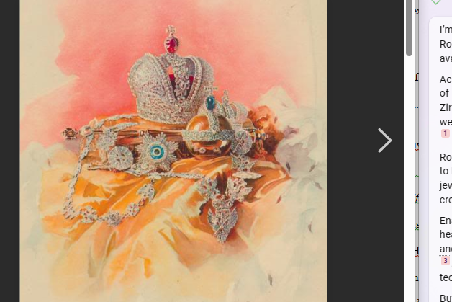
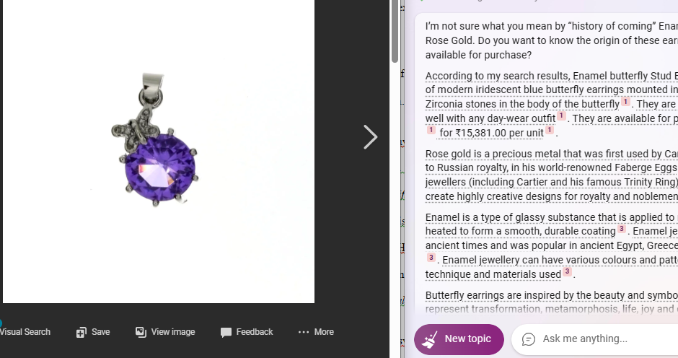
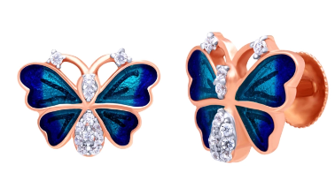
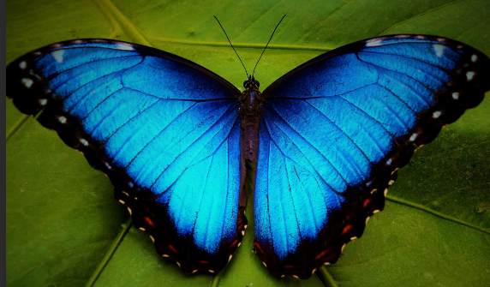
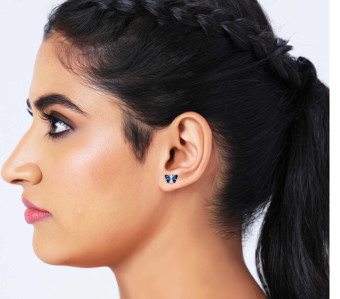
In order to make this design, generally needs the rose gold metal that is precious most and this design mainly followed the Russian Loyalty. This Russian royalty is one of the creative designs destination that escalates the design of an any armaments widely.
In my childhood time, I was playing and suddenly I saw this beautiful butterfly. That time, I wanted to catch it but I could not collect this Blue Morpho Butterfly. At present, I want to make this ear rings design through following the formation of that blue butterfly.

