Slide 1
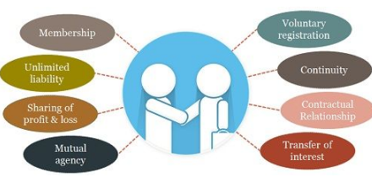
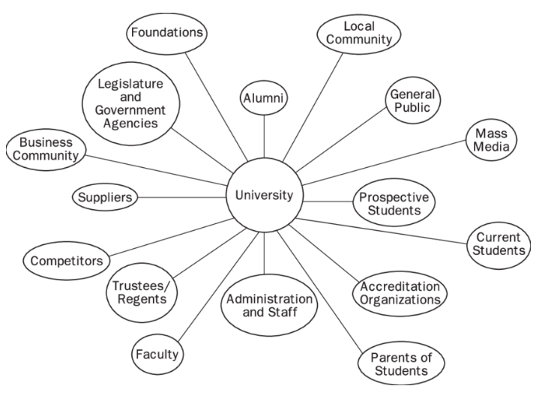

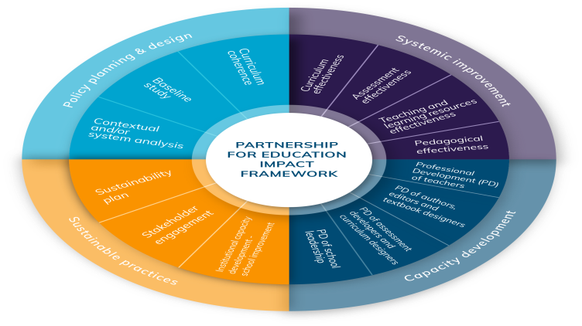
Identifying the stakeholders
The stakeholders of the partnership will be the parents, students, teachers, school administrators, the business community and government representatives. In this context, the main stakeholders of the educational institutions will be students, the business community and educational administrators. Accordingly, the business community needs to analyse the total funding and resources of the institutions through the partnership. educational administrators monitor the allocation of resources and the teaching process regarding the partnership (Admiraal et al. 2021). On the other hand, the business community of the organisation can face challenges in sourcing funds from Oxford University due to limited resources.
Explaining the performance indicators and how data are used to measure the effectiveness of the partnership
The measurement of data is important in order to assess the effectiveness of the partnership with the organisation. As commented by Winstone and Carless (2019), collecting feedback and monitoring plays an important role in measuring the effectiveness of a partnership. Thus, the educational organisation can collect feedback from each other through performance indicators such as internal process quality in the process of partnership.
Incorporating the rationale for the presentation of partnership outputs relevant to the stakeholders
The relevance of stakeholders is effective for the partnership outputs due to the conceptualisation of the educational process. As opined by Luckin and Cukurova (2019), the relevance of stakeholders helps in implementing the findings of research for educational purposes. Therefore, the way of presenting the partnership outputs is necessary for the organisation to make engagement with stakeholders.
Emphasising the purpose of the partnership and describing its aims and objectives
The purpose of the partnership is to develop the learning progress of the institution with the resources of Oxford University.
Aim
The aim of the partnership is to improve the quality of teaching and learning assessment through collaboration with Oxford University.
Objectives
To enhance the process of learning through the partnership
To improve the quality of the educational process through collaboration with Oxford University
TASK TWO: INDIVISUAL LEAFLET
Discussing the process of partnership management
A partnership can be managed through communicating with each other via phone calls, e-mailing or face-to-face meetings. As per the view of Stachová et al. (2019), the different management process is a challenging factor for partnership in educational activities. Therefore, the educational boundaries and management process need to be effective for successfully organising the partnership.
Discussing Communication strategy of partnership
Verbal communication can help the organisation in communicating with Oxford University regarding the development of learning progress. As evaluated by Zutshi et al. (2021), verbal communication helps in mitigating organisational challenges positively. Hence, the organisation need to use verbal communication for improving the quality of the learning process effectively.
Evaluating the Impact of Stakeholders and Government Policies
The impact of stakeholders and government policies is prominent in order to manage the effectiveness of partnerships. Accordingly, both organisations need to maintain the guidelines of government policies and stakeholders' expectations in framing the learning assessments.
Summarising the maintenance of partnership
The organisation needs to communicate with Oxford University effectively for achieving the goal of partnership process. Moreover, both organisations can set a clear vision and goal to achieve the aim of the partnership positively.

Slide 2
REFERENCES
Admiraal, W., Schenke, W., De Jong, L., Emmelot, Y. and Sligte, H., (2021). Schools as professional learning communities: what can schools do to support professional development of their teachers?. Professional development in education, 47(4), pp.684-698.
Luckin, R. and Cukurova, M., (2019). Designing educational technologies in the age of AI: A learning sciences‐driven approach. British Journal of Educational Technology, 50(6), pp.2824-2838.
Stachová, K., Papula, J., Stacho, Z. and Kohnová, L., (2019). External partnerships in employee education and development as the key to facing industry 4.0 challenges. Sustainability, 11(2), p.345.
Winstone, N. and Carless, D., (2019). Designing effective feedback processes in higher education: A learning-focused approach. Routledge.
Zutshi, A., Mendy, J., Sharma, G.D., Thomas, A. and Sarker, T., (2021). From challenges to creativity: enhancing SMEs’ resilience in the context of COVID-19. Sustainability, 13(12), p.6542.

