Slide 1
ASS023-3 CHILDHOODS IN A GLOBAL CONTEXT

Slide 2
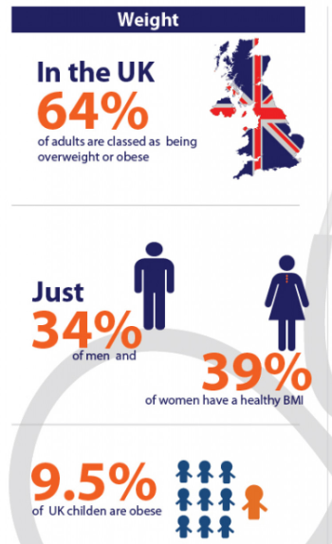
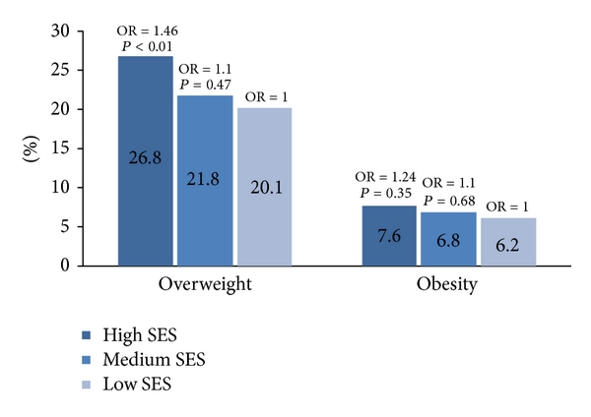
CRITICAL POINTS OF COMPARISON
23.4% of 10-12 years old children faced obesity in the UK
24% of school students gained weight in Romania
Notes:
In the UK, 10.1% of obesity levels have been found among 4 to 5-year-old children. On the other hand, 23.4% of 10-12 years old children face the same issues in their lives (Parliament.uk, 2023). Compared to the UK, 8-year-old Romanian children faced 26.8% of obesity issues. Additionally, 24% of school students gained weight during the pandemic situation (Romaniajournal.ro, 2022). Thus, the obesity issue is quite higher in Romania. Mainly 10 to 12 years of children majorly faced obesity issues in both countries. However, obesity and overweight issues majorly affect Romanian children. Besides that, the CDC framework has been imposed in the UK to resolve obesity issues. This framework mainly focused on the age, gender and weight levels of children. Contrarily, the IOM framework has been used in Romania to address the overweight problems among children. Mainly systematic diagnosis procedures have been followed throughout this framework in terms of addressing overweight problems of children.

Slide 3

ANTI-DISCRIMINATORY PRACTICE
Children do not get sufficient nutrition
Romanian children faced problem situations after the pandemic
Notes:
Discrimination issues cause obesity problems among children because family members are feeding their children excessively. As a result, children are facing these issues in their lives where in rural areas individuals or children do not get sufficient nutrition to overcome their health issues. Additionally, Romanian children faced problem situations after the pandemic outbreak because they were not allowed to play outdoor games. Moreover, physical inactivity created this obesity issue.

Slide 4
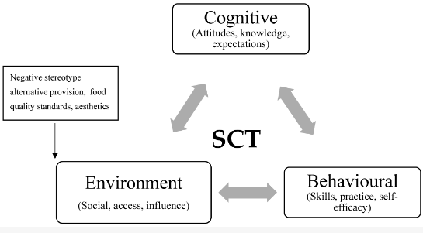
The Social Cognitive Theory (SCT)
Physical Activities
Mental Assistance
Nutritional Education
Congnitive
Situational
Behaviour
Notes:
Considering relevant models, and theories to analyse health and education services
“The Social Cognitive Theory (SCT)” has been recognised as mostly used theory related to child obesity. As per the views of Beauchamp et al. (2019), the SCT theory has promoted “psychological”, “educational” and “communicational” aspects of individual knowledge which has also developed from the context of social interactions. This theory has provided physical activities and nutrition education for children. These physical activities and nutrition education has helped children to reduce their weight and also reduce the chance of child obesity. However, Czogała et al. (2021) have stated that child obesity has promoted high blood pressure as well as high cholesterol rate among children. This has elevated the possibility of heart attack more prominent in the UK as well as Romania. On the other hand, the SCT theory can be used in rural communities to change the eating habits of children and maintain effective weight to avoid heart diseases.

Slide 5
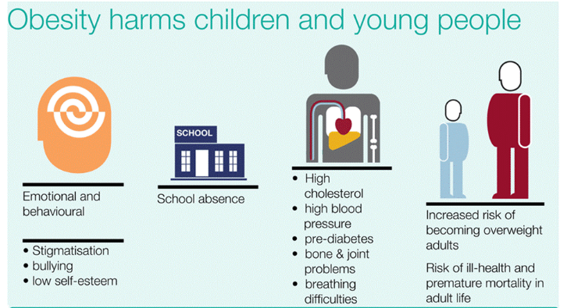
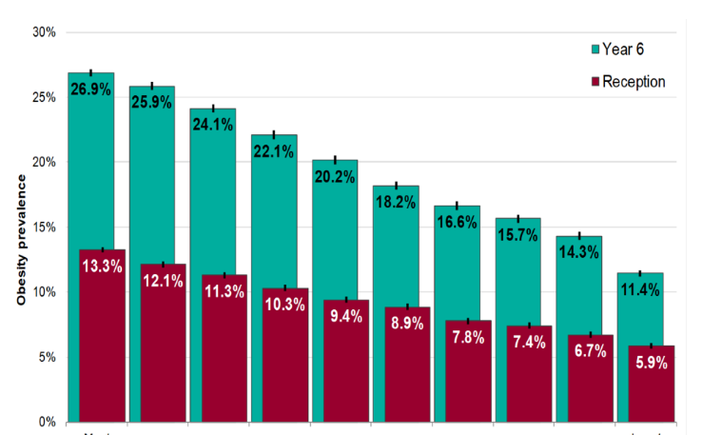
REFLECTION
Comparison
UK has a more prominent rate of child obesity
Essential Change
Family members have to provide more attention
Recommendatin
SCT theory can be used to mitigate the problem of obesity
Notes:
Own reflection
It can be summarised from the study that the UK has a more prominent rate of child obesity than Romania. Besides this, I have observed that children in the UK have been less physically active nowadays due to the advancement of the virtual world. Family members have to provide more attention to their children. In my opinion, this technique can help parents to effectively monitor their child’s mental and physical attributes. On the other hand, I have realised that the SCT theory can be used to mitigate the problem of obesity in both countries. The theory can be used to develop effective physical activity plans for children and mitigate their obesity issues.

Slide 6
REFERENCES
Beauchamp, M.R., Crawford, K.L. and Jackson, B., (2019). Social cognitive theory and physical activity: Mechanisms of behavior change, critique, and legacy. Psychology of Sport and Exercise, 42, pp.110-117.
Czogała, W., Czogała, M., Strojny, W., Wątor, G., Wołkow, P., Wójcik, M., Bik Multanowski, M., Tomasik, P., Wędrychowicz, A., Kowalczyk, W. and Miklusiak, K., (2021). Methylation and expression of FTO and PLAG1 genes in childhood obesity: Insight into anthropometric parameters and glucose–lipid metabolism. Nutrients, 13(5), p.1683.
Parliament.uk, (2023). Obesity statistics. Available at: https://commonslibrary.parliament.uk/research-briefings/sn03336/#:~:text=Childhood%20obesity%20in%20England,and%20published%20by%20NHS%20Digital. [Accessed 21 April 2023]
Romaniajournal.ro, (2022). Educational Program “Traista Cu Sanatate”: 24% Of School-Age Children Are Overweight In Romania. Available at: https://www.romaniajournal.ro/society-people/social/educational-program-traista-cu-sanatate-24-of-school-age-children-are-overweight-in-romania/#:~:text=According%20to%20the%20WHO%20Europen,55%25%20of%20adults%20experience%20overweight. [Accessed 21 April 2023]

