Slide 1
RISE OF CHINA

Slide 2
Introduction
Focusing on China's location, the country can be considered as the centre for international trade
In this study, the focus will be on the importance of international trade in the development of China.
Notes:
Focusing on China's location, the country can be considered as the centre for international trade, which has been regarding the consistent surpluses of trade. This country can also be considered as the largest exporter as well as importer country. In this study, the focus will be on the importance of international trade in the development of China.

Slide 3
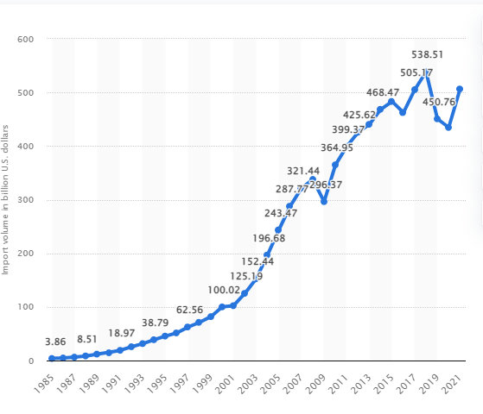
The gains and losses from the trade
While talking about the gains and losses of China in relation to international trade and development, it can be considered that China has become the powerhouse of exportation at the starting of the present century.
While talking about the gains and losses of China in relation to international trade and development, it can be considered that China has become the powerhouse of exportation at the starting of the present century.
Notes:
While talking about the gains and losses of China in relation to international trade and development, it can be considered that China has become the powerhouse of exportation at the starting of the present century. Approximately 15 years have passed when China is able to have a connection with the multilateral trading system, providing an increment in China's global economic participation. China provided a structured environment of international trade, with a disputed settlement mechanism, and cross border transactions which impacted the country’s lower tariffs and restraints as well. The level of exportation provided China with a variety of export sectors which impacted their global trade which increased to 15% in the year 2020. In the year 2021, China's exports increased up to 50% throughout the year which is almost $710 billion. The U.S is importing goods from China from the year 1985, and in 2021 it reaches about 506.37 billion in US dollars, which can be seen as an increasing trend, while talking about the U.S exports to China, their revenue increased about 124.65 billion in the year 2020 focusing on the fact that U.S is China's most important trade partner in the international business (Statista, 2022).

Slide 4
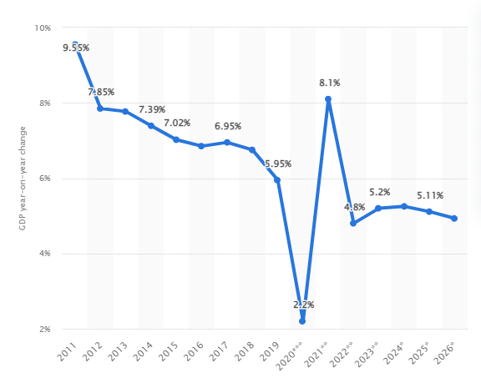
Trade policies and infant industry protection
In these policies, it can be identified that the country is not seeking any further liberalization in the trade market which will ultimately help them to reconstruct their economy.
It also talks about expanding the trades while developing the inbound and outbound investment.
Notes:
Talking about the trade policies of China, the objectives of their policies are almost the same, in comparison to last year. In these policies, it can be identified that the country is not seeking any further liberalization in the trade market which will ultimately help them to reconstruct their economy. It also talks about expanding the trades while developing the inbound and outbound investment. These policies also reflect the vast industrial and economic goals of China focusing on the motif of expanding the market which ultimately helps in the foreign investment. These policies are structured and outlined by provincial Five-year plans and also the negative lists and catalogues which can guide the implementation of the policies (Ftp.iza.org, 2022).
While talking about the infant industry protection, in this case, it can be said that infant industry protection is needed for the national welfare development but can not be considered and adopted as the equilibrium of the political economy. The human capital of the industry is helpful in determining the specialized skills which help in knowing the cost of the goods. In this way, the tariff cuts of China can be reflected in the infant industry protection.

Slide 5
International trade and employment
While looking at the scenario it can be said that the employment trends can be seen to grow rapidly in the year 2020 and most of the employment opportunities can be seen within China.
The significant economic transformation of the country has been seen in the increasing trends in employment (Bruegel.org, 2022).
Notes:
International trade and employment
While looking at the scenario it can be said that the employment trends can be seen to grow rapidly in the year 2020 and most of the employment opportunities can be seen within China. The significant economic transformation of the country has been seen in the increasing trends in employment (Bruegel.org, 2022). The country's integration into world trade can also be seen in the increase in labour productivity. The statistical benefit of the international trade in China led to the expansion of employment which is associated with the great number of foreign reserves. The implementation of the outward-oriented strategy helps the market to reform and reconstruct and which serves as the most important advantage of the international trade of China. The basis of international trade is the comparative advantages that ultimately help in the expansion of the production that can serve as the major demand in the business market (Unctad.org, 2022).

Slide 6
Exchange rates and purchasing power parity
While talking about the exchange rates of china, they have a fixed exchange rate system which reflects in their economic development (Wang, 2022).
The country basically had a dual exchange rate system.
Notes:
While talking about the exchange rates of china, they have a fixed exchange rate system which reflects in their economic development (Wang, 2022). The country basically had a dual exchange rate system. Focusing on creating a new model to create the exchange rates can serve as a major problem because of the complexity of the model. This country had two options, either de jure or de facto which is based on the CPI. Considering the purchasing power parity, it can be said that it is a conversion factor of units within a country and their currency for the requirement of the number of goods and the services in the domestic market, focusing on the conversion factor which is called GDP (South China Morning Post, 2022). China's purchasing power parity is growing continuously from 2.7 LCU per international dollar to 4.2 LCU; the growth rate can be observed at approximately 2.33%. According to the World bank statement, China’s purchasing power parities show that their GDP stood at U$$19.617 trillion (Knoema, 2022)

Slide 7
Macroeconomic theory
Macroeconomic theory talks about a group of economics.
They basically focus on the understanding of complex relations from a theoretical perspective (Economics.uq.edu.au, 2022).
Notes:
Macroeconomic theory talks about a group of economics. The basic work of them is to work with the issues of economics in the specific market. It is a phenomenon that includes economic growth, business cycle, inflation, international trades and many others. They basically focus on the understanding of complex relations from a theoretical perspective (Economics.uq.edu.au, 2022). Talking about international trade and macroeconomic theory, it can be said that the biased economic growth pattern of China, reflects the slowing down of the economy. In a broader sense the three significant components of the Chinese economy, financial development, economic growth and international trade, help in building the basic theoretical structure. A drastic outcome can be identifying that the remaining SOE sections are full of high productivity private firms so that the process can be smooth.

Slide 8
Conclusion
The entire study has focused on the rise and development of the country China in the international trade and business vehicle focusing on their economic structures.
The study also focuses on identifying their exporter and importer and also giving emphasis on the trade war
Notes:
The entire study has focused on the rise and development of the country China in the international trade and business vehicle focusing on their economic structures. By talking about various components like China’s present economic scenario and comparing it to the older one and talking about their profit and loss in their international trade and business. The study also focuses on identifying their exporter and importer and also giving emphasis on the trade war.
The entire study has focused on the rise and development of the country China in the international trade and business vehicle focusing on their economic structures. By talking about various components like China’s present economic scenario and comparing it to the older one and talking about their profit and loss in their international trade and business. The study also focuses on identifying their exporter and importer and also giving emphasis on the trade war.

Slide 9
References
Bruegel.org. 2022. [online] Available at: <https://www.bruegel.org/wp-content/uploads/2019/11/RP-19-04-Uri-AbdelAziz.pdf> n[Accessed 23 February 2022].
Economics.uq.edu.au. 2022. Macroeconomic Theory. [online] Available at: <https://economics.uq.edu.au/research/macroeconomic-theory> [Accessed 23 February 2022].
Ftp.iza.org. 2022. [online] Available at: <https://ftp.iza.org/dp5151.pdf> [Accessed 23 February 2022].
Knoema. 2022. China Purchasing power parity, 1960-2021 - knoema.com. [online] Available at: <https://knoema.com/atlas/China/topics/Economy/Inflation-and-Prices/Purchasing-power-parity#:~:text=In%202020%2C%20purchasing%20power%20parity,average%20annual%20rate%20of%202.33%25.> [Accessed 23 February 2022].
South China Morning Post. 2022. China ranks No 1 in buying power, but still clings to developing status. [online] Available at: <https://www.scmp.com/economy/china-economy/article/3085501/china-overtakes-us-no-1-buying-power-still-clings-developing> [Accessed 23 February 2022].
Statista. 2022. Statista - The Statistics Portal. [online] Available at: <https://www.statista.com/search/?q=china%27s+profit+and+loss+in+international+trade&qKat
Unctad.org. 2022. China: The rise of a trade titan | UNCTAD. [online] Available at: <https://unctad.org/news/china-rise-trade-titan> [Accessed 23 February 2022].
Wang, T., 2022. IV Exchange Rate Dynamics. [online] imfsg. Available at: <https://www.elibrary.imf.org/view/books/084/01236-9781589062580-en/ch04.xml> [Accessed 23 February 2022].

