Slide 1
Global Trends in Travel and Tourism Industry
DUE DATE: Friday 21st April at 2pm
Group Name
Member Names and IDs

Slide 2
Introduction
This presentation shows the different global trends in the tourism industry that are developing strongly in the present period. These trends will be showcased across the selected niche tourism segments of heritage tourism, shopping tourism and medical tourism. Ongoing developments in the global tourism environment such as the use of sustainable technologies will be incorporated into the presentation. The presentation concludes by discussing the impact of such changes across tourism, including benefits and costs. This provides a balanced perspective of positive and negative developments associated with tourism in this context.

Slide 3
Emerging global trends in the travel and tourism industry
Heritage tourism is defined as travelling to experience authentic stories and icons of the past (Lowry, 2017).
This involves tourists visiting the destination site to interact with authentic, long-standing structures such as monuments.
It also includes visiting the destination site to experience a socio-cultural community that has preserved its heritage over time.
Notes:
SN: Heritage tourism is a growing trend globally as it aligns with similar purpose-driven ideals among tourists, such as sustainable tourism. Heritage tourism ensures that the local destination site benefits culturally by allowing foreign visitors to experience it authentically. Exposure to foreign cultures in this way broadens the tourist’s understanding of global cultures, thereby improving intercultural understanding as a whole. An instance is observed in the nostalgia-driven motivation of Singaporeans towards the heritage of Kampong Lorong Buangkok, the "only surviving" village in the country (Campbell, 2020).

Slide 4
Emerging global trends in the travel and tourism industry
Shopping tourism is a comparatively new trend in the tourism industry that is driven by the purpose of purchasing goods at the destination site.
The presence of specialised retailers in the destination site can offer unique goods that are unavailable elsewhere, such as chocolates and wristwatches in Switzerland (Ramsey, Thimm and Hehn, 2019).
This tourism activity is a strong driving factor of economic performance in the destination site.
Notes:
SN: Shopping tourism has grown through the ease of interaction between global travellers and destination sites that have robust commercial performance. The uniqueness of retail products available in such destination sites drives consumer engagement, as evidenced in the instance of the Swiss market. Other instances such as Dubai show the growth of shopping tourism in the region, owing to low direct taxes on luxury products and other consumer goods (Abbas, 2019).

Slide 5
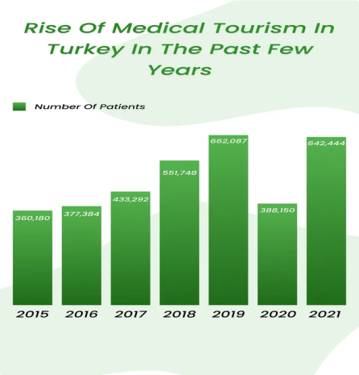
Emerging global trends in the travel and tourism industry
Medical tourism is a trend driven by consumers visiting destination sites to access the local medical facilities for their well-being.
The disparity in prices of private healthcare makes some destinations more affordable, particularly for expensive surgeries and other medical interventions.
Other macro-environmental factors such as lower foreign currency values also make medical tourism more affordable, such as in Turkey (Pirzada, 2022).
Figure 1: “Rise of medical tourism in Turkey”
(Source: https://www.clinicspots.com/blog/medical-tourism-in-turkey-statistics)
Notes:
SN: The increased affordability of air travel makes medical tourism more sustainable for such travellers, as they can quickly travel to and back from their destination site following their medical needs being fulfilled. Apart from emergency healthcare services, cosmetic surgeries are a key driving factor that motivates tourists to visit foreign sites. For instance, tourists from the UK visit Turkey to access affordable dental healthcare, rhinoplasty or other forms of cosmetic surgery (Bhanot, 2022).

Slide 6
Importance of emerging global trends in the travel and tourism industry
Heritage tourism is a valuable source of cultural preservation for the local destination site.
It can increase local and national awareness of the destination site as a culturally significant location, thereby increasing its protection through stakeholder engagement.
This will ensure that the local cultural heritage is preserved and secured against disappearing from society (Lussetyowati, 2015).
Notes:
SN: Heritage tourism has various positives apart from the quality of promoting tourism engagement. It ensures that the local community that lives in the heritage site can sustain their lives from the growth of tourism participation in the destination site. Increased publicity and awareness also contribute to this outcome as the local destination sites, such as the Singaporean village, become resilient against the changes such as globalisation which can erode local cultural customs.

Slide 7
Importance of emerging global trends in the travel and tourism industry
Shopping tourism is a strong development indicator for destination sites, as it promotes consumer expenditure through the purchase of goods.
Shopping tourism is therefore an economically stimulating segment of tourism, as tourists may visit a destination site primarily to shop.
This increases the economic growth of destination sites such as Dubai with its low taxes on consumer goods as well as a strong retail sector (Muro-Rodríguez, Pérez-Jiménez and Sánchez-Araque, 2020).
Notes:
SN: The instance of Dubai is a relevant comparison to this trend, as the region’s development relies strongly on tourism growth as a whole. For this purpose, tourism activities such as shopping tourism uniformly contribute to the growth of the local economy. It allows the destination site to become more economically powerful and therefore creates local economic, infrastructure and utilities development that is also accessible to the local communities. Therefore, shopping tourism contributes to the growth of the standard of living in the local community.

Slide 8
Importance of emerging global trends in the travel and tourism industry
Health tourism is an important trend that increases the equitable accessibility of healthcare to global visitors.
This ensures that cosmetic medical interventions as well as life-saving interventions are equally accessible to a wide demographic of visitors.
Health tourism also stimulates the local economy and increases the destination site’s healthcare infrastructure development (Pirzada, 2022).
Notes:
SN: The instance of Turkey is a positive example of healthcare tourism improving the destination site’s economic resiliency. In recent years, inflation has been among the highest in the world for Turkey, making the purchasing power of the Lira currency substantially lower for local communities. However, this also makes it more affordable to foreign visitors from more economically prosperous countries, and benefits from their spending in the local economy. Medical tourism in Turkey has therefore safeguarded the economy and local community from such adverse developments while offering benefits to medical visitors.

Slide 9
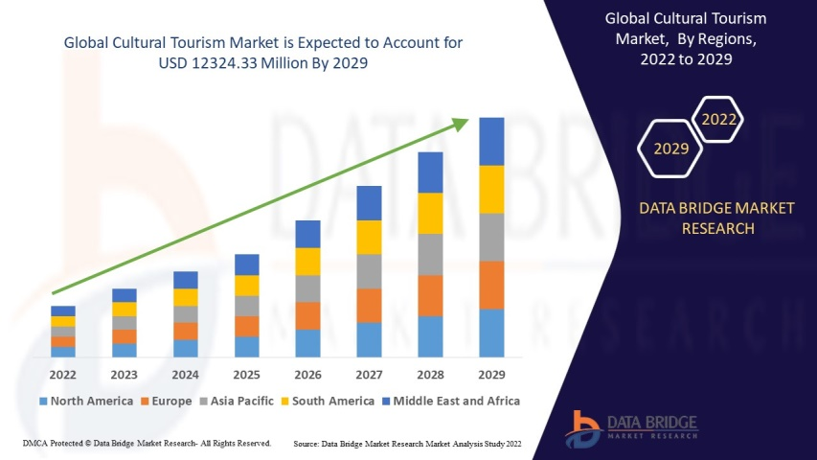
Impact of changes in global trends on the global tourism business competitiveness
The growth of heritage tourism creates competitive growth in the global tourism business.
This leads other destination sites to empower their local communities to promote their socio-cultural heritage values.
This increases the prevalence of culturally significant destination sites that are qualified for heritage representation in the destination site.
Figure 2: “Rise of global cultural tourism”
(Source: https://www.databridgemarketresearch.com/reports/global-cultural-tourism-market)
Notes:
SN: Heritage sites have been popular in the mainstream through the appeal of visiting heritage monuments such as the Colosseum in Rome. However, the growth of this trend has revitalised certain destination sites such as Antigua, the capital city of Guatemala. Other popular sites such as Spain have increased their cultural revival strategy to boost tourism performance, by revitalising Spanish cities in the UNESCO World Heritage List (Medina-Viruel et al., 2019).

Slide 10
Impact of changes in global trends on the global tourism business competitiveness
Shopping tourism increases the competitive performance of global destination sites such as Dubai and Switzerland.
This outcome creates competition among other global destination sites to improve their retail sector attractiveness for foreign tourists.
This stimulates economic development as a whole across global countries, securing the development of local infrastructural amenities for tourists as well as locals.
Notes:
SN: Shopping tourism development requires developing local physical retail spaces such as shopping districts, through which tourists are attracted to visit these destination sites. The performance of this activity involves diverse stakeholders, ranging from the government to private sector businesses. Therefore, this collaborative development of the destination site increases the quality of life of local community members, as they also gain access to the facilities and amenities related to shopping tourism.

Slide 11
Impact of changes in global trends on the global tourism business competitiveness
Medical tourism creates direct global competition among private medical industry operators, as it creates a global source of income for them.
This can see destination sites develop to offer a higher quality of healthcare services to attract medical tourists (Pirzada, 2022).
Such developments also benefit the local community as they can similarly access the healthcare facilities designed for medical tourists.
Notes:
Medical tourism creates direct global competition among private medical industry operators, as it creates a global source of income for them.
This can see destination sites develop to offer a higher quality of healthcare services to attract medical tourists (Pirzada, 2022).
Such developments also benefit the local community as they can similarly access the healthcare facilities designed for medical tourists.

Slide 12
Economic benefits and costs of trends in the destination country
Heritage tourism provides positive economic benefits to the destination site, through the participation of visitors from global regions.
This sees the local heritage conservation efforts grow considerably as local stakeholders gain the financial support to empower local heritage conservation attempts.
Through this economic intervention, the local heritage site preserves its sociocultural uniqueness in continuity (Otero, 2021).
Notes:
SN: Heritage tourism has seen tourism as a whole grow strongly in globally popular destinations, such as Egypt for its heritage of pyramids. Other destinations such as Rome have capitalised on heritage tourism owing to its rich history of human-made heritage monuments, art and other cultural offerings. It creates an intersectional growth in tourism engagement as well, as culturally driven tourism also grows food and wine tourism in the destination site (Cleave, 2011).

Slide 13
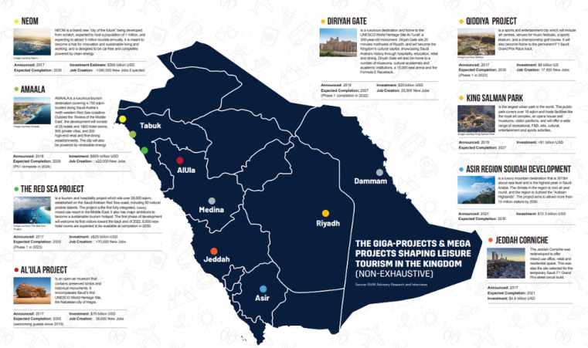
Social benefits and costs of trends in the destination country
Shopping tourism has the potential of generating negative impacts, as the local destination site will become dependent on tourism activity.
This makes them willing to overlook tourist behaviour as it continues to generate economic benefits for the destination site (Ramsey, Thimm and Hehn, 2019).
Such an outcome leads to the erosion of local social customs, such as through increased petty crimes or substance abuse (Martínez, Rosenfeld and Mares, 2008).
Figure 3: “Saudi Arabia economic tourism growth”
(Source: https://www.entrepreneur.com/en-ae/lifestyle/leisure-tourism-saudi-arabias-newest-frontier-on-the-road/434911)
Notes:
SN: Due to this global growth of shopping tourism, local tourism stakeholders must increase their cooperative practice to ensure that the cultural norms and customs are safeguarded against such tourism footfall. While there is a social benefit of increased intercultural exchange among locals and foreign travellers, there is also a negative where their dependency on foreign visitors makes them vulnerable to social exploitation.

Slide 14
Environmental benefits and costs of trends in the destination country
Medical tourism also has an environmental cost associated with the waste management of used medical items.
Medical waste can often be hazardous and require special waste treatment, which may not be possible in a developing country’s infrastructure (Khan et al., 2019).
Growth in medical tourism, therefore, places pressure on local infrastructure capabilities to safely treat medical waste, thereby endangering the environment.
Notes:
SN: The global competitive growth of medical tourism in this way presents a long-term challenge for the destination site. The challenges of medical waste disposal threaten the commitment of developing countries towards the Net Zero 2050 directive, which requires global participants to reduce carbon emissions and become net sustainable by 2050 (Fankhauser et al., 2021). Other activities such as heritage tourism have a comparatively higher environmental benefit, as travellers can be educated to serve as co-custodians or stewards of the environment and practise sustainable cultural tourism with local community partners (Bennett et al., 2018).

Slide 15
Conclusion
The presentation has discussed the impact of the changes in these global tourism trends, such as their contributions to the tourism destination site or other relevant factors. As global tourism continues to grow, the selected trends of heritage, shopping and medical tourism will continue to expand and offer more value to the destination sites. In the context of Net Zero 2050, sustainability will therefore become incorporated in these tourism activities, ensuring that the destination site’s sustainability is not compromised in the long-term.

Slide 16
Thank You! Any Questions or Comments?

Slide 17
Reference List
Abbas, W. (2019). Why new iPhones cost less in UAE than in India, UK and France. [online] www.zawya.com. Available at: https://www.zawya.com/en/business/why-new-iphones-cost-less-in-uae-than-in-india-uk-and-france-fmf09tmo [Accessed 3 Apr. 2023].
Bennett, N.J., Whitty, T.S., Finkbeiner, E., Pittman, J., Bassett, H., Gelcich, S. and Allison, E.H. (2018). Environmental Stewardship: A Conceptual Review and Analytical Framework. Environmental Management, [online] 61(4), pp.597–614. doi:https://doi.org/10.1007/s00267-017-0993-2.
Bhanot, M. (2022). Rhinoplasty in Turkey explained - why clinics in Istanbul are so popular. [online] LincolnshireLive. Available at: https://www.lincolnshirelive.co.uk/special-features/rhinoplasty-turkey-explained-clinics-istanbul-7713075 [Accessed 3 Apr. 2023].
Campbell, J. (2020). Singapore’s last village proves nostalgic tourism hit in pandemic. Reuters. [online] 5 Oct. Available at: https://www.reuters.com/article/us-health-coronavirus-singapore-tourism-idUSKBN26Q0IH [Accessed 3 Apr. 2023].
Cleave, P. (2011). Food and Wine Tourism: Integrating Food, Travel and Territory. Tourism Geographies, [online] 13(3), pp.504–505. doi:https://doi.org/10.1080/14616688.2011.575173.
Fankhauser, S., Smith, S.M., Allen, M., Axelsson, K., Hale, T., Hepburn, C., Kendall, J.M., Khosla, R., Lezaun, J., Mitchell-Larson, E., Obersteiner, M., Rajamani, L., Rickaby, R., Seddon, N. and Wetzer, T. (2021). The meaning of net zero and how to get it right. Nature Climate Change, [online] 12(1), pp.1–7. doi:https://doi.org/10.1038/s41558-021-01245-w.
Khan, B.A., Cheng, L., Khan, A.A. and Ahmed, H. (2019). Healthcare waste management in Asian developing countries: A mini review. Waste Management & Research, [online] 37(9), pp.863–875. doi:https://doi.org/10.1177/0734242x19857470.
Lowry, L.L. (2017). The SAGE International Encyclopedia of Travel and Tourism. 1st ed. Thousand Oaks, California: SAGE Publications, Inc. doi:https://doi.org/10.4135/9781483368924.
Lussetyowati, T. (2015). Preservation and Conservation through Cultural Heritage Tourism. Case Study: Musi Riverside Palembang. Procedia - Social and Behavioral Sciences, [online] 184, pp.401–406. doi:https://doi.org/10.1016/j.sbspro.2015.05.109.
Malhotra, N. and Dave, K. (2022). An Assessment of Competitiveness of Medical Tourism Industry in India: A Case of Delhi NCR. International Journal of Global Business and Competitiveness, [online] 17(2). doi:https://doi.org/10.1007/s42943-022-00060-0.
Martínez, R., Rosenfeld, R. and Mares, D. (2008). Social Disorganization, Drug Market Activity, and Neighborhood Violent Crime. Urban Affairs Review, [online] 43(6), pp.846–874. doi:https://doi.org/10.1177/1078087408314774.
Medina-Viruel, M.J., López-Guzmán, T., Pérez Gálvez, J.C. and Jara-Alba, C. (2019). Emotional perception and tourist satisfaction in world heritage cities: The Renaissance monumental site of úbeda and baeza, Spain. Journal of Outdoor Recreation and Tourism, [online] 27, p.100226. doi:https://doi.org/10.1016/j.jort.2019.100226.
Muro-Rodríguez, A.I., Pérez-Jiménez, I.R. and Sánchez-Araque, J.A. (2020). Impact of Shopping Tourism for the Retail Trade as a Strategy for the Local Development of Cities. Frontiers in Psychology, [online] 11. doi:https://doi.org/10.3389/fpsyg.2020.00067.
Otero, J. (2021). Heritage Conservation Future: Where We Stand, Challenges Ahead, and a Paradigm Shift. Global Challenges, [online] 6(1), p.2100084. doi:https://doi.org/10.1002/gch2.202100084.
Pirzada, N. (2022). The Expansion of Turkey’s Medical Tourism Industry. Voices in Bioethics, [online] 8. doi:https://doi.org/10.52214/vib.v8i.9894.
Ramsey, D., Thimm, T. and Hehn, L. (2019). Cross-border Shopping Tourism: A Switzerland-Germany Case Study. European Journal of Tourism, Hospitality and Recreation, [online] 9(1), pp.3–17. doi:https://doi.org/10.2478/ejthr-2019-0002.

