Slide 1

GLOBAL STRATEGY AND SUSTAINABILITY PART B- POWERPOINT PRESENTATION

Slide 2
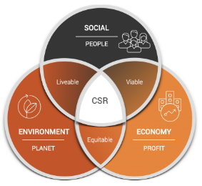
Introduction
Sustainability is considered as an important factor that helps companies to determine strategies that can help them to gain profits along with positive contributions in the environment. Furthermore, this part of the study determines the people, profit and planet aspect of the Triple Bottom Line model to determine how Zara sustains growth. Key factors that are the major interest of the CEO of Zara along with certain recommendations for the company to overcome the sustainable issues are presented.

Slide 3
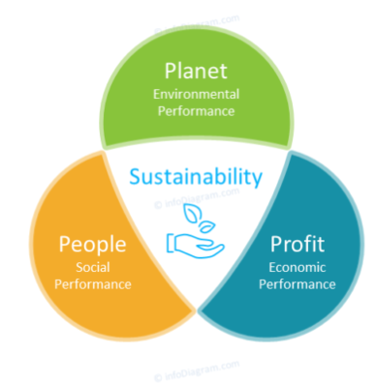
Profit aspect
Zara significantly generates collaboration with sustainable choices while manufacturing their clothes.
Zara has confirmed to use 100% organic products which tends to increase their value and consumers become more interested with their products.
Zara has taken fast fashion strategies which help the company to fulfil the demand of the market and the consumers before any other company (Zara.com, 2022).
Zara has also taken strategies to append little on advertisement and instead they tend to spend majorly on their stores to reduce energy consumption and increase brand reputation.
Notes:
Profit aspect of the Triple Bottom line determines the economic performance of the company. Thus, these strategies greatly help the company to increase their brand value and reputation which tends to attract most of the consumers and help in increasing profitability. The company also provides energy efficient shopping experience to their consumers which also significantly helps in getting trust and loyalty of the consumers.

Slide 4
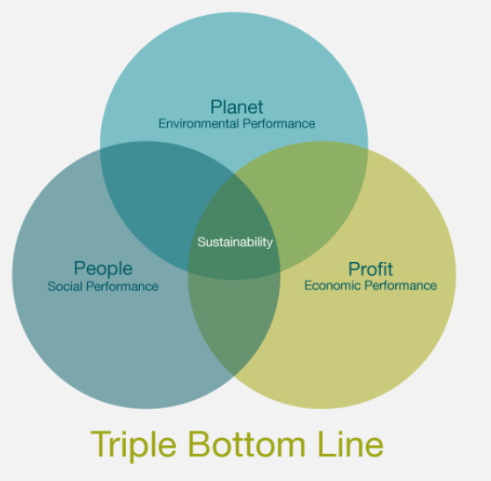
People aspect
Zara focuses on creating a more inclusive workforce, which can help their employees to get an experience of a more diverse work culture.
Complying with diversity and inclusion is important in order to positively contribute in the benefits for the society (Zara.com, 2021).
Zara positively contributes to the National relief funds and NGOs.
Zara also helps to promote gender equality and women empowerment.
Notes:
Social performance is denoted in the triple bottom line, people aspect. Furthermore, these factors significantly contribute to the well-being of the society. Moreover, it can be determined that Zara significantly is working in order to create value and mitigate societal issues. Thus, the strategic approaches of Zara majorly help the company to influence a positive outcome to the society. It also helps the company to increase brand awareness and also increases brand reputation. Business activities significantly help Zara to improve societal factors and work in order to promote well-being of the employees and society.

Slide 5
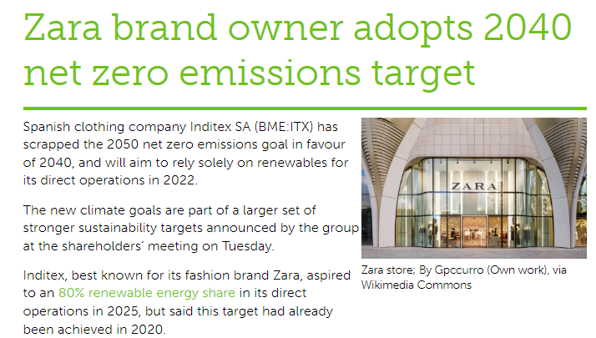
Planet aspect
Zara commits to meet its target of zero emission of carbon in their supply chain by 2025 (Zara.com, 2021).
Furthermore, the company has set their goals to meet zero net emission by 2040.
The company also tends to shift towards renewable energy sources and it has confirmed that the company has transferred its supply chain towards 80% renewable energy sources.
Additionally, the company uses 100% cellulose and recyclable polyester while manufacturing clothes.
Notes:
The Planet aspect of the Triple Bottom Line model also depicts the environmental performance of a company.
The practices and strategies taken by Zaar are majorly beneficial for the environment and also helps the company to gain sustainability. Furthermore, it can be determined that the initiatives and motives taken by Zara helps the company to achieve greater success and improvement of both society and environment.

Slide 6
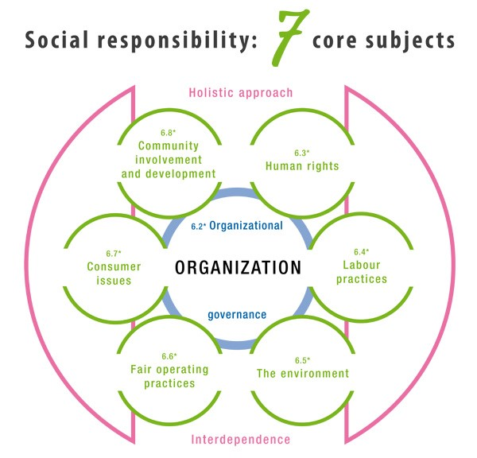
Key points of interest for the CEO of Zara on the sustainable development
Zara executives including Pablo Isla, CEO of Inditex conveys that the company will further go slow and focus on sustainable manufacturing to reduce the harmful effects on the environment.
The current point of interest of the CEO is to create alternative and eco-friendly fabrics and materials that can be used to manufacture clothes (Vogue.com, 2022).
The company tends to use recycled products and materials to significantly contribute to the environment and the society.
Zara is transferring their stores to become eco-efficient and using recycled packaging systems.
Notes:
Another key point of the CEO of the company is to incorporate in store donation programs and confirm to reach 20% of Zara's offerings. Hence, it can majorly help the company to increase their brand awareness and gain sustainability.

Slide 7

Relevant recommendations regarding the sustainable issues discussed
The company might consider complying with the Animal Welfare Policy and needs to implement policies in order to reduce and ban the usage of animal substances.
The company might also consider the well-being of their employees and provide accurate wages to satisfy their employee’s needs.
Sustainable choices and practices with the help of deploying effective technologies such as; AI, big data can be incorporated to distinguish better productivity and profitability.

Slide 8
Conclusion
The study tends to determine that Zara has taken significant strategies that help the company to gain sustainability. Furthermore, as the company has already taken significant strategies to deliver better outcomes which can be beneficial for the environment and society but also it needs to distinguish their certain ethical issues. Therefore, the CEO of the company is significantly working to increase their profitability and contribution in the environment.

Slide 9
References
Vogue.com (2022), As Zara Announces Its Latest Sustainability Goals, Three of Its Design Team Weigh In on Going Slower and Creating Responsibly; Available at: https://www.vogue.com/article/zara-sustainable-initiatives [Accessed on 25th March, 2023]
Zara.com, (2022) All about Zara Available at: https://www.zara.com/ [Accessed on 25th March, 2023]
Zara.com (2021), CORPORATE SOCIAL RESPONSIBILITY POLICY OF INDITEX TRENT RETAIL INDIA PRIVATE LIMITED; Available at: https://www.zara.com/static/pdfs/IN/csr_policy/CSR_India_Policy_20220525.pd [Accessed on 25th March, 2023]

