Slide 1
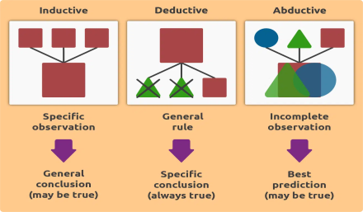
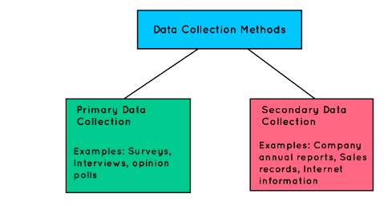
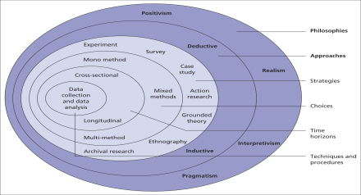
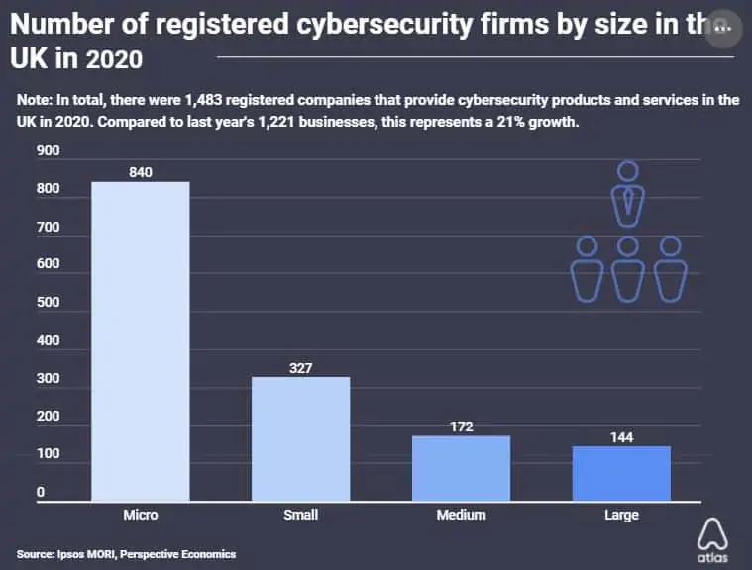
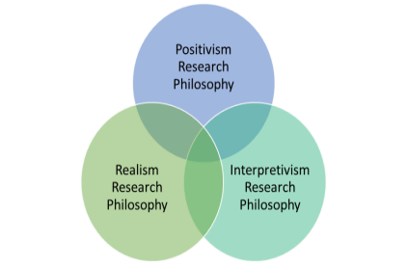
AN EMPIRICAL STUDY ABOUT SOCIAL MEDIA IMPACT ON THE RECRUITMENT & SELECTION PROCESS IN INFORMATION TECHNOLOGY COMPANIES IN THE UK
Introduction
Social media is used as the job requirement and selection platform in the IT organisation in the UK. This social media platform is less time-consuming and less cost-effecting. Common people can easily use this plan to find the proper IT job and also apply for the jobs. Nevertheless, in recent days, many IT organisations and job seekers face different types of challenges related to this requirement process. This study will recognize those issues and analyse them. Moreover, this study will identify a few types of recommendations which can help to mitigate those identified issues. This research study also helps to identify the proper research analysis, research approaches, data collection process, and ethical considerations.
Philosophy
The research philosophy refers to the appropriate direction of the research that is effective to attribute the research findings. As mentioned by HR and Aithal (2022), the research philosophy has three variants such as positivism, realism and interpretivism. The research will be conducted by using a positivism approach as it is helpful to gain factual knowledge regarding the subject of the research. The factual knowledge is helpful to include trustworthy measurements for the research that are effective to enhance the research outcome. The positivism research philosophy is more effective than the other philosophies as it helps to make interpretation of science that is essential to enhance the research outcome.
Ethical Consideration
This research will follow legislation of The Copyright, Designs and Patents Act 1988 that is helpful to maintain the security of the secondary data (Copyright Service.co.uk, 2023). Besides this research will be conducted by using proper texting and referencing for the taken articles and journals.
Source: Influenced by Hall et al. 2021
Data Collection process
The data collection process in a research process is helpful for problem solving and understanding. In the views of O'Cathain et al. (2019), the data collection process has two approaches such as primary and secondary. This research will be conducted by using a secondary qualitative process as it is helpful to assess the information regarding the research that have been collected and analysed previously. The secondary qualitative data collection process is helpful to maintain the time effectiveness and cost effectiveness of the research. Therefore, the secondary data collection process makes the research more effective than the primary data collection process by enhancing the cost effectiveness due to easy sources of relevant data for the research.
Source: comparitech, 2023
Source: Influenced by Saunders et al. 2015
Source: Influenced by Beierle et al. 2020
Approaches
The research approach is helpful to interpret, collect and analyse the data that is helpful to provide effective legitimacy for the research. As per the view of Chang (2023), the research approach has three variants such as deductive, inductive and adductive. This research will be conducted by using deductive approach as it will be helpful for logical thinking and enhance the decision making process. Besides, the deductive approach is more appropriate than other approaches as it helps to turn the general assumptions into specific ideas.
D. Conclusion
It can be concluded that social media has a significant impact on the recruitment & selection process in information technology companies in the UK. This research proposal summarises that the research will be conducted by using secondary qualitative data to identify the impact of social media in the It sector of the UK. Furthermore, this research will be highlighting the analysis regarding the challenges associated with social media implementation. Hence, this research will provide relevant recommendations for the future usage of social media.
Source: Influenced by Muhaise et al. 2020
Literature Review
Social media platforms help to enhance employment in the UK with the help of IT job opening access for job seekers. As mentioned by Abdalla et al. (2021), the important factor of the social media requirement platform is the presence of suitable knowledge on technological application uses. On the other hand, the proper job description is also needed on the requirement page of social media. It might be more helpful for the candidates to find out the proper jobs. As stated by Ruparel et al. (2020), these social media need to follow the proper policies and rules to maintain the security factor. The chatting facility can help the candidates to communicate with the HR of the IT organisations to collect genuine information regarding the job. Approximately, 86% of candidates in the UK, use social media to find the proper job openings in the IT sectors of the UK (Gov.uk, 2023) According to Hmoud and Laszlo (2019), nevertheless, nowadays a lot of IT organisations and job seekers face different types of challenges. The most commonly identified challenge is the security issue in social media requirement platforms and 39% of companies in the UK are affected by cybercrime in 2022. Cyber-criminals utilise this social media platform and spread fake job openings. They demand money against the offer of IT jobs. A lot of candidates suffer from this issue and ignore this social media to identify IT jobs. On the other hand, as opined by Dwivedi et al. (2021), the process of identifying job openings is easy to use for common candidates, but the application process is way more difficult to use. Hence, many candidates ignore this platform because of this reason. Job seekers need an easy pathway to apply for jobs via a social media platform, but in some cases, it has been difficult to access these job application pathways.
This research study can identify various types of effective factors related to the use of social media platforms for the IT job selection and recruitment process. This study has identified the impacts of the social media platform on the job requirement process in the UK’s IT industries. The IT organisation and candidates face security issues and complicated pathway-related issues, which have also been discussed by the researcher. Nevertheless, there is a research gap in this scenario. The gap in this study is that this study cannot recognise the effective mitigation process which can help to overcome the identified issues related to the social media requirement platform in the UK’s IT organisation.
Data Analysis
The data analysis for a research is essential to enhance the future aspects of the research by providing accurate information regarding the research. As commented by Kuckartz (2019), the data analysis process has two variants such as thematic and statistical. This research will be conducted by using thematic data analysis as it is helpful to address the research data that is helpful to enhance the research outcome.
Reference
HR, G. and Aithal, P.S., (2022). Why is it Called Doctor of Philosophy and Why Choosing Appropriate Research Philosophical Paradigm is Indispensable During Ph. D. Program in India?. International Journal of Philosophy and Languages (IJPL), 1(1), pp.42-58.
Chang, E.Y., (2023). Prompting large language models with the socratic method. arXiv preprint arXiv:2303.08769.
O'Cathain, A., Croot, L., Duncan, E., Rousseau, N., Sworn, K., Turner, K.M., Yardley, L. and Hoddinott, P., (2019). Guidance on how to develop complex interventions to improve health and healthcare. BMJ open, 9(8), p.e029954.
Kuckartz, U., (2019). Qualitative text analysis: A systematic approach. Compendium for early career researchers in mathematics education, pp.181-197.
Copyright Service.co.uk, (2023). UK copyright law: An introduction Available at: https://copyrightservice.co.uk/copyright/uk_law_summary [Accessed on: 10.04.2023]
Saunders, M.N., Lewis, P., Thornhill, A. and Bristow, A., 2015. Understanding research philosophy and approaches to theory development.
Muhaise, H., Ejiri, A.H., Muwanga-Zake, J.W.F. and Kareyo, M., (2020). The Research Philosophy Dilemma for Postgraduate Student Researchers. International Journal of Research and Scientific Innovation (IJRSI)|, VII, pp.202-204.
Hall, J., Gaved, M. and Sargent, J., (2021). Participatory research approaches in times of Covid-19: a narrative literature review. International Journal of Qualitative Methods, 20, p.16094069211010087.
Beierle, F., Tran, V.T., Allemand, M., Neff, P., Schlee, W., Probst, T., Zimmermann, J. and Pryss, R., (2020). What data are smartphone users willing to share with researchers? Designing and evaluating a privacy model for mobile data collection apps. Journal of Ambient Intelligence and Humanized Computing, 11, pp.2277-2289.

