Slide 1

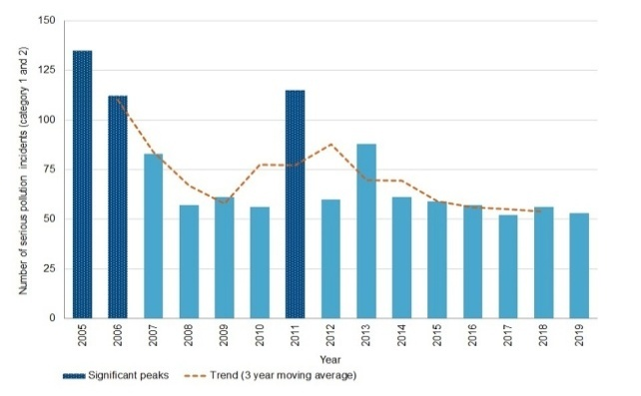
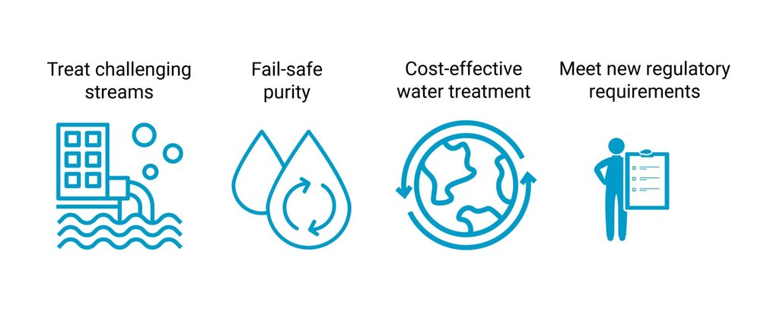

Environmental Challenges
Organisation
Innocent Drink is the eco-entrepreneurship company in the UK which focuses on mitigation of this challenge
This company makes commitment to improve sustainability of environment (Innocent Drinks.co.uk, 2022)
Challenge
About 398,000 discharge of raw sewage in the UK water (Sas.org.uk, 2022)
About 75% rivers are polluted in the UK (Sas.org.uk, 2022)
About 62 serious water pollution incidents have reported in the UK
SDG goal
SDG goal 6 related to water pollution which focuses on sustainability of water resources (Un.org, 2022)
References
Akhtar, N., Syakir Ishak, M.I., Bhawani, S.A. and Umar, K., (2021). Various natural and anthropogenic factors responsible for water quality degradation: A review. Water, 13(19), p.2660.
Innocent Drinks.co.uk, (2022) Mission and vision of Innocent Drink Available at: https://www.innocentdrinks.co.uk/fancy-a-job/our-values [Accessed on 4th April, 2023]
Sas.org.uk, (2022) Water quality in the UK Available at: https://www.sas.org.uk/water-quality/water-quality-facts-and-figures/ [Accessed on 4th April, 2023]
Singh, J., Yadav, P., Pal, A.K. and Mishra, V., (2020). Water pollutants: Origin and status. Sensors in water pollutants monitoring: Role of material, pp.5-20.
Un.org, (2022) SDG goals Available at: https://www.un.org/sustainabledevelopment/climate-action/#:~:text=Goal%2013%20calls%20for%20urgent,well%20below%202%20degrees%20Celsius. [Accessed on 4th April, 2023]
Solution
Have to focus on improvement of water quality and wastewater treatment
Implementation of integrated water resource management
Notes:
Introduction
Environmental challenges have been significantly boosted by industrialisation growth in UK along with various new startups during COVID-19 pandemic. Each new business in UK contributes to carbon emission growth within the country. However, in current years water pollution has been identified as a core environmental challenge. Hence, several water contamination incidents have been reported in UK imposing the need for identification and mitigation of water pollution issues which is a critical environmental challenge in the UK.
Main body
Water pollution not only impacts industries like water suppliers and fisheries but also harms healthy living of households. Water pollution has been observed to constantly increase in recent years due to sewage leakage and release of industrial waters into water bodies (Akhtar et al. 2021). The increasing water pollution has led to creation of various aligned problems like stomach infections, marine life degradation, and increasing mineral water prices. Nearly 398,000 tons of raw sewage are released into water bodies in the UK leading to 75% of rivers being polluted (Sas.org.uk, 2022). This has led to increasing contamination incidents in UK surpassing several global countries’ levels of water pollution. In 2022, approximately 62 serious water contamination incidents have been reported in UK (Sas.org.uk, 2022). The government of UK needs to focus on improving wastewater treatment and water quality to restrict growing environmental challenge of water pollution. Additionally, application of integrated water resource management can also be a suitable solution for mitigating water pollution issues. Thus, highlighting that water pollution has become a critical environmental issue that impacts lifestyle of UK’s population.
The organisation that helps mitigation of water pollution challenges in UK is Innocent Drink which is an eco-entrepreneurial business focusing on sewage waste released into water bodies. Furthermore, the company is committed to enhancing environmental sustainability (InnocentDrinks.co.uk, 2022). UK businesses are taking conscious steps to reduce production waste that can lead to minimisation of liquid waste released into water bodies. However, sewage waste released into water is a more critical issue as compared to industrial waste release (Singh et al. 2020). Water pollution not only impacts the industries like fisheries and mineral water suppliers but also harms households to a significant level. SDG Goal 6 concerning water pollution focuses on sustainability of water resources (Un.org, 2022). Government and businesses by complying with 6th SDG goal can suitably develop a sustainable environment mitigating water pollution. UK businesses are conscious of waste control and management systems that might lead to reduced water pollution in upcoming years improving living standards in the country.
Conclusion
Water pollution has been identified to be the most critical environmental issue that the company is fighting in recent years. The growing household and sewage waste accumulation in water bodies of UK has led to significant contamination incidents. Innocent Drinks has been identified to be the most effective business that offers solutions for water pollution elimination in the UK. Compliance with the 6th SDG goal can promote businesses to support water pollution challenge mitigation in future in the UK.

