Slide 1

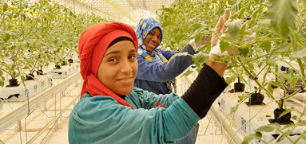
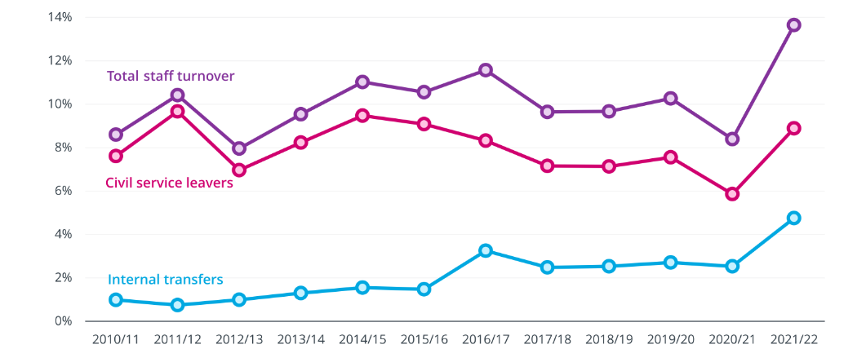
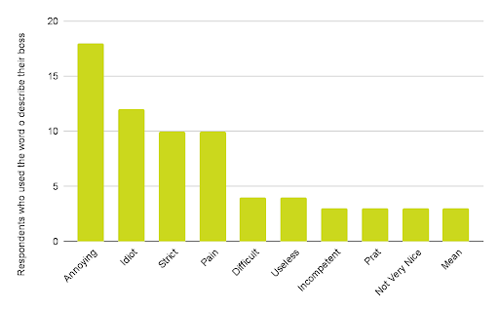
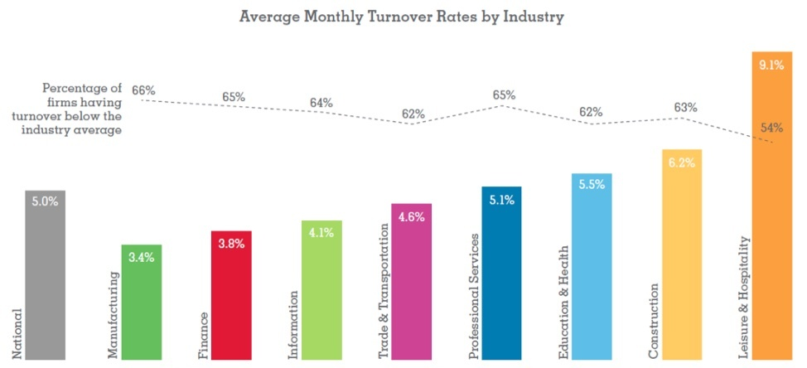
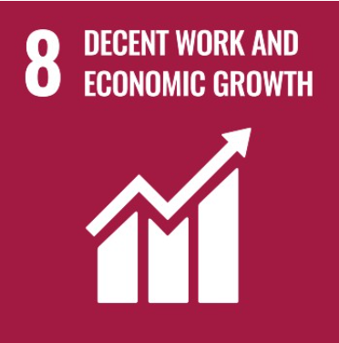
Ethical challenges (Staff Layoff)
Challenge
Staff layoff has mainly happened during Covid 19 pandemic condition
About two third employees are layoff from various companies in the UK during Covid 19 pandemic (People Management.co.uk, 2022)
This increases unemployment rate by 3.7% in the UK in 2022 (People Management.co.uk, 2022)
Solution
Elimination of human trafficking and forced labour
Arrangement of decent work for increasing employment rate and reduction of employee layoff
Promotion of development of policies for employees
References
Fairtrade.net, (2022) Mission and vision of Fairtrade Available at: https://www.fairtrade.net/about/mission#:~:text=Our%20mission%20is%20to%20connect,more%20control%20over%20their%20lives. [Accessed on 4th April, 2023]
Peoplemanagement.co.uk, (2022) Two-thirds of workers laid off during the pandemic were under 25, official figures show Available at: https://www.peoplemanagement.co.uk/article/1745085/two-thirds-of-workers-laid-off-during-the-pandemic-were-under-25 [Accessed on 4th April, 2023]
The Quint (2023). How Has Apple Avoided Mass Layoffs Like Meta, Google, and Microsoft? The Quint. Available at: https://www.thequint.com/explainers/apple-layoffs-mass-google-meta-amazon-microsoft-tech#:~:text=Apple's%20lean%20hiring%20process%20during,that%20it's%20avoided%20mass%20layoffs. [Accessed on: 12th April 2023]
Un.org, (2022) SDG goals Available at: https://www.un.org/sustainabledevelopment/climate-action/#:~:text=Goal%2013%20calls%20for%20urgent,well%20below%202%20degrees%20Celsius. [Accessed on 4th April, 2023]
unric.org (2023). Regional Information Centre For Western Europe. United States. Available at: https://unric.org/en/sdg-8/#:~:text=Goal%208%3A%20Promote%20inclusive%20and,all%20and%20improve%20living%20standards. [Accessed on: 7th April 2023]
Organisation
Fairtrade is an ethical enterprise in the UK focuses on elimination of staff layoff issue
This enterprise focuses on poverty reduction as a mission and provide opportunity to improve situation of employees (Fairtrade.net, 2022)
SDG goal
SDG goal 8 is related to staff layoff as this deals with employment and decent work (Un.org, 2022)
SDG 8 also focuses on economics growth
Notes:
Introduction
Staff layoff became a significant global ethical issue due to impact of Covid-19 pandemic on business market performance. Staff layoffs from a business perspective, have been considered to be essential to protect businesses from extensive losses and balancing sales with profitability. However, staff layoff from an employee perspective is an ethical challenge as they lost their jobs in critical health complication risk scenarios and restricted employability opportunities. Thus, making staff layoff a significant global challenge for businesses like Microsoft and Google.
Main body
UK companies in recent years have been evidently laying off employees to improve structural and profitability effectiveness. The unemployment rate in the UK increased by 3.7% in 2022 due to two-thirds of employees being laid off from various organisations (People Management.co.uk, 2022). The organisation that helps eliminate staff layoff challenges is Fairtrade which is an ethical enterprise in the UK. The company is focused on reducing poverty as its primary mission along with providing improvement situation opportunities to employees (Fairtrade.net, 2022). However, staff layout has also been restricted by several other global companies in UK. For instance, Apple has been the only tech company in UK that has avoided mass layoffs supporting mitigation of the global staff layoff challenge (The Quint, 2023). On other hand, all major competitors of Apple like Microsoft and Google in the UK tech market implemented massive staff layoffs during and in post-pandemic environment. Therefore, indicating that Fairtrade is a UK enterprise that helps eliminate employee layoff issues and Apple has supported its employees by restricting mass layoffs to date.
The protection of employee layoffs and employment sustainability led to effective compliance with 8th goal of SDG promoting sustainable employment, economic growth, and decent work for every individual. The SDG goal also states that inclusive and sustained economic growth drives progress, creating decent jobs for everyone and improving standards of living (unric.org, 2023). The 8th goal of SDG also focuses on economic growth of employees that needs to be compiled for ethical business operations in the UK. The businesses following SDG goals are capable of establishing sustainable and ethical business operations due to structured goals and objectives that are to be attained. The most significant solution that can be derived from application of 8th SDG goal is elimination of forced labour and human trafficking. Additionally, the organisations can also make arrangements for decent work and increase employment rate in a post-pandemic environment. Therefore, the issue of staff layoffs is an evident ethical challenge faced by companies and workforce in recent years that needs to be mitigated.
Conclusion
It has been identified that the unemployment rate in the UK has been constantly growing due to staff layoff challenges. Covid-19 pandemic in 2020 boosted the issue of staff layoff due to reduced sales and profitability of businesses. Fairtrade has been evaluated as an ethical UK business that supports elimination of staff layoff challenges and promotes SDG goal of inclusive and sustainable employment, economic growth, as well as work prosperity. It has also been analysed that companies in UK can improve decent work arrangements to create employability.

