Slide 1
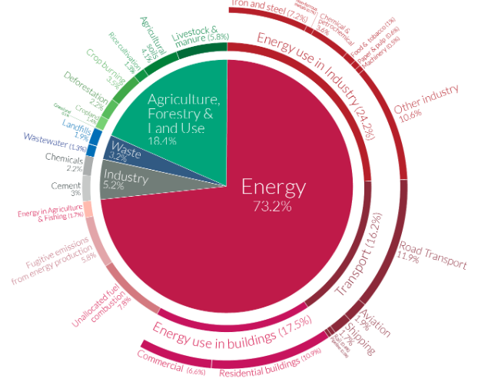
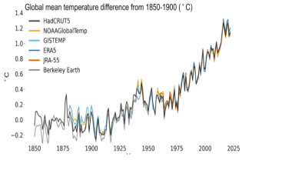

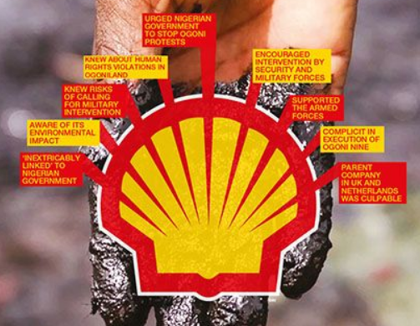
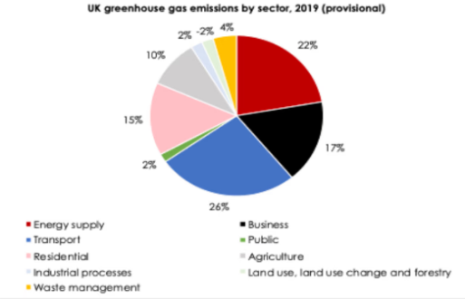
Global Challenges
Challenge
The temperature of the UK increased by 1 degree centigrade in each year due to global warming (Metoffice.gov.uk, 2022)
Emission of carbon dioxide has increased by 6% in 2022 in the UK and is another cause of global warming (Ons.gov.uk, 2022)
Shell company produced about 31.95 billion ton of carbon dioxide as this produces 508 million crude oil (Statista.com, 2022)
SDG goal
Global warming is related to SDG goal 13 which deals with climate action (Un.org, 2022)
SDG 13 focuses on taking action for reduction of climate change
Guideline
Companies can try to use renewable energy and try to save energy (Un.org, 2022)
Companies have to focus on process for transition to zero-carbon emission
References
Clientearth.org (2020), About Shell; Available at: https://www.clientearth.org/projects/the-greenwashing-files/shell/#:~:text=About%20Shell&text=In%202020%2C%20Shell%20disclosed%20emissions,1.5%C2%B0C%20carbon%20budget. [Accessed on: 10th April, 2023]
Cnbc.com (2023), Shell’s board of directors sued over climate strategy in a first-of-its-kind lawsuit; Available at: https://www.cnbc.com/2023/02/09/oil-shell-board-of-directors-sued-by-investors-over-climate-strategy.html#:~:text=Shell's%20directors%20are%20being,companies%20plan%20to%20cut%20emissions. [Accessed on: 10th April, 2023]
Foei.org (2019), These eight scandals prove Shell’s long history of contempt for people and planet; Available at: https://www.foei.org/eight-shell-scandals/#:~:text=Shell%20has%20been%20extracting%20oil,a%20number%20of%20villages%20uninhabitable. [Accessed on: 10th April, 2023]
Metoffice.gov.uk, (2022) Increasing temperature in the UK Available at: https://www.metoffice.gov.uk/weather/climate-change/effects-of-climate-change#:~:text=UK%20winters%20are%20projected%20to,to%20happen%20every%20other%20year. [Accessed on 4th April, 2023]
Ons.gov.uk (2022), UK Environmental Accounts: 2022; Available at: https://www.ons.gov.uk/economy/environmentalaccounts/bulletins/ukenvironmentalaccounts/2022#:~:text=Most%20greenhouse%20gas%20emissions%20are,%25)%20coming%20from%20fossil%20fuels. [Accessed on: 10th April, 2023]
Ons.gov.uk, (2022) Greenhouse gas emissions, UK: provisional estimates: 2021 Available at: https://www.ons.gov.uk/economy/environmentalaccounts/bulletins/greenhousegasintensityprovisionalestimatesuk/2021#:~:text=UK%20greenhouse%20gas%20(GHG)%20emissions,carbon%20dioxide%20equivalent%20(CO2e). [Accessed on 4th April, 2023]
Statista.com, (2022) Oil and natural gas liquids production of Shell from 2015 to 2022 Available at: https://www.statista.com/statistics/1105472/oil-and-gas-liquids-production-of-shell/#:~:text=In%202022%2C%20Shell%20produced%20nearly,through%20joint%20ventures%20and%20associates. [Accessed on 4th April, 2023]
Un.org, (2022) SDG goals Available at: https://www.un.org/sustainabledevelopment/climate-action/#:~:text=Goal%2013%20calls%20for%20urgent,well%20below%202%20degrees%20Celsius. [Accessed on 4th April, 2023]
Notes:
Introduction
Sustainable Development Goals are the collection of the seventeen objectives planned to increase prosperity of the planet and the people for creating a better future. Global warming is considered to be one of the major concerns of the environment and the majority of the companies and businesses have taken responsibility to eradicate the challenge. There are certain organisations and industries that are responsible for the challenge to become more harmful for the society and the environment.
Main body
Global warming is mainly caused by the emissions of greenhouse gases. Fuel & Energy Industry is considered as the most responsible industry that contributes majorly in the global warming increasing concerns of the UK. It has been identified that approximately 78% emissions accounted for fossil fuels in the UK (Ons.gov.uk, 2022). Furthermore, the continuous increase in carbon emission by the construction, fuel and energy, transportation industry and many more are responsible for the increasing concern of climate change, air pollution and other harmful gas emissions. In this case the SDG goal 13 which is Climate action is designed to combat global warming and climate change impacts (Un.org, 2022). The guidelines of the goal are to increase the use of renewable resources and solar systems to generate energy instead of fossil fuel. However, there are certain companies that majorly contribute to global warming and emit tons of carbon dioxide which harms the environment majorly.
Shell is a multinational oil and gas company which is considered to be contributing negatively to the environment. The company has been operating since 1897 in the UK and is considered to be contributing more than 1,377 million tonnes of carbon dioxide solely to the environment in the year 2020 (Clientearth.org, 2020). Hence, it has major harmful impacts to the environment and massively contributes to climate change and global warming. Furthermore, it has also been identified that the company has been emitting various harmful chemicals and dangerous gases in the air which majorly influenced global warming. The company has also been responsible for extracting oil from the Niger Delta for over a century (Foei.org, 2019). However, the company directors are being sued for failing to manage the climate emergency (Cnbc.com, 2023). Additionally, the company also confirms to comply with climate policies. However, it has been identified that the company has spent $22 million annually on anti climate lobbying (Foei.org, 2019). Thus, it can be analysed that the company majorly contributes to global warming and does not comply with the SDG goal.
Conclusion
Climate change is a global concern which is increasing rapidly due to global warming and the responsible industries are also contributing to endangering the future of the planet and people. It has been identified that SDG goal number 13 tends to impose a sustainable future for the planet and the people and reduce the harmful impacts of climate change. However, Shell companies in the UK are majorly responsible for contributing negatively to the environment and increasing global warming and climate change concerns for the UK population.

