Slide 1
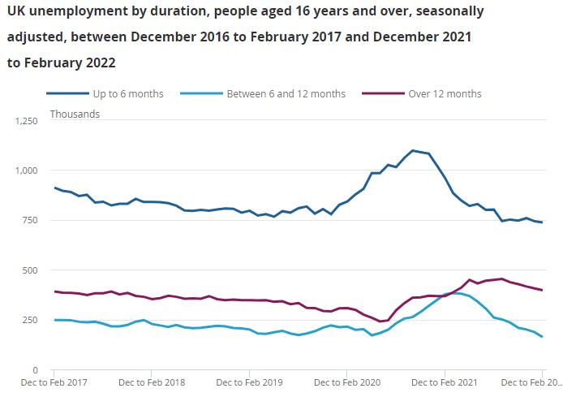



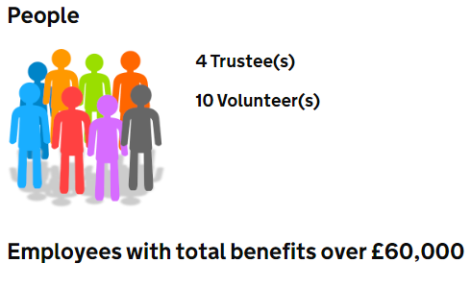
Social Challenges
Challenge
Unemployment rate in the UK is about 3.7% in 2022 (Ons.gov.uk, 2022).
Failing of real GDP is the cause of unemployment rate in the UK
Real GDP was fallen by about 0.5% in December, 2022 (Ons.gov.uk, 2022)
SDG goal
This is related to with goal 8 which deals with promotion of inclusive and sustainable economic growth, employment and decent work for all (Un.org, 2022)
This SDG goal focuses on creation of decent jobs for improvement of living standard
Solution
Focus on eradication of forced labour
Encouragement of people to participate in works
Organisation
Tiger Trust is a social enterprise which has focused on mitigation the issue of unemployment by inspiring and integration of communities and providing education and opportunity (Tigerstrust.co.uk, 2022)
References
Ons.gov.uk (2023), Employment in the UK: February 2023; Available at:
https://www.ons.gov.uk/employmentandlabourmarket/peopleinwork/employmentandemployeetypes/bulletins/employmentintheuk/february2023#:~:text=Unemployment,-The%20unemployment%20rate&text=Over%20the%20latest%20three%2Dmonth%20period%2C%20the%20unemployment%20rate%20increased. [Accessed on: 10th April, 2023]
Ons.gov.uk, (2022) Real GDP in the UK Available at: https://www.ons.gov.uk/economy/grossdomesticproductgdp/bulletins/gdpfirstquarterlyestimateuk/octobertodecember2022#:~:text=For%20more%20information%20please%20refer,of%200.1%25%20in%20November%202022. [Accessed on 4th April, 2023]
Register-of-charities.charitycommission.gov.uk (2021), TIGERS TRUST; Available at: https://register-of-charities.charitycommission.gov.uk/charity-details/?regid=1121748&subid=0 [Accessed on: 10th April, 2023]
Tigerstrust.co.uk, (2022) Mission and vision of Tiger Trust Available at: https://www.tigerstrust.co.uk/about-us/aims-values/ [Accessed on 4th April, 2023]
Un.org, (2022) SDG goals Available at: https://www.un.org/sustainabledevelopment/climate-action/#:~:text=Goal%2013%20calls%20for%20urgent,well%20below%202%20degrees%20Celsius. [Accessed on 4th April, 2023]
Notes:
Introduction
Social challenges refer to the issues of the society that affect the quality of life of individuals such as poverty, unemployment, racism, unequal opportunity and malnutrition. Unemployment is the focus of this section and it has been identified that unemployment is a major concern for the UK population which is decreasing the quality of life of the population of the UK. There are several companies in the UK that are majorly working in order to eradicate the unemployment rate and the SDG goal 8 "decent work and economic growth" is designed to increase employability.
Main body
Unemployment is considered as a major concern for the population of the UK which has the potential of increasing poverty, weak economic structure and financial issues. Furthermore, it has been figured that the unemployment rate of the UK has increased over the past 3 months (Ons.gov.uk, 2023). The major reason for the increasing unemployment rate of the UK is considered to be the struggling economy and the labour supply outstrips demand from employers. Therefore, it can be analysed that due to the external forces of Russia-Ukraine war, Brexit and pandemic are the major causes of increasing social challenges such as; unemployment. Sustainable Development Goal number 8 which describes decent work and economic growth tends to reduce unemployment issues and support economic growth.
The company Tiger Trust is working to eradicate unemployment. The company confirms that there employees are with total benefits over £60,000 (Register-of-charities.charitycommission.gov.uk, 2021). Furthermore, the mission of the company is to inspire, engage and improve communities and increase participation and education. Hence, the company is majorly working in order to reduce unemployment and increase the quality of life of individuals. Moreover, it can be analysed as delivering the best outcome. The sustainable development goal number 8 is being followed by the company which significantly contributes to the economy of the UK. Moreover, as the GDP of the Uk is also falling it needs proper adoption of strategies to reduce unemployment and financial issues. Therefore, companies and organisations of the UK are responsible to increase employability rate and providing chances to enhance the quality of life. The economy of the UK can be developed through reducing the unemployment rate and in which companies like Tiger trust need to provide equal opportunities to the population of the UK to enhance their financial condition. Therefore, the company mission is to contribute and take part in charitable action to comply with the SDG goal 8 and reduce unemployment.
Conclusion
Social challenges are a major concern for each individual and it has the potential of decreasing the economic condition of a country and decreasing the quality of life. Furthermore, it has been analysed that unemployment is an increasing concern of the UK. However, SDG number 8 tends to increase the economic growth and support the population of the UK to increase the quality of life.

