Slide 1

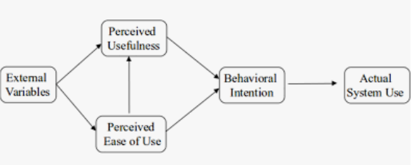
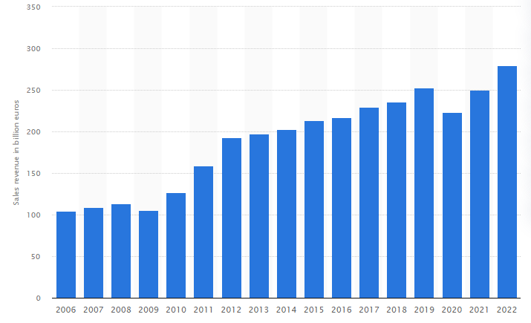
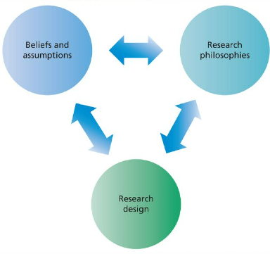
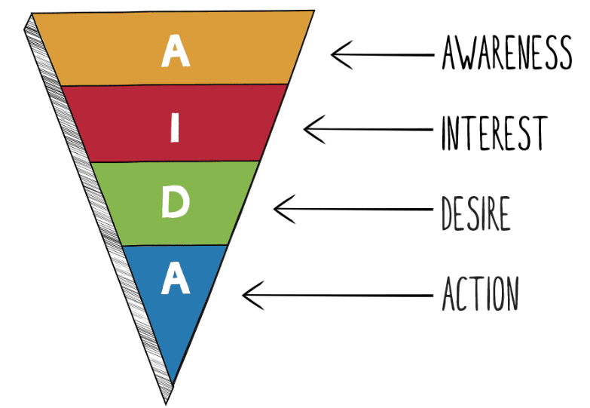
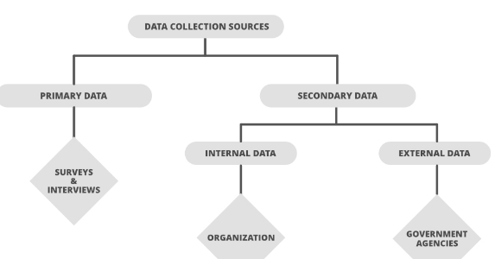
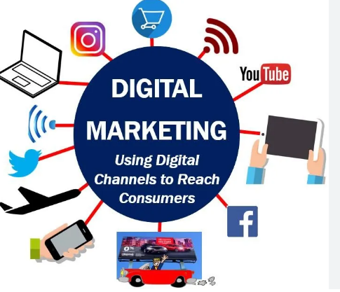
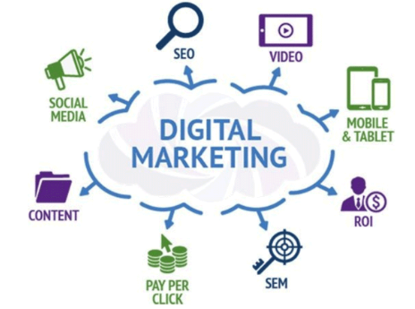
ROLE OF INFORMATION TECHNOLOGY IN REVOLUTIONISING THE MARKETER’S APPROACH TOWARDS DIGITAL MARKETING: A CASE STUDY OF VOLKSWAGEN
Background of the study
Volkswagen in the global automobile sector has been a highly famed brand.
The company achieved a high revenue of €279.2 billion as of 2022 worldwide (Statista, 2023).
The high revenue of the company has been enhanced by its global presence and online marketing approaches in every operating region in recent times.
Research methods
The researcher will use a positivist philosophy to collect data sources for the current study.
Positivism philosophy helps researchers to evaluate objective reality (Alharahsheh and Pius, 2020).
A deductive approach to research will be used in the current study.
The chosen approach aids researchers to analyse the collected data sources through scientific procedures (Pearse, 2019).
The researcher in the current study will use a descriptive design for the analysis of the collected data sources.
A primary quantitative data collection process will be used.
The researcher will create a set of 10 close-ended questions for surveying the consumers of Volkswagen.
The implementation of IT services in digital marketing activities of companies can enhance the prospects of the firms to increase their promotional activities.
IT service plays a pivotal role in terms of implementing various online marketing channels, such as social media, email, SEO and mobile applications (Peyravi et al. 2020).
AI and VR services have been crucial parts of IT services, which have increased the services for digital marketing in various global companies in recent times.
Companies incorporating IT for digital marketing can face issues regarding the lack of the right talent management and communication gaps.
The researcher will survey a total of 100 consumers of the company through online mediums.
The researcher will use a random-probability sampling method to collect 50 sample survey responses for the data analysis.
The researcher will utilise MS Excel to represent the survey responses using bar charts and pie charts.
The researcher will measure the response rates using the LIKERT scale, which will help in the creation of the bar and pie charts.
The statistical analysis of the data sources will help the researcher to identify the role of IT services to increase Volkswagen’s global digital marketing activities.
The researcher will maintain the Data Protection Act 2008 to maintain information privacy for the respondents in the survey.
Figure 1: Revenue of Volkswagen
(Source: Statista, 2023)
The implementation of consecutive information technology (IT) services by Volkswagen has enhanced the company’s approach to increasing digital marketing activities.
The current study will aim to evaluate the role of IT in increasing the current approaches of Volkswagen to increase digital marketing.
The objectives will achieve the goals shown below:
To evaluate the role of IT in increasing digital marketing at Volkswagen.
To analyse the issues to be faced by Volkswagen’s marketers to implement IT for digital marketing.
To suggest strategies for marketers at Volkswagen to improve its digital marketing through integrating IT services.
The implementation of the TAM model can help companies to analyse the behavioural intentions of consumers to utilise technological support (Soleimani and Zarafshani, 2022).
On the other hand, the AIDA model can help marketers to increase their awareness, interest, desire and actions for promotions (Purbaningsih et al. 2022).
The analysis of the literary sources faced a gap in analysing the role of IT in digital marketing.
The current study has aimed to fulfil the identified gap through consecutive data collection and analysis processes.
Summarised literature review and gap
The implementation of digital marketing approaches can help companies to increase their consumer reach in the global market.
It can also enhance their brand reputation (Desai and Vidyapeeth, 2019).
Digital marketing can also help companies to gain a highly engaged consumer base for the organisational processes and products.
Reference
Alharahsheh, H.H. & Pius, A. (2020) ‘A review of key paradigms: Positivism VS interpretivism’, Global Academic Journal of Humanities and Social Sciences, 2(3), pp.39-43.
Desai, V. & Vidyapeeth, B. (2019) ‘Digital marketing: A review’, International Journal of Trend in Scientific Research and Development, 5(5), pp.196-200.
Pearse, N. (2019, June) ‘An illustration of deductive analysis in qualitative research’, In 18th European conference on research methodology for business and management studies (p. 264).
Peyravi, B., Nekrošienė, J. & Lobanova, L. (2020) ‘Revolutionised technologies for marketing: Theoretical review with focus on artificial intelligence’, Business: Theory and Practice, 21(2), pp.827-834.
Purbaningsih, Y., Putri, S.E., Bangkara, B.A., Nurofik, A. and Zahari, M. (2022) ‘Understanding the AIDA Model in Marketing Small Business in the Digital Age: Opportunities and Challenges’, Budapest International Research and Critics Institute-Journal (BIRCI-Journal), 5(3), pp.19978-19989.
Soleimani, A. & Zarafshani, K. (2022) ‘Factors determining Adoption of Information Technology by Vocational Agricultural Teachers Using Technology Acceptance Model (TAM) in Kermanshah Province’, Iranian Journal of Information Processing and Management, 26(4), pp.885-902.
Statista (2023). Volkswagen AG's sales revenue from FY 2006 to FY 2022. Available at: https://www.statista.com/statistics/264349/sales-revenue-of-volkswagen-ag-since-2006/ (Accessed: 12 April 2023).
Conclusion
The current study will analyse the integration of IT services to increase the digital marketing approach of Volkswagen in the global market.
The analysis of the literature review identified that the researcher faced a gap in information in previous articles for analysing the role of IT in digital marketing.
The researcher will aim to collect datasets through primary data collection processes.
The researcher will use the random probability sampling method to collect 50 samples out of 100 survey responses.
The survey responses will be represented through bar charts and pie charts.
These charts will be developed in MS Excel.

