Slide 1
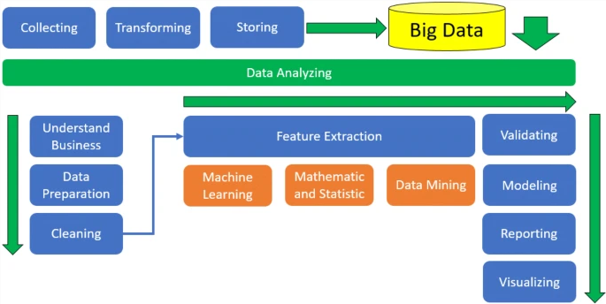
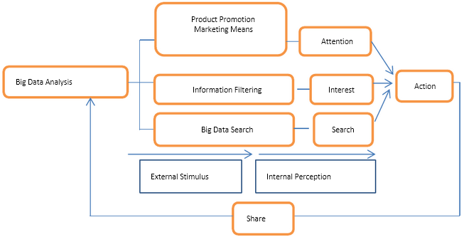
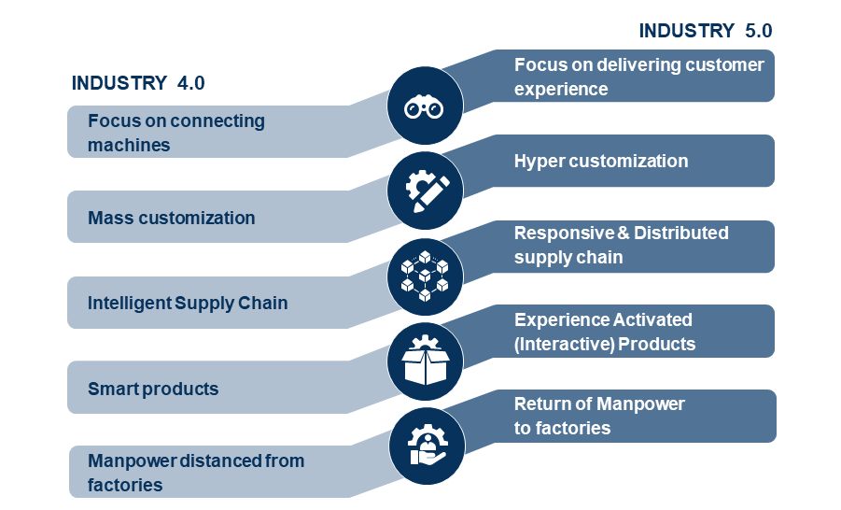
Influence of Big Data Analytics on Understanding the Customer Buying Trend
Introduction
Methodology
Future Work
This poster determines the influence of big data analytics in understanding the buying trends of customers. The use of big data in customer behaviour is discussed in this context through the literature review, and the subsequent methodology is attained for this poster. The analysis is performed to substantiate the performance of big data in consumer behaviour analysis, which leads the poster to assess future works in this context.
Secondary qualitative research methodology is used to determine the influence of big data analytics on consumer trends. This ensures that existing successful practices of big data analytics identified by large corporations are referenced to determine the influence on buyer behaviour and trends (Ruggiano and Perry, 2019). The research analysis will reference findings from analyst Bernard Marr’s collaboration with the leading successful brands of Amazon, Starbucks and Burberry. The analysis of evidence from these diverse companies will present an accurate insight into consumer behaviour across the markets of retail and technology, coffeehouse chain and luxury fashion respectively.
Big data analytics forms a part of the current framework of technologies expressed in the Industry 4.0 framework (Singh, 2020). Therefore, future big data analytics will become more effective in understanding consumer behaviour and trends by incorporating adjacent technologies of Industry 4.0, such as machine learning and artificial intelligence. The long-term implications of this development can be predicted in the theoretical framework of Industry 5.0, where digital technology integration results in prioritisation and maximisation of the customer experience as a whole (Maddikunta et al., 2021).
Analysis
Literature Review
Big Data Analytics at Amazon
Amazon has in-house data banks hosted on cloud servers which contain various data regarding consumers that interact with the company (Marr, 2021). As an e-commerce retailer, Amazon uses big data analytics to identify customer profiles from data analysis which allows it to be proactive in satisfying customer relationship management situations. This creates a 360-degree view of the consumer, which is used to segment consumers based on similar profiles (Marr, 2021). The behaviour of these consumers is therefore understood by Amazon, allowing it to personalise product recommendations and address customer issues satisfactorily.
Big Data Analytics at Starbucks
Starbucks uses big data analytics to determine localised consumer behaviour based on area demographics (Marr, 2018). This ensures new stores are opened in areas which will offer the highest engagement potential from consumers. Such information is gathered from users of the Starbucks smartphone app, numbering above 17 million active users as well as 13 million active users in the rewards programme of the brand (Marr, 2018). The data analytics, therefore, ensures the retail presence of Starbucks stores is optimised to maximise consumer engagement.
Big Data Analytics at Burberry
Burberry uses big data analytics to determine consumer trends, which allows its in-store representatives to make accurate recommendations to new and existing consumers (Marr, 2017). The data is gathered from RFID tags attached to new products, which presents a detailed data bank of valuable information. This is used to customise the luxury retail experience of Burberry customers across retail channels, resulting in a 50% increase in repeat customers by consumers (Marr, 2017).
Conclusion
The digital integration of the consumer lifestyle with the virtual environment has been accelerated in the 21st century due to two key determinants. The first cause of this factor is found in the growth and accessibility of affordable high-speed internet connectivity, making consumers active in the digital environment (Yamin, 2019). The second determinant is found in the diffusion of innovations leading to affordable and high-end consumer devices, ranging from smartphones and laptops to desktop computers (Kumar, 2004).
Through this unison of personal devices and digital connectivity, consumers interact across social, professional and commercial situations, creating a trail of personal data that forms their digital footprint (Makrides, Vrontis and Christofi, 2019).
Traditional data systems, therefore, become big data as the volume and variety of data grow exponentially through the continuous participation of consumers in the digital environment (Khade, 2016). Valuable consumer insights such as purchasing habits, personal tastes and preferences, goals and expectations, pain points, interests and other personal characteristics are revealed through the processing of big data (Hunke, Heinz and Satzger, 2021).
The use of contemporary digital technologies secures the processing of this large volume of data through data mining, machine learning and other techniques (Grover and Kar, 2017). Consequently, the awareness of this personalised data of individual consumers allows companies and their brands to tailor their marketing, sales and overall operations strategies to align with consumer interests (Khade, 2016). This results in a higher level of efficiency in designing products, supportive services, marketing and other functions based on an understanding of the customer buying trends and habits (Manko, 2021).
The research findings drew secondary qualitative data from the works of Bernard Marr’s analysis of big data analytics across different global organisations. The analysis confirmed that big data is used to a far-reaching extent in performing predictive analysis of consumer behaviour and trends, resulting in effective consumer engagement and market expansion strategies to be deployed by the companies in the poster. Their current expertise in using big data analytics makes them future-ready to integrate Industry 4.0 technologies towards understanding customers, and ultimately creating a peak level of customer experience and engagement because of Industry 5.0.
References
Grover, P. and Kar, A.K. (2017). Big Data Analytics: A Review on Theoretical Contributions and Tools Used in Literature. Global Journal of Flexible Systems Management, [online] 18(3), pp.203–229. doi:https://doi.org/10.1007/s40171-017-0159-3.
Hunke, F., Heinz, D. and Satzger, G. (2021). Creating customer value from data: foundations and archetypes of analytics-based services. Electronic Markets, [online] 32, pp.503–521. doi:https://doi.org/10.1007/s12525-021-00506-y.
Khade, A.A. (2016). Performing Customer Behavior Analysis using Big Data Analytics. Procedia Computer Science, [online] 79, pp.986–992. doi:https://doi.org/10.1016/j.procs.2016.03.125.
Kumar, S. (2004). Mobile communications: global trends in the 21st century. International Journal of Mobile Communications, [online] 2(1), p.67. doi:https://doi.org/10.1504/ijmc.2004.004488.
‌Maddikunta, P.K.R., Pham, Q.-V., B, P., Deepa, N., Dev, K., Gadekallu, T.R., Ruby, R. and Liyanage, M. (2021). Industry 5.0: A survey on enabling technologies and potential applications. Journal of Industrial Information Integration, [online] 26, p.100257. doi:https://doi.org/10.1016/j.jii.2021.100257.
Makrides, A., Vrontis, D. and Christofi, M. (2019). The Gold Rush of Digital Marketing: Assessing Prospects of Building Brand Awareness Overseas. Business Perspectives and Research, [online] 8(1). doi:https://doi.org/10.1177/2278533719860016.
Manko, B.A. (2021). Big data: The effect of analytics on marketing and business. Journal of Information Technology Teaching Cases, [online] 12(2). doi:https://doi.org/10.1177/20438869211057284.
Marr, B. (2017). The Amazing Ways Burberry Is Using Artificial Intelligence And Big Data To Drive Success. [online] Forbes. Available at: https://www.forbes.com/sites/bernardmarr/2017/09/25/the-amazing-ways-burberry-is-using-artificial-intelligence-and-big-data-to-drive-success/?sh=b21a8d24f63f [Accessed 14 Apr. 2023].
Marr, B. (2018). Starbucks: Using Big Data, Analytics And Artificial Intelligence To Boost Performance. [online] Forbes. Available at: https://www.forbes.com/sites/bernardmarr/2018/05/28/starbucks-using-big-data-analytics-and-artificial-intelligence-to-boost-performance/?sh=5faaed9065cd [Accessed 14 Apr. 2023].
Marr, B. (2021). Amazon: Using Big Data to understand customers. [online] Bernard Marr. Available at: https://bernardmarr.com/amazon-using-big-data-to-understand-customers/ [Accessed 14 Apr. 2023].
Ruggiano, N. and Perry, T.E. (2019). Conducting Secondary Analysis of Qualitative data: Should we, Can we, and how? Qualitative Social Work, [online] 18(1), pp.81–97. doi:https://doi.org/10.1177/1473325017700701.
Singh, H. (2020). Big data, industry 4.0 and cyber-physical systems integration: A smart industry context. Materials Today: Proceedings, [online] 46(1), pp.157–162. doi:https://doi.org/10.1016/j.matpr.2020.07.170.
Yamin, M. (2019). Information technologies of 21st century and their impact on the society. International Journal of Information Technology, [online] 11, pp.759–766. doi:https://doi.org/10.1007/s41870-019-00355-1.

