Slide 1
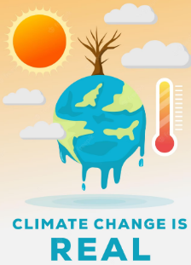
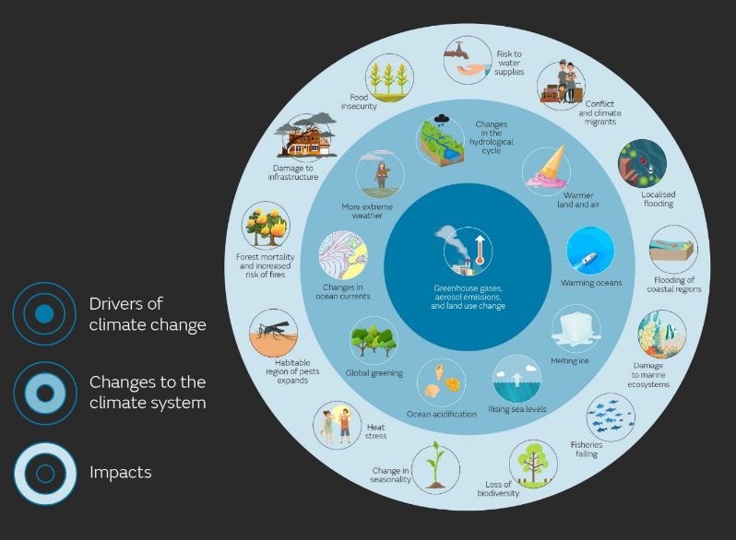
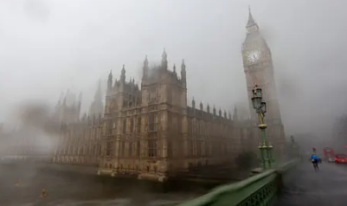
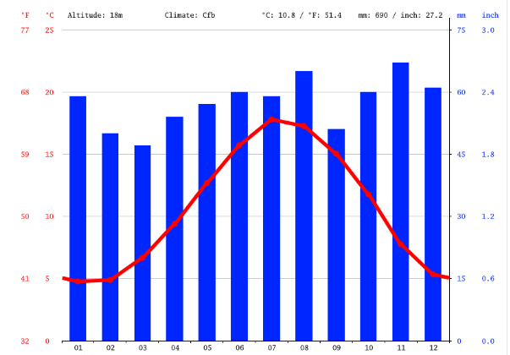
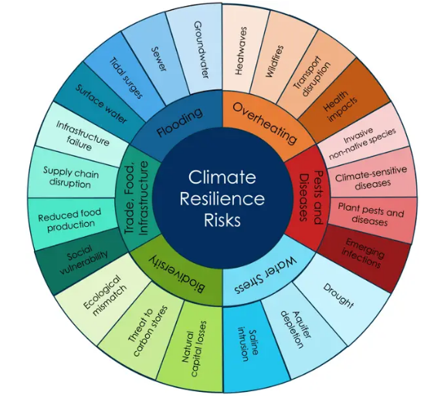
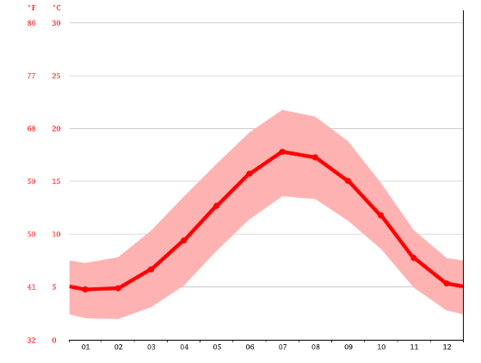
CLIMATE CHANGE
Impact of Climate Change on London
Climate change in the UK has a direct impact on the environment which has been reflected in the city’s economy and social growth. Due to the raising temperature in London, farming has been heavily impacted as the capacity of soil to grow vegetation has been reduced. The expected amount of droughts and longer span of drier summers have also been crucial due to higher temperatures and lack of rain. Rising sea level has also been a crucial impact of climate change that has affected the water temperature in oceans (Metoffice.gov.uk, 2023). Rising sea levels are a concerning sign of significant change in weather that can impact on the lives of organisms living in the sea.
It is observed that change in sustainable living has also become evident considering the loss of biodiversity that has been faced in the UK due to rapid shifts in the climate. Frequent occurrences of floods and storms can also impact disrupting structure of the buildings and transportation. Furthermore, it has been observed that changes in the pattern of rainfall can also impact the environment which often leads to drought.
Impact of Climate Change on London
(Source: Metoffice.gov.uk, 2023)
Personal Experiences of climate change
In London, the evident impact of climate change has been felt throughout the summer of 2022 along with scarcity of water has also been observed in terms of assessing impacts of climate change. I have observed in 2022 the heat waves have been more scorching and have impacted the vegetation heavily. In this regard, it is crucial to state that I have also followed the changed frequency of rainfalls which has been crucial considering its randomness. During March and April, significantly lesser amount of rainfall have been observed compared to November and December 2022. Sudden storms and immense amounts of snowfall have also caused disruptions in transportation and developing connections in March 2023, which depicts the extreme weather (Theguardian.com, 2023). Thus, the extreme change within London’s atmosphere throughout the year has been observed by me which is crucial to be assessed.
Temperature and Rainfall implication in London in 2022
(Source: Climate-data.org, 2022)
Extreme weather conditions
Climate change has directly impacted the environment of London, as in recent times it has experienced a hotter and drier summer. Heavy rainfall and heat waves in summer have also been observed in London. The Greater London Authority has forecasted that an average summer’s day can be up to 3℃ warmer, while the winter can be warmer in contrast within the middle of the century (London.gov.uk, 2023). Therefore, it can be observed that reducing emissions has become a key implication that can help in analysing the transition in the climate in London.
London has been facing a drier summer due to lack of greenery and vegetation in the city which has impacted the daily life of habitats in London. The driest month in London that is observed is March, with 47mm of rainfall which is significantly low considering the previous implication (Climate-data.org, 2022). This impacted the well-being of the individuals residing in London, especially impacting water management. Similarly, it also depicts the extreme weather changes which focus on understanding the impacts of irregular rainfall. Furthermore, detrimental blizzards and sudden snowfalls have also been crucial in determining the implications considering the weather changes in recent years.
In London, the temperature has increased recently which has been observed to impact the plantation and vegetation in the country. The warmest month of the year has been July, with the average temperature reaching 17.8℃ (Climate-data.org, 2022). Thus, it can be observed that many imminent risks of overheating, water stress and biodiversity issues have been observed in the environment of London which have impacted London’s environmental risks.
Climate resilience risks and solutions
(Source: Cityoflondon.gov.uk, 2022)
Temperature changes in London in 2022
(Source: Climate-data.org, 2022)
Energy crisis
European Energy crisis has been impacted due to climate change and countries that are leading towards changes in the environment have also been impacted. The prices of thermal coal and electricity generation have been impacted as many European countries have been focused on performing implications of global energy crisis. According to the opinion of Gernaat et al. (2021), energy development and usage of renewable energy sources have been key to understanding the implications of climate change. The usage of more coal fuels has shortened the storage of fuels which has impacted crucially in terms of developing implications on nature. According to the IMF analysis, UK households have a chance to lose 8.3% of total spending on energy bills which is crucial for environmental issues (Theguardian.com, 2022). In this regard, it can be stated that energy conservation is crucial to follow considering the lack of fuel storage.
Climate resilience
Considering the present scenario, the city of London has focused on facing key risks that are ensuing due to climate change. These risks include flooding, overheating, water stress, loss of biodiversity, pests and diseases and trading. Climate change is also impacting nature which is overheating which further has been detrimental to natural significance (Cityoflondon.gov.uk, 2022). The lack of water sources has also been observed considering the implications on nature that have been imminent since the summer can stay longer as the chances of drought can be doubled. Additionally, due to the change in climate, the storage of Carbon and the pollination systems have also been impacted. It is evident that London has a small part of gardens and water sources which have been crucial. Therefore, the city authority has been engaged to develop biodiversity action plans that are crucial in meeting sustainability goals in providing natural solutions (Cityoflondon.gov.uk, 2022). It has been important for the city authority to expand the natural spaces that are crucial in developing implications in order to enhance green spaces which help in developing sustainability in the city. In this aspect, it is important to state that climate change has been crucial to analyse implications as there are these six concepts and risks that are essential considering the natural resource management. These six factors implicates on understanding the key risks that are crucial to enhance mitigation drivers that help in mitigating issues.
References
Cityoflondon.gov.uk (2022). Climate resilience. Available at: https://www.cityoflondon.gov.uk/services/environmental-health/climate-action/climate-resilience [Accessed on: 12 April 2023]
Climate-data.org. (2022). LONDON CLIMATE. Available at: https://en.climate-data.org/europe/united-kingdom/england/london-1/#climate-graph [Accessed on: 12 April 2023]
Gernaat, D.E., de Boer, H.S., Daioglou, V., Yalew, S.G., Müller, C. and van Vuuren, D.P., (2021). Climate change impacts on renewable energy supply. Nature Climate Change, 11(2), pp.119-125.
London.gov.uk. (2022). Climate change and weather. Available at: https://www.london.gov.uk/programmes-and-strategies/environment-and-climate-change/climate-change/climate-change-and-weather [Accessed on: 12 April 2023]
Metoffice.gov.uk (2023). Effects of climate change. Available at: https://www.metoffice.gov.uk/weather/climate-change/effects-of-climate-change#:~:text=How%20will%20climate%20change%20impact,affected%20by%20climate%20change%2C%20too. [Accessed on: 12 April 2023]
Theguardian.com (2022). Energy crisis: UK households worst hit in western Europe, finds IMF. Available at: https://www.theguardian.com/money/2022/sep/01/energy-crisis-uk-households-worst-hit-in-western-europe-finds-imf [Accessed on: 12 April 2023]

