Slide 1
CRITICAL ISSUES IN INTERNATIONAL BUSINESS MANAGEMENT: ENVIRONMENTAL IMPACT

Slide 2
INTRODUCTION
Environmental impact refers to the effects of human activities on the environment in the form of generating environmental imbalance.
Human activities impact the physical environment in different ways such as overpopulation, burning fossil fuel, deforestation, and pollution.
In this context, consumer behaviour like cutting trees, and using unnecessary water in the agriculture industry also creates an environmental imbalance in the world.
Notes:
However, organisations focus on developing their strategic plan in terms of managing their production pattern by following the UN’s sustainable improvement goals. In addition, the UN’s sustainable development goals encourage businesses and consumers to balance the environmental impact which helps to ensure healthy lives, promote well-being for all ages and protect the environment significantly.

Slide 3
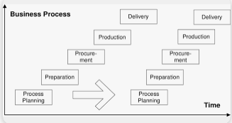
DISCUSSING THE CRITICAL ISSUES REGARDING CONSUMPTION AND PRODUCTION PATTERNS OF CONSUMERS AND BUSINESSES
Production patterns of the business lead to a negative impact on the environment.
Presently, industrial activities create a negative impact on the environment while managing their production patterns in the global market.
Production patterns refer to the overall production process of organisations in terms of creating products and services for their consumers.
The production patterns include labour, business capital, management system, and land to increase the business process.
As per the opinion of Kumar et al. (2020), organisations face issues to manage their production patterns due to the lack of management structure which generates environmental imbalance.
Notes:
In this context, the production pattern of business harms the environment through the pollution of water, air and soil. In turn, the industries including energy, agriculture, food retail, fashion, transport, and construction lead to generate an environmental imbalance and create pollution due to the harmful and chemical resources. As per the opinion of Suska-Malawska et al. (2021), the food retail sector creates environmental challenges such as land-use change, using excessive fertilisers, water wastage, and deforestation. In this context, the excessive usage of fertilisers by food retail organisations reduces the soil quality and hampers the overall process of eutrophication in the water bodies. The reduction of the quality of soil is the main reason which decreases the growth of the plants by reducing the quality of the soil. Thus, it can be stated that it leads to generating an environmental imbalance in the world.

Slide 4
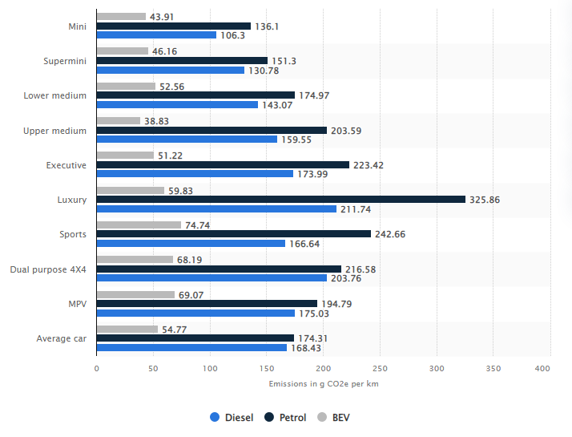
DISCUSSING THE CRITICAL ISSUES REGARDING CONSUMPTION AND PRODUCTION PATTERNS OF CONSUMERS AND BUSINESSES
The automotive industry produces vehicles with fuel engines which increases the carbon emission rate into the environment.
Moreover, people have also used burnt fossil fuels such as coal, and oil which also increase the carbon emission rate around the world.
The global transportation industry generates “7 billion metric tonnes” of carbon dioxide by providing petrol fuel vehicles in 2023 (Statista.com, 2023)
It will generate 39% of global transportation emission rates in the world in 2023.
For instance, the highest amount of CO2 was generated from luxury cars using petroleum as fuel in 2020 in the UK (Statista.com, 2023).
Notes:
As per the opinion of Biggs (2021), automotive organisations use gasoline and diesel fuels which contain toxic contents. The toxic contents include carbon monoxide, nitrogen oxide, “smog-causing volatile organic” and benzene which increases the emission rate into the environment. In turn, fossil fuels like petroleum and gasoline fuels increase the carbon monoxide rate and burning gasoline also creates “carbon dioxide” which increases pollution and greenhouse gas. Thus, it can be stated that greenhouse gas accelerates the global climate change process including the increased temperature of climate including ocean temperature, sea levels, and surface air.

Slide 5
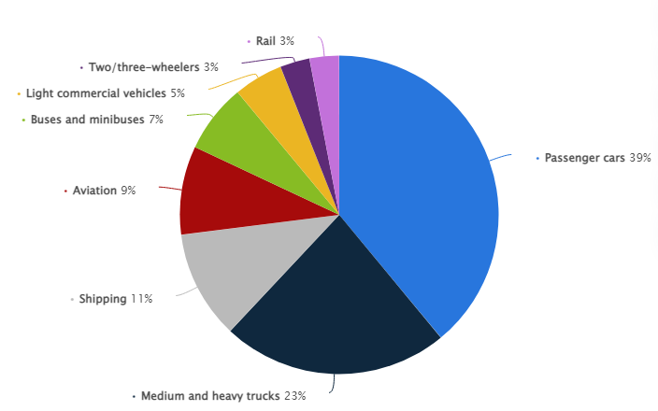
DISCUSSING THE CRITICAL ISSUES REGARDING CONSUMPTION AND PRODUCTION PATTERNS OF CONSUMERS AND BUSINESSES
The excessive use of plastic bags in the retail sector is a major cause of environmental degradation.
In turn, several plastic bag-related issues increased due to health concerns during the pending period (Statista.com, 2023).
Apart from this, logistics organisations also affect the environmental imbalance and pollution of the environment.
In this context, supply chain production includes toxic waste, loss of biodiversity, hazardous air emissions, and water pollution.
Additionally, marine transportation organisations create a negative impact on the marine environment hampering the life of aquatic animals.
Notes:
As per the opinion of Basak et al. (2020), scientists have proven that plastic leads to causing cancer and changes the hormonal activities of the human which decreases reproductive growth and cognitive impairment. On the other hand, the presence of plastic bags includes various toxic chemicals, additives and pollutants which leads to environmental imbalance. However, food or retail shops use plastic bags and plastic materials for product packaging purposes. As per the opinion of Adeyanju et al. (2021), the demand for plastic bags is very high in the current market among global people. Human activities lead to a negative impact on the environment of the world. It poses a serious environmental danger to animals as well as human health due to single-bag usage. It also increases environmental issues like stormwater, and drain blockage which leads to flooding in low-lying areas in the world. In addition, the marine transport inductees use the sea transportation route in terms of managing their distribution process in the global market. In turn, the toxic chemicals produced by marine transportation organisations reduce the balance of the aquatic lifestyle which has a severe impact on the environment.

Slide 6
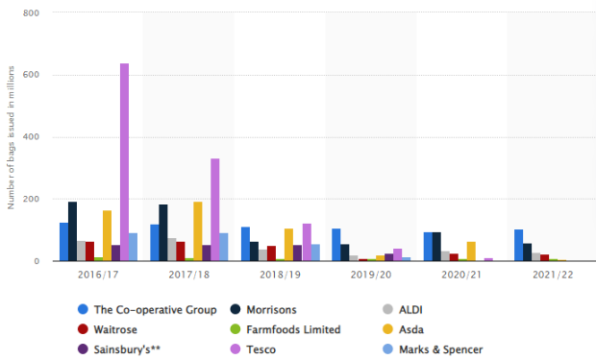
DISCUSSING THE CRITICAL ISSUES REGARDING CONSUMPTION AND PRODUCTION PATTERNS OF CONSUMERS AND BUSINESSES
Technology also causes faster consumption of fossil fuels and contamination of natural resources.
In addition, technologies also lead to the invention of global sectors that emit dangerous gases into the environment.
As per the opinion of Javaid et al. (2022), technology also increases the automation process of organisations leading to the carbon footprint in the environment by increasing Co2 emissions.
On the other hand, resource depletion is another negative impact of technology on the overall environment in the global market.
As per the opinion of Isabelle and Westerlund (2022), current organisations use artificial resources instead of natural resources which have been used by the technologies.
Notes:
It affects the global environment such as deforestation. In this context, carbon footprint affects climate change which increases the air pollution rate in the world. Moreover, it also leads to toxic acid rains and adds ocean acidification. In addition, the carbon footprint also leads to the melting of glaciers as well as polar ice. Thus, it can be stated that global organisations need to follow the sustainable improvement plan of the UN in terms of reducing the negative impact on the environment.

Slide 7
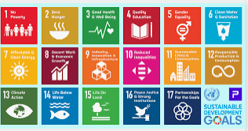
EVALUATING THE SOLUTIONS IN TERMS OF MITIGATING THE CRITICAL ISSUES REGARDING CONSUMPTION AND PRODUCTION PATTERNS OF CONSUMERS AND BUSINESSES
The application of SDGs helps organisations to manage the environmental impact of the business.
Global organisations can also focus on the UN’s SDGs in terms of reducing the environmental issues created through organisational operations.
As per the opinion of Alexandratos et al. (2019), agricultural companies focus on clean water and sanitisation in terms of using drip irrigation.
The application of drip irrigation increases the ability of the agricultural industry for preventing diseases by minimising water contents with stems and leaves.
Moreover, the agricultural industry can also focus on using legumes in terms of controlling soil quality.
Notes:
In this context, the legumes include fibre, protein, vitamin B, iron, and copper which increases the quality of the soil. As per the opinion of Jha et al. (2021), legumes enhance the N-supplying power of soils and increase soil reserves. On the other hand, the agricultural industry also focuses on managing hygienic measures which nullify factors of health deterioration and generate conditions for ensuring the production of good quality services and goods. As per the view of Giungato et al. (2023), sanitisation methods include the four approaches such as excrete management process, wastewater management process, solid waste and drainage system of reducing rainwater. In this context, the application of the sanitisation process helps the agricultural industry in reducing the spread of “antimicrobial resistance” and extra waste of water. Thus, it can be stated that clean water and sanitisation are the sustainable improvement goals which increase the ability of the agricultural industry to reduce the negative impact on the environment.

Slide 8
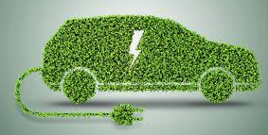
EVALUATING THE SOLUTIONS IN TERMS OF MITIGATING THE CRITICAL ISSUES REGARDING CONSUMPTION AND PRODUCTION PATTERNS OF CONSUMERS AND BUSINESSES
The automotive industry needs to focus on good health and well-being goals in terms of reducing carbon emissions and pollution rates around the global environment.
Presently, automotive organisations focus on producing electric vehicles in terms of reducing pollution in the environment.
As per the opinion of Woody et al. (2020), organisations use lithium-ion batteries instead of petrol fuel engines which helps to reduce the carbon emission rate into the environment.
The organisations produce electric vehicles which reduce the emission rate by around 66-69% in the overall European country (Statista.com, 2023).
Presently, electric cars are more eco-friendly instead of petrol fuel vehicles which helps to emit fewer greenhouse gases and air pollutants.
Notes:
Moreover, automotive cars produce energy stations which help to charge the batteries of the EV cars. Moreover, the charging station is more beneficial for humans instead of the petroleum station which also reduces the chances of a fire breakout. As per the opinion of Xia and Li (2022), electric vehicles also decrease the emission rate which helps to improve public health and reduce ecological damage.

Slide 9
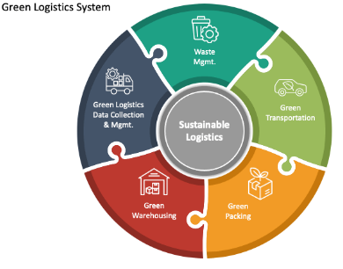
EVALUATING THE SOLUTIONS IN TERMS OF MITIGATING THE CRITICAL ISSUES REGARDING CONSUMPTION AND PRODUCTION PATTERNS OF CONSUMERS AND BUSINESSES
Logistics organisations need to focus on using sustainable transportation options in terms of reducing the negative environmental impacts in the global environment.
Moreover, green logistics practices are another strategic plan of logistics organisations for managing the environments in the world.
As per the opinion of An et al. (2021), green logistics practices secure a strong bottom line in managing consumer satisfaction.
Additionally, marine logistics organisations use slow streaming and using efficient vehicles in terms of reducing water pollution.
Moreover, logistics organisations can focus on minimising the waste in the water which helps to secure the aquatic lifestyle in the world.
Notes:
Marine organisations try to reduce vehicle pollution and control their waste management process in terms of managing the ocean. Moreover, the marine industry can also focus on innovation and infrastructural goals including sustainable transportation options for balancing the environmental impacts. It can maintain the 17 UN SDGs goals in terms of developing the environmental impact. In turn, the logistics organisations use energy-efficient vehicles, use alternative fuels, and handle fleet management plans which manage the balance of the environmental impact.

Slide 10
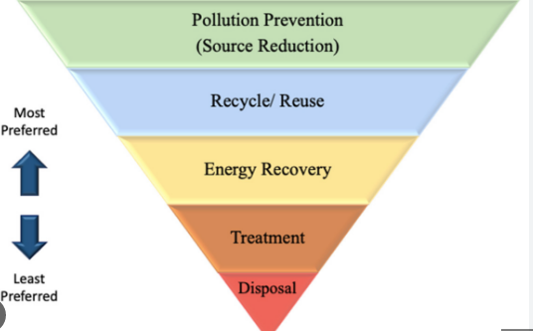
EVALUATING THE SOLUTIONS IN TERMS OF MITIGATING THE CRITICAL ISSUES REGARDING CONSUMPTION AND PRODUCTION PATTERNS OF CONSUMERS AND BUSINESSES
The food retail organisations can focus on developing decent work and economic growth by producing paper bags instead of plastic bags in the global market.
As per the opinion of Vadera and Khan (2021), paper bags are biodegradable, recycled, and reusable which helps to reduce the negative impact on the environment in the global market.
The food retail sector has used paper bags in terms of minimising pollution, and reducing climate change issues around the world.
Leading food retailers like Sainsbury's use paper bags for packaging their products and food items which helps to reduce pollution (Sainsbury.co.uk, 2023).
Food retail organisations can focus on contributing to the growth of the forest mass by using paper products in the global market.
Notes:
On the other hand, energy organisations also reduce energy use in terms of managing the carbon footprint issues in the environment. The energy industry can focus on using modern energy services such as solar panels in terms of reducing energy consumption rate. It can help to reduce pollution in the world by reducing the energy consumption rate. Energy organisations produce renewable energy sources in terms of using solar panels for reducing pollution in the world. Thus it can be stated that solar energy is one of the cleanest forms of energy which is a sustainable development plan of organisations for reducing pollution in the air. It also promotes energy independence which maintains the UN's sustainable goals for supporting households.

Slide 11
CONCLUSION
On a concluding note, it can be stated that the study has discussed the sustainable improvement plan which increases the ability of the industries in terms of managing the environmental impacts.
Moreover, production patterns and consumer behaviour also lead to a negative impact on the environment and the world.
In this context, the industry can focus on developing sustainable plans and strategies to increase its responsibilities for reducing pollutants in the air.
Notes:
In turn, global organisations like food retailers can focus on using paper bags instead of plastic bags in order to reduce the pollution rate in the environment. Moreover, the energy organisation provides solar system services which help to reduce the energy bills of the households and reduce pollution by processing renewable energy sources.

Slide 12
REFERENCES
Kumar, A., Luthra, S., Mangla, S.K. and Kazançoğlu, Y., (2020). COVID-19 impact on sustainable production and operations management. Sustainable Operations and Computers, 1, pp.1-7.
Stavi, I., Paschalidou, A., Kyriazopoulos, A.P., Halbac-Cotoara-Zamfir, R., Siad, S.M., Suska-Malawska, M., Savic, D., Roque de Pinho, J., Thalheimer, L., Williams, D.S. and Hashimshony-Yaffe, N., (2021). Multidimensional food security nexus in drylands under the slow onset effects of climate change. Land, 10(12), p.1350.
Biggs, B.C., (2021). Trace Gas Emissions from California Landfills and Dairies: The Impact on Disadvantaged Communities and the Environment. University of California, Irvine.
Adeyanju, G.C., Augustine, T.M., Volkmann, S., Oyebamiji, U.A., Ran, S., Osobajo, O.A. and Otitoju, A., (2021). Effectiveness of intervention on behaviour change against use of non-biodegradable plastic bags: a systematic review. Discover sustainability, 2, pp.1-15.
Basak, S., Das, M.K. and Duttaroy, A.K., (2020). Plastics derived endocrine‐disrupting compounds and their effects on early development. Birth defects research, 112(17), pp.1308-1325.
Isabelle, D.A. and Westerlund, M., (2022). A review and categorization of artificial intelligence-based opportunities in wildlife, ocean and land conservation. Sustainability, 14(4), p.1979.
Javaid, M., Haleem, A., Singh, R.P., Suman, R. and Gonzalez, E.S., (2022). Understanding the adoption of Industry 4.0 technologies in improving environmental sustainability. Sustainable Operations and Computers.
Statista.com, (2023). Global transportation issues. Available at: https://www.statista.com/statistics/1185535/transport-carbon-dioxide-emissions-breakdown/ [Accessed on: 14th April 2023]
Statista.com, (2023). Carbon footprint. Available at: https://www.statista.com/statistics/1233409/carbon-footprint-of-cars-by-type-uk/ [Accessed on: 14th April 2023]
Statista.com, (2023). Using plastic bags. Available at: https://www.statista.com/statistics/792070/single-use-plastic-carrier-bags-issued-england/ [Accessed on: 14th April 2023]
Statista.com, (2023). Electric cars. Available at: https://www.statista.com/chart/25412/life-cycle-emissions-savings-of-electric-cars/#:~:text=Depending%20on%20the%20current%20electricity,66%2D69%20percent%20in%20Europe [Accessed on: 14th April 2023]
Sainsburys.co.uk, (2023). the sustainable strategy of the company. Available at: https://www.sainsburys.co.uk/gol-ui/product/by-sainsburys-paper-bags?catalogId=10241&productId=879474&storeId=10151&langId=44&krypto=LOp5ys2M7euOLagGc2HhnY1RxHC7u%2BpW9VpbdrE09AYbrKIn6z%2F4IPYnTIyTWi2Dq%2BygRdG9LgqHse5idvO7uQRruS7g7sXmsUmGzkgYa95wnzLneLtE%2BIt%2BPVov4iZr&ddkey=https%3Agb%2Fgroceries%2Fby-sainsburys-paper-bags [Accessed on: 14th April 2023]
Alexandratos, S.D., Barak, N., Bauer, D., Davidson, F.T., Gibney, B.R., Hubbard, S.S., Taft, H.L. and Westerhof, P., (2019). Sustaining water resources: Environmental and economic impact. ACS Sustainable Chemistry & Engineering, 7(3), pp.2879-2888.
Jha, C.K., Kumar, A. and Sinha, S.K., (2021). Legumes as Soil Building Crops for Improving Soil Quality Index in Sugarcane Production System. AGRICULTURE & FOOD: e-NEWSLETTER.
Giungato, P., Moramarco, B., Rana, R.L. and Tricase, C., (2023). Carbon footprint of FFP2 protective facial masks against SARS-CoV-2 used in the food sector: effect of materials and dry sanitisation. British Food Journal.
Woody, M., Arbabzadeh, M., Lewis, G.M., Keoleian, G.A. and Stefanopoulou, A., (2020). Strategies to limit degradation and maximize Li-ion battery service lifetime-Critical review and guidance for stakeholders. Journal of Energy Storage, 28, p.101231.
Xia, X. and Li, P., (2022). A review of the life cycle assessment of electric vehicles: Considering the influence of batteries. Science of the Total Environment, p.152870.
An, H., Razzaq, A., Nawaz, A., Noman, S.M. and Khan, S.A.R., (2021). Nexus between green logistic operations and triple bottom line: evidence from infrastructure-led Chinese outward foreign direct investment in Belt and Road host countries. Environmental Science and Pollution Research, 28(37), pp.51022-51045.
Vadera, S. and Khan, S., (2021). A critical analysis of the rising global demand of plastics and its adverse impact on environmental sustainability. J. Environ. Pollut. Manag, 3, p.105.

