Slide 1

Supporting Dignity and Respect Through Ethical Principles

Slide 2
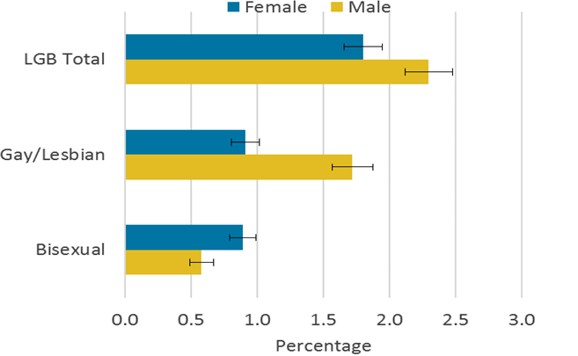
Introduction
The aim of the presentation is to provide an assessment on supporting respect and dignity to the people based on ethical principles
The considered target population for the presentation is the Young LGBT community, who face familial rejections
The presentation shares valuable insights about the strategies that can be deployed by the social workers in addressing the mentioned challenge
A specific case study is taken into consideration from Stonewall Housing excerpt to conduct the study

Slide 3
Young homeless LGBT population in UK
A meagre portion of the UK population accounts to the LGBT segment
As of 2020, 93.6% of the UK population labeled themselves as heterosexual (tuc.org.uk, 2023)
The same year identified 3.1% of the UK population to belong to the LGBT community and it is growing (ons.gov.uk, 2023)
People aged between 18 to 24 years identified as LGBT community comprise 8% of the population as of 2020 ratio (tuc.org.uk, 2023)
There is a total estimate of almost 80,000 people who make up to the LGBT population in the UK (ons.gov.uk, 2023)
24% of the 80,000 benchmark fall into the young LGBT community (ons.gov.uk, 2023)
Out of the 24%, 69% of the population have found to be homeless, facing familiar rejection, attack on dignity and even suffering from homophobia (tuc.org.uk, 2023)
Notes:
this slide introduces the numbers and percentages that comprise a significant portion of the UK population, which include the LGBT community. A considerable percentage of the homeless include young LGBTs who face family non-acceptance, social castration and identity crisis.

Slide 4
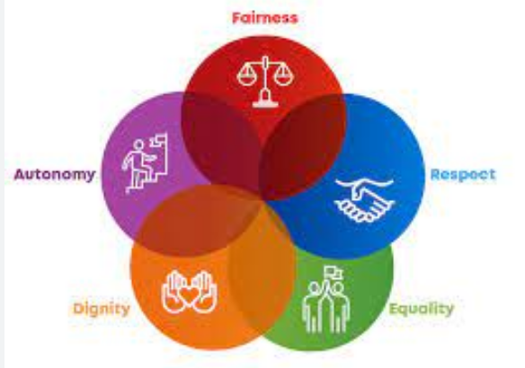
1st Question: Ethical concepts: Freedom
The Human Rights Act 1998 defines the right of the people in the UK, irrespective of their caste, orientation and race (Butchard and Kinderman, 2019)
Every individual has the right and freedom to act autonomously in selecting the type and delivery of care
The FREDA principles determine the professionals standards and values of act for the social workers to be followed in the given situation (Henrickson, 2018)
The social worker is supposed to offer autonomy to the client in the given situations to select the treatment process
Notes:
this slide introduces the FREDA principles and concept of freedom or autonomy of the client in selecting or refusing to take attention from the social care worker. The client also has the right to know about the process of care.

Slide 5

Rights
The client in this regard has the right to know about the process of treatment and the person offering the treatment (George and Ekoh, 2020)
He even has the right to ask questions and even quit seeking a proper explanation on the type of treatments offered (Witt and Medina-Martinez, 2022)
Notes:
this slide defines the rights of the client in knowing the type of treatment along with the possible course of action. Further, the slide also talks about the right of the client to even refuse to take the treatment if he feels so with a good reason behind it.

Slide 6

Responsibilities
It is the responsibility of the social care worker to deliver the best course of treatment to the client
The social worker must comply with the responsibilities and thereby deliver the best care practices to the client (Redcay et al., 2019)
Notes:
this slide explains about the responsibilities of the social workers, who assure to deliver the best course of treatment along with complying with the ethical standards and deliver the best care practices to the client.

Slide 7

Use of power in care
The social care workers must act in power and dignity to render respect to the clients
The social worker possesses the power to discharge the duties to the clients with discretionary powers and authenticity (Hafford‐Letchfield et al., 2018)
The social care worker must also be aware of the client’s need and have the knowledge to deliver the required care for the client (Westwood, 2022)
Notes:
this slide interprets the use of power in care delivery by the social worker in the given case study. The social workers must exert his power in the best possible way to ensure discharge of duties in an ethical way.

Slide 8
2nd Question: Strategies to employ support and respect to Jamie’s dignity
7: 2nd Question: Strategies to employ support and respect to Jamie’s dignity
The FREDA principles focus on Fairness, Respect, Equality, Dignity and Autonomy
The social workers must focus on delivering dignity and respect to Jamie by providing care and upholding the respect of the client (Stein et al., 2020)
The social workers need to determine the capacities of Jamie and ambitions and hence ensure protection of the rights of Jamie
Further, the social care worker must promote social activities and encourage motivational interviewing through effective conversation (Henrickso et al., 2020)
Notes:
This slide introduces the strategies that can be deployed by the social care workers to deliver the best of care practices along with dignity and respect to the considered client Jamie. Since, Jamie is a young LGBT member; she needs to be encouraged in conversation along with motivating social activities.

Slide 9

Strategies continued
The social care worker for Jamie must create a conducive environment for her to open up and share her views and feel relaxed
Jamie must be allowed to share her views and opinions in respect to selecting their way of dressing up
Jamie must be given enough importance to make decisions and behave with dignity and self-respect
Notes:
This slide continues the previous slide and reveals some additional strategies that can be deployed by the social care worker to ensure that Jamie retains her confidence. Further, Jamie should be allowed to talk and share more along with acting in a confident manner, by taking part in the decision making processes.

Slide 10
3rd Question: Ways to maintain effective communication
The social workers in this case scenario need to maintain a process of effective communication
The best ways to ensure maintenance of effective communication can be done through continued conversations and interactions with the clients
The social care workers must engage in both verbal and non-verbal skills with Jamie and develop respectful relationship with the clients (Silva et al., 2021)
Listening skills and active participation with client conversation would be helpful
Notes:
this slide responds to the second question of the case study and identifies the ways which can be used by the social care worker to maintain effective communication with Jamie. The use of both verbal and non-verbal skills must be done to engage the process. Additional focus is laid on the use of active listening skills to interact with Jamie in an engaging manner.

Slide 11

Using interpersonal skills
Engage in efficient verbal skills with the client
The social care worker must allow Jamie to talk more and even find strategies to manage conflicts
The social care worker must clarify with Jamie by knowing her issues and findings strategies to resolve difficult situations along with engaging in continued communication (George and Ekoh, 2020)
The care worker must also ensure to communicate with Jamie, by integrating the attributes of critical thinking, keeping patience, and showing an empathetic approach
Notes:
this slide continues the previous one and recognizes the interpersonal skills that can be used by social care workers in delivering the best communication practices with Jamie. The skills include empathetic approach along with keeping patience and even indulge in a process of critical thinking (Butchard and Kinderman, 2019). Further, focus needs to be laid on allowing Jamie to speak more and share her problems.

Slide 12
Compassion, dignity and respect
The social care workers must engage in complying with the tenets of compassion, dignity, and respect
In communicating with the client Jamie, it is important to consider her age
The social care worker must also emphasise on engaging in a compassionate approach and deliver the care services based on empathy and resilience
The social care workers must also focus on ensuring a protection of the dignity and respect for Jamie and change her perception about life (Henrickson, 2018)
Jamie must be motivated by the social care worker through a coherent process of engagement and involvement in the decision making process
Notes:
this slide interprets the three fundamental aspects of compassion, dignity, and respect, which play an important role in the process of care delivery for Jamie, by the social care worker. The slide talks about empathy, resilience, change of perception about life and involvement in the decision making process.

Slide 13
Delivering best possible support to Jamie
The social care worker in regards to the delivery of care for Jamie, must consider her age and vulnerable nature
The best possible care services can be delivered to Jamie by promoting the laws and policies, which would protect the rights and freedom of Jamie
Further focus should be laid on affirming support for Jamie, by allowing her to speak her heart out and even express her issues
Jamie must be comforted and the social care worker must emphasise on upholding her dignity , respect and ensuring the retention of confidence within her
Jamie must be allowed to express her opinions along with retaining the ability to feel confident along with sustaining her identity
The social care workers must focus on convincing her about her social identity and prevent her from indulging in any form of unsocial activities
Notes:
This slide discusses the best possible ways wherein the social care worker must attain to deliver the best care services to Jamie and retain her social identity and confidence. Additionally, the slide also states that Jamie must be allowed to engage in effective decision making processes, wherein the social care workers must ensure social support, by engaging in motivational interviewing process

Slide 14

Conclusion
The presentation shares adequate information about the ways in which a social care worker would be able to deploy care to LGBT clients
Specific strategies are mentioned that can be applied in the given case of Jamie, which would include empathy, respect, dignity and autonomous decision making processes

Slide 15
References
Butchard, S. and Kinderman, P., 2019. Human rights, dementia, and identity. European Psychologist.
Cobb, A.S.and P. (2022) Sexual orientation, UK: 2020, Sexual orientation, UK - Office for National Statistics. Office for National Statistics. Available at: https://www.ons.gov.uk/peoplepopulationandcommunity/culturalidentity/sexuality/bulletins/sexualidentityuk/2020 (Accessed: April 21, 2023).
George, E.O. and Ekoh, P.C., 2020. Social workers' perception of practice with lesbians, gays and bisexuals (LGBs) in Nigeria. Journal of Comparative Social Work, 15(2), pp.56-78.
Hafford‐Letchfield, T., Simpson, P., Willis, P.B. and Almack, K., 2018. Developing inclusive residential care for older lesbian, gay, bisexual and trans (LGBT) people: An evaluation of the Care Home Challenge action research project. Health & social care in the community, 26(2), pp.e312-e320.
Henrickson, M., 2018. Promoting the dignity and worth of all people: The privilege of social work. International Social Work, 61(6), pp.758-766.
Henrickson, M., Giwa, S., Hafford-Letchfield, T., Cocker, C., Mulé, N.J., Schaub, J. and Baril, A., 2020. Research ethics with gender and sexually diverse persons. International journal of environmental research and public health, 17(18), p.6615.
Redcay, A., McMahon, S., Hollinger, V., Mabry-Kourt, H.L. and Cook, T.B., 2019. Policy recommendations to improve the quality of life for LGBT older adults. Journal of Human Rights and Social Work, 4, pp.267-274.
Safe housing for LGBT people is a matter of life and death (no date) TUC. Available at: https://www.tuc.org.uk/research-analysis/reports/safe-housing-lgbt-people-matter-life-and-death (Accessed: April 21, 2023).
Silva, J.C.P.D., Cardoso, R.R., Cardoso, Â.M.R. and Gonçalves, R.S., 2021. Sexual diversity: a perspective on the impact of stigma and discrimination on adolescence. Ciência & Saúde Coletiva, 26, pp.2643-2652.
Stein, G.L., Berkman, C., O'Mahony, S., Godfrey, D., Javier, N.M. and Maingi, S., 2020. Experiences of lesbian, gay, bisexual, and transgender patients and families in hospice and palliative care: perspectives of the palliative care team. Journal of Palliative Medicine, 23(6), pp.817-824.
Westwood, S., 2022. Religious‐based negative attitudes towards LGBTQ people among healthcare, social care and social work students and professionals: A review of the international literature. Health & Social Care in the Community, 30(5), pp.e1449-e1470.
Witt, H. and Medina-Martinez, K., 2022. Transgender rights & the urgent need for social work advocacy. Social Work in Public Health, 37(1), pp.28-32.

Slide 16


