Slide 1
OPERATIONS RESEARCH & LOGISTICS
CASE STUDY ON ASTON MARTIN

Slide 2
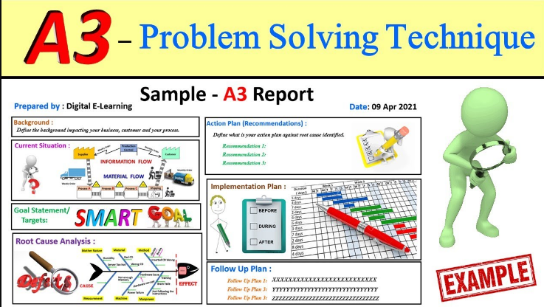
Introduction
The operation and logistics methodology of Aston Martin is performed
A3 Tool is used for conducting the assignment
The study identifies the logistics challenge of Aston Martin in particular the waiting line system.
An action plan is proposed for optimising operation and tracking progression.
Notes:
The assignment performs analysis on the operation and logistics methodology of Aston Martin in particular the waiting line system. The study is presented with the help of the A3 tool including information related to the logistics challenge of Aston Martin. Goals and targets are identified with the presentation of an action plan and tracking of progression.

Slide 3
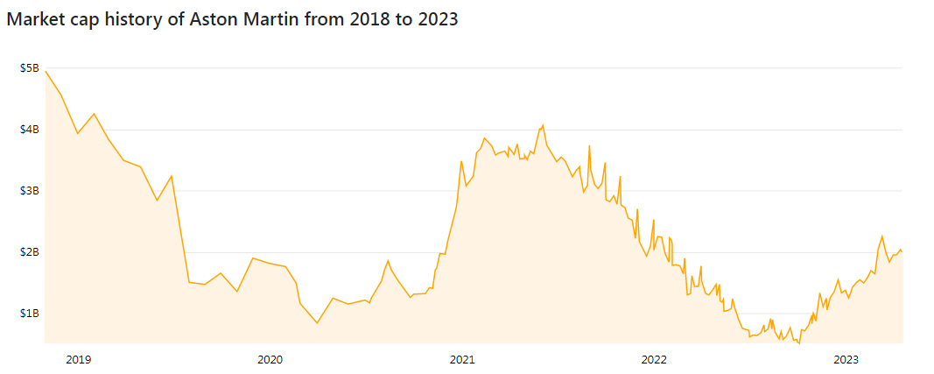
Company background
Aston Martin manufactures provide service for sports car
The market cap of Aston Martin is 2.01 billion dollars in 2023 (Companies market cap, 2023).
Problem: Fail in delivery of cars due to electrical problems in SC and weakness of the pound (Independent.Co.UK, 2022).
Figure: Market cap of Aston Martin
(Source: Companies market cap, 2023)
Notes:
Aston Martin is an automotive company that manufactures and provides services on exclusive sports car brands. Aston Martin holds a market cap of 2.01 billion dollars in 2023 and holds the 3740th position in the automobile sector (Companies market cap, 2023). The current logistics problem faced by Aston Martin is the failure to deliver fewer cars due to SC issues affected by the weakness of the pound and electrical problems (Independent.Co.UK, 2022).

Slide 4
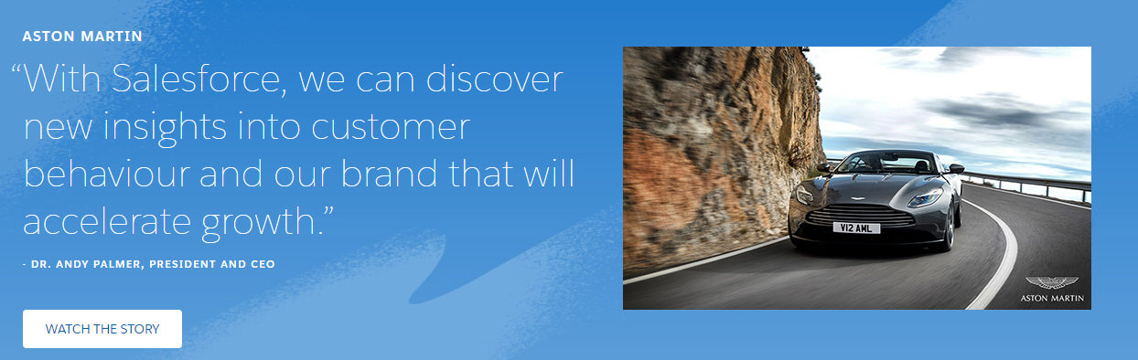
Situational analysis of the waiting line system
The waiting-for-line system is beneficial for eliminating time-wasting distractions
It manages relations with customers and reduces consumer complaints (Ebert et al. 2019).
Aston Martin uses Sales force technology to perform waiting-for-line system
Sales force technology adds quality to customers' service and relationships (Sales force, 2023).
A3 tools are implemented for creating a plan and undertaking problem-solving action
Notes:
The implementation of a waiting-for-line system is important in a business for eliminating time-wasting distractions and managing customers and decreasing consumer complaints (Ebert et al. 2019). It deals with the management of customer services and reducing wait time. Aston Martin maintains its relationship with customers and provides service with the help of Salesforce technology that adds quality to customers' service and relationships (Sales force, 2023).

Slide 5
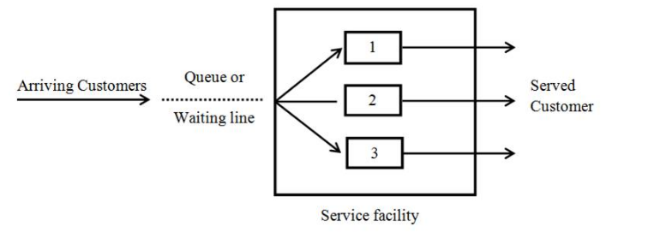
Proposal for introducing a waiting line system in Aston Martin
Plan is proposed for implementing the waiting-for-line system in Aston Martin
The result of implementation will be eliminating time waste distractions
Improved service quality through enhancing visibility (He et al. 2022)
Improving the customer journey and reducing waste time
Notes:
The plan proposed is associated with the implementation of the waiting-for-line system in the service delivery process of Aston Martin. The implementation of this system will provide several benefits such as improving employee efficiency by eliminating time waste distractions in managing customers (He et al. 2022). Improved service quality for enhancing visibility, and better storewide sides for improving the customer journey and reducing waste time

Slide 6
An action plan for implementation
Strategy | Success criteria | Action | Resources | Implementation | Time taken
Reducing waste time | Improved employee efficiency and reduced customer time interaction | Providing communication training and customer handling training | Technological guidance and support | Implemented with a reduced physical line | 2-3 weeks
Improving service quality | Reduction in the waiting line of customers | Introducing technology for improving interaction | Customer data | Development of tailored service | 4-5 weeks
Increased customer loyalty | Repetitive revenue | Introduction of the queue management system | Customers Feedback | Implemented with prioritization service | 5-6 weeks

Slide 7
Tracking progress on the action plan and follow-up activities
Progress is tracked by creating deliverables
The setting of milestones with realistic expectations
Implementation of project tracking software for analysing results (Akbar et al. 2019).
Notes:
Tracking of progression takes place through creating deliverables and setting milestones with realistic expectations. The utilisation of project tracking software for analysing results and tracking changes is introduced action takes place (Akbar et al. 2019). In addition, maintaining transparency in results and achieving measurable goals.

Slide 8
Reference list
Akbar, M.A., Sang, J., Khan, A.A., Mahmood, S., Qadri, S.F., Hu, H. and Xiang, H., (2019). Success factors influencing requirements change management process in global software development. Journal of Computer Languages, 51, pp.112-130.
Companies market cap, 2023. The market capitalization of Aston Martin. Available at: https://companiesmarketcap.com/aston-martin/marketcap/ Available at:
Ebert, J.F., Huibers, L., Christensen, B., Lippert, F.K. and Christensen, M.B., (2019). Giving callers the option to bypass the telephone waiting line in out-of-hours services: a comparative intervention study. Scandinavian Journal of primary health care, 37(1), pp.120-127.
He, S., Shen, F., Jin, L., Song, D., He, X. and Khan, M., (2022). Characteristics of subway air quality and favourable locations for passengers waiting and taking the subway. Atmospheric Pollution Research, 13(7), p.101482.
Independent.Co.UK, (2022). Supply chain problems hit Aston Martin deliveries and profits. Available at: https://www.independent.co.uk/business/supply-chain-problems-hit-aston-martin-deliveries-and-profits-b2215800.html Available at:
Salesforce, (2023). Aston Martin gears up for growth with Salesforce. Available at: https://www.salesforce.com/in/customer-success-stories/aston-martin/ [Accessed on 16th April 2023].

Slide 9
Thank you

