Slide 1
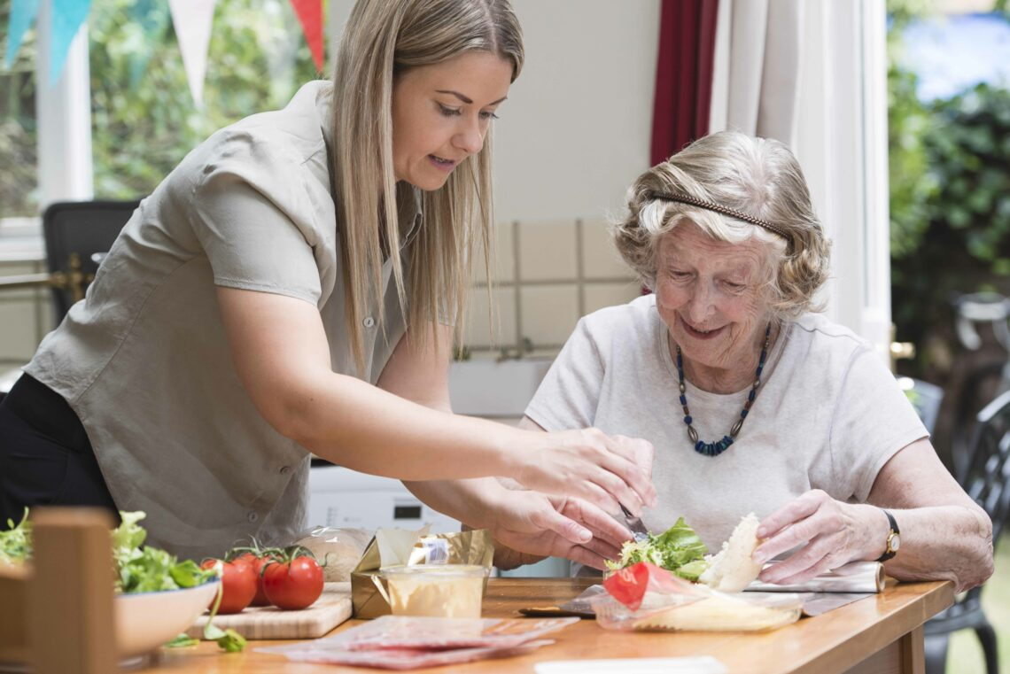
HEALTH AND WELL-BEING PRESENTATION

Slide 2
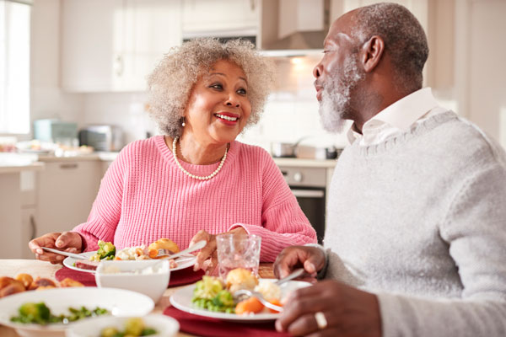
Group member 1: Refer to national guidelines and indicate using statistics whether your age group are meeting the guidelines.
People aged 65 years or more adopt similar eating patterns to younger adults.
A proper diet should be maintained to intake all the nutrients.
The elderly people should reduce their dietary intake of fat and simple sugars.
They should increase in taking starchy foods, vitamin D and polysaccharides.
Notes:
The Working Party On the Nutrition of Elderly People is seen to recommend that people who are aged 65 or more adopt a similar diet just like younger adults (Statutory Framework for the Early Years foundation stage, 2022). Additionally, it has been advised that they should have a diet that provides all the nutrients effectively that can provide them with proper nutrition.

Slide 3
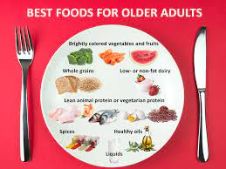
Refer to national guidelines and indicate using statistics whether your age group are meeting the guidelines… (Cont..)
They are encouraged to increase their impact on Vitamin C.
Elderly people should eat more fresh vegetables, whole grain cereals and fruits.
Their diets should moderate their plasma cholesterol levels.
Maintaining physical activity and consuming oily fish have been advised.
Notes:
A general assumption can be seen that older people should eat smaller amounts of meals. However, this is not true in many cases and it should be also mentioned that their meals should be nutritious as well as balanced. This means it is important for them to eat regularly and eat enough to get the perfect amount of nutrition.

Slide 4
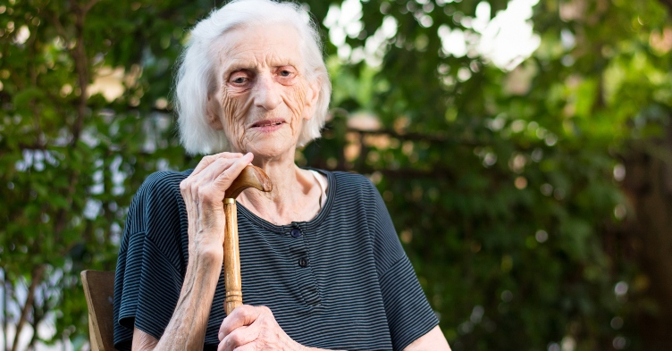
Refer to national guidelines and indicate using statistics whether your age group are meeting the guidelines… (Cont..)
The effect of malnutrition seems to be quite visible in the older population in the UK.
This reflects that proper guidelines are not being maintained.
1 among 10 people in the UK is lacking proper nutrition (Age UK, 2021).
Different social and economic factors are responsible for the scenario.
Notes:
It has been identified that malnutrition happens because of inadequate food intake along with dietary deficiency. In addition to this, it has also been observed that nutritional inadequacy in the elderly is also related to physiologic, pathologic, psychologic and sociological factors. Apart from that, the difficulty of the clinicians in the process of identifying the underlying factors that are contributing to the problems is also considered to be the biggest issue.

Slide 5
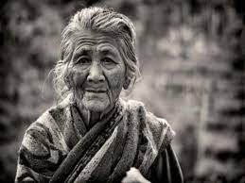
Short term and long term consequences of poor habits for chosen focus
It brings severe changes in daily living and the quality of life in older people.
This issue can develop geriatric syndrome in older adults.
It has the ability to increase mortality and morbidity.
Notes:
The information highlights that different social factors like isolation and loneliness are seen to be associated with decreasing nutrition and creating an impact on dietary intake among older adults. 3.8 million people in the UK aged over 65 are seen to live alone which is also creating an impact on their eating behaviour (Evans, 2019).

Slide 6
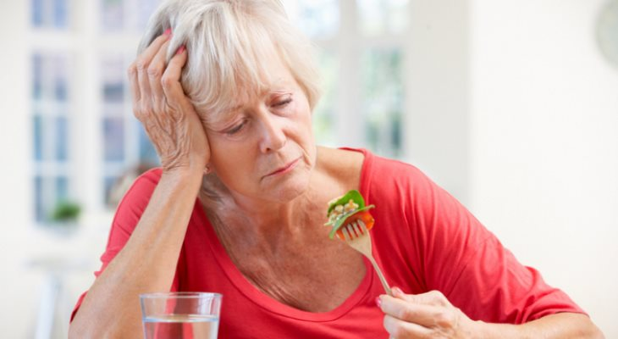
Group member 2: Identify 3 key aims and explain the benefit of achieving those aims. Ensure your aims can be measured
Increasing the awareness of the elderly population about the nutritional benefits of food.
Organising events that can help them to increase their physical activities by 20%.
Providing them with mental support so that they do not feel isolated.
Notes:
With the declining activity levels, it has been seen that energy falls in older age and eating less amount of food is seen to be expected from the older population (Krok-Schoen et al., 2019). Due to the fact that the total amount of food consumption is gradually declining, it becomes really important to intake a huge amount of nutritious food so that the energy requirements can be made in the elderly people. This particular campaign is highlighting three of the significant aims that can provide significant benefits to the population while dealing with the issue.

Slide 7
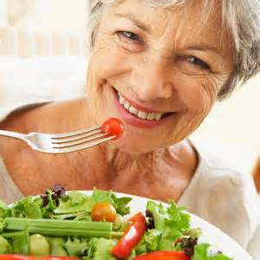
Identify 3 key aims and explain the benefit of achieving those aims. Ensure your aims can be measured… (Cont..)
While increasing awareness it can be easy to make them understand the need to intake nutritious food.
Participating in physical activity events can make them physically active.
Getting mental support can make them happy which can enhance their move to intake food.
Notes:
With the help of increasing awareness among these people, can enlighten and motivate them to be healthy in the process of eating nutritious food. In addition to this, providing them with the right opportunity to participate in physical activity events can allow them to be active which is beneficial to deal with diseases (Jiménez-Pavón et al., 2020). Apart from that, arranging mode care homes and providing them mental support for those who live alone so that they do not feel reluctant to have food timely.

Slide 8

Identify types of evaluation and ways of measuring whether the aims have been achieved
Gathering community insights and benchmarks can help to evaluate the outcomes of the campaign.
Being engaged in social listening can also help to understand the outcomes.
Developing an online portal and doing surveys about its effectiveness is beneficial.
Using social media to spread the campaign and obtain the campaign matrix.
Notes:
Getting connected with the community members can provide and see total evidence of the campaign's reach along with its impact. With the help of this, it becomes also easy to identify the changes in behaviour among the population who are at the risk. Using social media platforms can help to identify the views of the campaign, which reflects that people are getting conscious of this particular matter (Chauhan et al., 2021). Creating and testing a hashtag can also help to know about the success of this campaign along with setting up a social listening service like Google Alerts can also help in this scenario. Additionally, by counting the shared and downloaded content, it can be easy to know if the message has been amplified or not. Apart from that, identifying the demographics of the visitors is also beneficial.

Slide 9
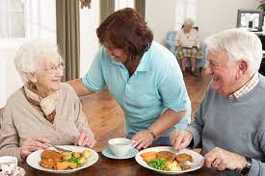
Create an eye-catching poster to advertise the campaign
Focus
Increasing the awareness of the elderly population about the nutritional benefits of food.
Organising events that can help them to increase their physical activities by 20%.
Providing them with mental support so that they do not feel isolated.
Activities
While increasing awareness it can be easy to make them understand the need to intake nutritious food.
Participating in physical activity events can make them physically active.
Getting mental support can make them happy which can enhance their move to intake food.
Benefits
Gathering community insights and benchmarks can help to evaluate the outcomes of the campaign.
Being engaged in social listening can also help to understand the outcomes.
Developing an online portal and doing surveys about its effectiveness is beneficial.
Using social media to spread the campaign and obtain the campaign matrix.
Notes:
This particular poster has been used to advertise the campaign that has been made to increase awareness among elderly people in the UK to enhance their nutrition-taking abilities.

Slide 10

Group member 3: Identify potential partners
Partnering with potential funders can help to promote the campaign in a better way (Chimhowu et al., 2019).
The connection can be developed with the philanthropy sectors for the development of the designs.
Taking the help of the nutritionist and doctors is also considered to be beneficial in this case.
Partnership can be developed with the local community for getting better outcomes.
Notes:
While using this potential partner it can be easy for this particular campaign to achieve great success and to reach a maximum number of the elderly population in the UK so that bigger changes can be made.

Slide 11

Psychological Benefits
It can make the elderly population physically and mentally fit.
The campaign is also beneficial for making them conscious of their weaknesses.
It has the ability to bring positive psychological changes.
Notes:
A lot of psychological benefits can be provided to the targeted population by developing this campaign, which can help them in many different ways.

Slide 12
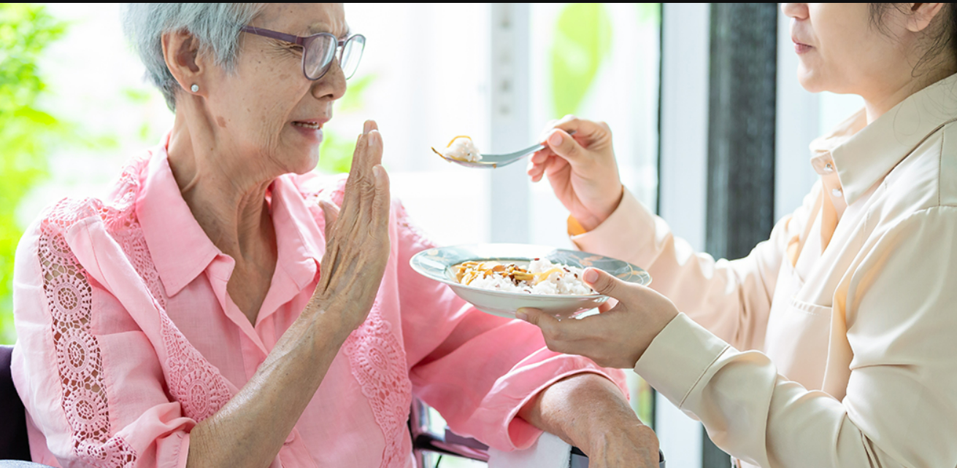
Sociological Benefits
A broader range of the population can be targeted with the help of this (Vlaev et al., 2019).
Significant responses can be provided to deal with the issue of malnutrition.
A healthy society can be made.
Notes:
The above-mentioned sociological benefits are seen to be quite evident in the process of promoting the campaign that can help the elderly population.

Slide 13
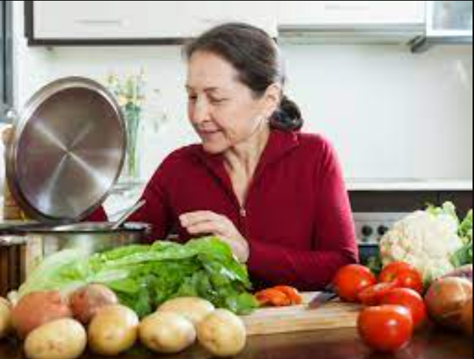
Physiological Benefits
It can be easy to deal with different elderly diseases.
Physical activities among the population can be increased.
Providing a healthy lifestyle to them can be easy.
Notes:
In the process of conducting this particular health camping a lot of benefits can be noticed among which the physiological benefits get significant importance. These benefits have been discussed in the above bullet points to provide proper knowledge that can help the target population.

Slide 14
Reference list
Chauhan, P., Sharma, N. and Sikka, G., 2021. The emergence of social media data and sentiment analysis in election prediction. Journal of Ambient Intelligence and Humanized Computing, 12, pp.2601-2627.
Chimhowu, A.O., Hulme, D. and Munro, L.T., 2019. The ‘New’national development planning and global development goals: Processes and partnerships. World Development, 120, pp.76-89.
Evans, C. 2019 Malnutrition in the elderly: A multifactorial failure to thrive, The Permanente journal. U.S. National Library of Medicine. Available at: https://www.ncbi.nlm.nih.gov/pmc/articles/PMC3396084/#:~:text=Malnutrition%20is%20often%20due%20to,a%20combination%20of%20these%20factor . (Accessed: April 18, 2023).
Jiménez-Pavón, D., Carbonell-Baeza, A. and Lavie, C.J., 2020. Physical exercise as therapy to fight against the mental and physical consequences of COVID-19 quarantine: Special focus in older people. Progress in cardiovascular diseases, 63(3), p.386.
Krok-Schoen, J.L., Archdeacon Price, A., Luo, M., Kelly, O.J. and Taylor, C.A., 2019. Low dietary protein intakes and associated dietary patterns and functional limitations in an aging population: a NHANES analysis. The journal of nutrition, health & aging, 23(4), pp.338-347.
Malnutrition, 2021 Age UK. Available at: https://www.ageuk.org.uk/information-advice/health-wellbeing/conditions-illnesses/malnutrition/#:~:text=It's%20estimated%20that%20around%20one,people%20in%20the%20UK%20today (Accessed: April 18, 2023).
Statutory framework for the Early Years foundation stage - gov.uk, 2022. Available at: https://assets.publishing.service.gov.uk/government/uploads/system/uploads/attachment_data/file/974907/EYFS_framework_-_March_2021.pdf (Accessed: April 18, 2023).
Vlaev, I., King, D., Darzi, A. and Dolan, P., 2019. Changing health behaviors using financial incentives: a review from behavioral economics. BMC public health, 19(1), pp.1-9.

