Slide 1
ROLE OF IOT IN THE SECURITY OF SMART HOME

Slide 2
Table of Contents
Introduction
Slide-1
A different vision of Aspiration for AI from Scientific Literature and Published Material
Slide-2
Chart the historical context of the topic and explain significant events in its Development.
Slide-3.
The social impact and ethical aspects of the IoT, including comparatively from different ethical perspectives.
Slide-4.
Identify and examine key challenges or barriers to further developing current knowledge and practice in the topic.
Slide-5.
Establish and justify a position, grounded in the above context and discussions, on how research in this area should proceed.
Slide-6
Recommendation.
Slide-7.
Conclusion
Slide-8.

Slide 3
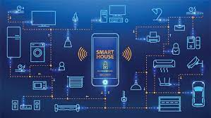
Introduction
This presentation aims to explain the historical context of the IoT
How various schools of thought on AI( Artificial Intelligence) have helped to approach this IoT
Ethical issues related to IoT
It will also identify the current state of the art related to IoT and will examine the key challenges in developing current practices in IoT.
Notes:
The development of AI and usage of the IoT in the security level of Smart home building ensure various interphases and connectivity between various devices and users interface.
This presentation aims to explain the historical context of the IoT and how various schools of thought on AI( Artificial Intelligence) have helped to approach this IoT and will lay emphasis on the social and ethical issues related to IoT. It will also identify the current state of the art related to IoT and will examine the key challenges in developing current practices in IoT.

Slide 4
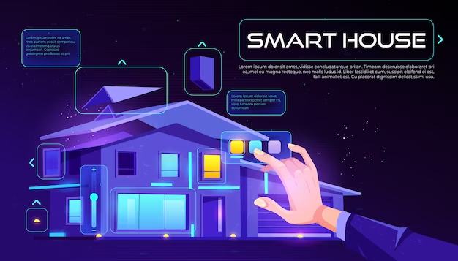
A different vision of Aspiration for AI from Scientific Literature and Published Material
Kumar et al.,(2021) show that AI can be used in order to estimate the level of comfort of the users in terms of their living standards such as smart remote control, optimal utilization of resources, and the level of security in the home appliances
Rio et al., (2019) show there are mainly six major components by which the AI can monitor the overall operation and they are recognition of the activity, processing of data, voice recognition, image processing, phase of decision making, and predictive analysis of the operation.
The smart program (like Google Family link) can send an SOS message automatically if any unnatural behaviour is detected from their end.
Notes:
AI can be used in order to estimate the level of comfort of the users in terms of their living standards such as smart remote control, optimal utilization of resources, and the level of security in the home appliances. There are mainly six major components by which the AI can monitor the overall operation and they are recognition of the activity, processing of data, voice recognition, image processing, phase of decision-making, and predictive analysis of the operation.
They can share their location and if any mishap happens then parents can know the location of their children by their smartphones and take preventive measures. The smart program (like Google Family link) can send an SOS message automatically if any unnatural behaviour is detected from their end.

Slide 5
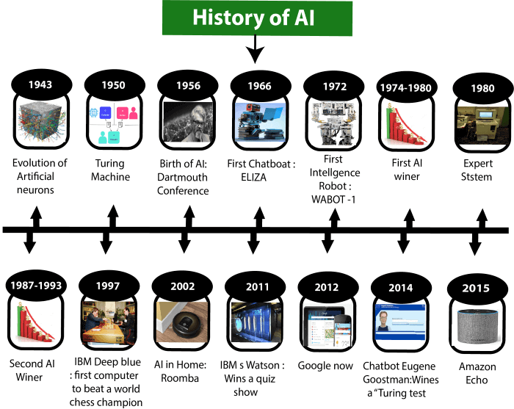
Chart the historical context of the topic and explain significant events in its Development.
In the year 2008, the European Technology Platform on Smart Systems Integration (ETA EPoSS) formulates the word ‘Internet of Things (IoT)’ which is based on smart communication among people
In the year of 2009, CASAGRASS suggests a proposal for integration between physical and virtual objects. It offers identification, sensing of the object, and connectivity between different parameters of AI (Chin et al., 2019)
.In the year of 2010, The Internet Engineering Task Force (IETF) formulates the very concept of seamless communication between the different sections of AI
The INTEL in the year 2017 creates a robust design in the electronic processor that is embedded with the internal core system
Notes:
In the year 2008, the European Technology Platform on Smart Systems Integration (ETA EPoSS) formulates the word ‘Internet of Things (IoT)’ which is based on smart communication among people. In the year of 2009, CASAGRASS suggests a proposal for integration between physical and virtual objects. It offers identification, sensing of the object, and connectivity between different parameters of AI.In the year of 2010, The Internet Engineering Taskforce (IETF) formulates the very concept of seamless communication between the different sections of AI. The INTEL in the year 2017 creates a robust design in the electronic processor that is embedded with the internal core system to generate the data for the user interface

Slide 6
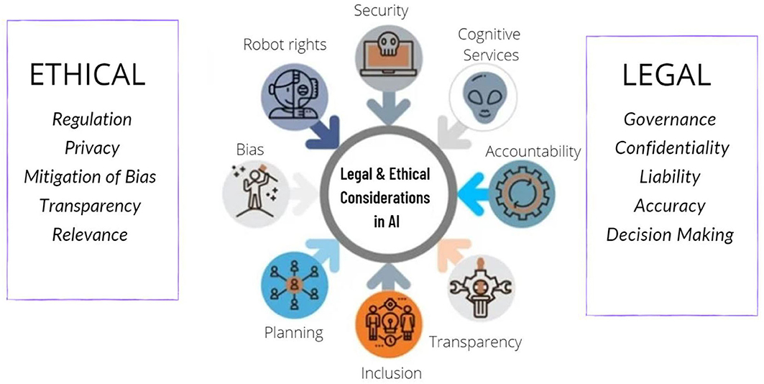
The social impact and ethical aspects of the IoT, including comparatively from different ethical perspectives.
The number of devices that are connected today is about 31 billion which is estimated to rise to 75 billion by 2025.
Authentication is required to control such devices so that the information cannot easily tamper so it should be encrypted and protected by a password.
It has been observed that cybercriminals often hack Security locks and other systems by easily getting access with the help of IoT devices that are connected.
Notes:
The use of IoT devices has become ubiquitous and the number of devices that are connected today is about 31 billion which is estimated to rise to 75 billion by 2025. Secondly, authentication is required to control such devices so that the information cannot easily tamper so it should be encrypted and protected by a password, thirdly, only authorised users should have access to such devices (Ketu and Mishra, 2022). It has been observed that cybercriminals often hack Security locks and other systems by easily getting access with the help of IoT devices that are connected and captured various camera footage without the knowledge of the individual.

Slide 7
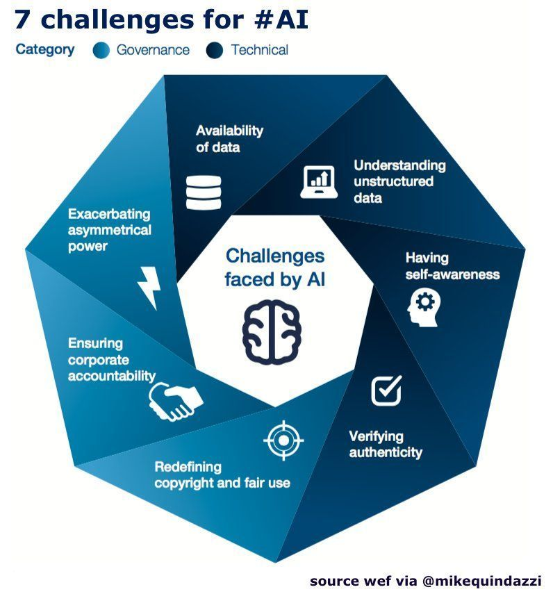
Identify and examine key challenges or barriers to further developing current knowledge and practice in the topic.
Integration-For the proper working of the IoT, it is necessary to integrate it with various devices and with various security platforms and data storage platforms like OS. Reliability-For the effectiveness of the IoT in smart homes it is necessary to be reliable and should be working efficiently few sensors that are easily available are in expensive but not reliable.
Strong Connectivity- Before implementing the IoT in smart homes it is necessary that the connectivity.
Quality check-It is important to check the quality of the devices connected with the IoT from time to time so that the security does not get open to threats.
Design of the device-IoT becomes an important thing across the world as the interface allows to use of multiple devices at a time
Notes:
Integration-For the proper working of the IoT, it is necessary to integrate it with various devices and with various security platforms and data storage platforms like OS.
Reliability-For the effectiveness of the IoT in smart homes it is necessary to be reliable and it should be working efficiently few sensors that are easily available are in expensive but not reliable.
Strong Connectivity- Before implementing the IoT in smart homes it is necessary that the connectivity.
Quality check-It is important to check the quality of the devices connected with the IoT from time to time so that the security does not get open to threats.
Design of the device-IoT becomes an important thing across the world as the interface allows to use of multiple devices at a time

Slide 8
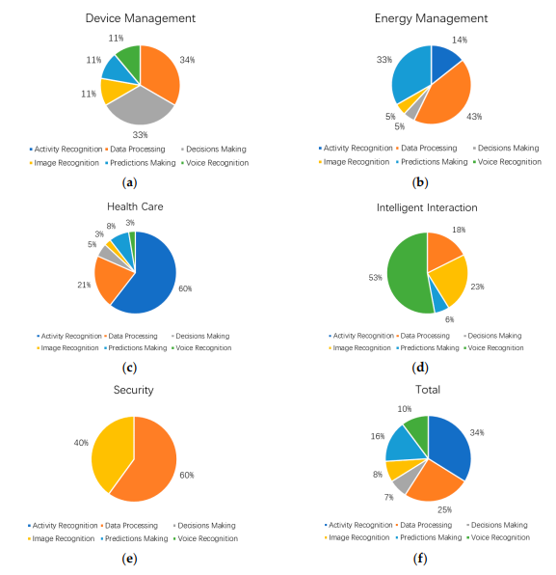
Establish and justify a position, grounded in the above context and discussions, on how research in this area should proceed.
In the case of security and surveillance, there are 60% of the data processing and 40% of the image recognition are done by AI.
In the overall data, it is seen that there is extensive work in the field of decision-making, voice-over control, and image recognition by AI is needed
AI can monitor body gestures and movements with a body temperature of the unknown and can trigger the alarm to generate consciousness.
Notes:
In the case of security and surveillance, there are 60% of the data processing and 40% of the image recognition are done by the AI in order to produce the outcomes. Any trespassing in the home premises by unauthorised people and AI can monitor the body gesture and movement with a body temperature of the unknown and can trigger the alarm to generate consciousness.
In the overall data, it is seen that there is extensive work in the field of decision-making, voice-over control, and image recognition by AI is needed. The overall neural architecture of building an AI framework is a huge task and time-consuming, however, with the aid of modern technology and innovation, AI is getting better with the passage of time.

Slide 9
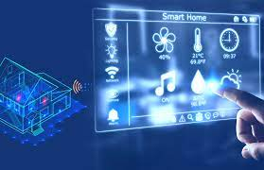
Recommendation
The most concerning fact, in this case, is the data privacy and data security of the people (Park et al., 2019).
The data may be affected by malware attacks and leakage of the data is always associated with people’s privacy and other important information.
There are visually impaired people and voice-over control can be a good medium for them (Abdi et al., 2019). The smart transcription and translation integrated with AI can be useful in this case.

Slide 10
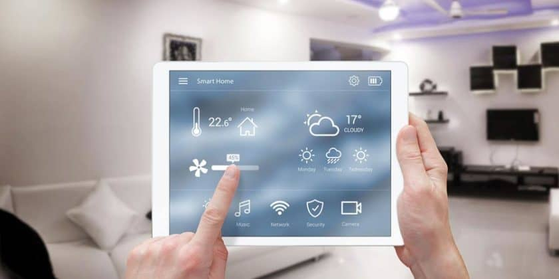
Conclusion
The Internet of Things (IoT) and AI are integral parts of each other and it saves a considerable amount of time for people and smart interaction with modern devices
the hierarchy in the AI algorithm still needs a considerably good amount of work to integrate with people’s lives and their daily work.
The avoidance of data breaches and malware attacks must be reduced in order to convey user information to the wrong hand.
Notes:
The Internet of Things (IoT) and AI are integral parts of each other and it saves a considerable amount of time for people and smart interaction with modern devices and well-established connectivity with a family member in the case of an emergency. Although it is true, that the hierarchy in the AI algorithm still needs a considerably good amount of work to integrate with people’s lives and their daily work. The avoidance of data breaches and malware attacks must be reduced in order to convey user information to the wrong hand.

Slide 11
References H
Guo, X., Shen, Z., Zhang, Y. and Wu, T., 2019. Review on the application of artificial intelligence in smart homes. Smart Cities, 2(3), pp.402-420.
Chin, J., Callaghan, V. and Allouch, S.B., 2019. The Internet-of-Things: Reflections on the past, present and future from a user-centered and smart environment perspective. Journal of Ambient Intelligence and Smart Environments, 11(1), pp.45-69.
Bryson, J.J., 2019. The past decade and future of AI’s impact on society. Towards a new enlightenment, pp.150-185.
Eliseeva, D.Y., Fedosov, A.Y., Agaltsova, D.V., Mnatsakanyan, O.L. and Kuchmezov, K.K., 2020. The evolution of artificial intelligence and the possibility of its application in cyber games. Amazonia Investiga, 9(28), pp.123-129.
Dong, B., Shi, Q., Yang, Y., Wen, F., Zhang, Z. and Lee, C., 2021. Technology evolution from self-powered sensors to AIoT enabled smart homes. Nano Energy, 79, p.105414.
Park, M., Oh, H. and Lee, K., 2019. Security risk measurement for information leakage in IoT-based smart homes from a situational awareness perspective. Sensors, 19(9), p.2148.
Notes:
Abdi, N., Ramokapane, K.M. and Such, J.M., 2019, August. More than Smart Speakers: Security and Privacy Perceptions of Smart Home Personal Assistants. In SOUPS@ USENIX Security Symposium.
Rio, Buck, J.J., Bainbridge, S.J., Burger, E.F., Kraberg, A.C., Casari, M., Casey, K.S., Darroch, L., J.D., Metfies, K., Delory, E. and Fischer, P.F., 2019. Ocean data product integration through innovation-the next level of data interoperability. Frontiers in Marine Science, 6, p.32.
Kumar Singh, Lv, Z., Qiao, L., A. and Wang, Q., 2021. AI-empowered IoT security for smart cities. ACM Transactions on Internet Technology, 21(4), pp.1-21.
Sepasgozar, S., Karimi, R., Farahzadi, L., Moezzi, F., Shirowzhan, S., M. Ebrahimzadeh, S., Hui, F. and Aye, L., 2020. A systematic content review of artificial intelligence and the internet of things applications in smart home. Applied Sciences, 10(9), p.3074.
Rocha, H.R., Honorato, I.H., Fiorotti, R., Celeste, W.C., Silvestre, L.J. and Silva, J.A., 2021. An Artificial Intelligence based scheduling algorithm for demand-side energy management in Smart Homes. Applied Energy, 282, p.116145.

