Slide 1
INTERNATIONAL MANAGEMENT GOVERNANCE AND SUSTAINABILITY - MMW226465 COURSEWORK 1 - GROUP ASSIGNMENT
SELECTED SDG: SDG 5

Slide 2

INTRODUCTION
The contemporary business landscape requires businesses to adapt to changes in the international environment.
The study provides an evaluation of the business management of Burberry in the international context.
There is a focus on the achievement of SDG 5: Gender equality by the company.
Notes:
Businesses face management challenges such as adapting to changing business needs in the areas of sustainability (SDG 5: gender equality) and governance. In this context, the study provides a discussion on the governance and sustainability strategy adopted by Burberry to manage changes in the international business environment.

Slide 3

1. ANALYSING OF THE EXPECTATION OF BURBERRY IN THE ACHIEVEMENT OF THE SDG 5: GENDER EQUALITY
The expectations of Burberry in the achievement of the SDG 5 include:
Increasing the number of women managers
Decreasing the pay gap between men and women employed in the business
Notes:
Sustainable Development Goals represent the core sustainability objectives such as gender equality that can enable the achievement of sustainability in the contemporary business landscape. In this context, SDG 5 provides the objective of achieving gender equality and the empowerment of women and girls across the world (United Nations, 2023). Accordingly, Burberry needs to focus on improving gender equality in its work to achieve the objective of SDG 5. SDGs represent business objectives that help improve sustainability (Mio et al. 2020). Burberry commits to deploying women leaders in its business and helping in the professional development of women by providing equal opportunities to grow through a mentoring framework (Burberry, 2023). Therefore, it can be understood that the expectation of Burberry in the achievement of the SDG 5 is to enhance gender equality in its job roles and management positions by employing more women.

Slide 4

1. ANALYSING OF THE EXPECTATION OF BURBERRY IN THE ACHIEVEMENT OF THE SDG 5: GENDER EQUALITY
The expectations of Burberry in the achievement of the SDG 5 include:
Mitigate instances of sexual harassment (Burberry, 2023)
Make women feel welcome at Burberry offices
Notes:
Furthermore, the company’s expectations include mitigating the gender pay gap in its business operations and achieving an inclusive workplace culture (Burberry, 2023). Thus, it can be said that Burberry’s prime expectation in the achievement of SDG 5 is to modify its internal practices and culture to generate gender-equal outcomes.

Slide 5
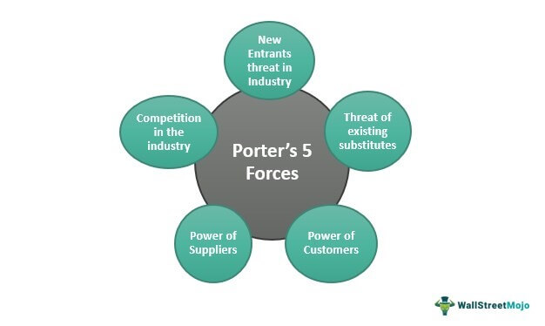
2. ANALYSING THE INTERNATIONAL MANAGEMENT ENVIRONMENT OF BURBERRY
Porter’s five forces | Impact
The threat of new entrants | Low
The threat of Substitute products | Low
Notes:
The international management environment is affected by external forces in the market like competitive rivalry, which encourages businesses to adopt a suitable management strategy to develop competitiveness in the market. Burberry operates across 34 countries and has been an iconic brand since 1891 that provides luxury products using the latest technological advancement (Burberry, 2023). Therefore, it can be interpreted that Burberry faces a low threat of new entrants because of the prominence of its brand reputation. Furthermore, the product line-up of Burberry includes unique offerings like the Burberry Trench Coat, which is historically important and still appealing today (Burberry, 2023). Thus, it can be said that the company faces a low threat of substitute products as Burberry products have an iconic place in the fashion industry that cannot be replaced by similar products.

Slide 6
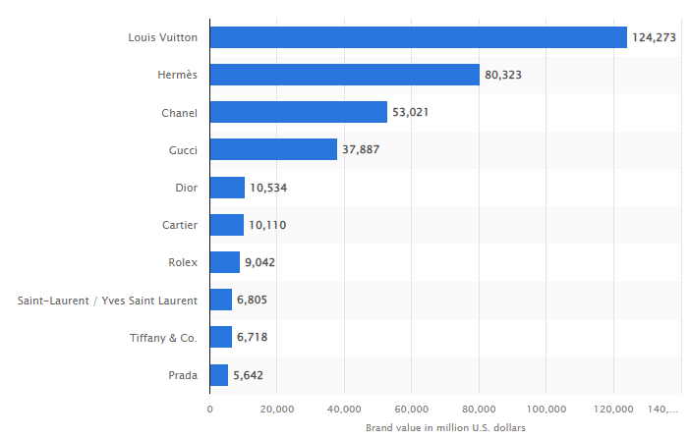
2. ANALYSING THE INTERNATIONAL MANAGEMENT ENVIRONMENT OF BURBERRY
Porter’s five forces | Impact
Buyer power | Low
Supplier power | High
Competitive Rivalry | High
Notes:
Burberry faces a low Buyer power because the main appeal of the company’s product to the buyers is because of its brand and iconic products that competitors cannot provide. Burberry selects suppliers that can maintain its standard of fabric quality and sustainability (Burberry, 2023). Therefore, the company’s list of suppliers is small, which leads to a high supplier power. According to the above Figure, the most prominent luxury brands worldwide include Louis Vuitton with a brand value of over 124,000 USD and Hermes with a value of over 80,000 USD and others (Statista, 2023). Therefore, the competitive rivalry faced by Burberry is high because of the existence of strong global luxury brands.

Slide 7
2. ANALYSING THE CHANGE ADAPTATION STRATEGY OF BURBERRY IN THE INTERNATIONAL BUSINESS ENVIRONMENT IN THE LAST 5 YEARS
There have been changes in the regulatory framework of UK corporate governance in the last 5 years (Kyere and Ausloos, 2021).
Burberry has adapted to the changes by maintaining compliance with UK corporate governance regulations.
Further, the company has achieved higher employee satisfaction by improving workplace culture.
Notes:
Changes in the international business environment such as changes in consumer product preferences require businesses to adapt to the new trends to ensure that they can maintain their competitiveness. Changes in the regulatory framework like the introduction of UK Corporate Governance Regulations have been a major international business environment transformation that has affected Burberry (Burberry, 2022). The changing regulations in the international business environment in the last 5 years have resulted in increased compliance costs for Burberry and the need to change operational procedures. In this context, Burberry has adopted a strategy to move beyond simple compliance with regulations by also focusing on the happiness of its employees and the overall workplace culture (Burberry, 2022).

Slide 8
2. ANALYSING THE CHANGE ADAPTATION STRATEGY OF BURBERRY IN THE INTERNATIONAL BUSINESS ENVIRONMENT IN THE LAST 5 YEARS
The COVID-19 pandemic has resulted in challenges as the disease spreads easily (Liu et al. 2020).
Burberry has increased sanitation frequency to minimise the spread of the disease.
It has reduced physical interaction to lower the chance of employees and customers contracting the disease.
Notes:
Further, the recent COVID-19 pandemic has resulted in economic and social challenges for Burberry as the spread of the disease posed a great threat to the company's ability to maintain the well-being of its employees and customers. Burberry has adopted a global strategy of increasing sanitisation and minimising physical contact to mitigate the spread of the disease (Burberry, 2022). Furthermore, the global strategy utilises local inputs for addressing regional developments to maintain the health and safety of its employees and customers. Therefore, Burberry adapts to changes introduced by the COVID-19 pandemic in the last 5 years by improving its resilience to the spread of the disease by considering locally tailored strategies to increase effectiveness.

Slide 9
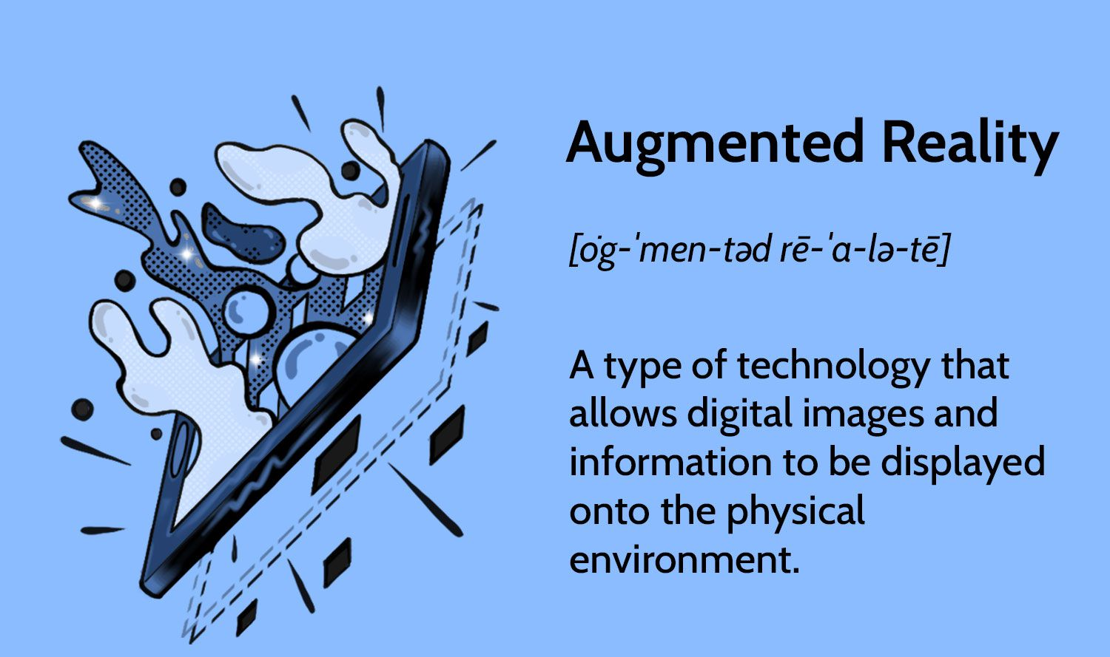
2. ANALYSING THE CHANGE ADAPTATION STRATEGY OF BURBERRY IN THE INTERNATIONAL BUSINESS ENVIRONMENT IN THE LAST 5 YEARS
Technological advancement has been another change that has impacted Burberry.
For instance, Augmented Reality has improved the immersiveness of video media.
Burberry has adapted to the changes by utilising technology to improve its customer experience.
Notes:
Further, technological advancements such as the introduction of Augmented Reality (AR) have the potential to change the contemporary customer experience. In this context, Burberry adapted to the change by hosting an event on Jeju Island, South Korea that utilised AR to provide an immersive experience to the audience (Burberry, 2022). Therefore, Burberry has swiftly addressed emerging business threats and utilised new opportunities to adapt to the changes in the business environment in the last 5 years.

Slide 10
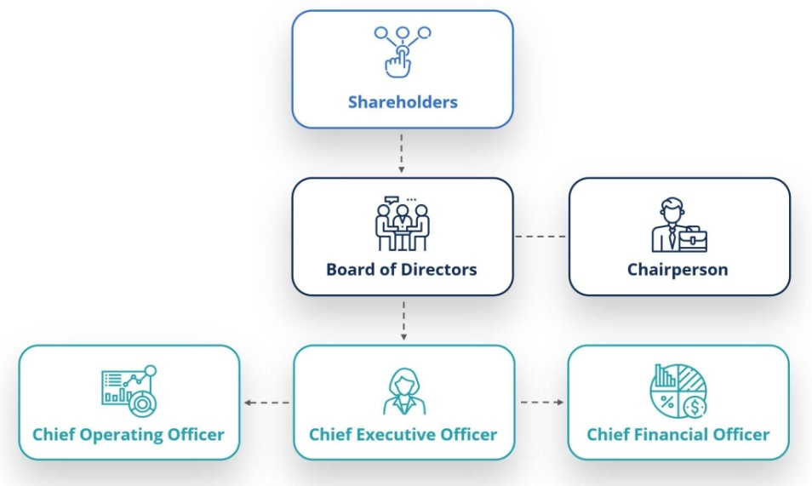
3. ANALYSING THE CORPORATE GOVERNANCE STYLE OF BURBERRY
Corporate Governance represents the rules and practices that help manage a business.
The corporate governance style of Burberry emphasises the Board managing the business.
Further, committees like remuneration support the board in its responsibilities.
Notes:
The Corporate Governance style of Burberry emphasises the role of the Board to establish the company's purpose and values and set long-term objectives and strategic aims (Burberry, 2023). It can be interpreted that the Corporate Governance style of Burberry follows a classical approach by empowering the board, which is supported by Audit, Nomination, and Remuneration Committees to manage the business.

Slide 11
3. ANALYSING THE CORPORATE GOVERNANCE STYLE OF BURBERRY
The principles of Burberry's Corporate Governance strategy comply with the UK Corporate Governance Code of 2018 (Burberry, 2023).
Burberry adheres to the regulation by empowering its board to be the central decision-making body.
Further, the business has an independent remuneration committee in compliance with the regulation.
Notes:
The UK Corporate Governance Code of 2018 mandates the establishment of a central board for businesses that manage an organisation in a manner that complies with the values of the company (Financial Reporting Council, 2018). Burberry complies with the regulation by providing the decision-making power to its board which decides its long-term business strategy.

Slide 12
3. ANALYSING THE CORPORATE GOVERNANCE STYLE OF BURBERRY
The UK Corporate Governance Code of 2018 requires businesses to conduct independent audits.
In compliance, Burberry has a separate committee for Audits that overlook related processes.
The company also implements an ESG governance strategy to achieve sustainability.
Notes:
Burberry conducts independent audits in its business through its separate Audit committee. Furthermore, Burberry has a separate Environment, Society, and Governance (ESG) strategy that is headed by the Chief Executive Officer (CEO) (Burberry, 2023). Therefore, Burberry can achieve sustainability through its Corporate Governance strategy by using its ESG strategy.

Slide 13
4. ANALYSING THE SDG 5 ADDRESSING STRATEGY OF BURBERRY
Measures in the SDG 5 strategy of Burberry:
Increasing number of women in Manager Development Programmes (MDP)
Increasing number of women in Executive Development Programmes (EDP)
Notes:
The primary strategy of Burberry to achieve SDG 5 is to increase its number of women leaders. In this context, Burberry focuses on having more women in its MDP and EDP (Burberry, 2023). Therefore, the company encourages the training of more women leaders that it can deploy in its operations.

Slide 14

4. ANALYSING THE SDG 5 ADDRESSING STRATEGY OF BURBERRY
Measures in the SDG 5 strategy of Burberry:
Implement inclusive policies
Penalising sexual harassment
Notes:
Burberry also improves the achievement of SDG 5 by creating an encouraging workplace environment for women. In this context, the company implements inclusive policies like non-discrimination and penalises sexual harassment of women.

Slide 15
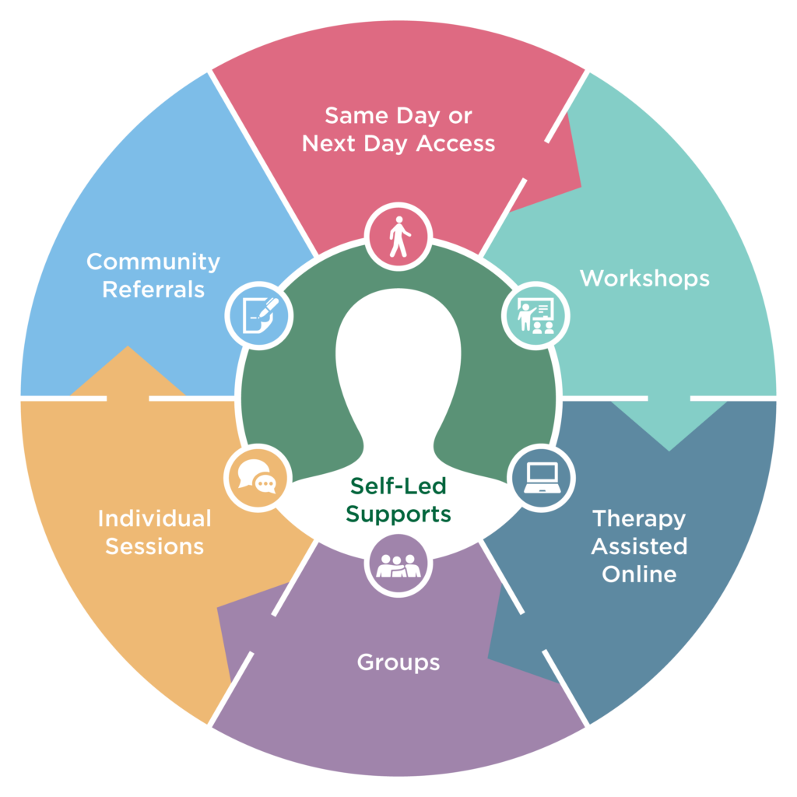
4. ANALYSING THE SDG 5 ADDRESSING STRATEGY OF BURBERRY
Measures in the SDG 5 strategy of Burberry:
Providing mental counselling
Helping access menopause specialists
Notes:
The company implements a strategy to increase the support provided to women to maintain their well-being. In this context, the company provides counselling and specialist advice for women experiencing menopause (Burberry, 2023). Thus, the company achieves SDG 5 by providing support to women.

Slide 16
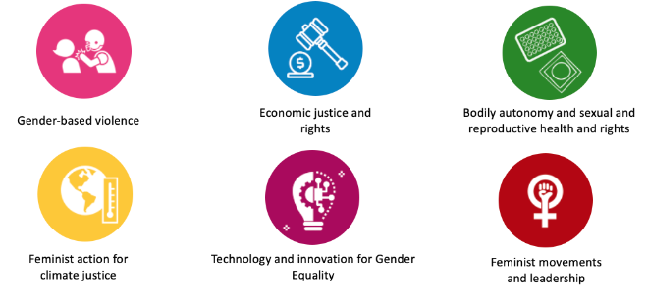
4. ANALYSING THE SDG 5 ADDRESSING STRATEGY OF BURBERRY
Measures in the SDG 5 strategy of Burberry:
Providing training opportunities
Implementing a mentorship programme for women
Notes:
The company provides training opportunities to women to help them build their professional skills. Burberry also implements a mentorship programme that provides developmental opportunities for women to achieve professional growth (Burberry, 2023). Therefore, training and development measures are also important components of the company’s strategy to achieve SDG 5.

Slide 17
ANALYSING THE SDG 5 ADDRESSING STRATEGY OF BURBERRY
Measures in the SDG 5 strategy of Burberry:
Engaging with women to determine the issues that they face in the workplace
Making improvements to training programmes based on feedback from female employees
Notes:
Burberry collects feedback from its female employees to determine the issues that they face at the workplace. Engaging with employees helps the company improve its training programmes by utilising its mentoring framework to derive feedback (Burberry, 2023). Therefore, the strategy adopted by Burberry to achieve SDG 5 covers several areas to ensure gender equality in its workplace.

Slide 18
5. ACTIONABLE RECOMMENDATIONS BASED ON THE FINDINGS AND ANALYSIS
Re-evaluate the gender pay gap and offer new remunerations based on equality
It can help Burberry reduce its gender pay gap and increase inclusiveness.
It can motivate women to work at the company and achieve professional growth.
Notes:
The gender pay gap is an important contemporary issue for gender equality in the business world (Blundell, 2020). Accordingly, Burberry needs to pay men and women the same amount of money for having the same job role.

Slide 19
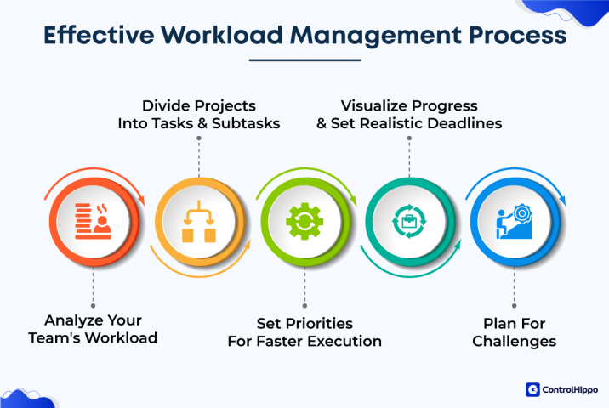
5. ACTIONABLE RECOMMENDATIONS BASED ON THE FINDINGS AND ANALYSIS
Readjust workload based on the job roles
Burberry can implement the recommendations by dividing workload based on job role and not gender.
It can create a gender-equal workplace culture at the offices of Burberry.
Notes:
Burberry can improve inclusiveness at the workplace by dividing workload based on job roles instead of gender, to improve gender equality at its workplaces.

Slide 20
5. ACTIONABLE RECOMMENDATIONS BASED ON THE FINDINGS AND ANALYSIS
Provide easy access to menstrual health facilities
Menstruation can be a difficult experience for working women (Grandey et al. 2020).
Therefore, providing menstrual health facilities for women can improve gender equality at Burberry offices.
Notes:
Burberry can provide menstrual health facilities like free pads and tampons. Further, health professionals that can treat any sustained discomfort can also improve the facilities.

Slide 21
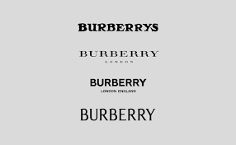
CONCLUSION
In conclusion, there is a robust strategy for achieving SDG 5 by providing training to women in Burberry.
Burberry complies with the regulation of Corporate Governance by empowering its board to make decisions.
The company can reduce the gender pay gap by paying men and women with the same job role the same amount of money.
Notes:
It can be concluded that the current strategy of Burberry in its governance and sustainability is strong as it achieves SDG 5 by encouraging the development of women leaders. However, the company can improve its gender equality metric by adjusting workload division based on job role instead of gender.

Slide 22
REFERENCE LIST
Blundell, J., (2020). Wage responses to gender pay gap reporting requirements. Available at SSRN 3584259.
Burberry, (2022). ANNUAL REPORT 2021/22. Available at: https://www.burberryplc.com/content/dam/burberry/corporate/oar/2022/pdfs/Burberry_2021-22_Annual_Report.pdf [Accessed on: 17.4.23]
Burberry, (2023). CORPORATE GOVERNANCE. Available at: https://www.burberryplc.com/en/company/governance.html [Accessed on: 17.4.23]
Burberry, (2023). GENDER EQUALITY. Available at: https://www.burberryplc.com/en/people/diversity_and_inclusion/gender-equality.html [Accessed on: 17.4.23]
Burberry, (2023). OUR LOCATIONS. Available at: https://burberrycareers.com/content/Where-We-Are/?locale=en_GB [Accessed on: 17.4.23]
Burberry, (2023). THE BURBERRY TRENCH COAT. Available at: https://www.burberryplc.com/en/company/unmistakably-burberry/trench-coat.html [Accessed on: 17.4.23]
Burberry, (2023). TRANSPARENCY IN THE SUPPLY CHAIN AND MODERN SLAVERY STATEMENTS. Available at: https://us.burberry.com/legal-cookies/transparency-in-the-supply-chainmodern-slavery-statements/ [Accessed on: 17.4.23]
Financial Reporting Council, (2018). THE UK CORPORATE GOVERNANCE CODE. Available at: https://www.frc.org.uk/getattachment/88bd8c45-50ea-4841-95b0-d2f4f48069a2/2018-UK-Corporate-Governance-Code-FINAL.pdf [Accessed on: 17.4.23]
Grandey, A.A., Gabriel, A.S. and King, E.B., (2020). Tackling taboo topics: A review of the three M s in working women’s lives. Journal of Management, 46(1), pp.7-35.
Kyere, M. and Ausloos, M., (2021). Corporate governance and firms financial performance in the United Kingdom. International Journal of Finance & Economics, 26(2), pp.1871-1885.
Liu, Y., Lee, J.M. and Lee, C., (2020). The challenges and opportunities of a global health crisis: the management and business implications of COVID-19 from an Asian perspective. Asian Business & Management, 19, pp.277-297.
Mio, C., Panfilo, S. and Blundo, B., (2020). Sustainable development goals and the strategic role of business: A systematic literature review. Business Strategy and the Environment, 29(8), pp.3220-3245.
Statista, (2023). Brand value of the leading 10 most valuable luxury brands worldwide in 2022. Available at: https://www.statista.com/statistics/267948/brand-value-of-the-leading-10-most-valuable-luxury-brands-worldwide/ [Accessed on: 17.4.23]
United Nations, (2023). THE 2030 AGENDA FOR SUSTAINABLE DEVELOPMENT. Available at: https://sustainabledevelopment.un.org/content/documents/21252030%20Agenda%20for%20Sustainable%20Development%20web.pdf [Accessed on: 17.4.23]

